Slide 1
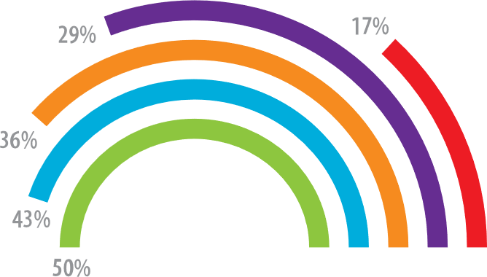
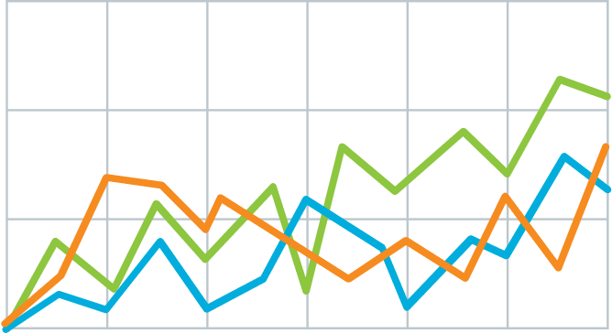
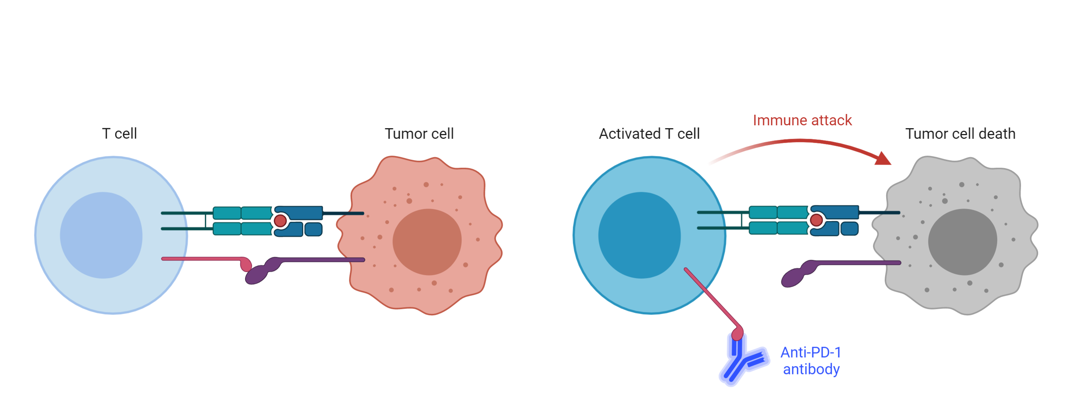
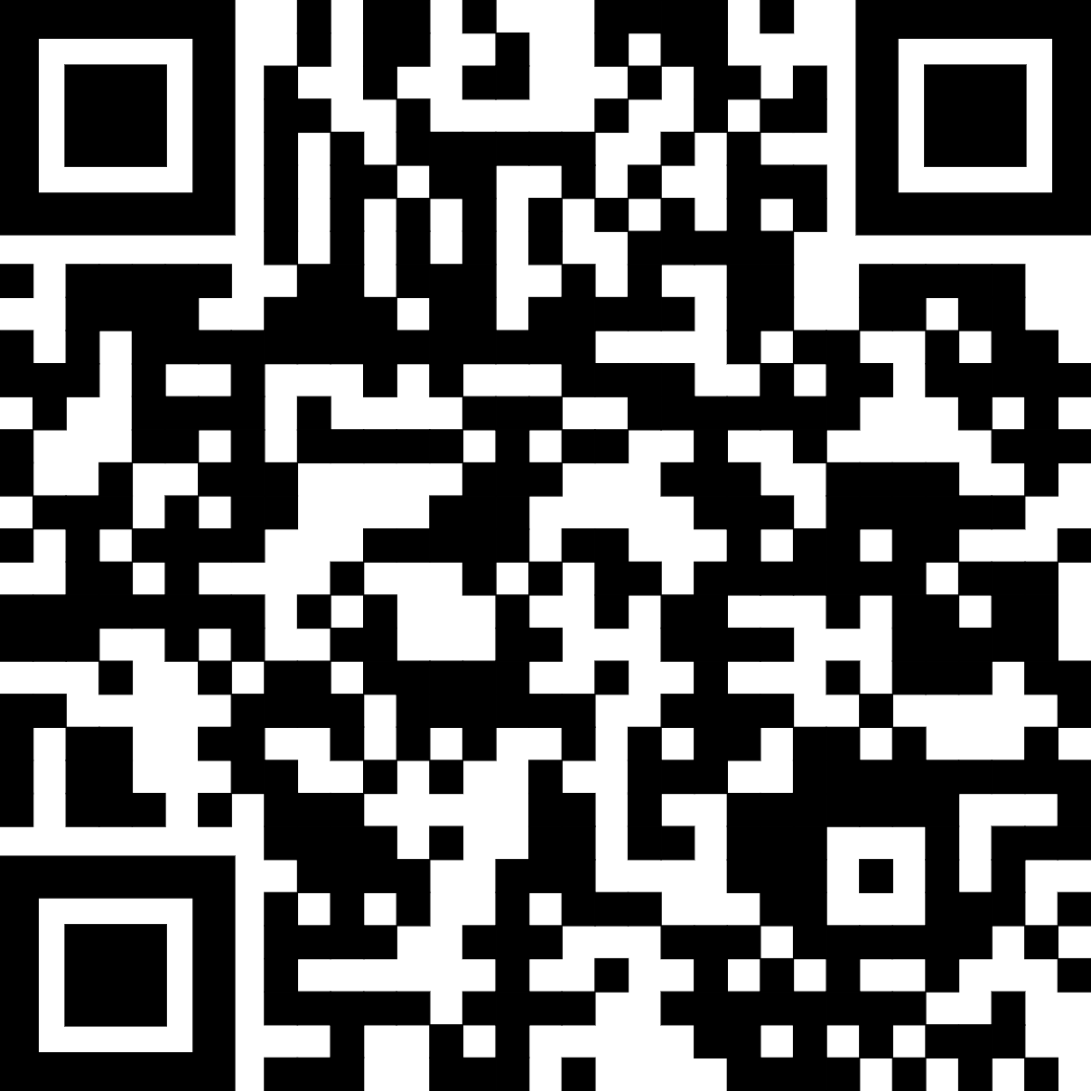

Teach people what you learned in 5 seconds (takeaway, not title)
Anonymization of data for open science in psychology
Background: There is a great demand for making more research data openly available. Unfortunately, many datasets cannot be publicly available for privacy reasons.
Result 1: Quickly explain what the graph shows. Help people think.
Result 2: Big figures are easier to skim at a distance, and more accessible.
v
v
Methods
Survey
Longitudinal
v
1
Immune checkpoint inhibits T-cell activation.
2
Anti-PDF-1 antibodies permit T cell activation
Limitation: This is only one interpretation of findings that suggest effective posters are uncluttered, have big figures & text, and include callout boxes with takeaways. It is missing your personality and creative flair.
Leeroy Jenkins, Shuri Wright, Emmett Brown

