Slide 1
Synthetic Data (and Anonymisation) in Psychological Research
1_Literature review

Slide 2
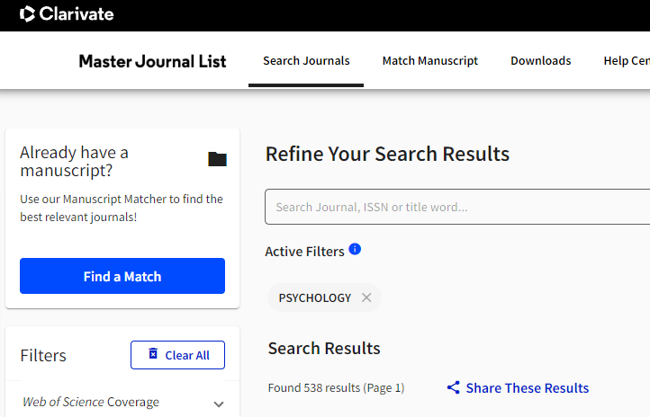
https://mjl.clarivate.com/search-results

Slide 3
2018 [Klein] A Practical Guide for Transparency in Psychological Science
The goal of this paper is thus to provide a practical guide to help researchers navigate the process of preparing and sharing the products of research, including materials, data, analysis scripts, and study protocols.
Regardless of the privacy concerns surrounding raw data, it should almost always be possible to share anonymised data in tabular format as they are used in statistical analyses (see Supplementary Material: Anonymisation).
One of the major burdens facing scientists is keeping up with the evolution in standards and resources. That’s why the SM will be updated regularly and collaboratively. This “live” version is available at http://open-science-guide.uni-koeln.de will therefore differ from the publisher’s version.

Slide 4
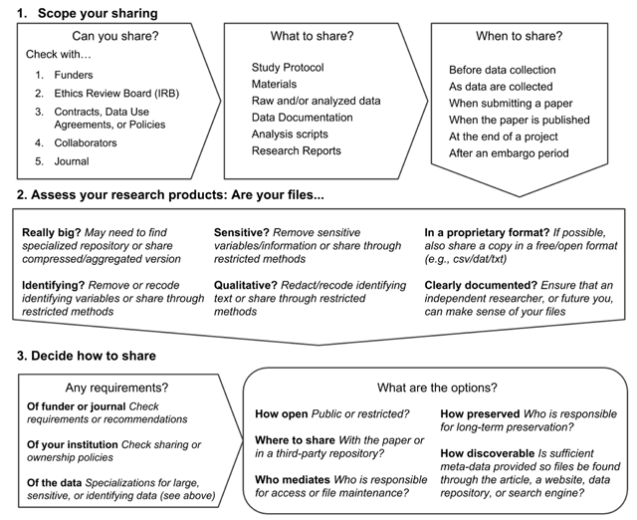
2018 [Klein] A Practical Guide for Transparency in Psychological Science

Slide 5
2018 [Klein] A Practical Guide for Transparency in Psychological Science
2 Anonymization
There are two ways in which participants can be identified: 1) through direct identifiers, such as names, addresses or photos, 2) through combinations of indirect identifiers (e.g., date of birth + job title + name of employer).
For some variables it may be advisable or even required to restrict or transform the data. For example, for income information, a simple step is to restrict the upper and lower range (using top- and/or bottom-coding)

Slide 6
2012 [US HHS] Guidance Regarding Methods for De-identification of Protected Health Information in Accordance with the Health Insurance Portability and Accountability Act (HIPAA) Privacy Rule
The United States Department of Health and Human Resources has developed a “de-identification standard” to comply with the HIPAA (Health Information Portability and Accountability Act) Privacy rule.
The guidance explains and answers questions regarding the two methods that can be used to satisfy the Privacy Rule‘s de-identification standard: Expert Determination and Safe Harbor.
This guidance is intended to assist covered entities to understand what is de-identification,
The HIPAA Privacy Rule protects most ―individually identifiable health information, like to: the individual‘s past, present, or future physical or mental health or condition (etc.)

Slide 7
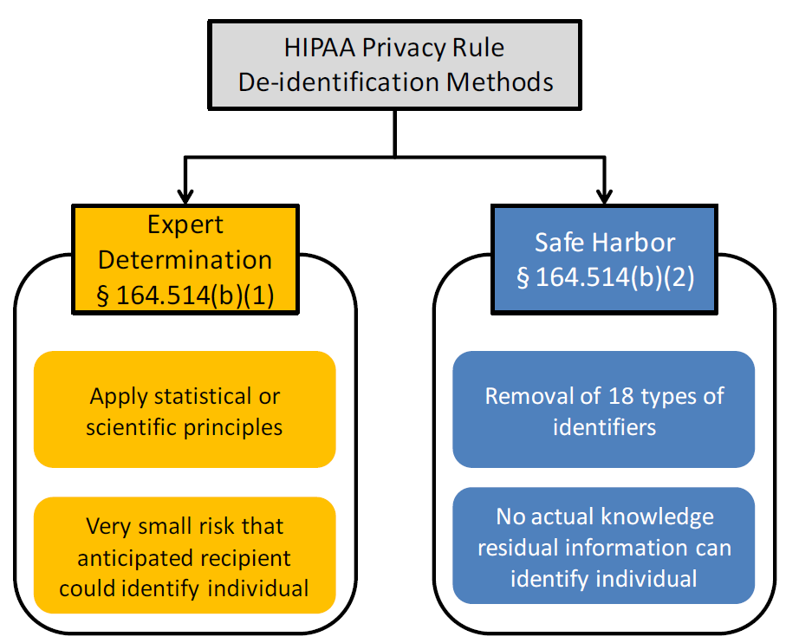
2012 [US HHS] Guidance Regarding Methods for De-identification of Protected Health Information
Figure 1. Two methods to achieve de-identification in accordance with the HIPAA Privacy Rule.

Slide 8
2012 [US HHS] Guidance Regarding Methods for De-identification of Protected Health Information
2.3. What is an acceptable level of identification risk for an expert determination?
There is no explicit numerical level of identification risk that is deemed to universally meet the ― „very small“ level indicated by the method.
The ability of a recipient of information to identify an individual (i.e., subject of the information) is dependent on many factors, which an expert will need to take into account while assessing the risk from a data set.
This is because the risk of identification that has been determined for one particular data set in the context of a specific environment may not be appropriate for the same data set in a different environment or a different data set in the same environment.
As a result, an expert will define an acceptable ―very small risk based on the ability of an anticipated recipient to identify an individual.

Slide 9
2022 [Hallinan] Information Provision for Informed Consent Procedures in Psychological
This tutorial thus aims to provide general practical guidance to psychological researchers allowing them to understand which forms of information must be provided to research subjects in consent materials according to the GDPR.
According to Article 4(1) GDPR, “‘personal data’ means any information relating to an identified or identifiable natural person (‘data subject’); an identifiable natural person is one who can be identified, directly or indirectly, in particular by reference to an identifier such as a name, an identification number, location data, an online identifier or to one or more factors specific to the physical, physiological, genetic, mental, economic, cultural or social identity of that natural person” (Regulation 679/2016).

Slide 10
2022 [Rodrigue] Current recommendations practices for anonymising data from clinical trials in order to make it available for sharing A scoping review
We systematically searched MEDLINE, EMBASE and Web of Science from inception to 8 February 2021.
Any publication reporting recommendations on anonymisation to enable data sharing from clinical trials was included.
The most commonly used anonymisation techniques are: removal of direct patient identifiers; and careful evaluation and modification of indirect identifiers to minimise the risk of identification.
Twelve studies (28%) recommended the use of privacy models (such as k-anonymity, l-diversity and differential privacy)

Slide 11
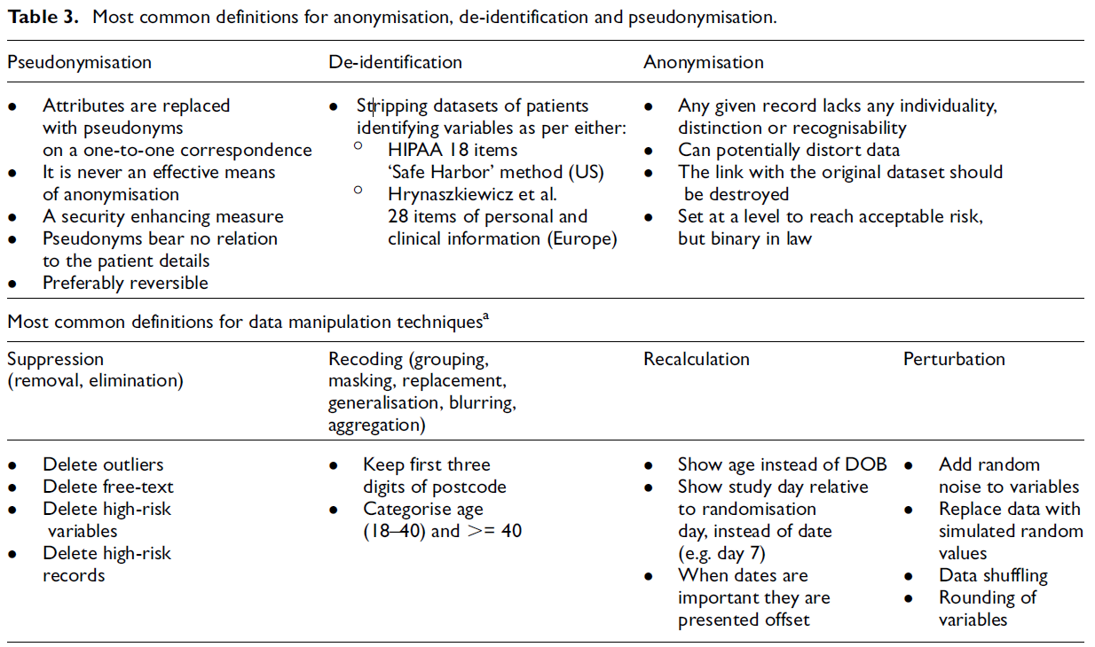

Slide 12
2023 [Stam] Qualitative data anonymisation - theoretical and practical considerations for anonymising interview transcripts
Swiss Centre of Expertise in the Social Sciences
After defining qualitative data anonymisation and addressing some common forms of resistance when it comes to anonymising such data, this guide presents the main anonymisation techniques.

Slide 13

2015 [Divanis] Medical Data Privacy Handbook
This handbook covers Electronic Medical Record (EMR) systems, which enable the storage, management, and sharing of massive amounts of demographic, diagnosis, medication, and genomic information. It presents privacy-preserving methods for medical data, ranging from laboratory test results to doctors' comments.
The authors explore scenarios and techniques for facilitating the anonymization of different types of medical data, as well as various data mining tasks. Other chapters present methods for emerging data privacy applications and medical text de-identification, including detailed surveys of deployed systems.

Slide 14
2020 [Quintana] A synthetic dataset primer for the biobehavioural sciences to promote reproducibility and hypothesis generation
This practical guide with accompanying R script enables biobehavioural researchers to create synthetic datasets and assess their utility via the synthpop R package.
Synthetic datasets are already being used, for example, to share confidential census data. However, this approach is rarely used in other areas of research. Now, Daniel S. Quintana demonstrates how synthetic datasets can be used in psychology and medicine.

Slide 15
2022 [Grund] Using Synthetic Data to Improve the reproducibility of Statistical Results in Psychological Research
In this article, we investigated the statistical properties of synthetic data with a particular emphasis on the reproducibility of statistical results.
To this end, we compared conventional approaches to synthetic data based on multiple imputation (MI) with a data-augmented approach (DA-MI) that attempts to combine the advantages of masking methods and synthetic data, thus making the procedure more robust to misspecification.
In the present article, we investigated the statistical properties of synthetic data as a tool for fostering data sharing and nurturing reproducibility and robustness in psychological research.

Slide 16
2022 [Arvanitis] A method for machine learning generation of realistic synthetic datasets for validating healthcare applications
The objective of the paper is the development of a method for the generation of realistic synthetic datasets, statistically equivalent to real clinical datasets, and demonstrate that the Generative Adversarial Network (GAN) based approach is fit for purpose.

Slide 17
2021 [Choi] Deep Learning Approach to Generate a Synthetic Cognitive Psychology Behavioral Dataset
The proposed framework with a fine-tuned generative adversarial network algorithm was compared with a random generation method to verify generation performance, including the representation of the statistical characteristics of the original datasets.
We found that the generated datasets from the proposed framework exhibited more similar statistical characteristics with the original dataset than the randomly generated datasets based on five evaluation methods.
Based on the experimental results, we confirmed that the proposed framework with GAN algorithms can generate statistically similar synthetic datasets with the statistical characteristics of the original dataset.

Slide 18
2019 [Christensen] Fully Synthetic Longitudinal Real-World Data From Hearing Aid Wearers for Public Health Policy Modeling
It contains longitudinally sampled observations from 53 individuals
Differential privacy, using DataSynthesizer

