Slide 1

Notes:
01 — Autonomous Enterprise SAP BTP Agent Demo
HTML source: 1page.html

Slide 2
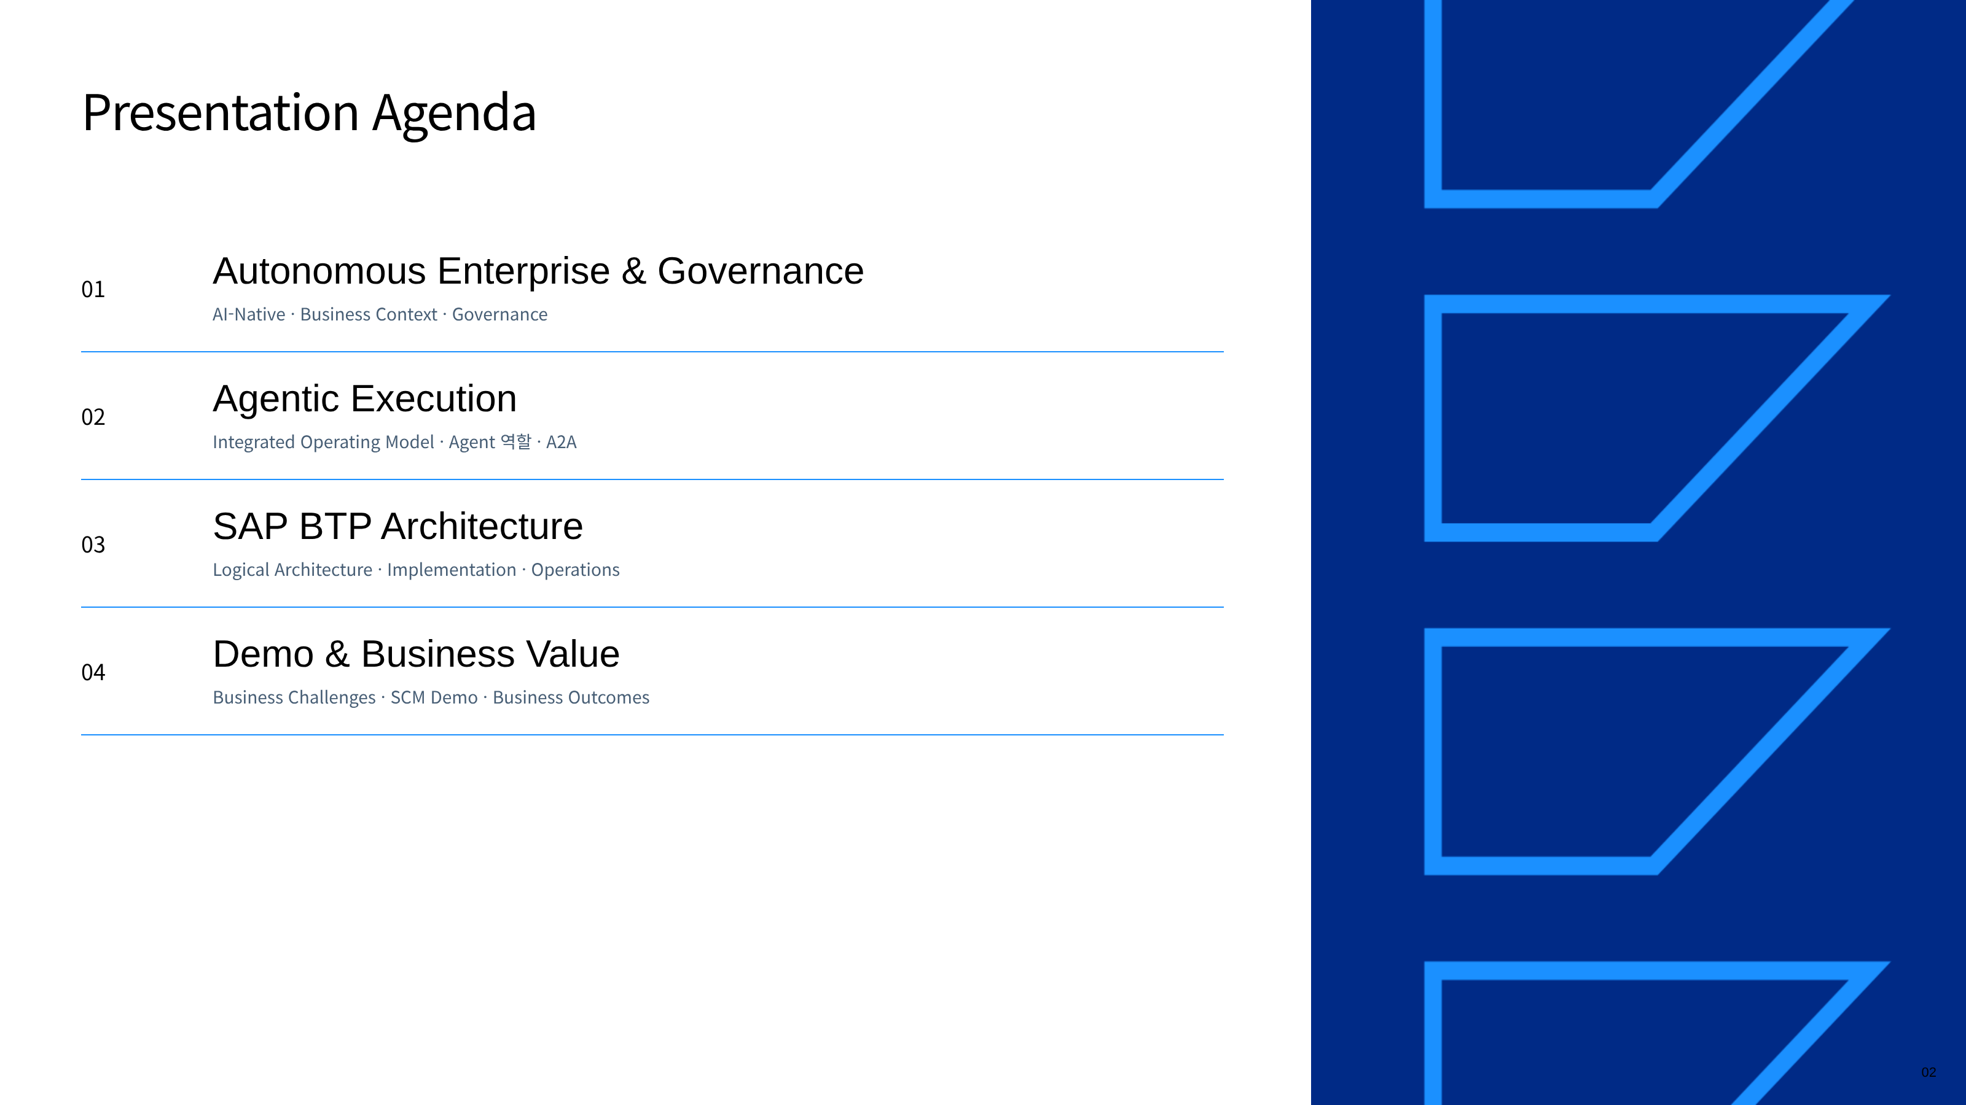
Notes:
02 — Presentation Agenda
HTML source: agenda.html

Slide 3
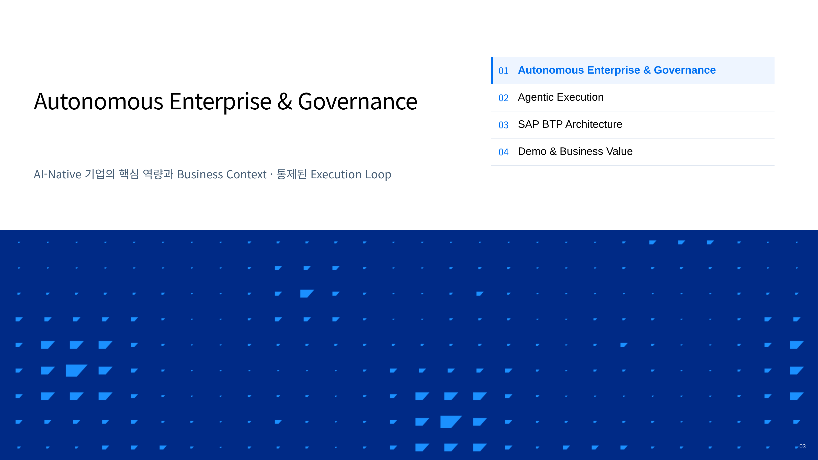
Notes:
03 — Autonomous Enterprise & Governance
HTML source: divider-01-vision.html

Slide 4
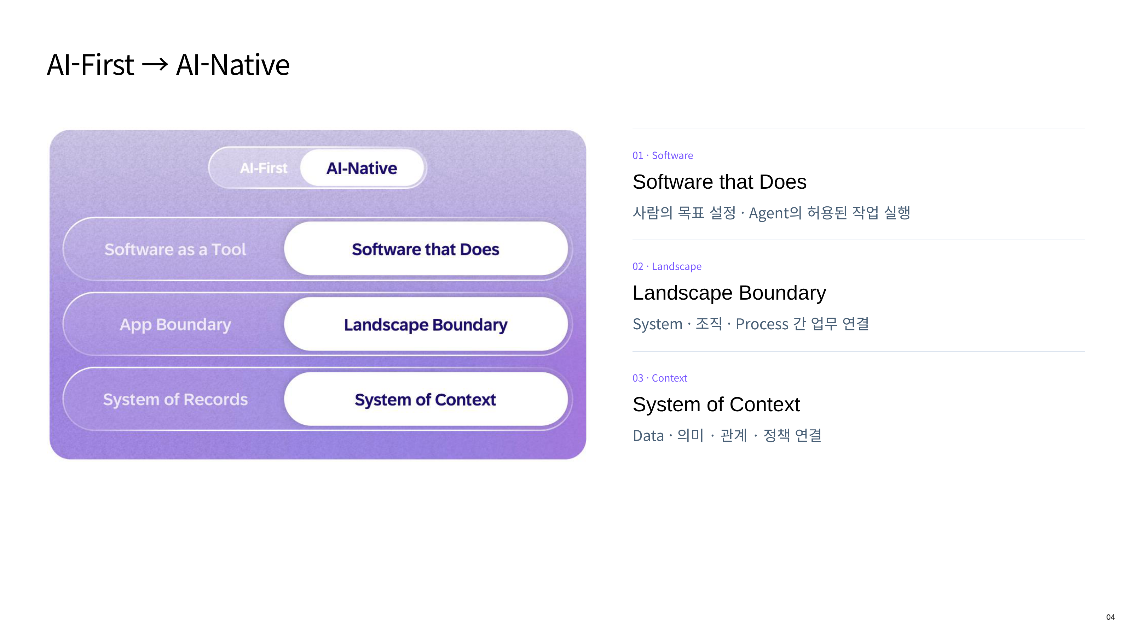
Notes:
04 — AI-First → AI-Native
HTML source: ai-native.html

Slide 5
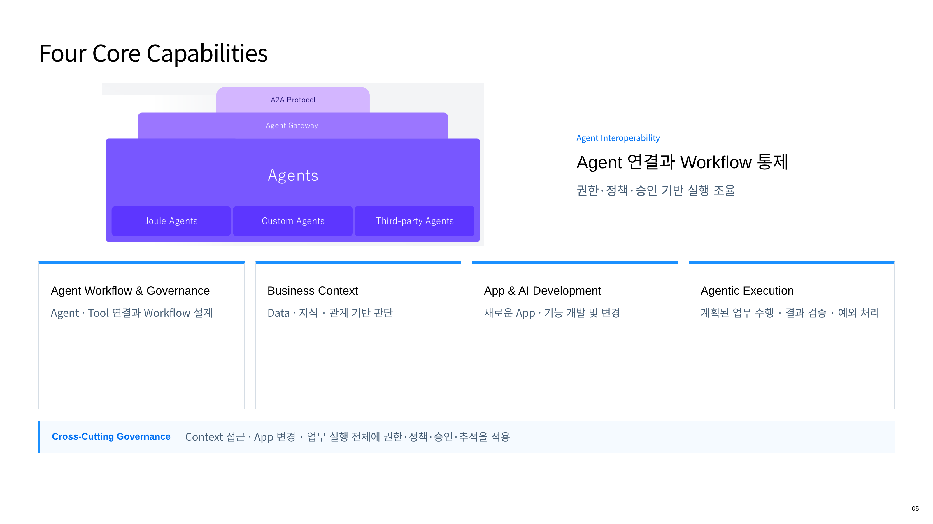
Notes:
05 — Four Core Capabilities
HTML source: 8page.html

Slide 6
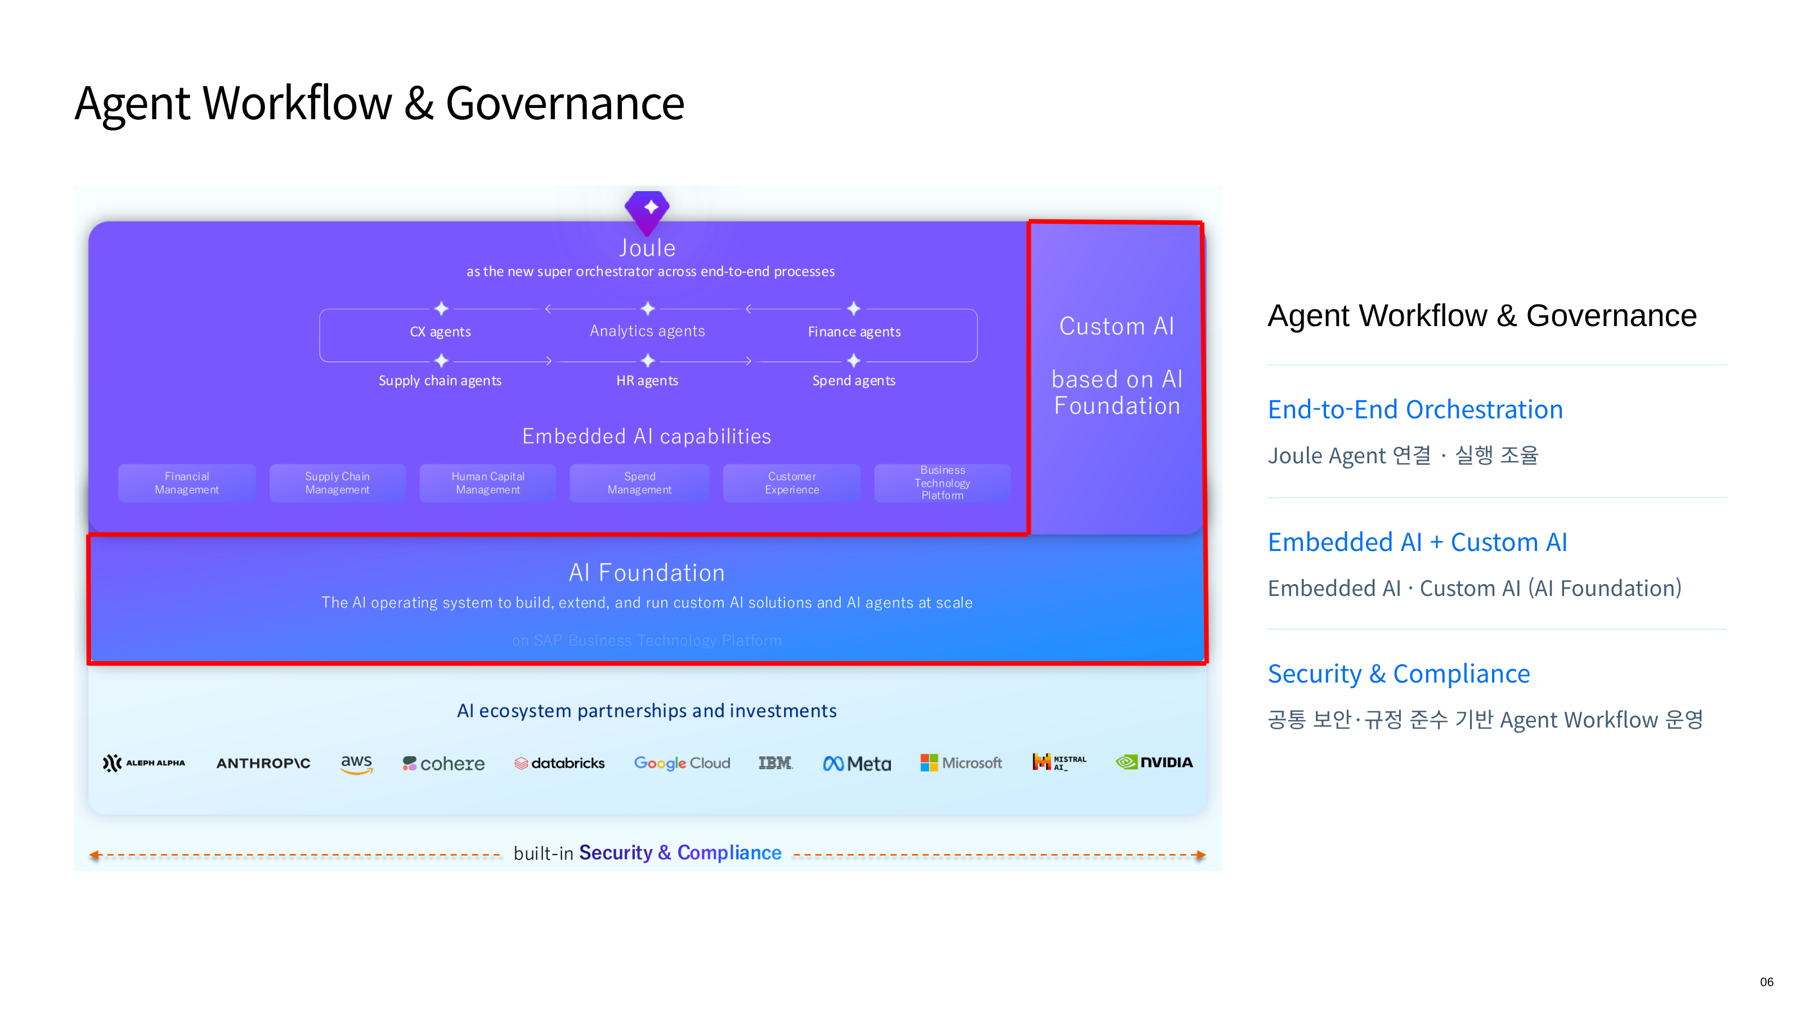
Notes:
06 — Agent Workflow & Governance
HTML source: 3page.html

Slide 7
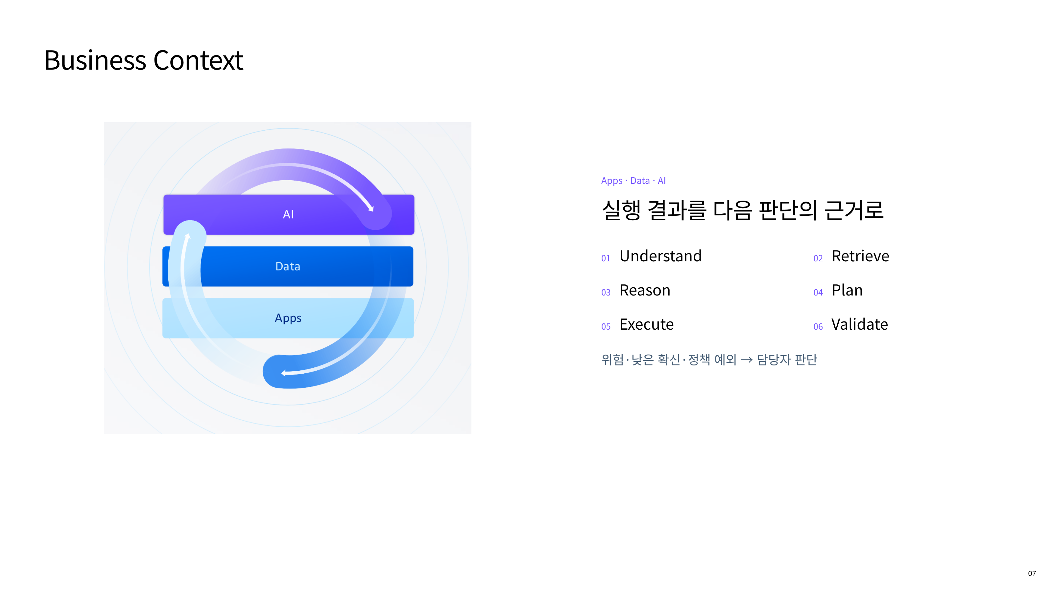
Notes:
07 — Business Context
HTML source: 7page.html

Slide 8
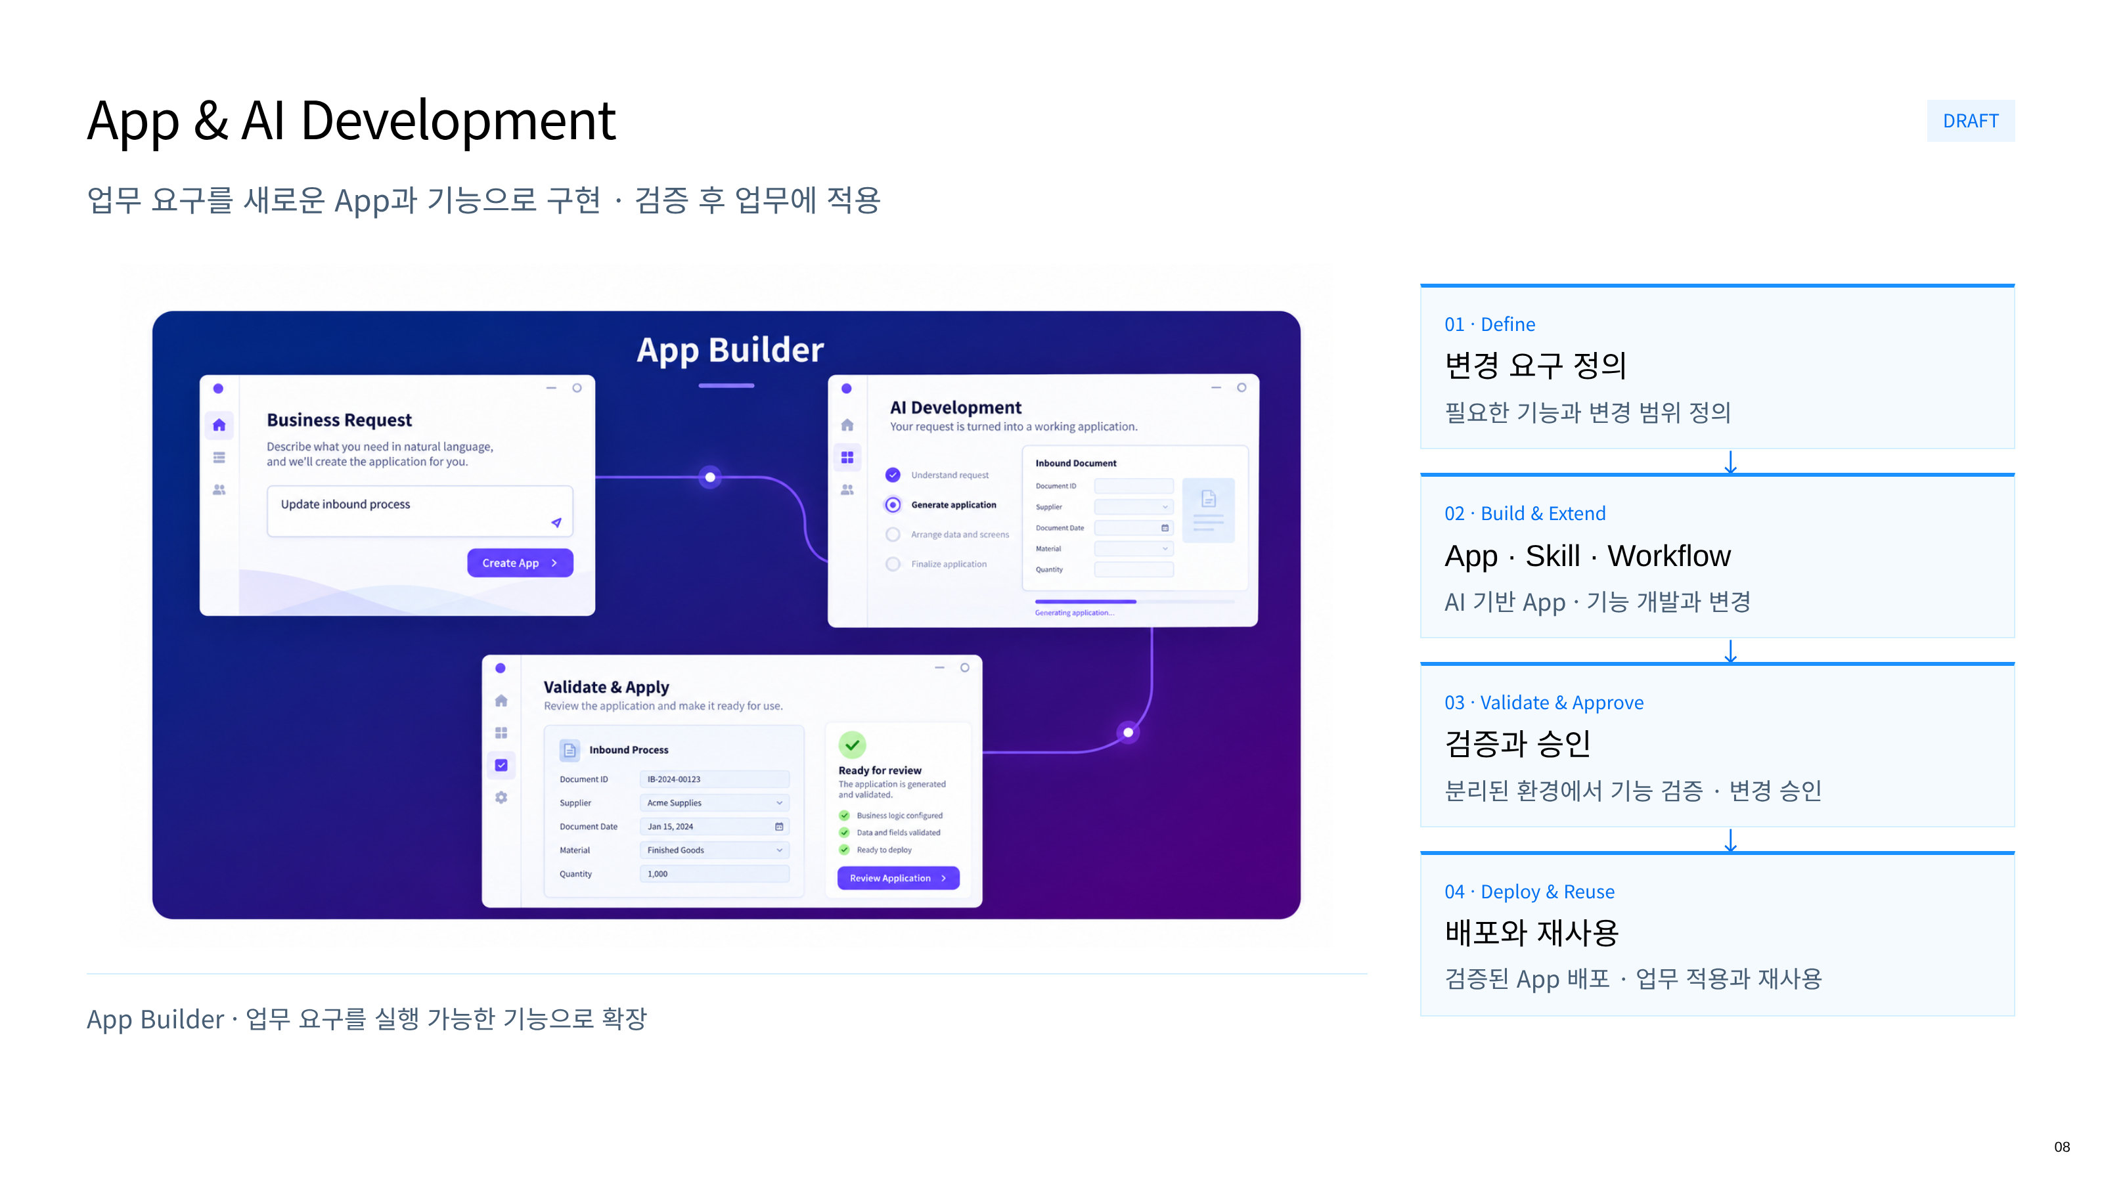
Notes:
08 — App & AI Development
HTML source: app-ai-development-draft.html

Slide 9
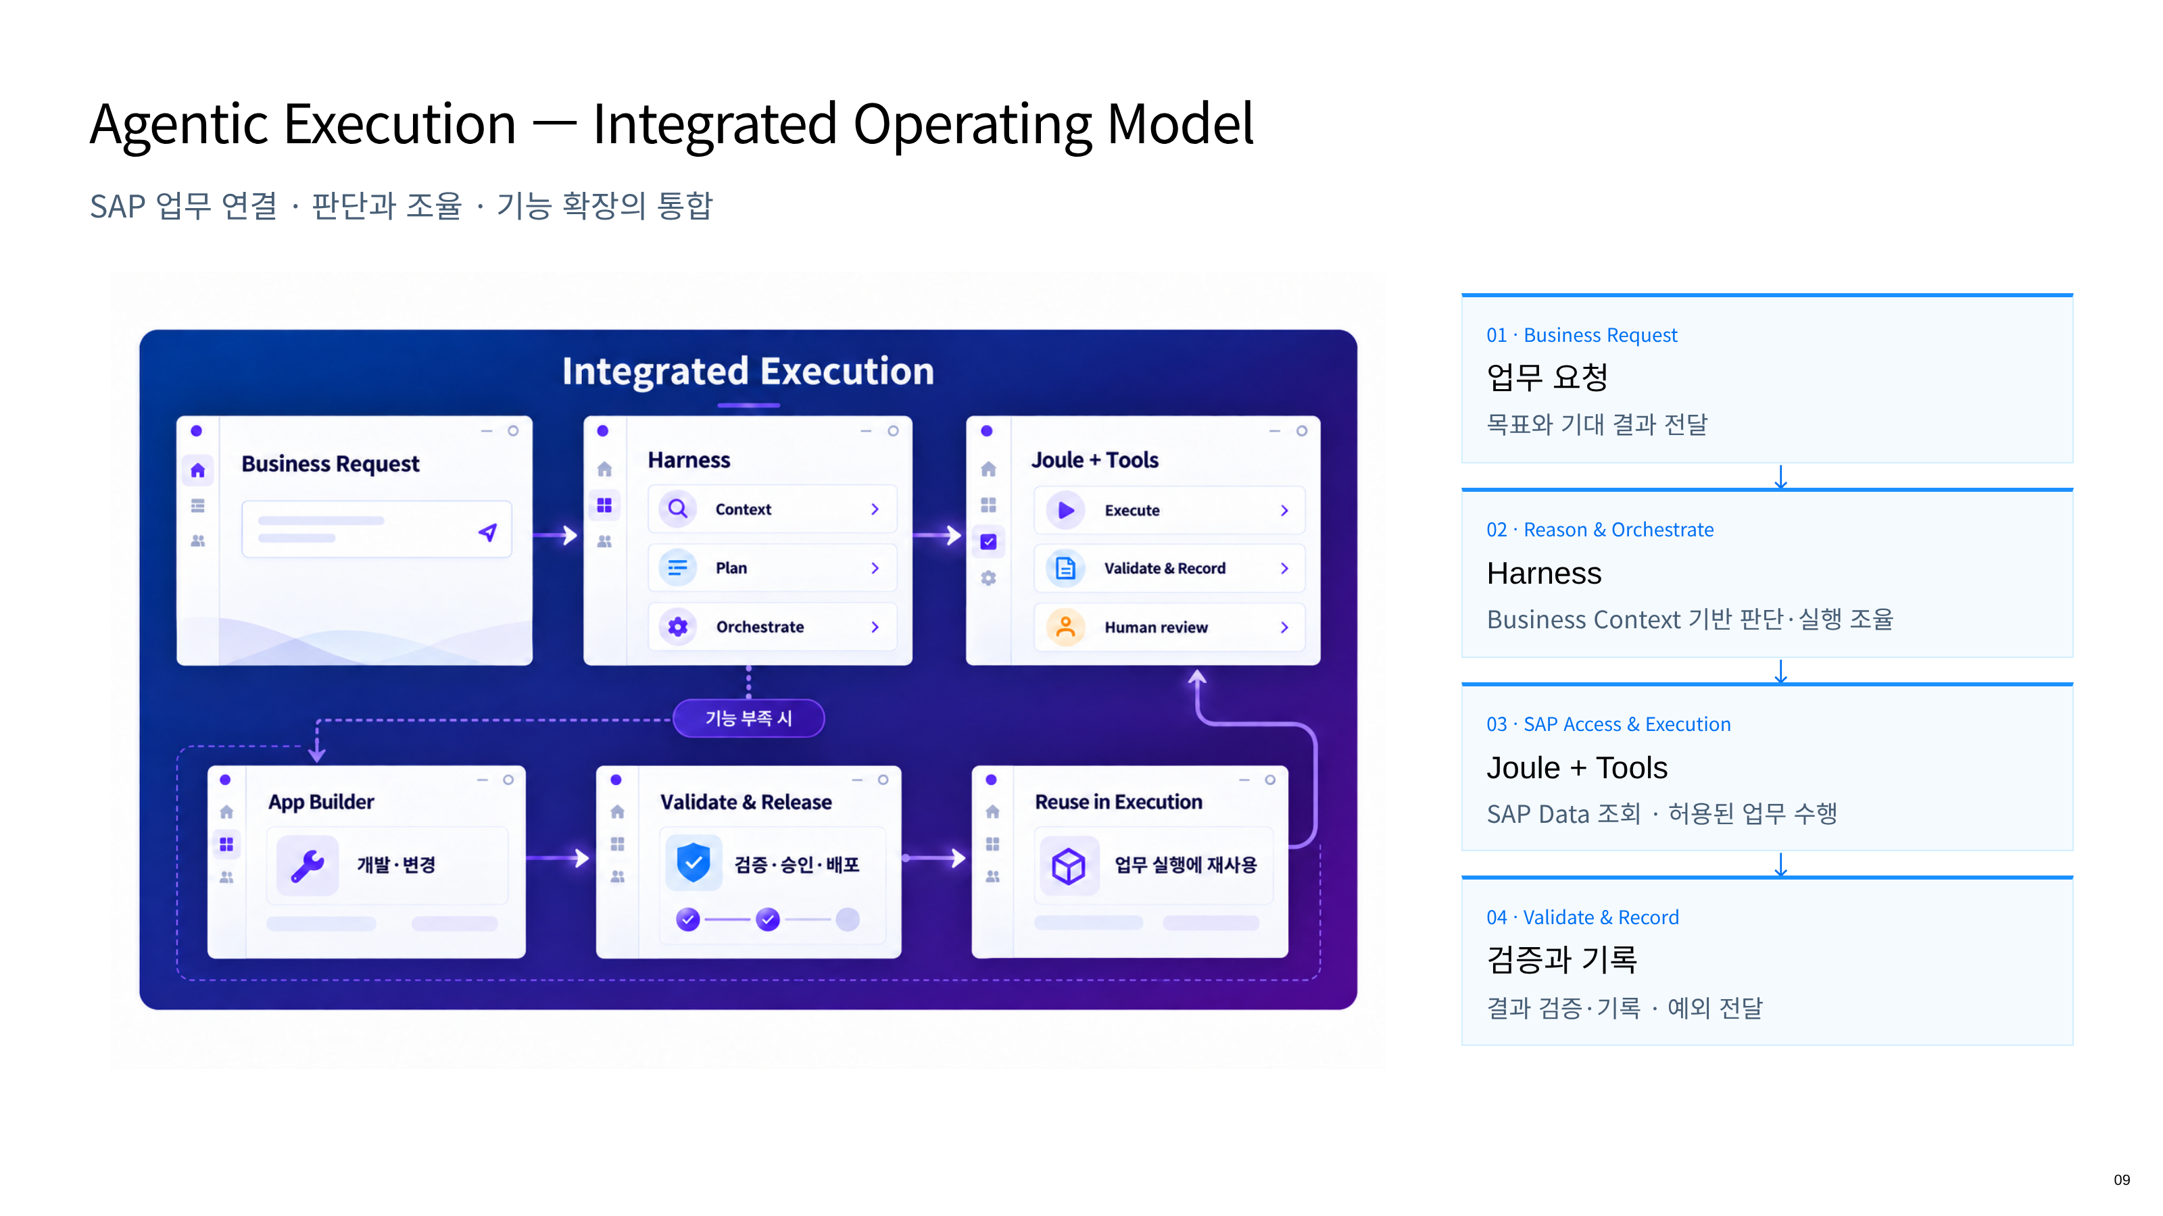
Notes:
09 — Agentic Execution — Integrated Operating Model
HTML source: 6page.html

Slide 10
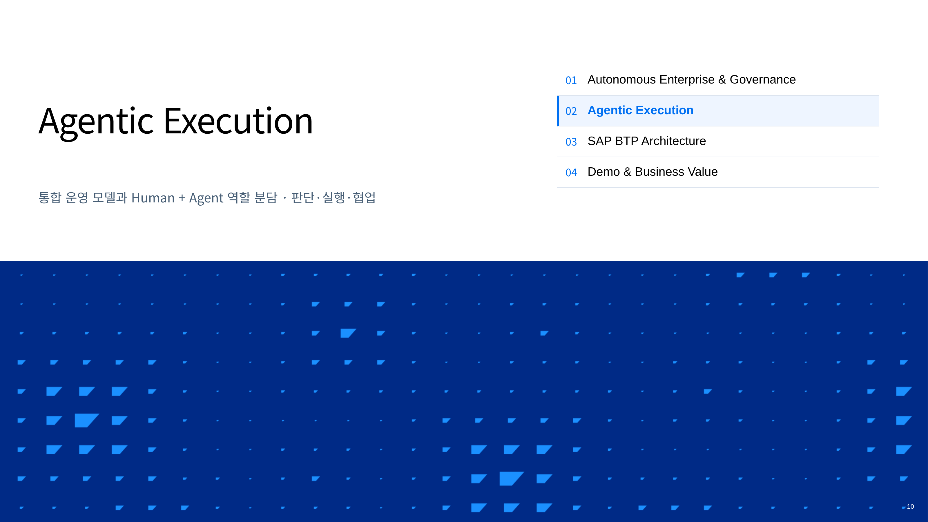
Notes:
10 — Agentic Execution
HTML source: divider-02-agents.html

Slide 11
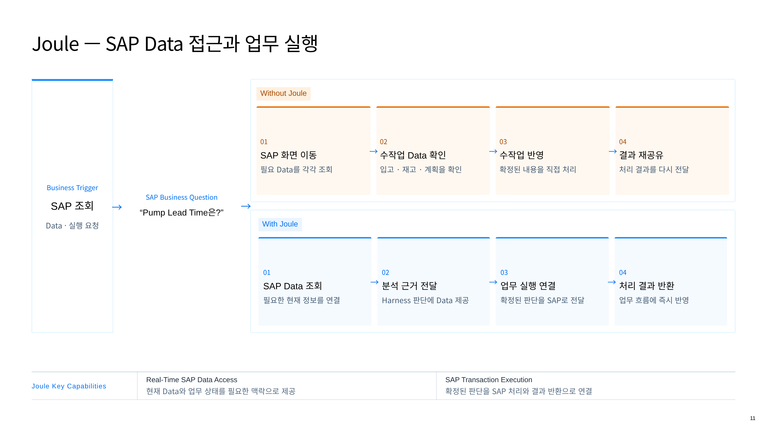
Notes:
11 — Joule — SAP Data 접근과 업무 실행
HTML source: 10page.html

Slide 12
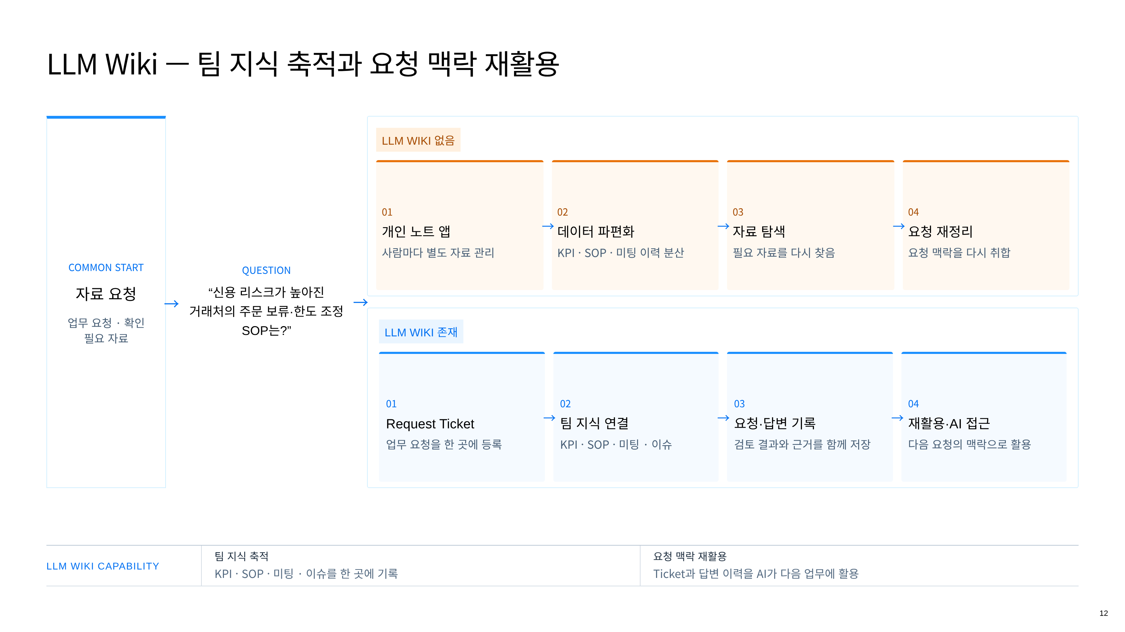
Notes:
12 — LLM Wiki — 팀 지식 축적과 요청 맥락 재활용
HTML source: llm-wiki-explanation.html

Slide 13
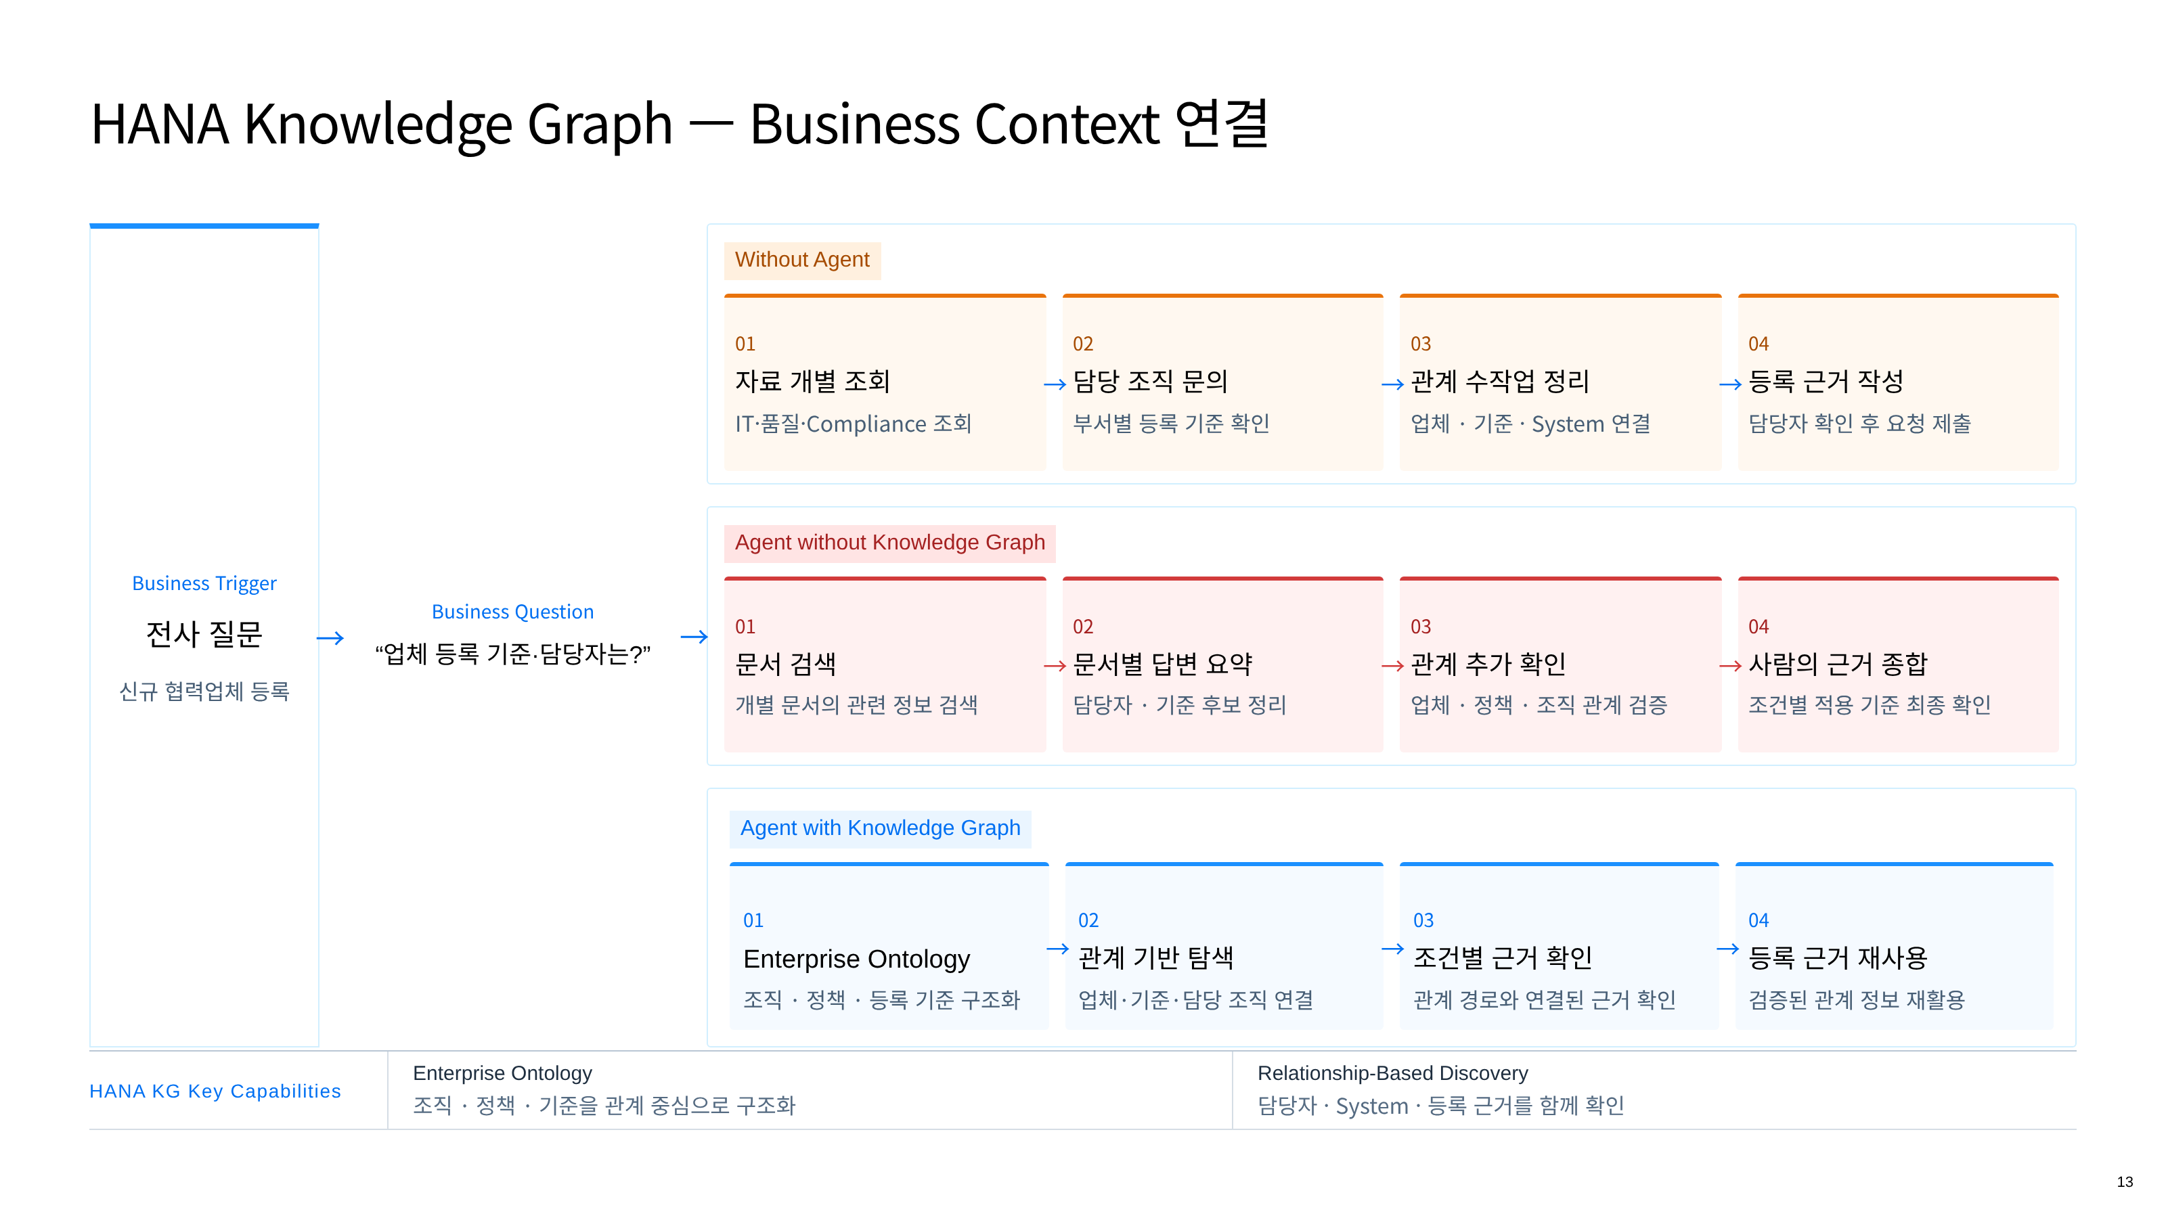
Notes:
13 — HANA Knowledge Graph — Business Context 연결
HTML source: 9page.html

Slide 14
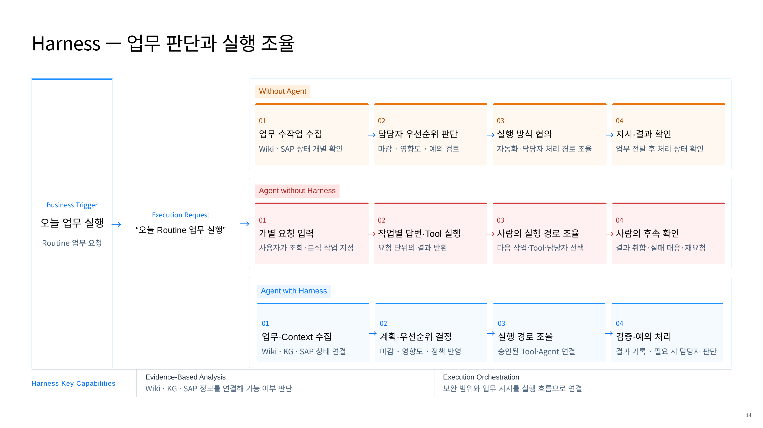
Notes:
14 — Harness — 업무 판단과 실행 조율
HTML source: 11page.html

Slide 15
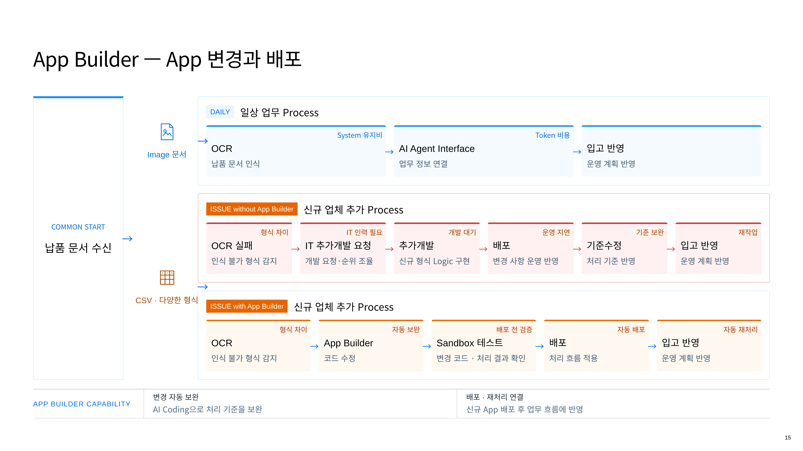
Notes:
15 — App Builder — App 변경과 배포
HTML source: app-builder-explanation.html

Slide 16
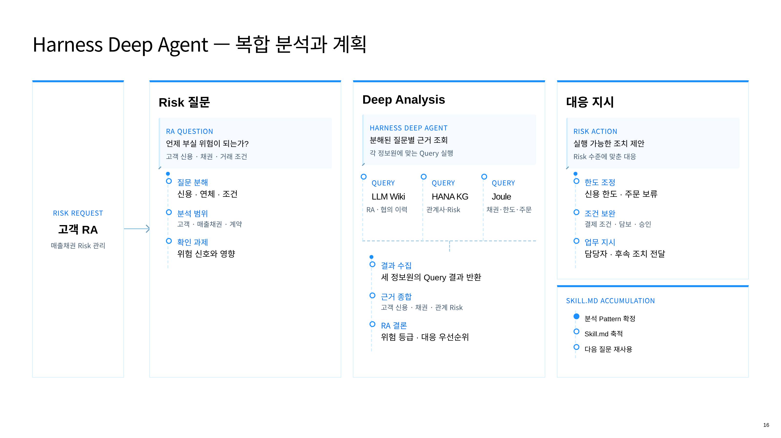
Notes:
16 — Harness Deep Agent — 복합 분석과 계획
HTML source: 12page.html

Slide 17
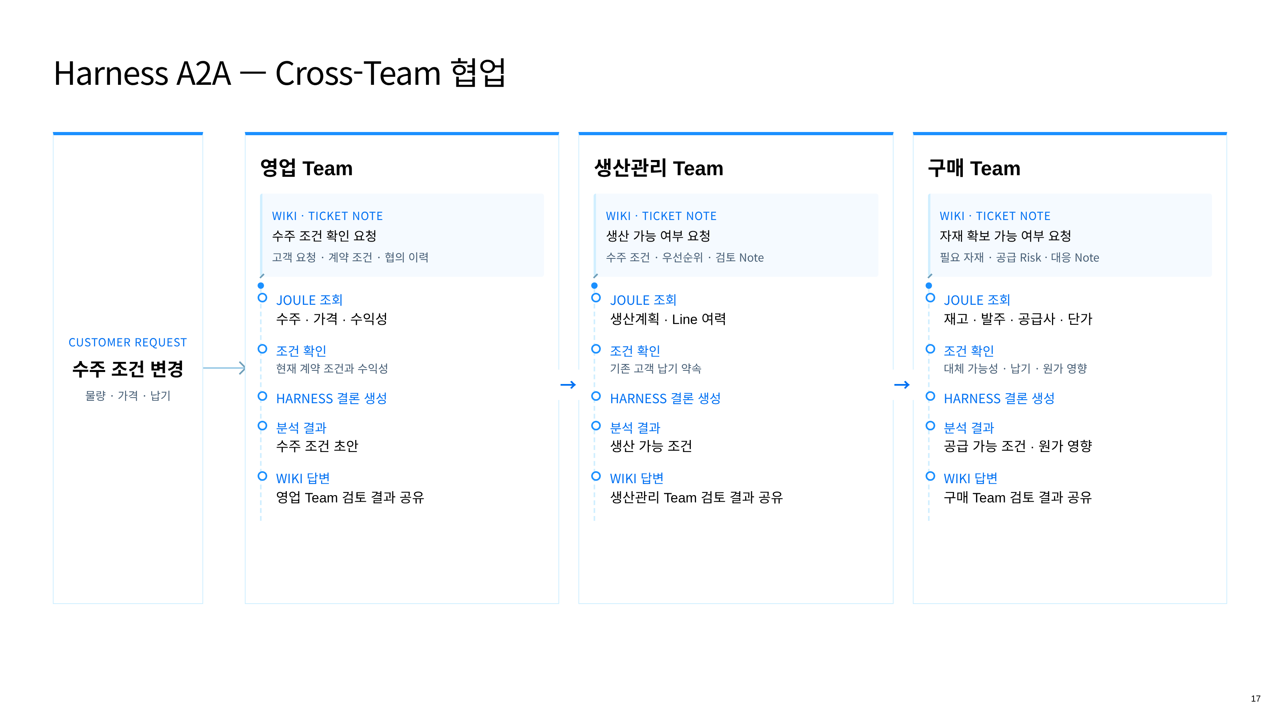
Notes:
17 — Harness A2A — Cross-Team 협업
HTML source: 13page.html

Slide 18
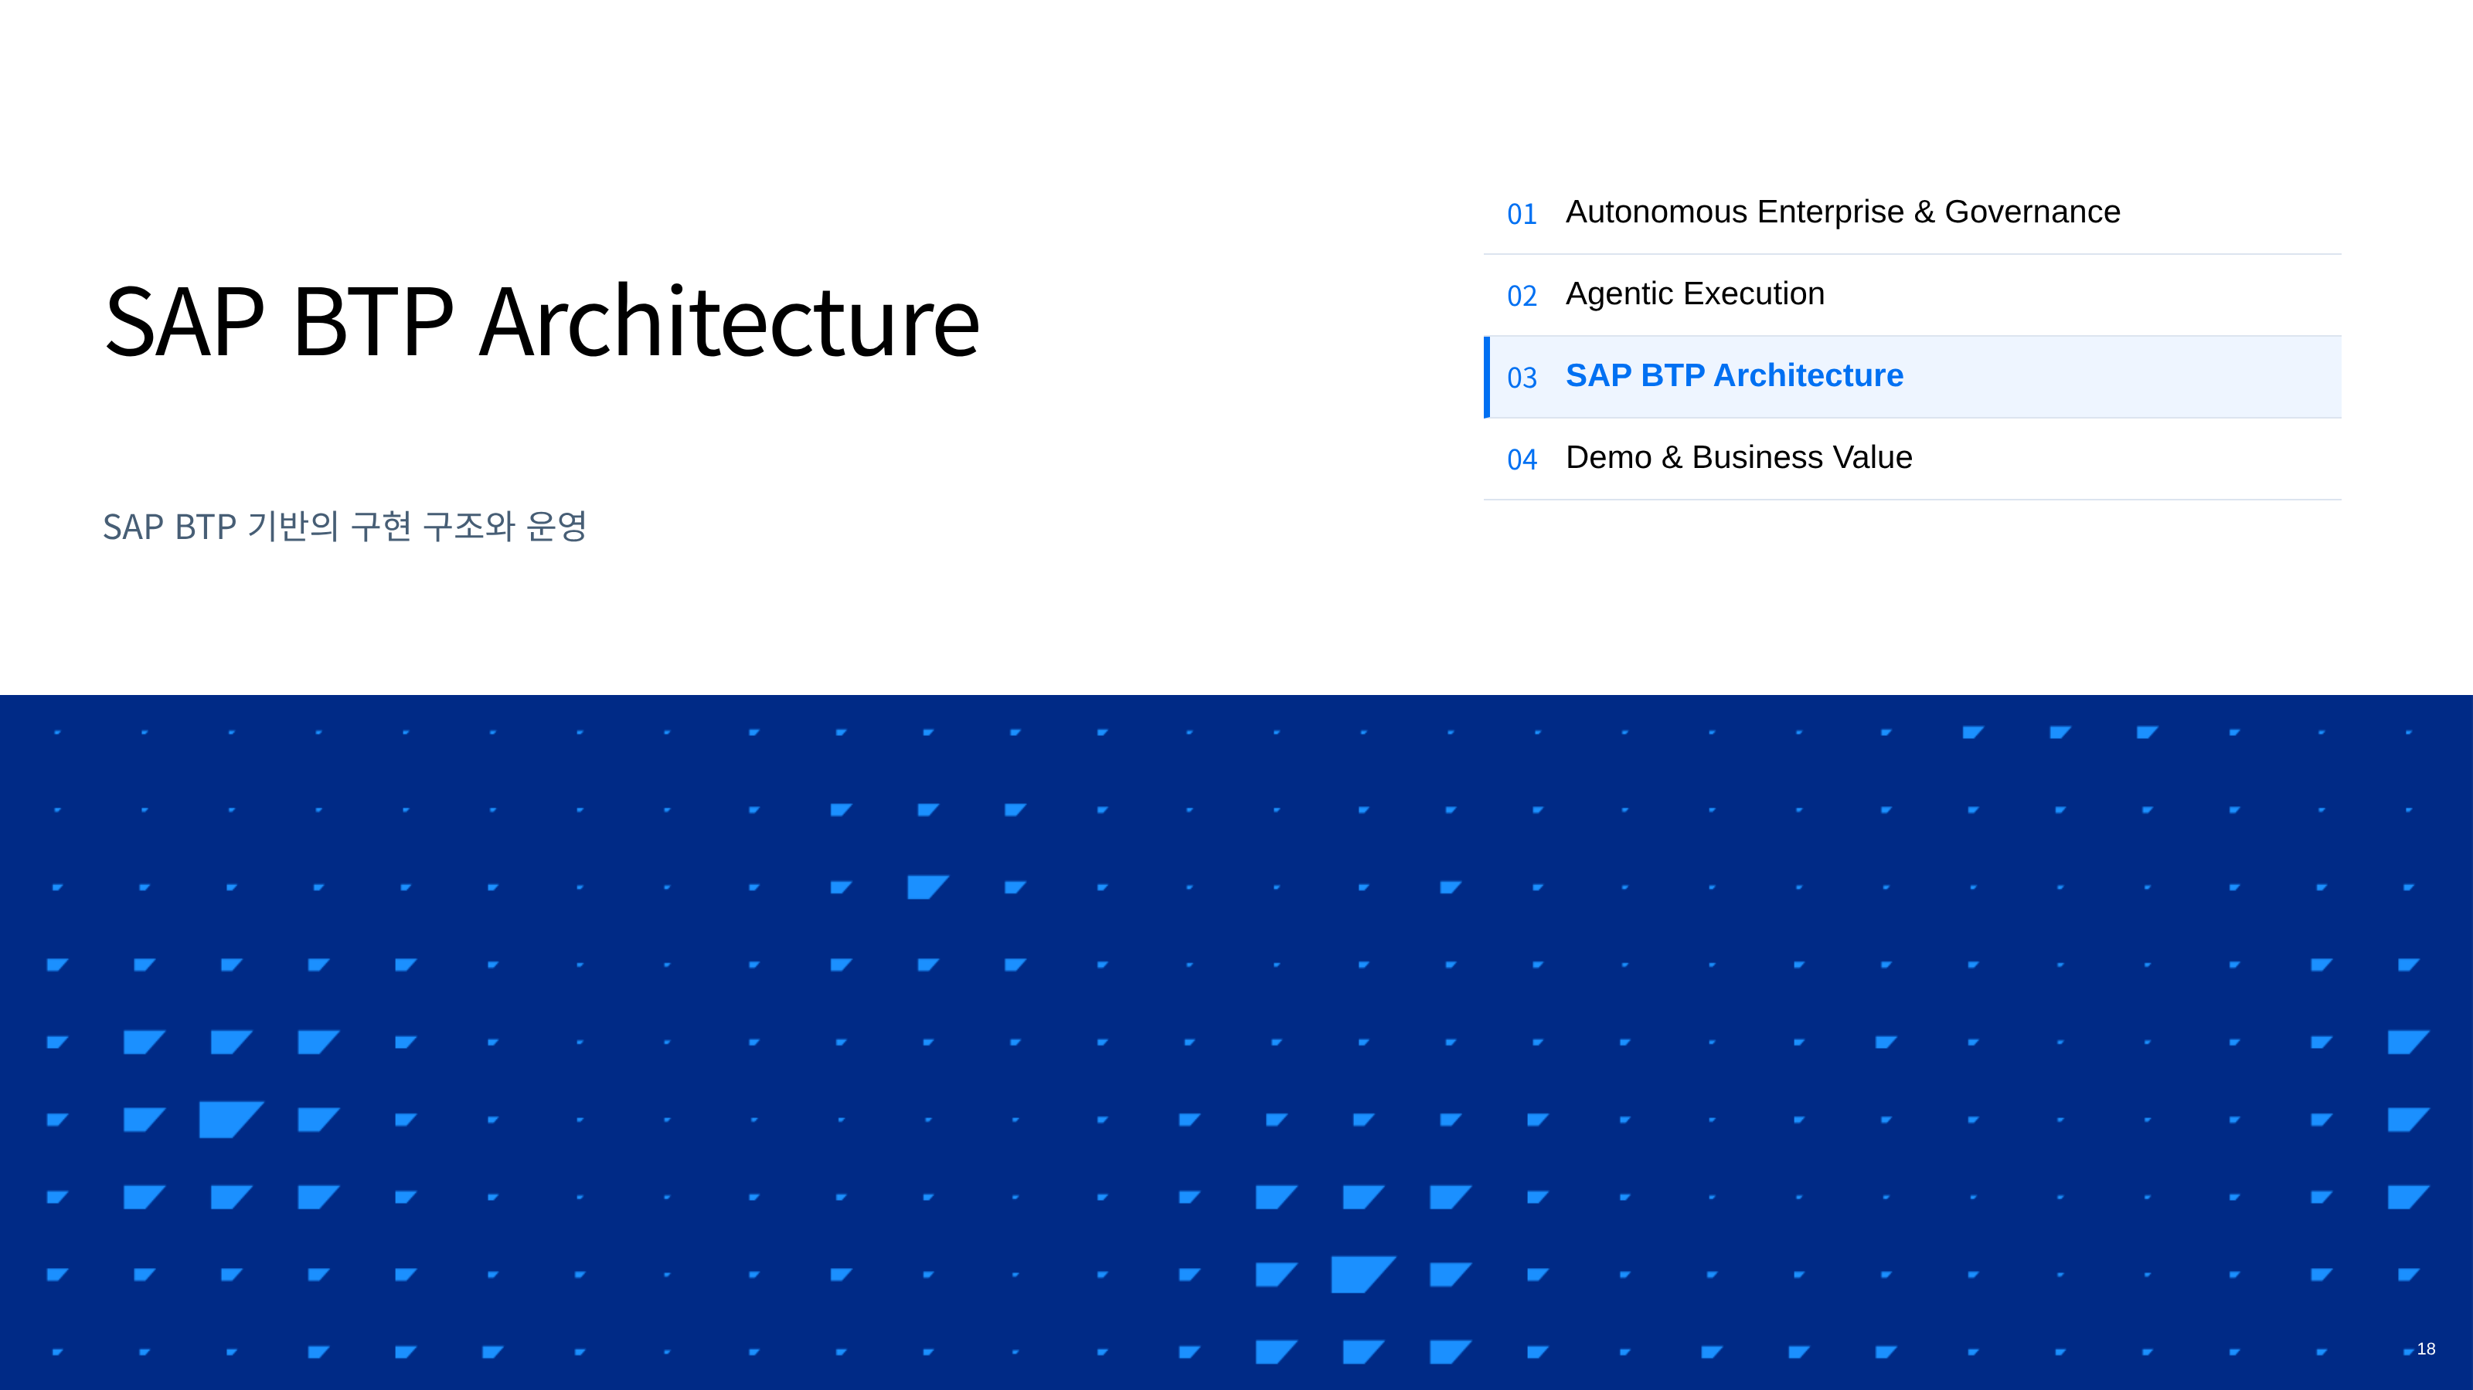
Notes:
18 — SAP BTP Architecture
HTML source: divider-04-platform.html

Slide 19
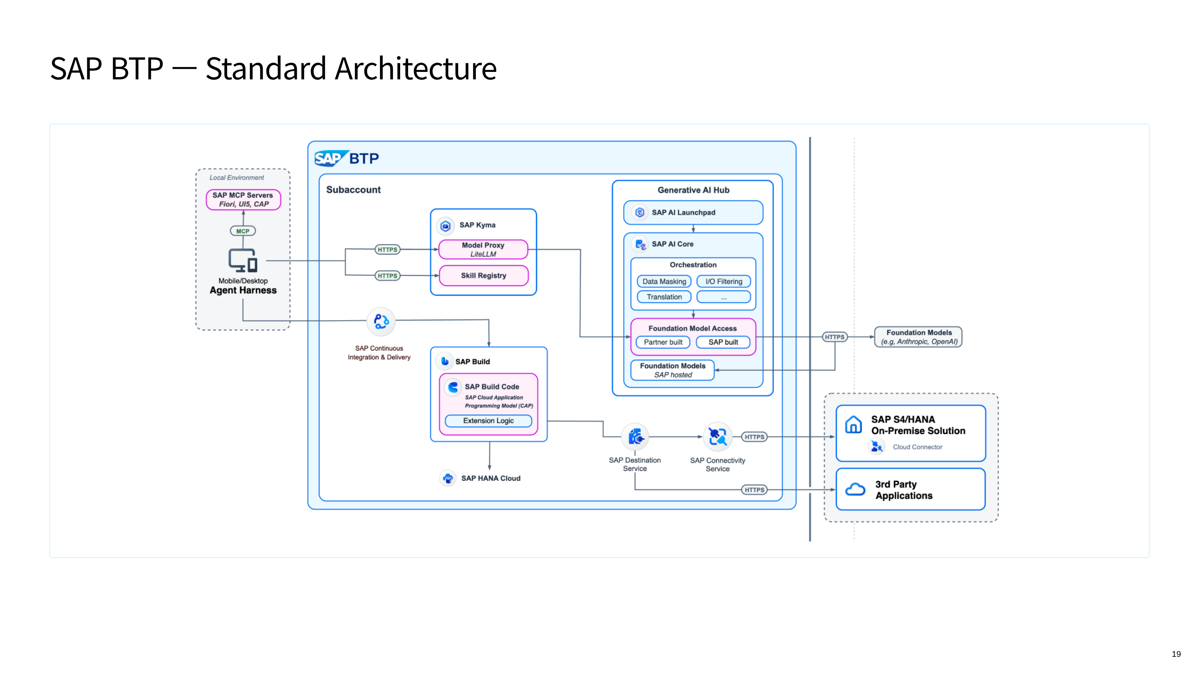
Notes:
19 — SAP BTP — Standard Architecture
HTML source: 19page.html

Slide 20
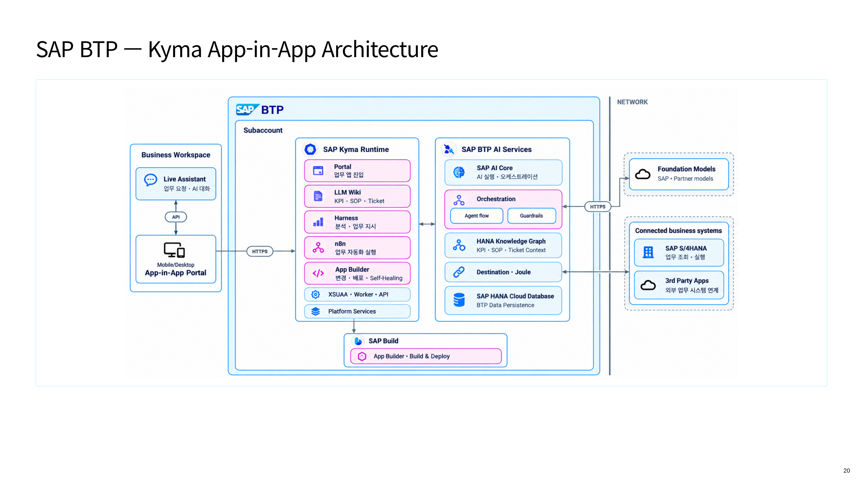
Notes:
20 — SAP BTP — Kyma App-in-App Architecture
HTML source: 20page.html

Slide 21
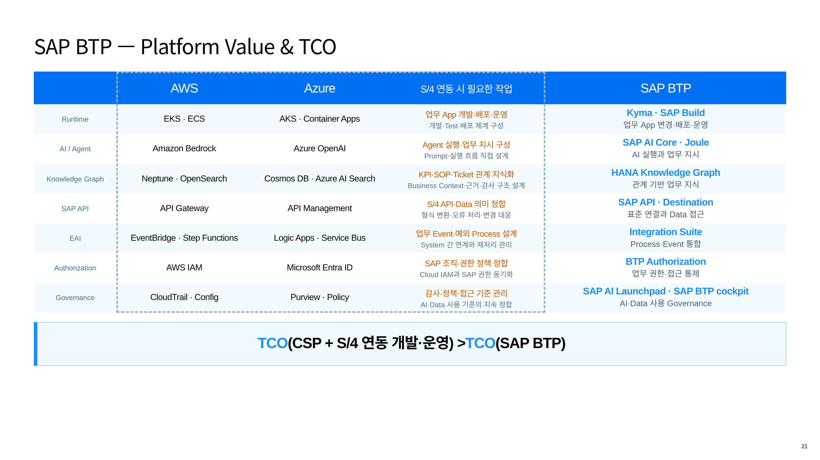
Notes:
21 — SAP BTP — Platform Value & TCO
HTML source: 16page.html

Slide 22
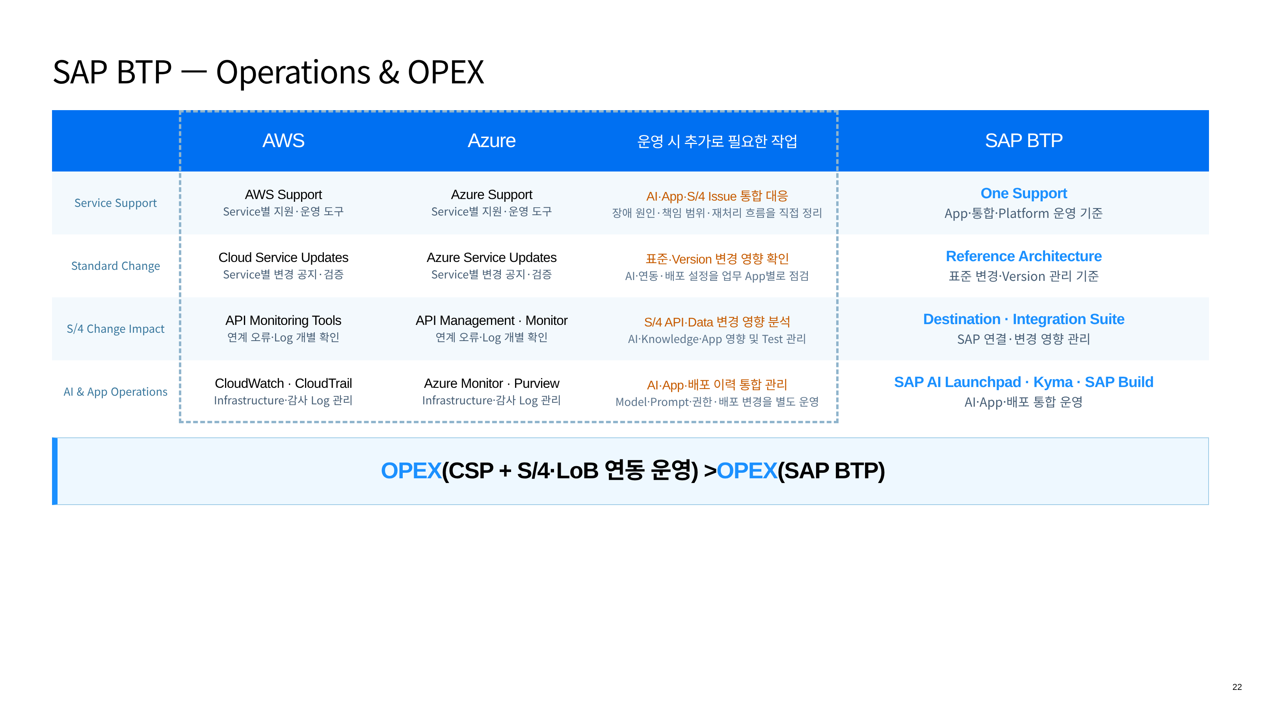
Notes:
22 — SAP BTP — Operations & OPEX
HTML source: 17page.html

Slide 23
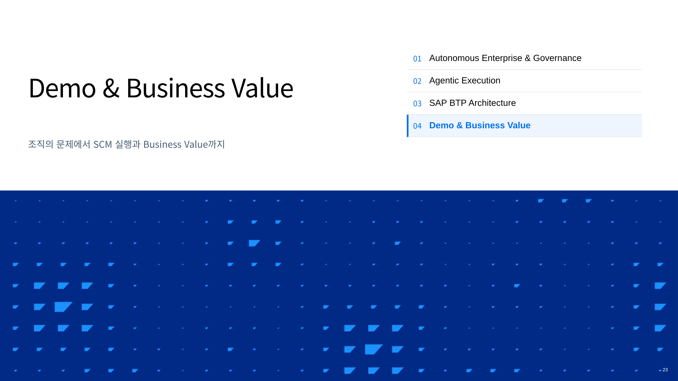
Notes:
23 — Demo & Business Value
HTML source: 21page.html

Slide 24
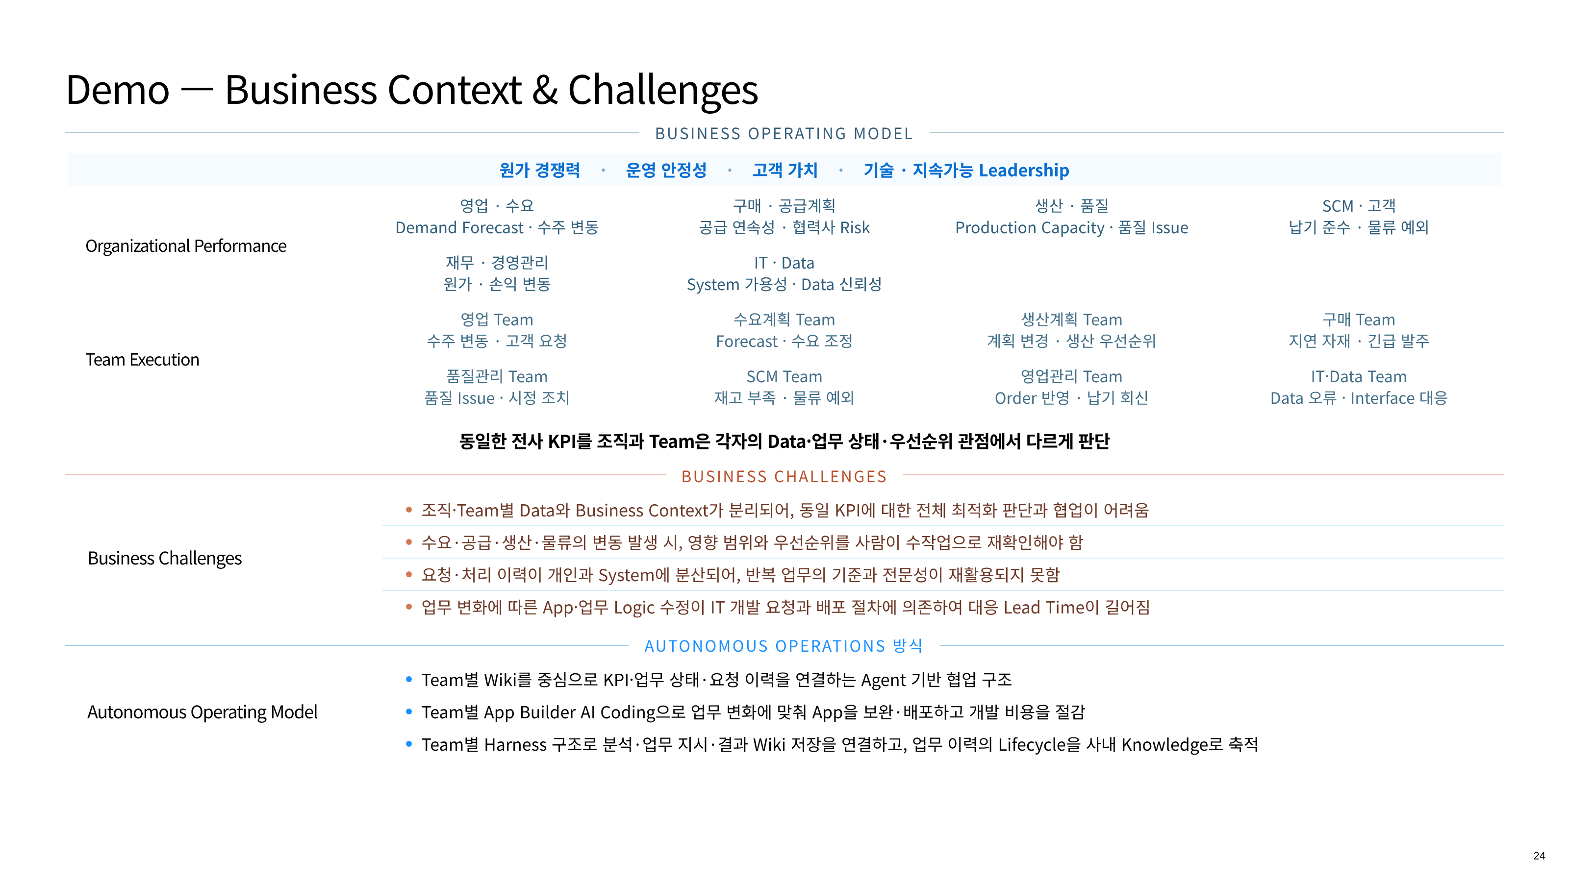
Notes:
24 — Demo — Business Context & Challenges
HTML source: 2page.html

Slide 25
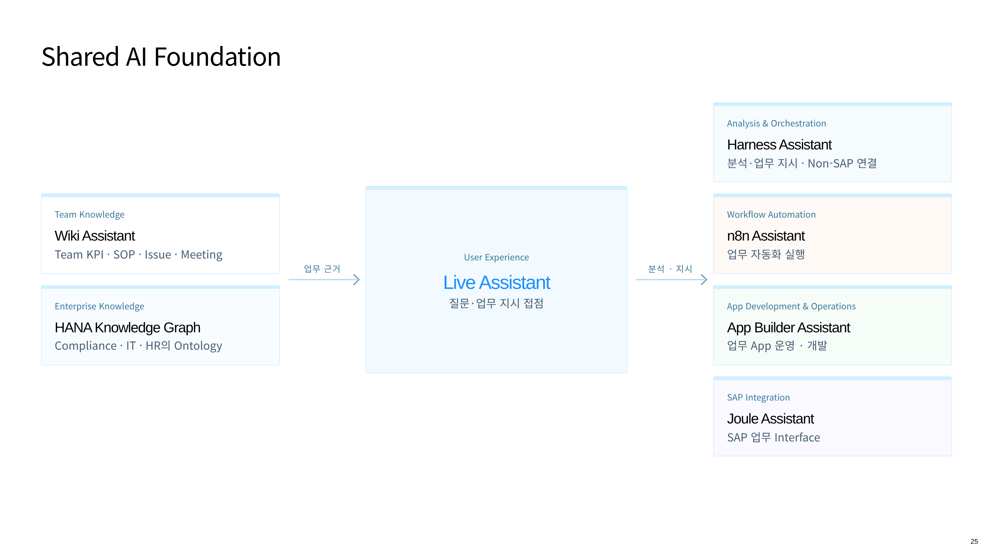
Notes:
25 — Shared AI Foundation
HTML source: 4page.html

Slide 26
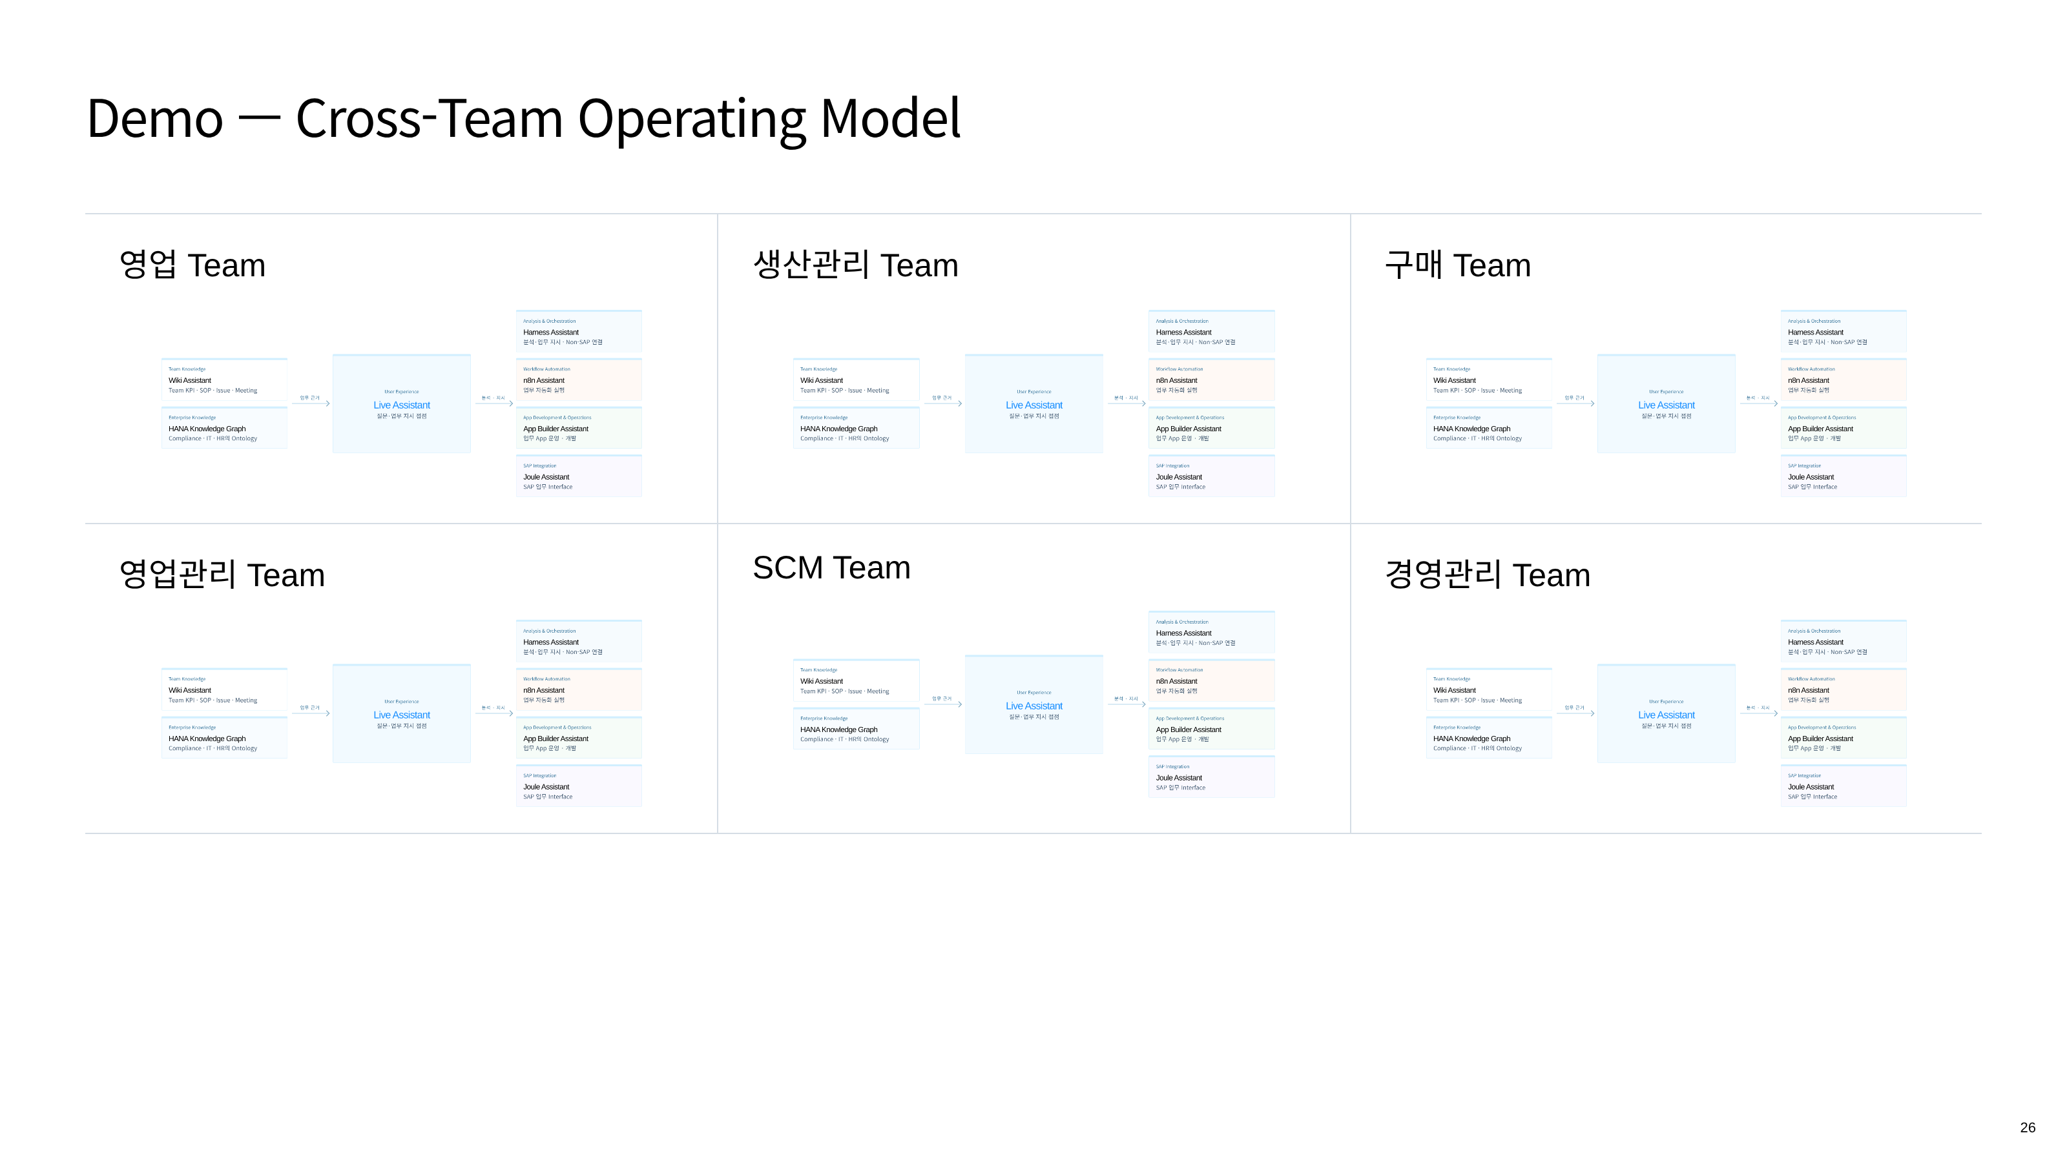
Notes:
26 — Demo — Cross-Team Operating Model
HTML source: 5page.html

Slide 27
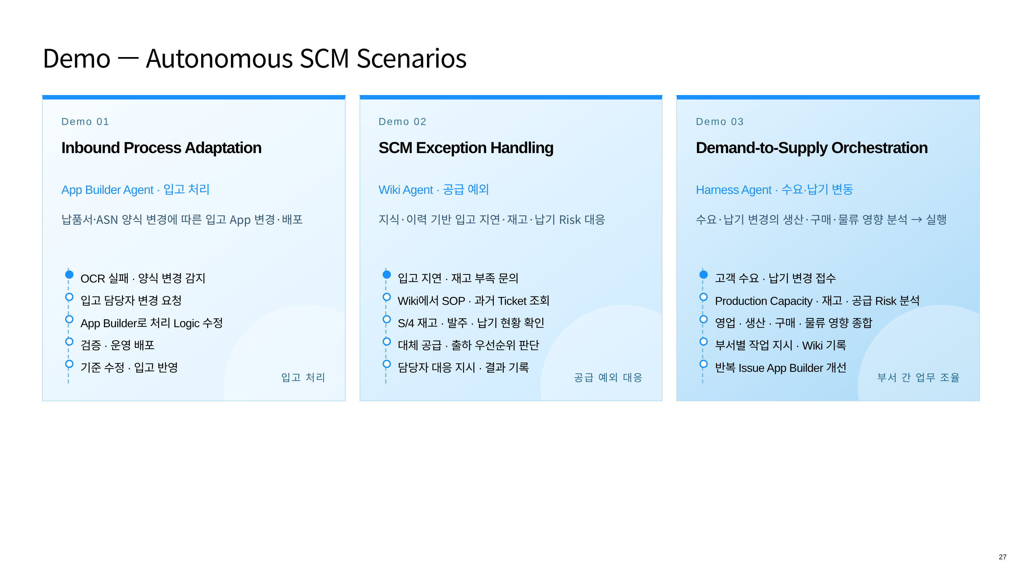
Notes:
27 — Demo — Autonomous SCM Scenarios
HTML source: 22page.html

Slide 28
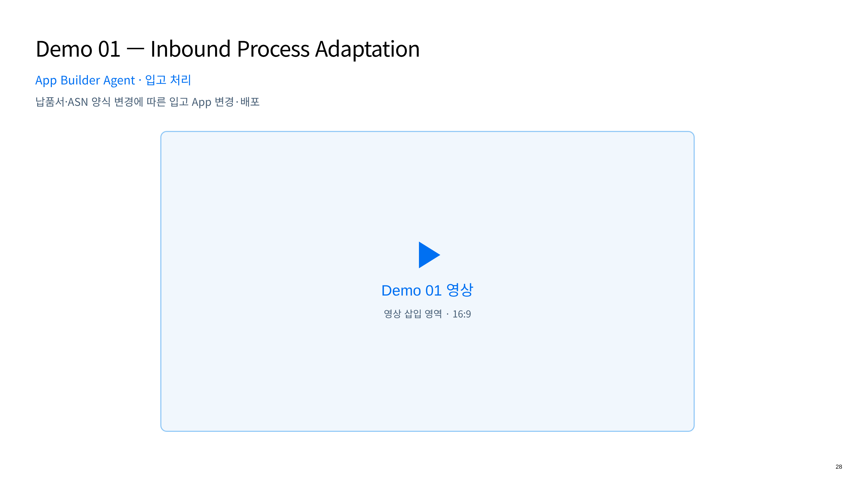
Notes:
28 — Demo 01 — Inbound Process Adaptation
HTML source: demo-video-01-inbound.html

Slide 29
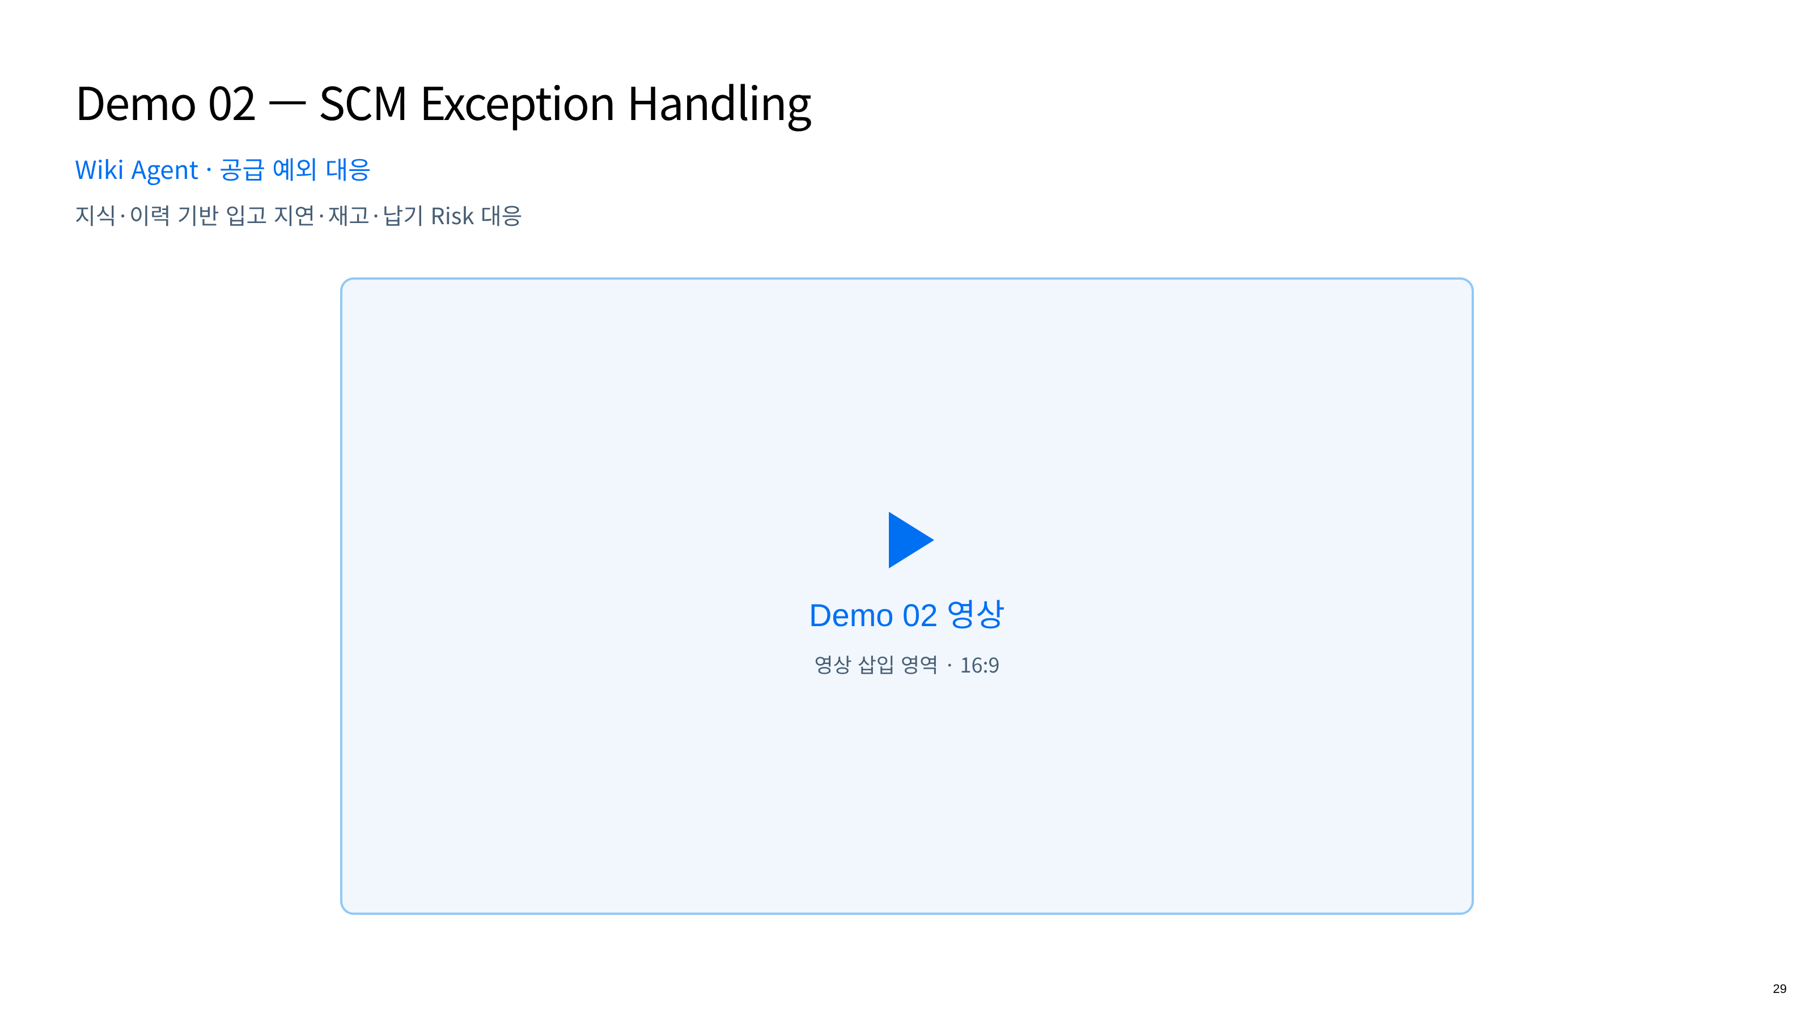
Notes:
29 — Demo 02 — SCM Exception Handling
HTML source: demo-video-02-exception.html

Slide 30
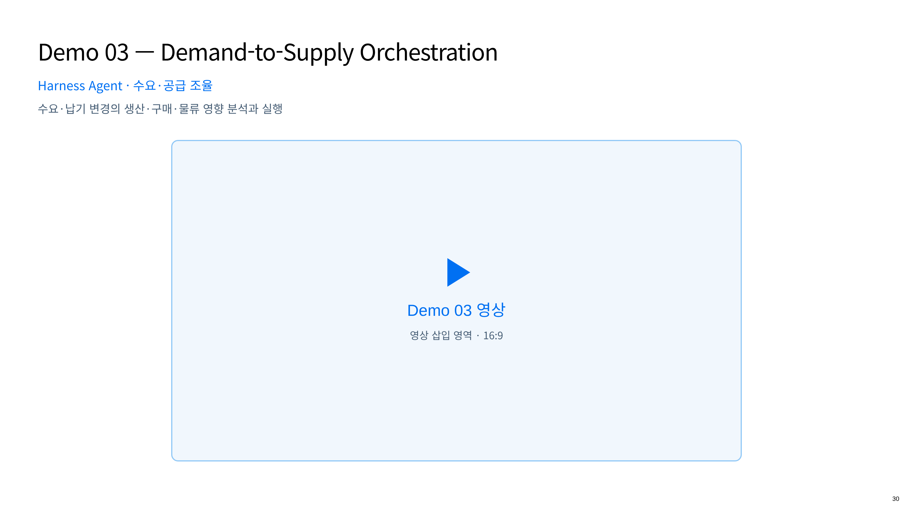
Notes:
30 — Demo 03 — Demand-to-Supply Orchestration
HTML source: demo-video-03-orchestration.html

Slide 31
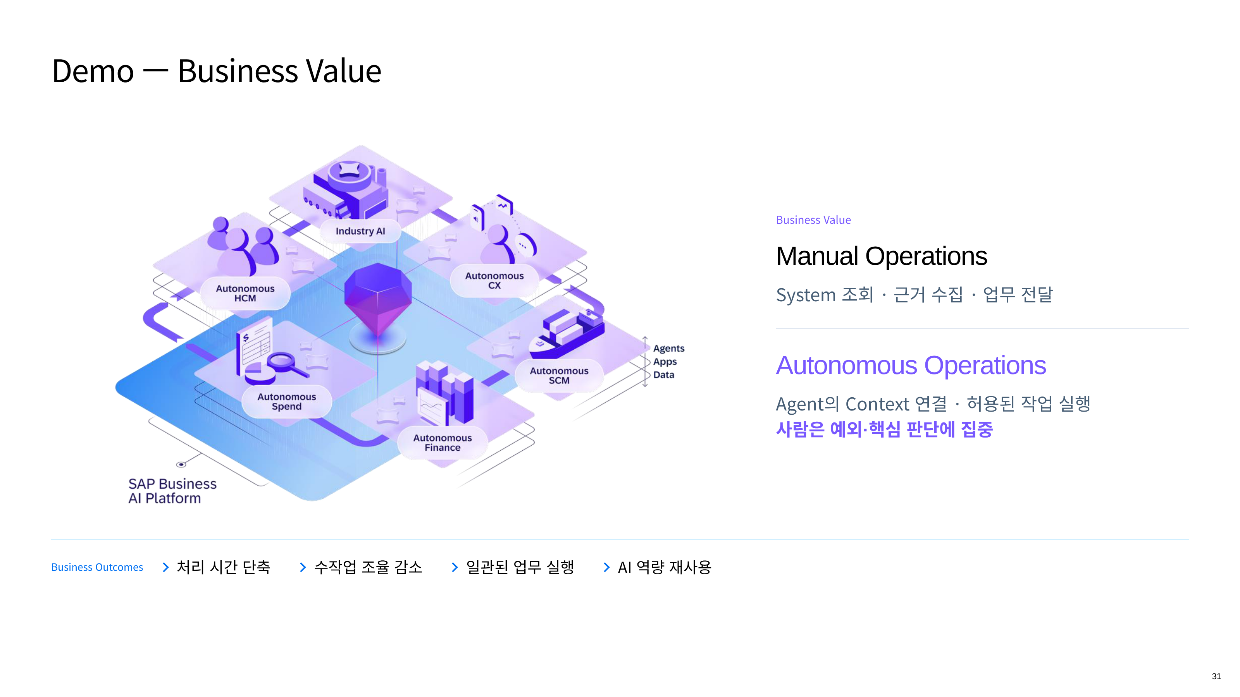
Notes:
31 — Demo — Business Value
HTML source: 23page.html

