Slide 1


The Autonomous Enterprise & Business AI Platform
Partner Opportunity
Executive Summary
July 2026
INTERNAL – SAP and Partners Only
1
Notes:
Converted from supplied PDF, page 1. Text and vector shapes are editable. Embedded screenshots and image-based text remain pictures. Standard Arial font used for portability.

Slide 2



The Autonomous
Enterprise Opportunity
Gartner
for Partners
Enterprise AI software market will
reach
US$ 297B
Lead the shift to a new operating model for businesses in
the age of AI:
in 2027
▪ Shift from AI proof of concepts to outcome-based business value
▪ AI strategy-to-run: advisory, agent orchestration, training, managed lifecycle
(2022–2027 CAGR ~37%)
▪ Build repeatable IP and differentiate via your domain and industry expertise
▪ Accelerate customer time-to-value with FDE and agent-led transformation
▪ Leverage SAP’s €100m Ecosystem Fund to drive customer adoption
INTERNAL – SAP and Partners Only
PUBLIC
Notes:
Converted from supplied PDF, page 2. Text and vector shapes are editable. Embedded screenshots and image-based text remain pictures. Standard Arial font used for portability.

Slide 3
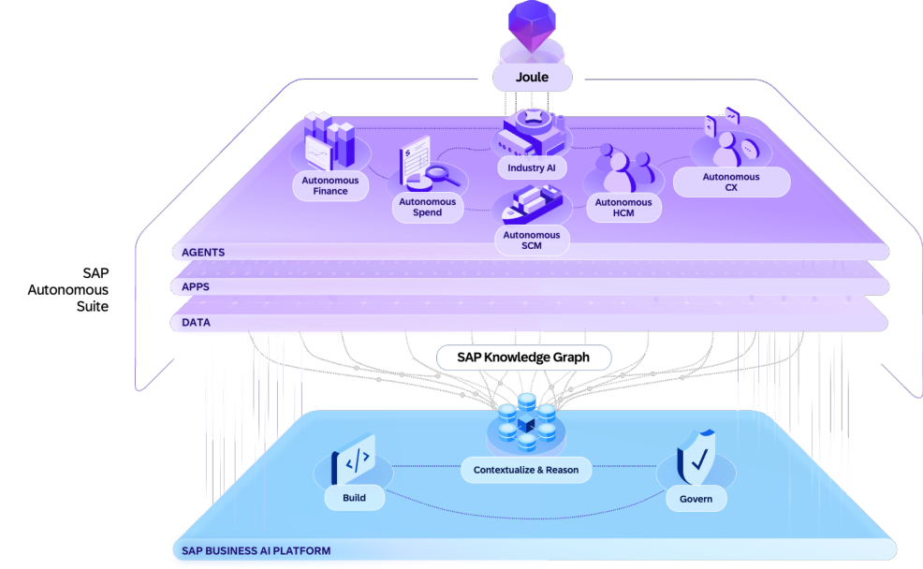










Key elements of the
Autonomous Enterprise
1
Joule as the new engagement layer, bringing together data,
workflows, and agents across SAP systems and beyond
2
SAP Autonomous Suite to reinvent how enterprises run,
based on AI assistants and agents executing work E2E
3
Industry AI embeds the process knowledge, compliance
rules, and data models specific to your industry
4
SAP Business AI platform delivering business context,
unified data, models, and enterprise-grade governance
5
Accelerate adoption of the Autonomous Enterprise with our
agent-led transformation and RISE/GROW offerings
INTERNAL – SAP and Partners Only
© SAP SE
Notes:
Converted from supplied PDF, page 3. Text and vector shapes are editable. Embedded screenshots and image-based text remain pictures. Standard Arial font used for portability.

Slide 4
SAP’s Autonomous Enterprise – License Opportunities
Partner Commercialization Guidance
New Autonomous Suite
Existing Install Base
Customer
BASE AI - Joule and
Enable foundational, conversational AI available
1
embedded AI features
across all SAP applications and leverage AI capabilities
Free of charge
Free of charge
embedded directly into SAP applications.
+
+
Lead RISE, GROW and LOB customer engagements
2
AI First – Business AI in SAP
with role-specific assistants, agents, and data products -
SAP AI units: ~10% (min of €10k)
SAP AI units: activate Joule and
Autonomous Suite
as the foundation for success in the new agentic era of
of Autonomous Enterprise deal
sell min of €10k
enterprise management.
+
+
3
Partner Agents &
Innovate, design and build agents on SAP Joule
BTPEA: ~10% (min of €10k) of
BTPEA: activate Joule Studio
AI Innovation
Studio/ SAP Business AI Platform monetized via
Autonomous Enterprise deal
users and sell min of €10k
BTPEA to deliver high-value, customer-specific solutions.
+
+
Drive adoption: Ensure customer
Drive adoption/consumption:
4
AI Adoption &
Uncover licenses up/x-sell and services opportunities by
has clear identified AI use cases
utilize unused credits to drive new
Consumption
intentionally working with the install base.
via AI Discovery Workshop &
business via AI Discovery
Adoption Plan
Workshop & Adoption Plan
+
+
Incorporating SAP BDC to maximize AI’s value with
5
Ignite AI with BDC and the
complete, harmonized and maintained business context.
BDC CU: Based on customer
BDC CU: Based on customer data
Open Data Ecosystem
Convert legacy systems to BDC and increase deal scope
landscape starting at €20k ACV
landscape
with Open Data Ecosystem partners.
Notes:
Converted from supplied PDF, page 4. Text and vector shapes are editable. Embedded screenshots and image-based text remain pictures. Standard Arial font used for portability.

Slide 5

Partner’s Path to Revenue with SAP’s Autonomous Enterprise
Monetize outcome-based business value
Cloud at Volume
Agentic Transformation
Repeatable IP & Differentiation
•
Position and sell SAP’s Autonomous
•
Offer AI Advisory Services and
•
Build differentiated domain or
Enterprise with Joule, Autonomous
Process Redesign
industry-specific agents on Joule
Suite and Business AI Platform
•
Implement Joule, Autonomous Suite
Studio
•
Scale via RISE and GROW Motions
and Business AI Platform
•
Register agents on SAP Agent Hub
•
New Public Cloud ERP at Volume -
•
Establish modern data fabric with
and sell Agents through SAP Store
100B TAM opportunity in 2027
BDC as foundation for AI
•
Deploy agents in customer's platform
•
Drive adoption via co-innovation to fill
•
Extend SAP Assistants and deploy
account to drive consumption –
SAP white space areas
own custom or productized agents
leverage € 100m ecosystem fund
•
A2A integration to 3rd party systems
•
Deploy productive minimum 10+
Agents & Win: TechEd keynote
•
Agent governance, orchestration and
mention + booth showcase
lifecycle operations e.g. hire, train,
retire
Continuous value services and innovation
INTERNAL – SAP and Partners Only
INTERNAL – SAP and Partners Only
5
5
Notes:
Converted from supplied PDF, page 5. Text and vector shapes are editable. Embedded screenshots and image-based text remain pictures. Standard Arial font used for portability.

Slide 6
The Autonomous Enterprise & Business AI Platform
Partner Opportunity
Deep Dive
July 2026
INTERNAL – SAP and Partners Only
6
Notes:
Converted from supplied PDF, page 6. Text and vector shapes are editable. Embedded screenshots and image-based text remain pictures. Standard Arial font used for portability.

Slide 7




Agenda
–
Deep Dive
Autonomous Enterprise and Business AI Platform
Business AI Partner Programs
▪
SAP Partner-led AI Adoption Incentive
▪
Partner agent race to SAP TechEd
Marketing Assets, Learning & Enablement for Partners
PUBLIC
7
Notes:
Converted from supplied PDF, page 7. Text and vector shapes are editable. Embedded screenshots and image-based text remain pictures. Standard Arial font used for portability.

Slide 8

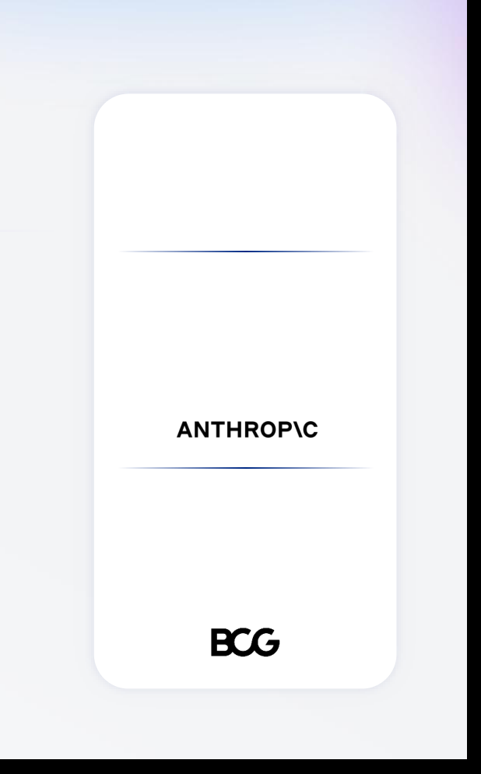
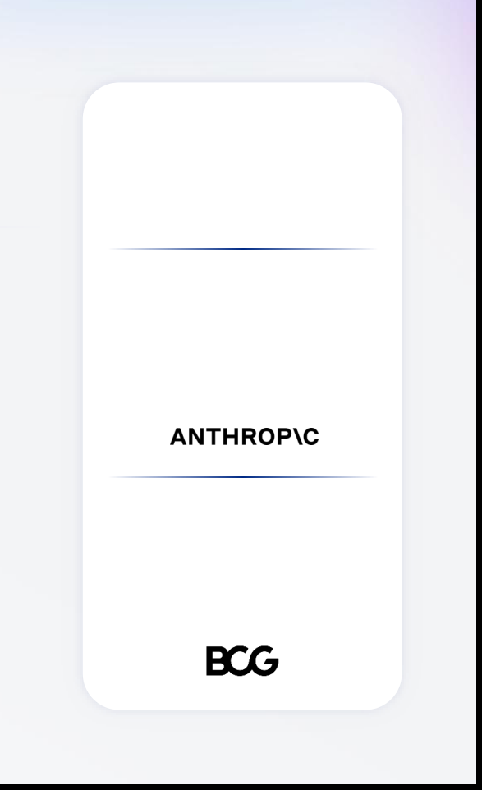














AI is everywhere, but results aren't
What you
Publicly available content &
80%
need for an
generic LLMs
AI PoC
generic LLM accuracy
42%
Process knowledge
and business context
report data access & quality
issues as leading barrier
Accurate and connected
business data
74%
What you need
Trustworthy and secure
of orgs stuck in pilot mode
for enterprise-
Governance
with no path to scale
grade AI outcomes
PUBLIC
8
PUBLIC
8
Notes:
Converted from supplied PDF, page 8. Text and vector shapes are editable. Embedded screenshots and image-based text remain pictures. Standard Arial font used for portability.

Slide 9
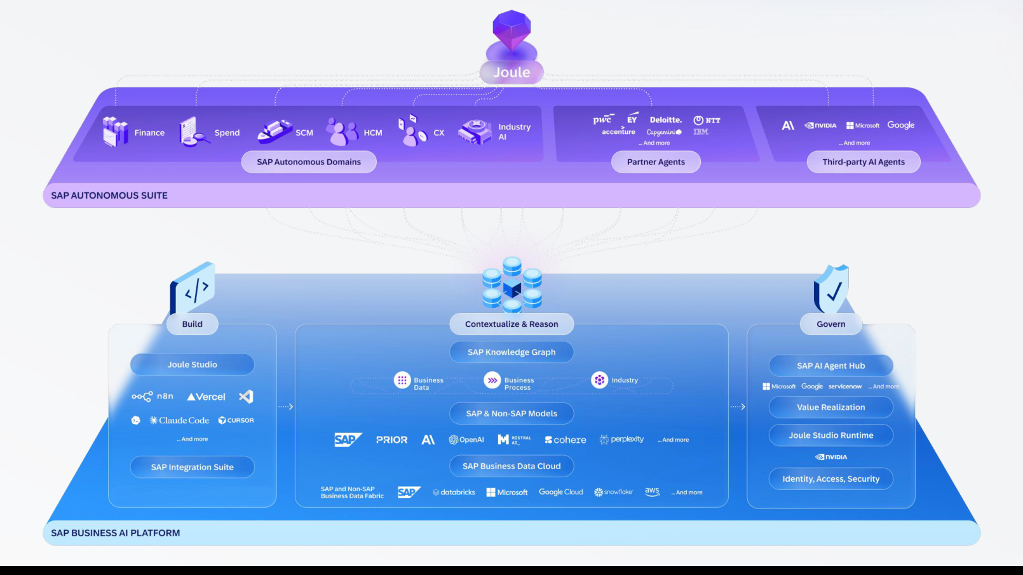
SAP’s Autonomous Enterprise Vision and Strategic Partnerships
PUBLIC
9
PUBLIC
9
Notes:
Converted from supplied PDF, page 9. Text and vector shapes are editable. Embedded screenshots and image-based text remain pictures. Standard Arial font used for portability.

Slide 10

Autonomous Enterprise
-
PARTNER ECOSYSTEM VALUE
What is the vision for partners in the
How will SAP help partners achieve success within
Autonomous Enterprise?
Autonomous Enterprise?
Partners are our force multiplier to land
NEW - SAP announced EUR 100m invest in
Autonomous Enterprise vision
ecosystem
SAP Business AI Platform as partner’s platform of
NEW - Training curriculum for Sales, Presales,
choice for co-innovation
Consultants & Developers
Turn Partner Agent Innovation Into Revenue
NEW - Competitive commercial constructs and
incentives
Accelerate the Autonomous Enterprise
NEW - Business AI Partner Programs
Scale Channel Growth - win in the Corporate
market segment
INTERNAL – SAP and Partners Only
10
PUBLIC
© SAP SE
10
Notes:
Converted from supplied PDF, page 10. Text and vector shapes are editable. Embedded screenshots and image-based text remain pictures. Standard Arial font used for portability.

Slide 11


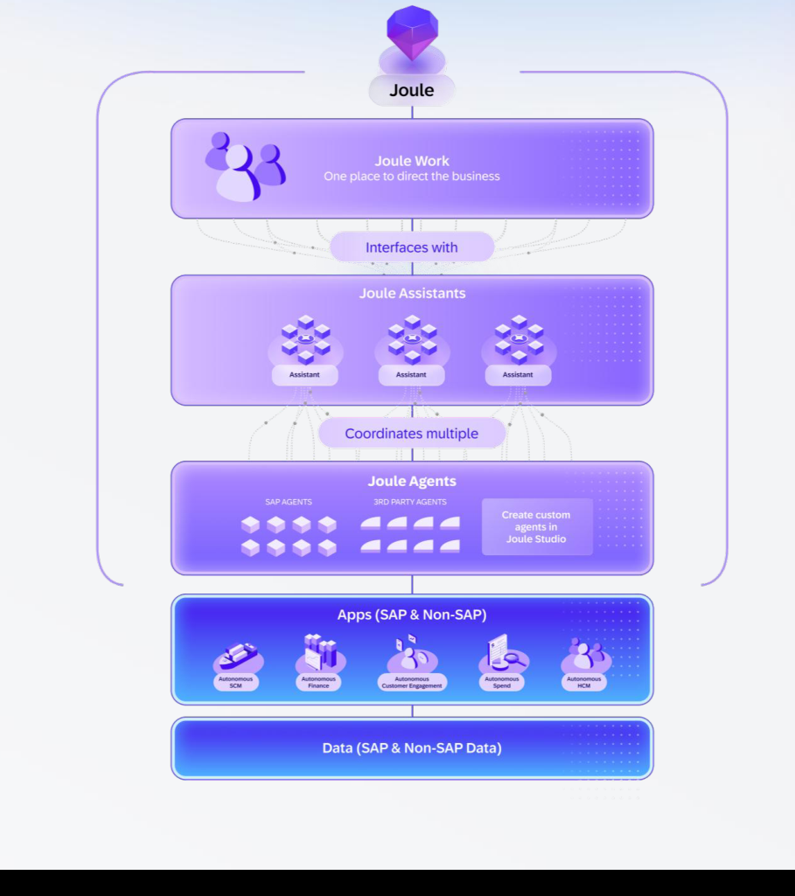
1
Joule
Joule
A new way to engage with and execute
end-to-end business processes.
What is Joule Work?
Joule Work is a new stand-alone dynamic workspace where people can execute
business-wide workflows across SAP and non-SAP systems.
What is a Joule Assistant?
Assistants use deep role and process context to coordinate Joule Agents and
autonomously execute complex workflows across the business, like smart teammates.
What is a Joule Agent?
Joule Agents are purpose-built AI agents with deep business process expertise,
accessible through Joule Assistants, that automate well-defined, multi-step enterprise
workflows so you can get more done.
What is Joule Studio?
Joule Studio is the AI development solution for customers to build AI Agents, apps, and
workflows on an SAP-managed runtime.
Visual represents a mix of current
PUBLIC
& visionary product structure
Notes:
Converted from supplied PDF, page 11. Text and vector shapes are editable. Embedded screenshots and image-based text remain pictures. Standard Arial font used for portability.

Slide 12
























































2
Autonomous Suite
The Autonomous Suite runs based on AI assistants and
agents executing work across all domains
Joule
Autonomous
Autonomous
Autonomous
Autonomous
Autonomous
Finance
Spend
SCM
HCM
CX
SAP Autonomous Suite
Assistants
Finance
Procurement
Supply Chain
HR
CX
Assistants
Assistants
Assistants
Assistants
Assistants
Agents
Skills
+
Joule Studio to build, extend and connect agents targeted to customers’ business needs
Applications
Domain-specific Overview
Domain-specific Overview
Discover Joule Assistants
Discover Joule Assistants
PUBLIC
Notes:
Converted from supplied PDF, page 12. Text and vector shapes are editable. Embedded screenshots and image-based text remain pictures. Standard Arial font used for portability.

Slide 13





SAP Business AI commercial model — pre-built AI
How SAP-delivered, out-of-the-box AI is included or paid for
Base AI
Premium AI
Two access paths
Consumption-based
User-based
Joule Base
Agents
AI features
Natural language
interactions
Joule for
Free
Document AI
Consultants
Document
grounding
Embedded AI
Joule for
AI capabilities directly built
Developers
into SAP applications
…
Included in cloud subscriptions
Measured per action
Measured per
Measured per user
request / record
per month
Free
Paid, powered by AI Units
SAP Business AI Commercial Model - Deck for Partner
INTERNAL – SAP and Partners Only
13
PUBLIC
13
Notes:
Converted from supplied PDF, page 13. Text and vector shapes are editable. Embedded screenshots and image-based text remain pictures. Standard Arial font used for portability.

Slide 14




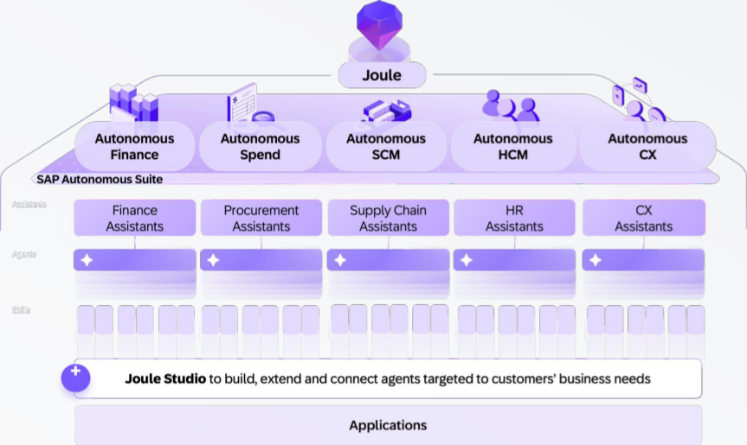
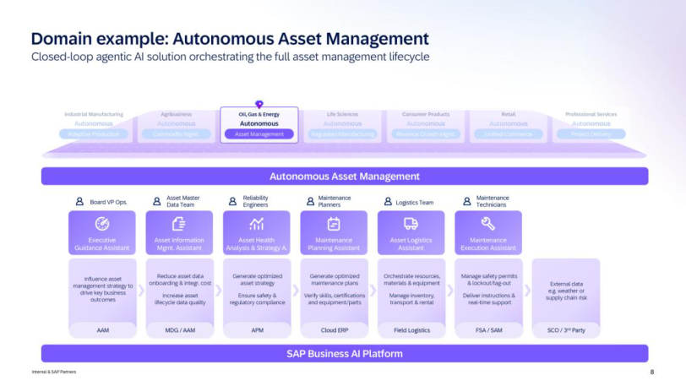
2
Autonomous Suite
3
Industry AI
Partner Co-Innovation Opportunity to complement
SAP’s Autonomous Suite and Industry AI Portfolio
Autonomous Domain AI
Industry AI
Extend existing SAP’s Assistants In Autonomous
Focusing on entire value-chain transformations
Suite and build industry-specific agents
PUBLIC
Notes:
Converted from supplied PDF, page 14. Text and vector shapes are editable. Embedded screenshots and image-based text remain pictures. Standard Arial font used for portability.

Slide 15


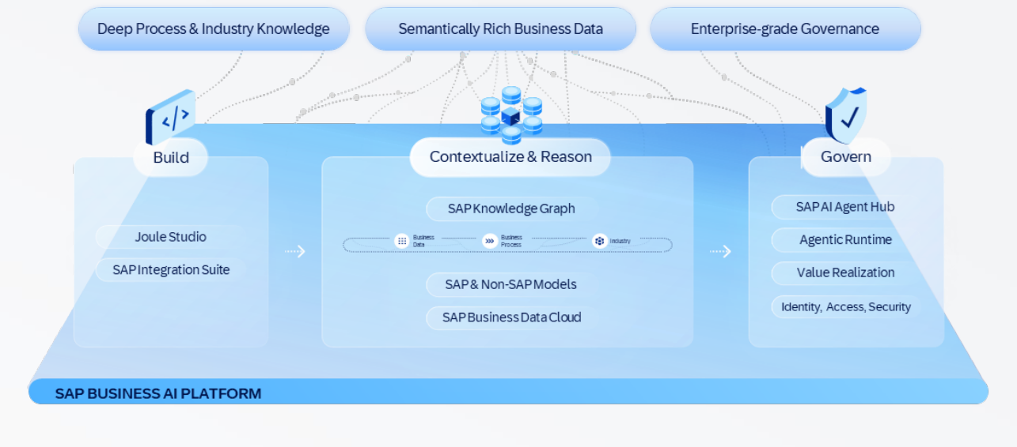
4
SAP Business AI Platform
The platform for building, running, and governing AI
your business can actually depend on
The foundation that combines deep process context, unified business data, and
Build: Build AI agents & apps with
purpose
-
built models with enterprise
-
grade governance
best-in-class tools & models
300+
Agents built by Partners
in SAP Joule Studio
Contextualize & Reason: 50 years of
encoded business process expertise
7.3M
Data fields in Knowledge
Graph
Govern: Command center for
enterprise-wide AI agent governance
>55k
AI agents managed in SAP AI
Agent Hub across customers
15
PUBLIC
15
PUBLIC
Notes:
Converted from supplied PDF, page 15. Text and vector shapes are editable. Embedded screenshots and image-based text remain pictures. Standard Arial font used for portability.

Slide 16






4
SAP Business AI Platform
Joule Studio
Build Trusted Custom Agentic Solutions
“Joule Studio generated an
Intent Driven Development
end-to-end solution in 10–15
No Code to Pro Code | Any Tool, Many Frameworks | Agents, Apps & Workflows
minutes, replacing three to four
days of manual development and
coordination.”
Developer, Sony Corporation*
“The guided prompts made it easy
Business Context
to dial in personas and features
SAP Knowledge Graph | SAP Domain Models | SAP Data, Processes & Apps
fast. I went from zero to a
working solution in only 30
minutes.”
Architect, IBM*
Trusted Governance
Agent Observability | Process Insights | Managed Runtime
16
PUBLIC
16
PUBLIC
Notes:
Converted from supplied PDF, page 16. Text and vector shapes are editable. Embedded screenshots and image-based text remain pictures. Standard Arial font used for portability.

Slide 17
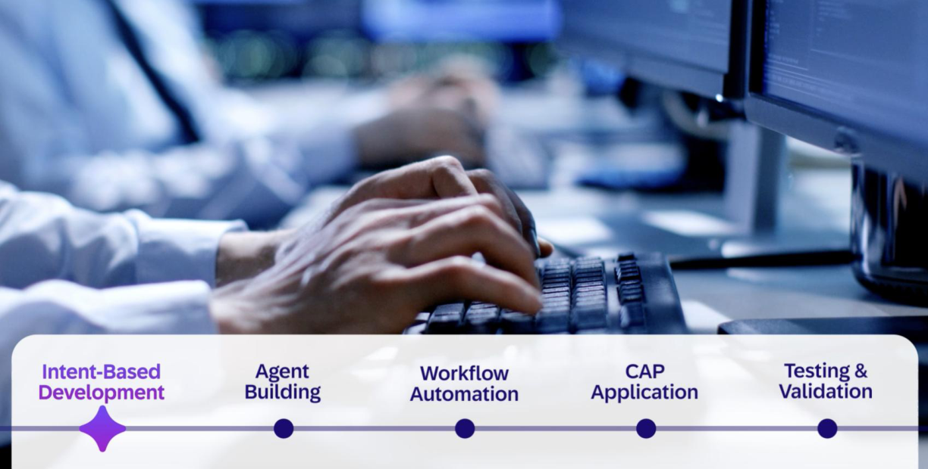
4
SAP Business AI Platform
Joule Studio Demo
PUBLIC
Notes:
Converted from supplied PDF, page 17. Text and vector shapes are editable. Embedded screenshots and image-based text remain pictures. Standard Arial font used for portability.

Slide 18






4
SAP Business AI Platform
The Partner Agent Build Journey
SAP Business AI Platform as partner’s platform of choice to
•
Extend SAP Agents and Assistants
•
Complement SAP’s Industry and Domain Assistants/Agents and fill white space
•
Innovate and build high value agents across domains
Design, develop, test
Publish Agents on
Register, Discover
Buy Agents on
Agent
agents using
SAP Store
and Validate
SAP Store
Provisioning
Joule Studio
Agents on SAP
Agent Hub
Available
Joule Studio 1.0
✓
N/A
✓
Deployed to Customer
AI Foundation
Account
Roadmap
Joule Studio 2.0
SAP Agent Hub &
ISV/SaaS based Agents
SAP Store Integration
A2A Integration
18
PUBLIC
18
PUBLIC
Notes:
Converted from supplied PDF, page 18. Text and vector shapes are editable. Embedded screenshots and image-based text remain pictures. Standard Arial font used for portability.

Slide 19



4
SAP Business AI Platform
Free
SAP Business AI commercial model — custom-built AI
Promotion
Until end of
How customer-built AI is enabled at design time and paid for at runtime
2026
Joule Work
Design
-
Time tooling
Joule Studio runtime
Productive runtime where custom-
Access layer
Full authoring environment
built agents, apps,
and workflows actually run
For shared experiences,
Tooling for building and testing
Productive runtime for custom-built
approvals, dev spaces, Agent
agents, apps, and workflows, with
agents, apps, workflows, and
Hub, MCP builder, and BTP-
AI-assisted development under
extensions, billed on resource
hosted apps/extensions
fair-use limits
consumption across Compute,
Storage, Transactions, and AI Tokens
Premium spaces / experiences
Usage of AI capabilities for intent-based
BTPEA, CPEA (pending
may be priced in the future.
development is subject to fair-use limits;
approval), or PAYG
beyond these limits, additional pricing applies
Free
Free
Paid
Under a time-bound promotion, running custom agents will remain free through 2026 across both BAF and Joule Studio runtime.
INTERNAL – SAP and Partners Only
SAP Business AI Commercial Model - Deck for Partner
19
PUBLIC
19
Notes:
Converted from supplied PDF, page 19. Text and vector shapes are editable. Embedded screenshots and image-based text remain pictures. Standard Arial font used for portability.

Slide 20


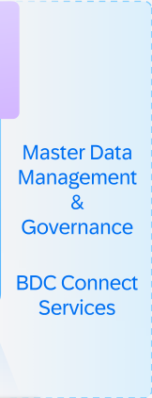
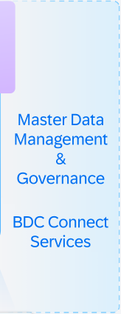







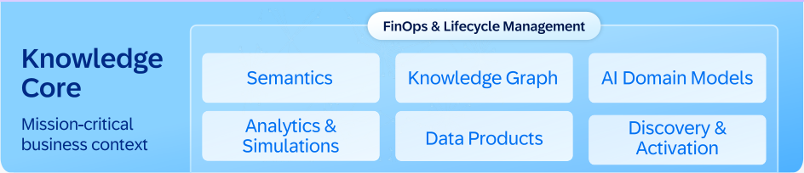

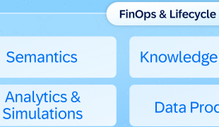

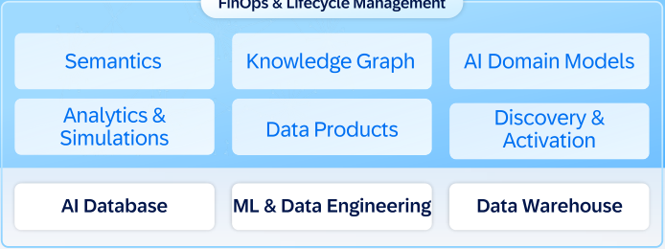




















4
SAP Business AI Platform
Contextualize & Reason
SAP Business Data Cloud’s comprehensive strategy for enterprise data
AI Agents
Joule
Intelligent
Partner-focused Sales & Adoption Plays
Agents
content
FinOps & Lifecycle Management
Master Data
▪ Establish E2E Data Fabric via zero-copy BDC Connect
Knowledge
Management
▪ Ignite AI with SAP Business Data Cloud as the foundation
Core
Semantics
Knowledge Graph
AI Domain Models
&
Governance
Mission
-
critical
Analytics &
Data Products
Discovery &
▪ BW Modernization and Hana Move
business context
Simulations
Activation
BDC Connect
Services
▪ Develop and market Intelligent Content
Intelligent
AI Database
ML & Data Engineering
Data Warehouse
Compute
▪
Endorsed/Solex partnerships eg Snowflake, Collibra
Lake Storage
SAP
Business
Non
-
SAP data
Hybrid
SaaS
Cloud
-
native
On
-
SAP
data
Warehouse
premises
Edge
20
PUBLIC
20
PUBLIC
Notes:
Converted from supplied PDF, page 20. Text and vector shapes are editable. Embedded screenshots and image-based text remain pictures. Standard Arial font used for portability.

Slide 21





















4
SAP Business AI Platform
Govern
SAP AI Agent Hub
Plan &
Discover &
Observe &
Secure &
Optimize &
Build
Provision
Analyze
Govern
Decommission
SAP AI Agent Hub
Agent & MCP
Agent Evals &
Identity &
Agent
Agent Mining
Agent Org &
Registry
Assessment
Access Control
Observability
Skills Mapping
LeanIX
Joule Studio
Cloud Identity Service
Cloud ALM
Signavio
Integration Suite
SuccessFactors
Unparalleled Architecture Insight | Unmatched Business Context
Discovery Sources
21
PUBLIC
21
PUBLIC
Notes:
Converted from supplied PDF, page 21. Text and vector shapes are editable. Embedded screenshots and image-based text remain pictures. Standard Arial font used for portability.

Slide 22


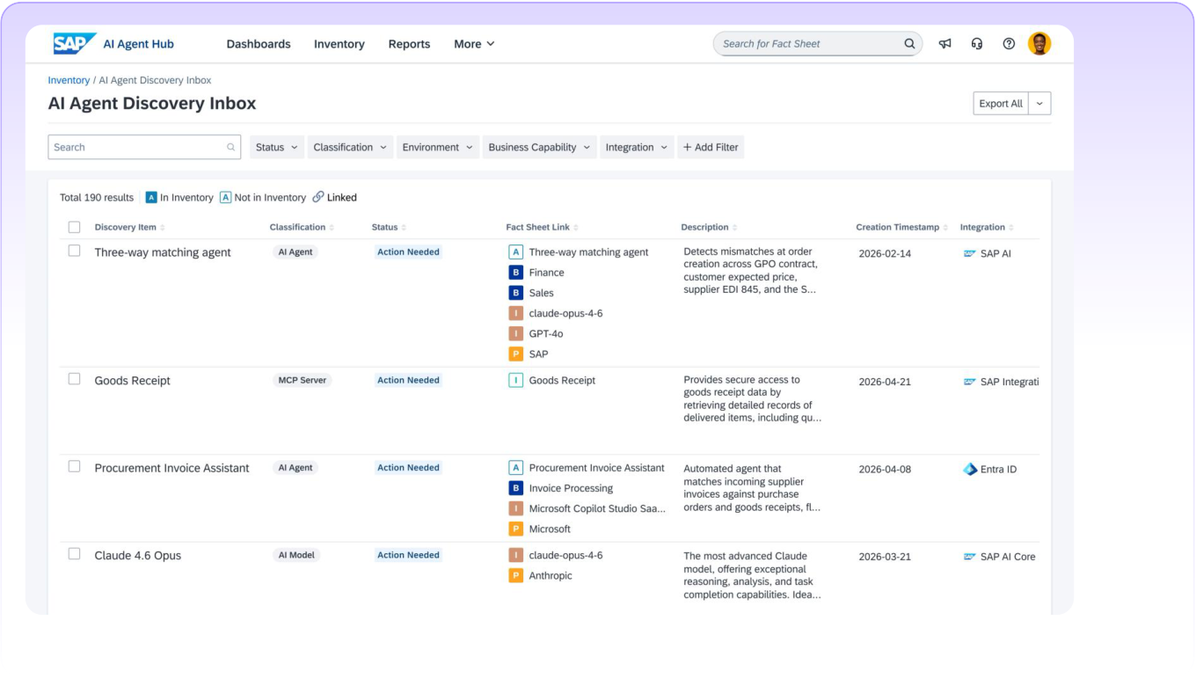
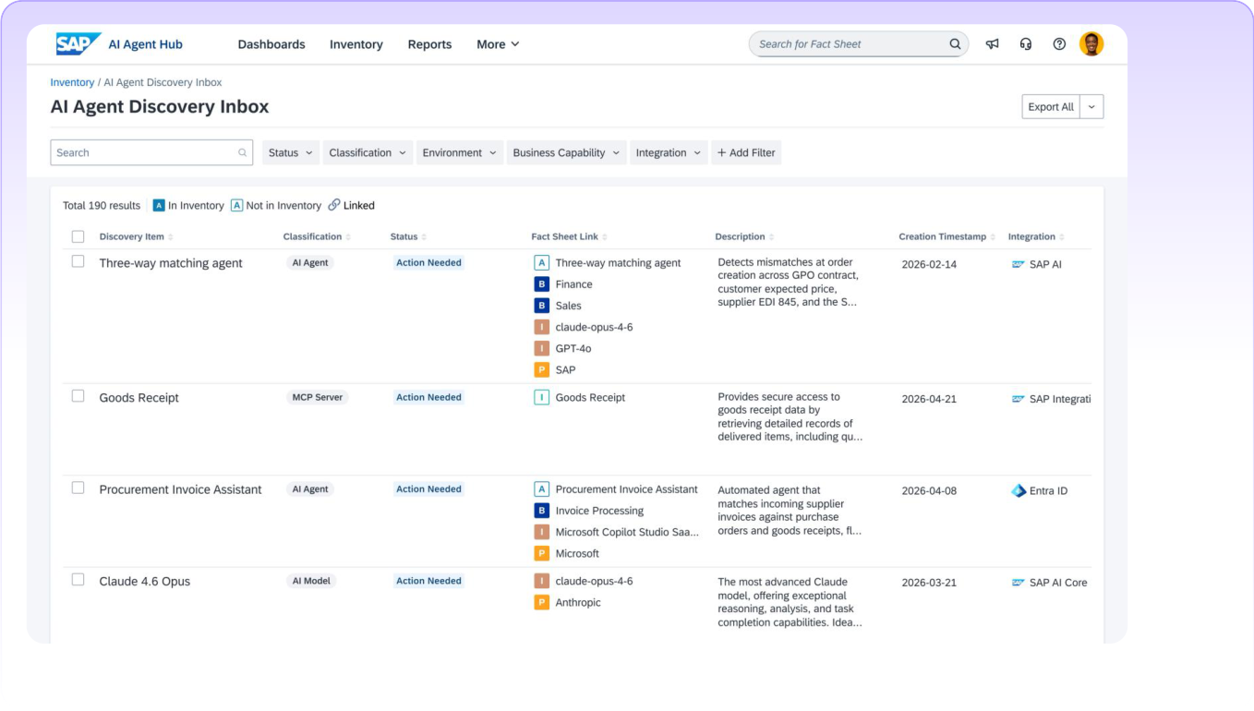
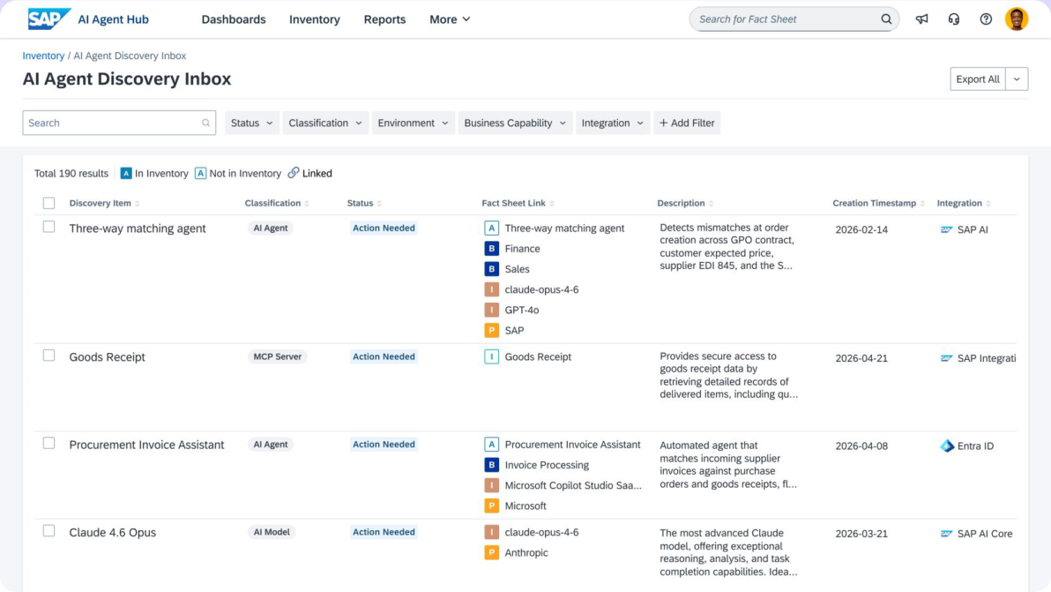
4
SAP Business AI Platform
Demo:
Discover and observe agents in a context-rich AI inventory
Discover and observe agents in a context
-
rich AI inventory
PUBLIC
22
Notes:
Converted from supplied PDF, page 22. Text and vector shapes are editable. Embedded screenshots and image-based text remain pictures. Standard Arial font used for portability.

Slide 23
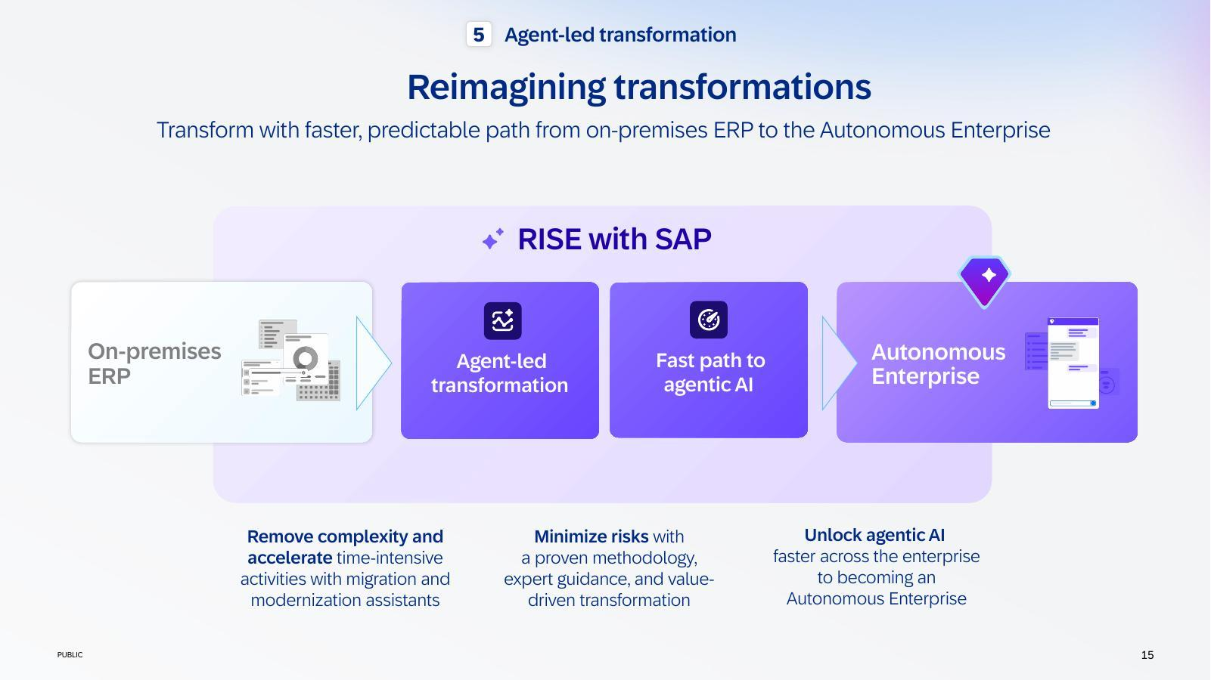
PUBLIC
23
Notes:
Converted from supplied PDF, page 23. Text and vector shapes are editable. Embedded screenshots and image-based text remain pictures. Standard Arial font used for portability.

Slide 24
Agenda
–
Deep Dive
Autonomous Enterprise and Business AI Platform
Business AI Partner Programs
▪
SAP Partner-led AI Adoption Incentive
▪
Partner agent race to SAP TechEd
Marketing Assets, Learning & Enablement for Partners
PUBLIC
24
Notes:
Converted from supplied PDF, page 24. Text and vector shapes are editable. Embedded screenshots and image-based text remain pictures. Standard Arial font used for portability.

Slide 25
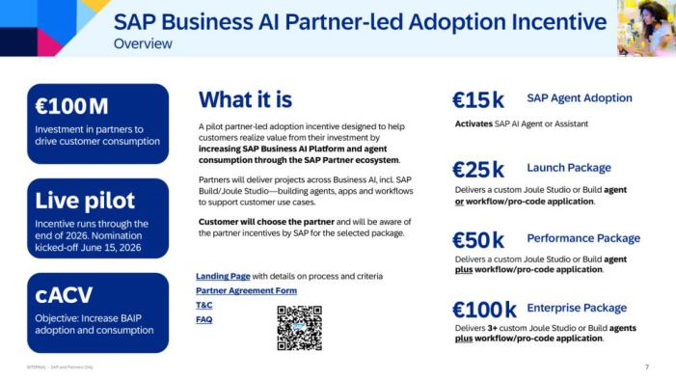
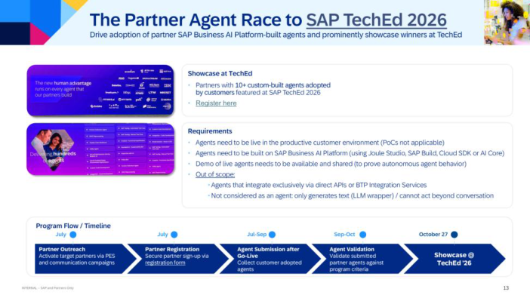
Business AI Partner Programs Announcements
supporting SAP’s Autonomous Enterprise Vision and Business AI Platform Adoption
SAP Business AI Partner
-
led Adoption Incentive
Partner Agent Race
-
2
-
TechEd
▪ Info on Partner Portal
▪ Partner Registration Link
PUBLIC
25
Notes:
Converted from supplied PDF, page 25. Text and vector shapes are editable. Embedded screenshots and image-based text remain pictures. Standard Arial font used for portability.

Slide 26
Agenda
–
Deep Dive
Autonomous Enterprise and Business AI Platform
Business AI Partner Programs
▪
SAP Partner-led AI Adoption Incentive
▪
Partner Agent Race to SAP TechEd
Marketing Assets, Learning & Enablement for Partners
PUBLIC
26
Notes:
Converted from supplied PDF, page 26. Text and vector shapes are editable. Embedded screenshots and image-based text remain pictures. Standard Arial font used for portability.

Slide 27



SAP Business AI Partner
-
led Adoption Incentive
Overview
€100M
What it is
€15k
SAP Agent Adoption
Investment in partners to
A pilot partner-led adoption incentive designed to help
Activates SAP AI Agent or Assistant
drive customer consumption
customers realize value from their investment by
increasing SAP Business AI Platform and agent
consumption through the SAP Partner ecosystem.
€25k
Launch Package
Partners will deliver projects across Business AI, incl. SAP
Live pilot
Build/Joule Studio—building agents, apps and workflows
Delivers a custom Joule Studio or Build agent
to support customer use cases.
or workflow/pro-code application.
Incentive runs through the
Customer will choose the partner and will be aware of
end of 2026. Nomination
the partner incentives by SAP for the selected package.
€50k
Performance Package
kicked-off June 15, 2026
Delivers a custom Joule Studio or Build agent
Landing Page with details on process and criteria
plus workflow/pro-code application.
cACV
Partner Agreement Form
T&C
€100k
Enterprise Package
Objective: Increase BAIP
FAQ
€100k
adoption and consumption
Delivers 3+ custom Joule Studio or Build agents
plus workflow/pro-code application.
27
Notes:
Converted from supplied PDF, page 27. Text and vector shapes are editable. Embedded screenshots and image-based text remain pictures. Standard Arial font used for portability.

Slide 28


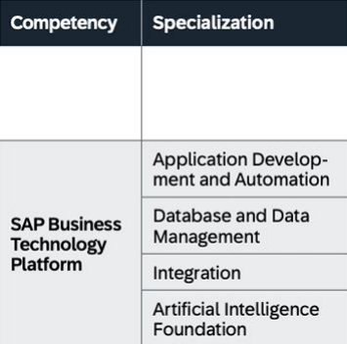
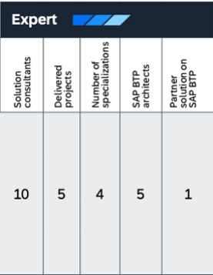
SAP Business AI Partner
-
led Adoption Incentive
Partner Eligibility Criteria
SAP PartnerEdge partner
Achieved SAP BTP Expert Competency
SAP due diligence
Valid due diligence of at least level 2 and in
good standing with SAP.
SAP vendor number
Vendor number must exist in SAP’s
procurement system.
Partners must meet SAP PartnerEdge requirements and maintain eligibility throughout the program
28
Notes:
Converted from supplied PDF, page 28. Text and vector shapes are editable. Embedded screenshots and image-based text remain pictures. Standard Arial font used for portability.

Slide 29
SAP Business AI Partner
-
led Adoption Incentive
Partner Sign
-
Up Process
Step 1
Step 2
Step 3
Review & Sign Partner Agreement
Submit Registration
SAP Validates & Approves
• Review the Partner Payment
• Submit the signed form to SAP via
• SAP reviews your onboarding
Addendum and Terms &
the contact form on the Partner
request and confirms your
Conditions from the SAP Partner
Portal using the file attachment
approval status based on fulfilled
Portal
function
eligibility criteria
• Sign the Partner Agreement Form
• Registration are open since June
• SAP shares final approval
15, 2026 - sign up early to
feedback through established
maximize your chance of
communication channels
participation
• Once approved, you are eligible
for customer matching
Partners participate and are paid at the entity level - the relevant regional or local entity must sign the agreement
29
Notes:
Converted from supplied PDF, page 29. Text and vector shapes are editable. Embedded screenshots and image-based text remain pictures. Standard Arial font used for portability.

Slide 30

SAP Business AI Partner
-
led Adoption Incentive
Customer Eligibility Criteria
Eligible
Excluded
•
Existing SAP Business AI Platform
•
Public Sector Customers and
customers with a valid, active
Government Entities
subscription (direct from SAP or via
•
Customers that do not meet the
reseller)
minimum subscription and eligibility
•
Net new customers signing a new
criteria defined in the program Terms &
agreement for eligible SAP Business AI
Conditions
Cloud Services during the program
•
Customers with BTP PAYG or
period
Subscription Agreements
•
Minimum subscription term of 3 years
for net new customers
•
Commercial customers in Enterprise
and Corporate segments
•
Minimum €100K ACV (BTP + AI Units)
30
Notes:
Converted from supplied PDF, page 30. Text and vector shapes are editable. Embedded screenshots and image-based text remain pictures. Standard Arial font used for portability.

Slide 31
SAP Business AI Partner
-
led Adoption Incentive
Customer & Partner Engagement Journey
1
Customer Nomination: Partners nominate eligible customers through their SAP representative (e.g. Partner Business
Manager or Account Executive). Nominations must always be submitted by an SAP employee
2
Eligibility Validation: SAP conducts compliance, profitability and program eligibility checks
3
Customer Enrollment: Following successful validation, SAP nominator is asked to obtain signed customer consent form and
returns it to the SAP Incentive Program team
Partner Selection & Matching: Customers select their preferred partner. If they don’t select a partner, SAP provides a
4
partner shortlist based on quantitative criteria (i.e. available current and past engagement through documented
implementation projects). Final partner choice always rests with the customer
5
Project Scoping, Delivery & Incentive Payout: Customer and partner agree on incentive package(s) and SOW secured
through initial customer sign-off. A final customer sign-off confirms delivery and triggers incentive payment
31
Notes:
Converted from supplied PDF, page 31. Text and vector shapes are editable. Embedded screenshots and image-based text remain pictures. Standard Arial font used for portability.

Slide 32
Agenda
–
Deep Dive
Autonomous Enterprise and Business AI Platform
Business AI Partner Programs
▪
SAP Partner-led AI Adoption Incentive
▪
Partner agent race to SAP TechEd
Marketing Assets, Learning & Enablement for Partners
PUBLIC
32
Notes:
Converted from supplied PDF, page 32. Text and vector shapes are editable. Embedded screenshots and image-based text remain pictures. Standard Arial font used for portability.

Slide 33

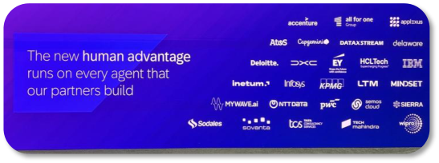

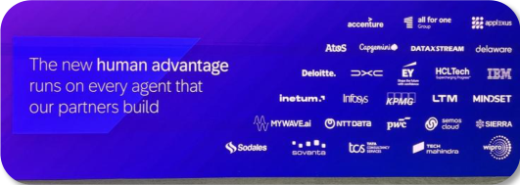
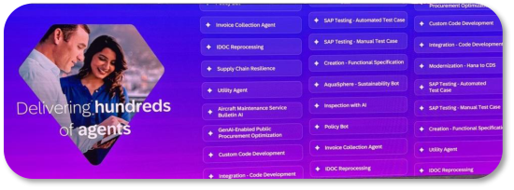

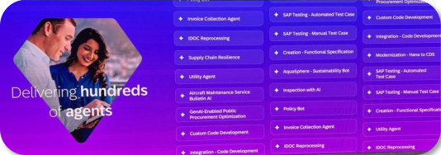

The Partner Agent Race to SAP TechEd 2026
Drive adoption of partner SAP Business AI Platform-built agents and prominently showcase winners at TechEd
Showcase at TechEd
•
Partners with 10+ custom-built agents adopted
by customers featured at SAP TechEd 2026
•
More Information / Register here
Requirements
•
Agents need to be live in the productive customer environment (PoCs not applicable)
•
Agents need to be built on SAP Business AI Platform (using Joule Studio, SAP Build, Cloud SDK or AI Core)
•
Demo of live agents needs to be available and shared (to prove autonomous agent behavior)
•
Out of scope:
• Agents that integrate exclusively via direct APIs or BTP Integration Services
• Not considered as an agent: only generates text (LLM wrapper) / cannot act beyond conversation
Program Flow / Timeline
July
July
Jul-Sep
Sep-Oct
October 27
Partner Outreach
Partner Registration
Agent Submission after
Agent Validation
Showcase @
Activate target partners via PES
Secure partner sign-up via
Go-Live
Validate submitted
and communication campaigns
registration form
Collect customer adopted
partner agents against
TechEd ’26
agents
program criteria
33
Notes:
Converted from supplied PDF, page 33. Text and vector shapes are editable. Embedded screenshots and image-based text remain pictures. Standard Arial font used for portability.

Slide 34
Agenda
–
Deep Dive
Autonomous Enterprise and Business AI Platform
Business AI Partner Programs
▪
SAP Business AI Partner-led Adoption Incentive
▪
Agent Race to TechEd
Marketing Assets, Learning & Enablement for Partners
PUBLIC
34
Notes:
Converted from supplied PDF, page 34. Text and vector shapes are editable. Embedded screenshots and image-based text remain pictures. Standard Arial font used for portability.

Slide 35
































All that Partners Need to Succeed With AI
Partner accessible link
Initial AI Conversation/
AI Customer Value Discovery/
Proposal & Deal Closure
AI Use Case Activation and Development
Customer Pitch
Use Case Activation & Development Plan
New
AI Discovery Workshop
New
New
New
AI Discovery Workshop
Autonomous Enterprise
Understanding Commercial Model
How to Order & Activate Guides
Learn more about SAP's Autonomous
Align AI with customer business priorities
Overview of the 2026 SAP Business AI
Offers clear guidance on SAP Business AI
Enterprise strategy & value for partner
Identify & prioritize high-value AI use cases
Commercial Model (Learning), and insight into
ordering and activation across SAP cloud
ecosystem
Define a clear path to AI Adoption
Selling SAP Business AI
applications
Supporting assets:
Supporting asset: AI price list
Supporting asset: Partner AI adoption resources blog
AI in Industries
AI feature catalog I AI estimator I Value calculator
New
New
Industry use cases illustrating the value of SAP
SAP Services for Partners
Business AI and agents.
Joule Assistants
SAP AI services to accelerate build, adoption,
View available Joule Assistants & the public
activation, and delivery of SAP Business AI
roadmap across solution areas
offerings incl. agents
SAP Business AI Persona Value Deck*
Supporting assets: Explore agents on SAP.com I more
Enablement & Certifications
Showcases SAP Business AI value by
Joule Studio Agent Builder
mapping solutions to key personas’ daily
SAP Business AI enablement resources and
needs, challenges, and priorities
Build custom AI agents that reason, orchestrate
certifications for partners, incl. demos / TDD
processes, and solve complex business
Updated quarterly
problems across SAP and non-SAP systems.
New Joule Studio 2.0 Launch FAQs
Monthly LinkedIn Newsletter
Bookmark
Leverage Joule for Consultants & Joule for Developers
Subscribe to receive the latest
SAP Business AI on SAP Partner portal
To accelerate customer implementations. Explore
J4C I J4D
SAP Business AI updates
INTERNAL – SAP and Partners Only
*Will be updated to reflect the 2026 strategy
©2026 SAP SE or an SAP affiliate company. All rights reserved.
35
Notes:
Converted from supplied PDF, page 35. Text and vector shapes are editable. Embedded screenshots and image-based text remain pictures. Standard Arial font used for portability.

Slide 36














Autonomous Enterprise Learning & Enablement | All Partners
Comprehensive partner AI enablement plan – structured, scalable, and always live
Key Assets
Autonomous Enterprise
Key Partner Enablement Sessions
Get Started @Partner Portal
Autonomous Enterprise L0 Presentation
Learning Journeys and Certifications
•
Replay: Autonomous Enterprise & SAP Business AI Platform
•
Autonomous Enterprise
•
SAP Business AI Platform L1 Presentation
•
Applying SAP’s 2026 Strategy for Partners
•
Replay: Business AI Commercials
•
SAP Business AI Platform
•
^{NEW} Positioning the Autonomous Enterprise (leads
Replay: Business AI Platform – AI adoption incentive
•
Joule Studio
•
Joule L1 Presentation
•
•
July 1: Get Certified on Positioning the Autonomous Enterprise
•
Joule Work
•
Joule L2 Presentation
to SAP Certification)
•
•
Joule Toolkits
•
^{NEW} Building Confidence in AI with SAP
•
July 6-9: SAP AI Adoption and Learning Week
•
^{NEW} AI Commercial Model for Partners
•
^{NEW} Discovering SAP’s Commercial Model for AI
•
Jul 21: Autonomous Enterprise and SAP Business AI Platform
•
Jul 30: SAP Business AI Platform End-to-End
Joule
Autonomous Suite
Industry AI
Get Started
Get Started
Get Started
•
Explore Joule
•
SAP Autonomous Suite
•
SAP Business AI for your Industry
•
^{NEW} Joule Assistants Inventory and Roadmap
•
Autonomous Domain L1 Decks
•
Industry AI Overview Video
•
^{NEW} Joule Studio Launch FAQ
Supply Chain, HCM, Spend, Finance, CX
Learning Journeys
Learning Journeys
Partner Enablement Sessions
•
Introducing Joule & Introducing Joule for Consultants
•
^{Soon Updated} Introducing Autonomous Spend, CX, SCM, HCM,
•
Industry AI
•
Setting Up Joule Across Organizational Landscapes
S4HC
•
Getting Started with Joule for Business Users
SAP Business AI Platform
Build
Contextualize & Reason
Govern
Certifications
Demos & Partner Academies
Certifications
Demos & Partner Academies
Certifications
•
Build for Developer
•
Joule Studio End-2-End Video
•
SAP Business Data Cloud
•
SDE Scenarios
•
Solution Transformation Consultant
•
Backend Developer – CAP
•
Agent Lifecycle End-2-End Video
•
Data Analyst – SAC
•
SAP Business Data Cloud Partner
•
Business Transformation Consultant
•
Integration Developer
•
Create an AI Agent with Joule Studio
•
Data Engineer – SAP HANA
Academy
•
^{NEW} Data Architect
•
Gen AI Hub Academy
•
Generative AI Developer
Key Enablement Sessions
Key Enablement Sessions
Key Enablement Sessions
•
Replay: Deep Dive Live Session on BUILD
•
Replay: Deep Dive Live Session on CONTEXTUALIZE & REASON
•
Replay: Deep Dive Live Session
•
July 9: Govern AI Agents with Integration Suite
•
July 15: BDC & AI: tell the story to drive adoption
GOVERN
•
Aug 4: Extending Joule Studio with n8n
•
Aug 18: Leveraging Data Product Studio
•
Sept 1: Agent Lifecycle - from idea to
•
Aug 11: Extending Joule Studio with Vercel
•
Aug 25: SAP Knowledge Graph deep dive
PUBLIC
36
PUBLIC
value
36
•
Sept 16: How Build and Joule Studio co-exist
•
Sep 15: RPT-1.5 & predictive scenarios in the Autonomous Suite
Notes:
Converted from supplied PDF, page 36. Text and vector shapes are editable. Embedded screenshots and image-based text remain pictures. Standard Arial font used for portability.

Slide 37

Autonomous Enterprise & SAP Business AI Platform
Five live sessions building partner readiness foundation from platform vision to governance
Elevate your expertise. One webinar at a time. Earn your edge.
P A R T N E R W E B I N A R S E R I E S
A 5 - P A R T L E A R N I N G P A T H
June 8
01
June 9
02
June 16
03
June 18
04
June 22
05
60 min
60 min
60 min
60 min
60 min
Autonomous Enterprise and SAP
SAP Business AI Platform
SAP Business AI Platform – Build
SAP Business AI Platform –
SAP Business AI Platform –
Business AI Platform
Commercials
Deep Dive
Contextualize and Reason Deep
Govern Deep Dive
Dive
Explain SAP's Autonomous
Navigate the SAP Business AI
Understand the platform vision and
Learn how SAP Business Data Cloud
Understand how to centrally
Enterprise vision and the newly
Platform licensing and commercial
how Joule Studio and Integration
and the Business AI Platform power
discover, validate, and govern AI
launched SAP Business AI Platform
models relevant to partners.
Suite fit into SAP's AI-driven
the Autonomous Enterprise.
agents, LLMs, and MCP servers
and its relevance to partner go-to-
ecosystem.
across an organization using SAP.
market strategies.
Watch Replay →
Watch Replay →
Watch Replay →
Watch Replay →
Watch Replay →
Watch Replay →
Watch Replay →
#Foundations
#AICommercials
#Build
#Contextualize
#Govern
Attend all 5 webinars and earn your Record of Achievement and prepare for upcoming hands-on enablement.
Autonomous Enterprise and SAP Business AI Platform Essentials
PUBLIC
37
PUBLIC
37
Notes:
Converted from supplied PDF, page 37. Text and vector shapes are editable. Embedded screenshots and image-based text remain pictures. Standard Arial font used for portability.

Slide 38
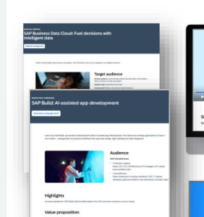
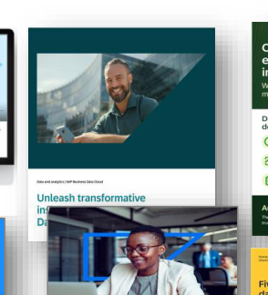
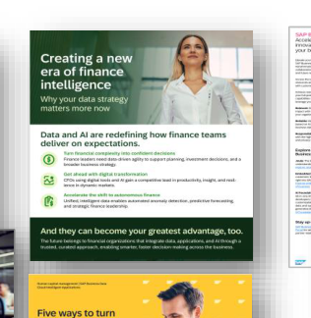
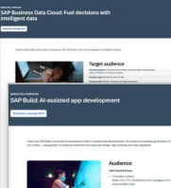

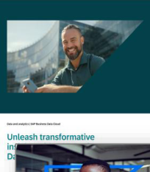
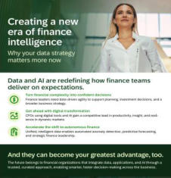
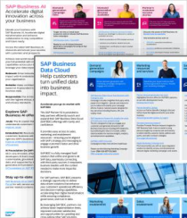
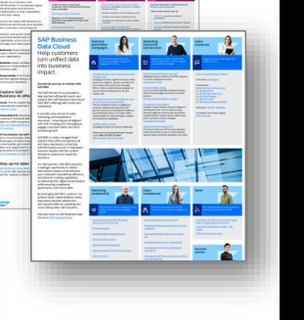
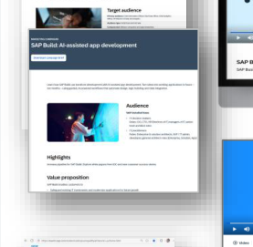
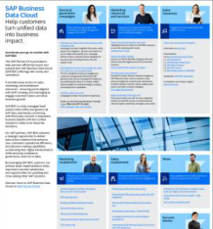
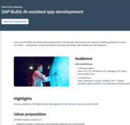
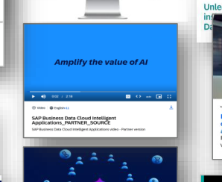
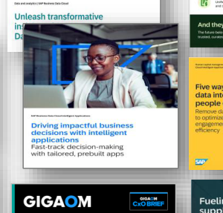
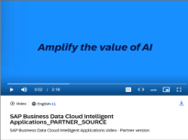
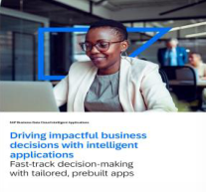
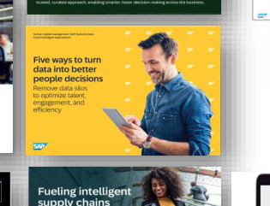
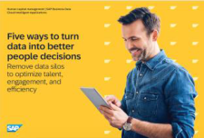
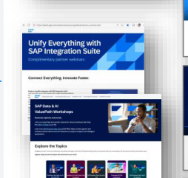
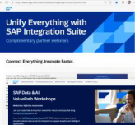
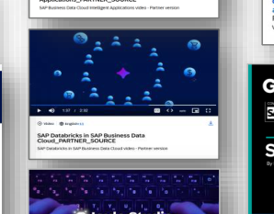
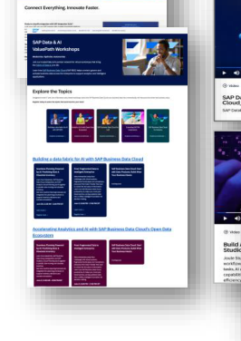
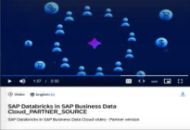
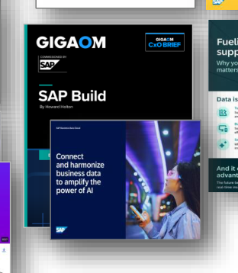
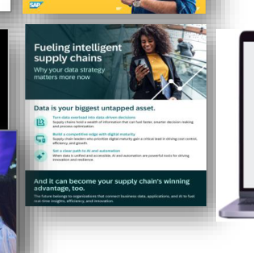










SAPBusiness AI Platform: Partner Marketing Programs
Strategy
Key Programs
Key Assets
Partner Kits & Marketing
Videos
Thought Leadership
LoB ebooks &
Enablement
Support partner demand generation and pipeline growth
& E-books
Infographics
through targeted campaigns and persona-based content.
Enable partners with tailored marketing assets that increase
engagement, lead quality, and revenue opportunities.
Key Programs
BAIP ValuePath Workshops & Webinars
•
Achieve incremental pipeline through collaboration with
SAP. Engage practitioners and influencers across buying
committee
•
Read more- Playbooks: SAP BDC, SAP Build, SAP
Integration Suite
Partner Demand Generation Campaigns
•
SAP BDC: Fuel Decisions with Intelligent Data (refresh:
Promotional Copies:
July)
emails, Landing Page,
•
AI-assisted app development
•
Unified AI across the entire enterprise with Joule Base and
Social Media Posts
Joule Agents
•
AI infused marketing campaigns
•
SAP BAIP Value to Pipeline Demand Gen campaign and
enablement, building on best practices (New: Sept)
•
SAP Joule Studio: Autonomous Enterprise Developer
campaign (new: Sept)
•
SAP Integration Path to Agentic AI
•
SAP CIAM: Compliant Identity (new: July)
•
AI Tools for Demand Generation Content Creation
•
SAP BAIP Event in Box: Data & IT Connect (new: Aug)
Partner Kits & Marketing Enablement
•
Partner Demand Kit to provide easy access to sales,
marketing, and enablement resources: SAP BDC ; AI
•
SAP Partner Benefit Catalog DG offerings
PUBLIC
38
Notes:
Converted from supplied PDF, page 38. Text and vector shapes are editable. Embedded screenshots and image-based text remain pictures. Standard Arial font used for portability.

Slide 39

Contact information:
Thorsten Leiduck
SVP and Head of Global Business AI Ecosystem
thorsten.leiduck@sap.com
© 2023 SAP SE or an SAP affiliate company. All rights reserved. See Legal Notice on www.sap.com/legal-notice for use terms, disclaimers, disclosures, or restrictions related to this material.
Notes:
Converted from supplied PDF, page 39. Text and vector shapes are editable. Embedded screenshots and image-based text remain pictures. Standard Arial font used for portability.

