Slide 1
Prototype – OBELIX visualization
Kyra Kieskamp
Week 1

Slide 2
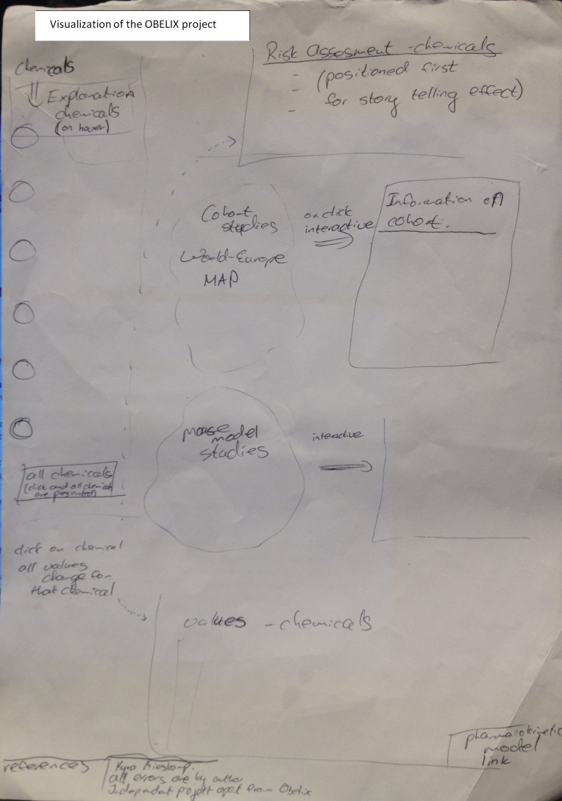

Slide 3
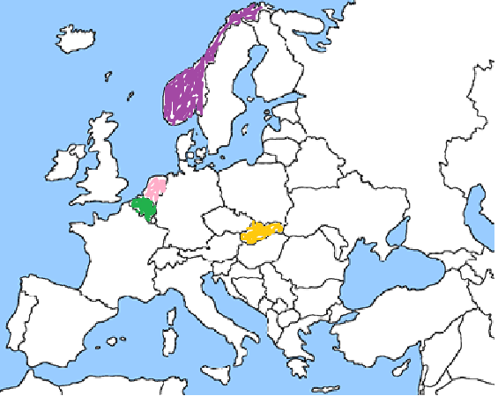
Cohorts:
  Belgium
    FLEHS-1
    FLEHS-2
  Norwegian
    HUMIS
  Slovak
    Michalove
  Dutch
    LINC
Final color use: to be determined
Code example: http://code.minnpost.com/simple-map-d3/

Slide 4
On hover
Color intensity/saturation increases
N = 2600
Initiated in 2003
Milk samples

Slide 5

On hover
Overview all cohorts
HUMIS:
N = 2600
Initiated in 2003
Milk samples
Michalove
N = 143
Initiated in 2003
Cord and Milk samples

Slide 6
On mouse-click

Slide 7
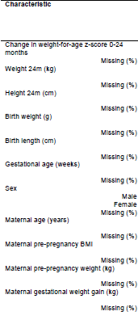

The Cohort Characteristics will potentially be presented in a visualization (the MVP is this representation as presented in the research article)

Slide 8
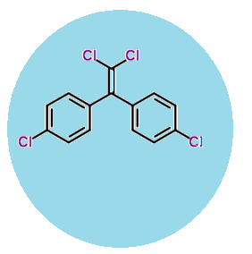
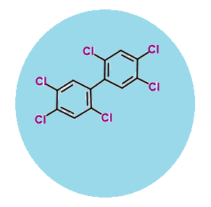
On hover
Information on the chemcial
p,p’-DDE
PCB153

Slide 9

Risk Assessment BPA
Endocrine disrupting chemcials
Explanation risk assessment
p,p’-DDE
Text, explanation of research
N = 2600
Initiated in 2003
Milk samples
Overview all cohorts
Information on type of tests conducted with that cohort
PCB153
Textbox /graph with chemical info
BPA: Bisfenol A
-found in plastic
BPA
Human study
Animal study
At concentration:
At concentration:
Effects exposure
Effects exposure

Slide 10
Risk Assessment graph (visualization?)
Endocrine disrupting chemcials
Textbox /graph with info on chemical
p,p’-DDE
Text, explanation of research
Overview all cohorts
PCB153
Risk Assessment graph

Slide 11
Risk Assessment graph (visualization?)
Endocrine disrupting chemcials
p,p’-DDE
Text, explanation of research
Overview all cohorts
PCB153
Effects chemicals figure

