Slide 1

Megasoft Management Training System
Desktop application Combined with Full BI Solution
Kyrellos El Naggar

Slide 2

Problem Statement
Megasoft Trainings Department use disconnected systems for record management
Leads to inefficiency
Increases risk of human error
Consumes significant time and resources

Slide 3
Problem Solution
Megasoft TMS helps admin to do tasks easily.
Reduces mistakes in data.
Saves time for staff.
Simple design easy to use.
Produce useful insights.

Slide 4
Megasoft TMS Features
Keeps all student info, courses, and scores in one place.
Supports Full CRUD (Create, Read, Update, Delete), searching and filtering data
Creates printable and PDF reports quickly

Slide 5
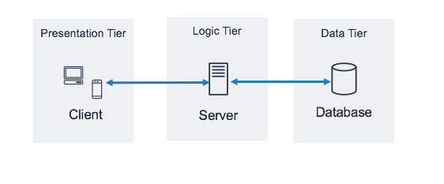
System Architecture
3-Tier Architecture

Slide 6
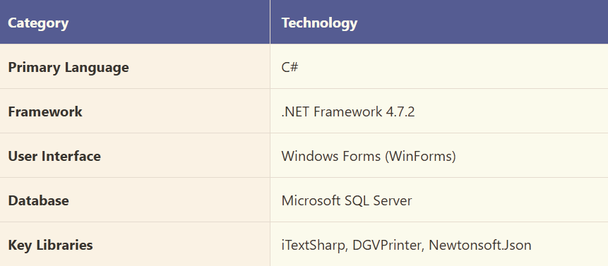
Technology Stack

Slide 7
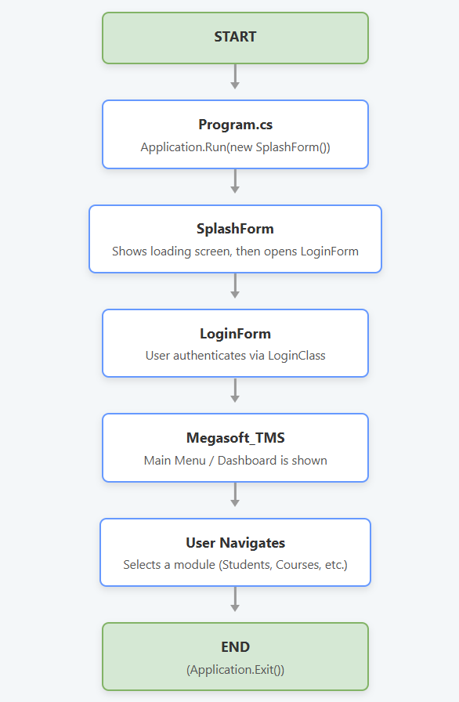
System Execution Flow

Slide 8
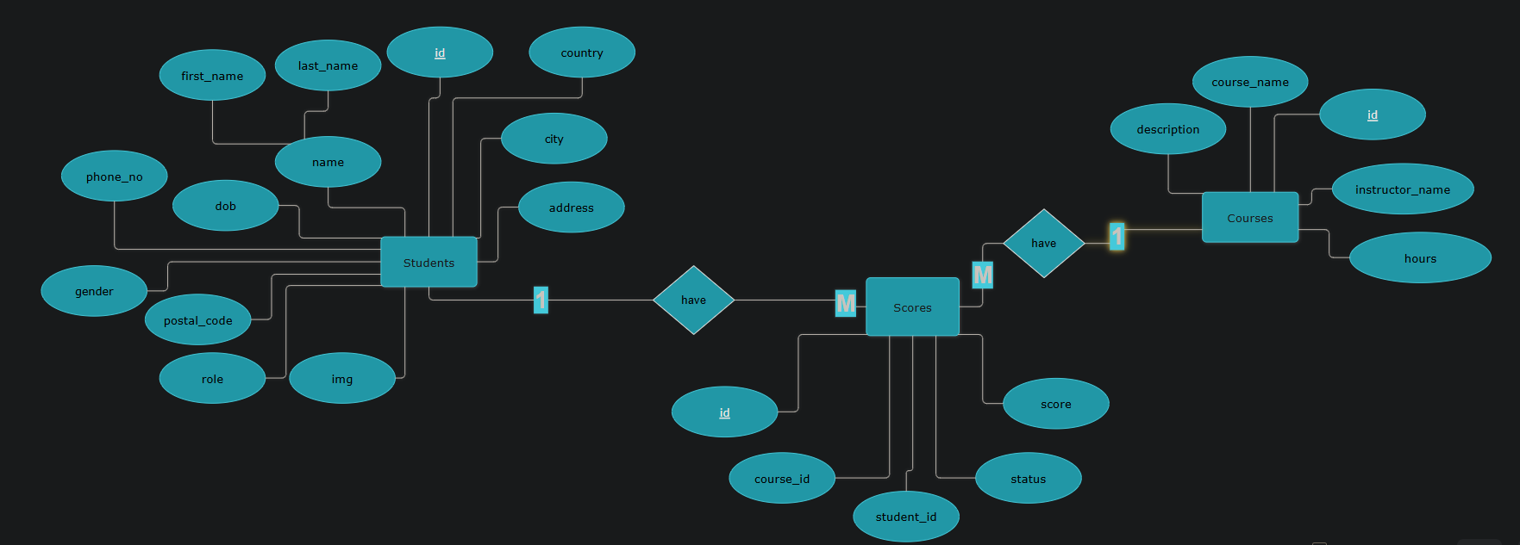
ERD of Megasoft Database

Slide 9
Full Business Intelligence Solution

Slide 10
From Raw Data to Insights
SSIS to ingest Data build ETL process
Created 3 packages and 3 databases: ODS , STG, and DWH
Designed a star schema.
SSAS Tabular model:
Created key measures to improve calculation performance
Used Power BI for reporting
Developed an interactive dashboard to provide clear data insights

Slide 11
Thank You!

