Slide 1
Calibrated Concept Placement
Hierarchy-aware conformal prediction for ontology concept placement Findings as of 2026-06-25 · MM-S14-Disease (CPP benchmark running)

Slide 2
The task, and the bottom line
TASK: a clinical text mentions a NEW disease not yet in SNOMED CT. Place it by choosing the right
(parent → child) insertion edge among ~238,000 candidates. Analogy: file it in the right drawer of a huge cabinet.
BOTTOM LINE:
• Guaranteeing the EXACT edge is impossible here — but guaranteeing the correct REGION is feasible and
useful to a curator. We wrap the placement model in a hierarchy-aware conformal layer to do this.
• Backbone: Oxford LM concept-placement model (ESWC 2024). Our contribution = the calibration layer.

Slide 3
Phase 0 — reproduction holds (GO)
• Rebuilt their full pipeline (Edge-Bi-encoder + Edge-Cross-encoder, top-50). Faithful to the paper.
• Our test InR_any@10 = 20.3% vs paper 26.5% (within their reported validation/test variance).
• Retrieval recall@50 = 49.6% vs paper 50.0% — near-exact match on the retrieval step.
• Several metrics match or exceed theirs (e.g. InR_all@10 10.1% vs 8.7%).
• → Solid, comparable foundation to build the calibration layer on.

Slide 4
Phase 1 — naive calibration hits two walls
WALL 1: exact-edge prediction sets are not viable.
• Coverage is hard-capped at recall@pool (~50%): the gold edge is simply not retrieved half the time.
• To promise >50% coverage, the set explodes to the entire 50-edge pool — useless.
WALL 2: the model's confidence is anti-correlated with exact correctness.
• Its MOST-confident predictions (score ≈ 0.999) are correct 0% of the time — 'confident false positives'.
• → Both naive fallbacks (small sets, abstain-by-confidence) fail. This is the wall the project anticipated.

Slide 5
The insight that rescues it: near-misses are NEAR
When the model misses the EXACT edge, its prediction is still ontologically CLOSE to the gold.
• Measured with Wu–Palmer similarity over the SNOMED hierarchy (parent + child placement):
• Exact-edge coverage (top-10): 0.20
• Right-region coverage (full-edge WP≥0.7): 0.77 · close (WP≥0.8): 0.62
• Among exact MISSES: average closeness ≈ 0.81 (about one hop from gold).
• Filing-cabinet: it rarely picks the exact folder, but almost always opens the right drawer.
• This is the 'lenient evaluation' the original authors left as future work — we calibrate on it.

Slide 6
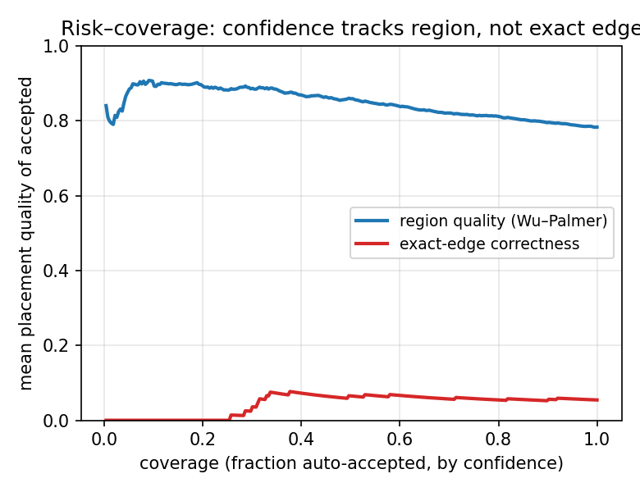
Result 1 — confidence tracks REGION, not exact edge
Selective prediction (auto-accept the most confident):
• Region quality (blue) stays 0.78–0.91.
• Exact correctness (red) hugs zero — and is 0 at the highest confidence.
• Continuous risk AURC: 0.15 (region) vs 0.96 (exact).
• → The model knows when it's in the right region; usable for curator triage.

Slide 7
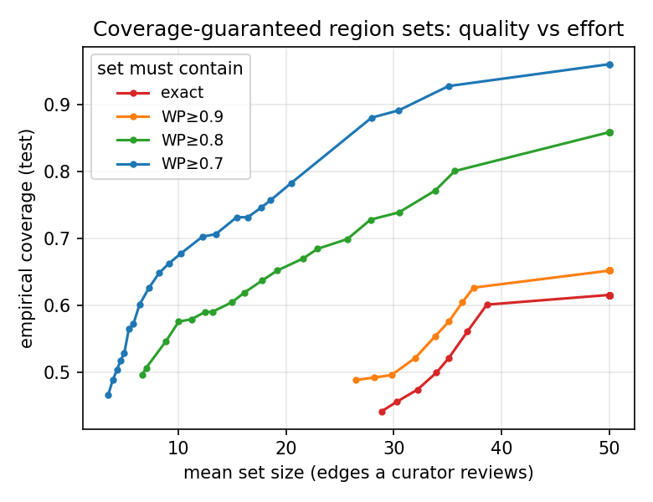
Result 2 — small coverage-guaranteed region sets
How many edges a curator reviews vs coverage:
• WP≥0.7: ~10-edge set → 65% coverage; ~30 → 88%.
• WP≥0.8 (closer): ~19 edges → 65%.
• Exact / WP≥0.9: only exist at 27–50 edges (no small set).
• → Relaxing exact→region makes small, trustworthy sets possible.

Slide 8
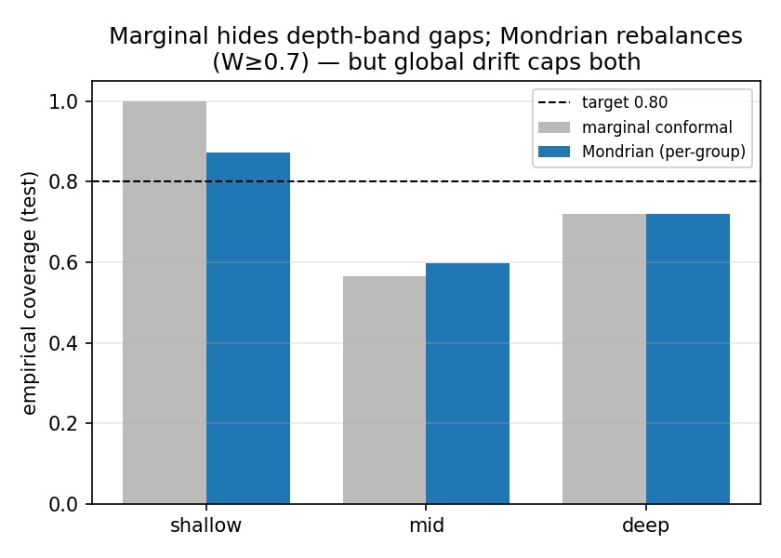
Calibration & subgroup fairness (with an honest limit)
Class-conditional (Mondrian) conformal:
• Marginal conformal HIDES subgroup gaps (mid-depth 57% vs shallow 100%).
• Mondrian rebalances: worst group improves, easy groups get tighter sets.
• BUT it can't fix the overall undershoot — test concepts are uniformly harder than calibration ones (concept drift).
• Honest limitation the paper must own (see also fig2 calibration, fig4 drift).

Slide 9
Status
• STATUS: reproduction GO · exact-edge calibration NO-GO · region calibration WORKS.

