Slide 1
Merging time prediction
Mining Software Repositories 2015-16

Slide 2

SURVEY
60% Respond : Very useful
Others:
do not use Git
won't benefit from such a feature.
Post the questionnaire in Quora, Facebook, via personal email.

Slide 3

Motivation
If my pull request takes around a year or longer to get merged, it shows to me that the project is either understated or no longer active. That will hold me back from making more pull requests. The other way around, if it is likely to be merged pretty quickly (say, within a couple of months for a big project), that will encourage me to contribute more since I can see that my changes are taken seriously AND are worth something.

Slide 4
Related WORK
Research Questions:
RQ1: How popular is the pull based development model?
RQ2: What are the lifecycle characteristics of pull requests?
RQ3: What factors affect the decision and the time required to merge a pull request?
RQ4: Why are some pull requests not merged?

Slide 5
Related WORK
Research Questions:
RQ1: Does the correlation between the natural language explanation and the accompanying code fragment impact the time to answer a post?
RQ2: Can the quality of a code fragment explanation, with respect to human readability, be assessed automatically?

Slide 6
Related WORK
Research Questions:
RQ1: Predicting Response time in Stack Overflow!

Slide 7
Research questions
RQ1: Which features contribute most to the prediction of the time for merging?
RQ2: How can we predict the merging time of a pull request?

Slide 8
Process
Initial Analysis
Intermediate
Analysis
Feature Importance
Classification
Evaluation
Distribution of Important Features
Data Preparation
Pearson Correlation
Feature Importance
Classifiers (Naïve Bayes and Random Forest)

Slide 9
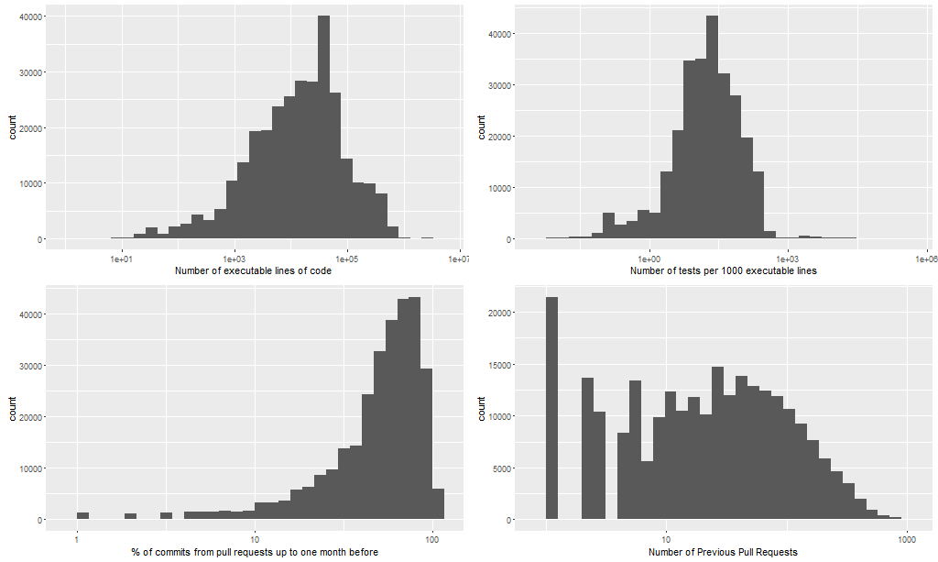
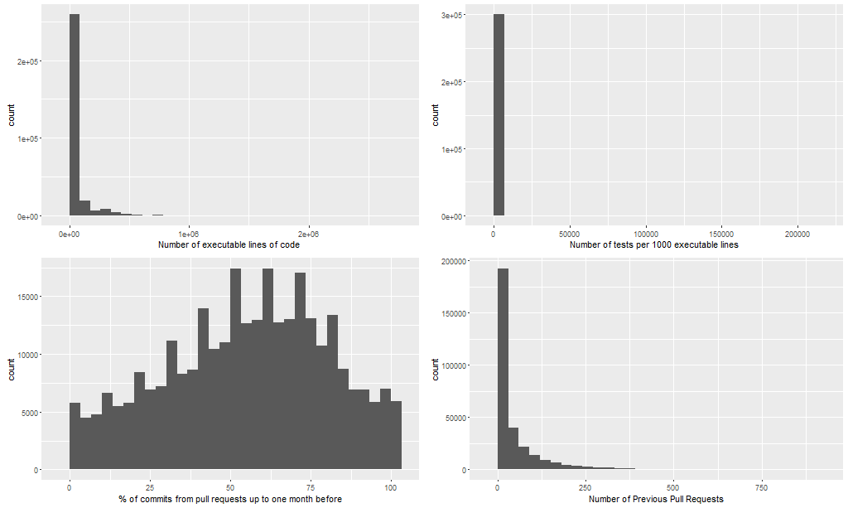
Analysis
Log Distributions
Normal Distributions

Slide 10
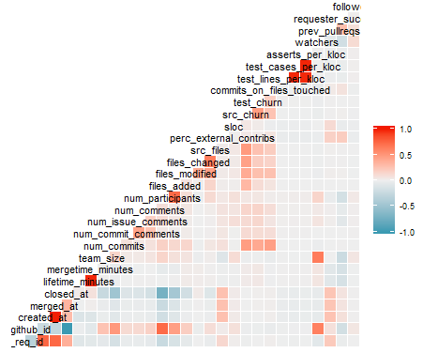
Pearson Correlation
Correlation
Previous pull requests
Number of test lines
Number of Executable lines
Requester Success

Slide 11
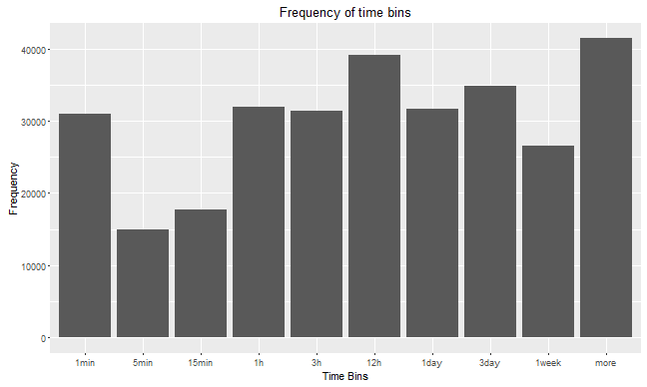
Time bins
Significant amount of Pull Request is merged < 1 minutes
The majority of Pull Requests is merged between 1 hour and 3 days.
~4000 Pull Requests are merged after 1 week.

Slide 12
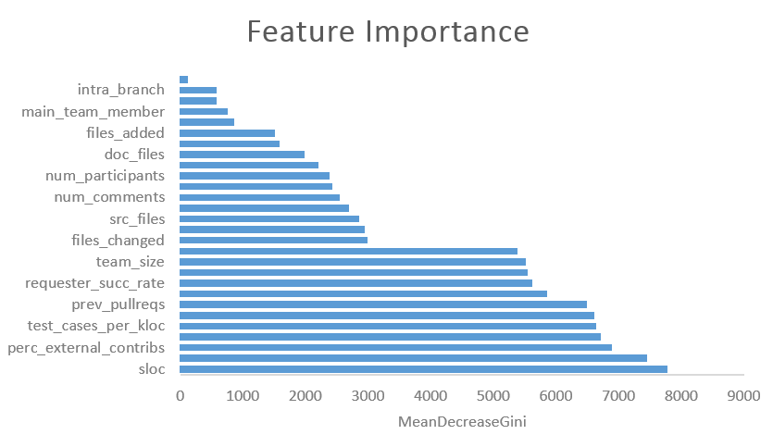
Feature importance
Sloc: Number of executable lines of code in the main project repo
Perc_external_contribs: % of commits from pull requests up to one month
Test_cases_per_kloc: Number of tests per 1000 executable lines

Slide 13
Naïve Bayes classification
Class | Recall | Precision | Accuracy
1min | 0.77633 | 0.74476 | 0.76055
5min | 1.339e-03 | 9.976e-01 | 4.995e-01
15min | 0.41699 | 0.67049 | 0.54374
1h | 0.12402 | 0.87381 | 0.49892
3h | 0.0054209 | 0.9944655 | 0.4999432
12h | 0.13204 | 0.90699 | 0.51952
1day | 9.480e-04 | 9.985e-01 | 4.997e-01
3day | 0.14634 | 0.92118 | 0.53376
1week | 0.0103774 | 0.9962237 | 0.5033005
more | 0.12300 | 0.98259 | 0.55279
Accurate results for the class of 1 min
Insufficient results for other classes due to the type of the classifier
Assumptions :
Statistical Independence

Slide 14
Random Forest classification
Class | Recall | Precision | Accuracy
1min | 0.82374 | 0.93375 | 0.87874
5min | 0.45397 | 0.99071 | 0.72234
15min | 0.44373 | 0.98891 | 0.71632
1h | 0.55490 | 0.94077 | 0.74783
3h | 0.49346 | 0.96419 | 0.72883
12h | 0.57531 | 0.91280 | 0.74406
1day | 0.47859 | 0.96469 | 0.72164
3day | 0.50402 | 0.95100 | 0.72751
1week | 0.44906 | 0.98123 | 0.71514
more | 0.8129 | 0.8970 | 0.8550
Accurate results for the class of 1 min and more.
Accurate results for other classes [0.71514, 0.74783]

Slide 15
Conclusion
Initial Analysis
Intermediate
Analysis
Feature Importance
Classification
Evaluation
Find the features that contribute the most in the prediction of merging time
Accuracy up to 87%
Precision up to 93%
Recall up to 82%

