Slide 1
程式設計實習(二)
江秋紜
2015/03/25

Slide 2
Operator Overloading
運算子多載(operator overloading)
例如:+, -, *, /, %, <<, >>
程式碼較清楚
使用上較方便
成員函式命名方式
例如: Operator+, Operator-, Operator*

Slide 3
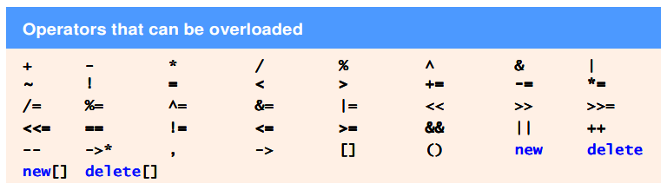
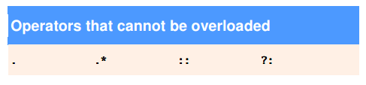
Operator Overloading

Slide 4
hw4
#ifndef DATE_H
#define DATE_H
#include <iostream>
using namespace std;
class Date{
friend ostream &operator<<(ostream &, const Date &);
public:
Date(int m = 1, int d = 1, int y = 1900);
void setDate(int, int, int);
Date &operator++();
Date operator++(int);
const Date &operator+=(int);
static bool leapyear(int);
bool endofMonth(int) const;
private:
int month;
int day;
int year;
static const int days[];
void helpIncrement();
};
#endif

Slide 5
hw4
#include <iostream>
#include "Date.h“
using namespace std;
int main()
{
Date d1;
Date d2(12, 27, 1992);
Date d3(0, 99, 8045);
cout << "d1 is " << d1 << endl
<< "d2 is " << d2 << endl
<< "d3 is " << d3 << endl << endl;
cout << "d2 += 7 is " << (d2 += 7) << endl << endl;
d3.setDate(2, 28, 1992);
cout << "d3 is " << d3 << endl;
cout << "++d3 is " << ++d3 << endl << endl;

Slide 6
hw4
Date d4( 7, 13, 2002);
cout << " d4 is " << d4 << endl;
cout << "++d4 is " << ++d4 << endl;
cout << " d4 is " << d4 << endl << endl;
cout << " d4 is " << d4 << endl;
cout << "d4++ is " << d4++ << endl;
cout << " d4 is " << d4 << endl;
system("pause");
return 0;
}

Slide 7
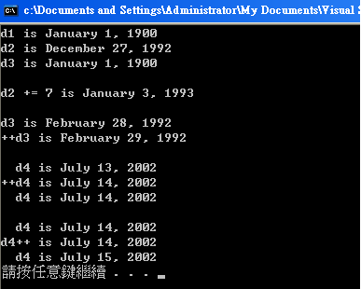
hw4

