Slide 1
程式設計實習(二)
江秋紜
2015/05/20

Slide 2
Object-oriented programming
ATM
Bank Database
Cash Dispenser
Account Manager
Account
Transaction
Deposit Slot
Keyboard
Screen
Checking Account
Withdrawal
Deposit
Balance Inquiry
Close Account

Slide 3
Final Project
Making an auction system
At least eight class
Need to use inheritance
Need members.dat and commodities.dat

Slide 4
Final Project
members.dat
AccountNumber Password Name IDNumbers E-mail Phone Address
commodities.dat
ProductID ProductName Price Quantity Seller Buyers
data are separated by \t

Slide 5
Final Project
(1)Login
1.Login
★檢查帳號是否存在
★檢查密碼是否正確,輸入超過三次錯誤即結束
2.Registered
★檢查帳號是否已被註冊
★輸入帳號,密碼,姓名,身分證字號(檢查是否合法),電子信箱,電話(輸入為手機,檢查是否為十碼),地址
完成註冊後要將其資料存入members.dat

Slide 6
Final Project
(2)Post auction items
★檢查是否已經登入
★登入後讓使用者輸入product name, price, quantity
★新增完商品要將其存入commodities.dat
★結束新增即回到首頁

Slide 7
Final Project
(3)View the website commodities
★列出commodities.dat檔內所有的資料,格式如下: Product ID, Product Name, Price, Quantity, Seller, Buyers
★商品若售出要減其數量並且於commodities.dat存入買家帳號
★商品數量若為零要告知無法購買
★結束購買輸入0回到首頁
(0)Exit

Slide 8
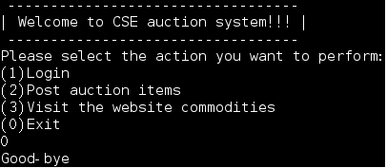
Final Project

Slide 9
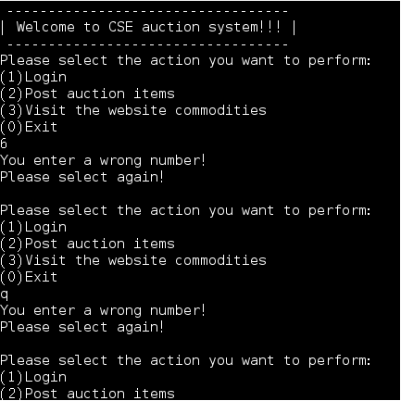
Final Project

Slide 10
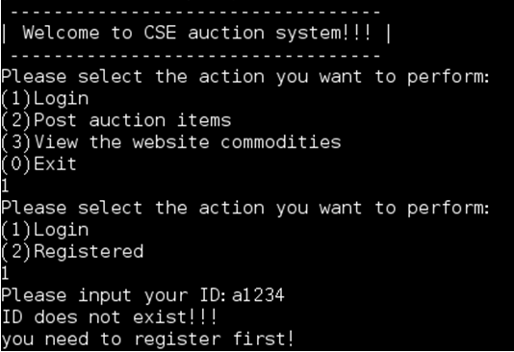
Final Project

Slide 11
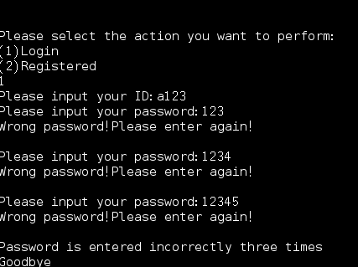
Final Project

Slide 12
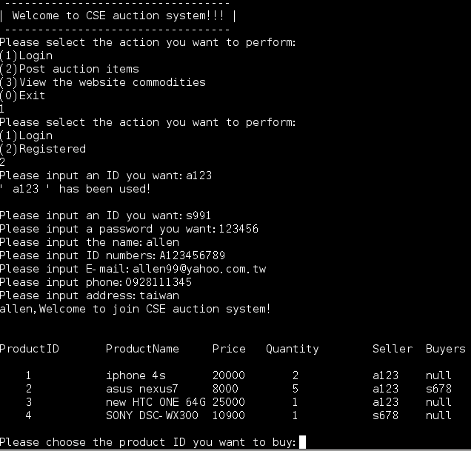
Final Project

Slide 13
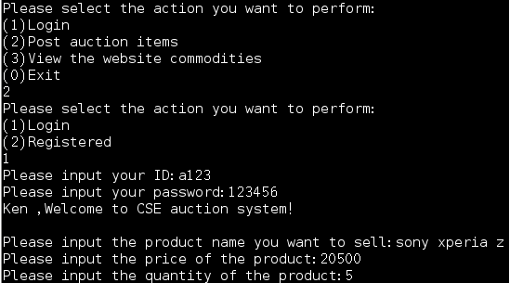
Final Project

Slide 14
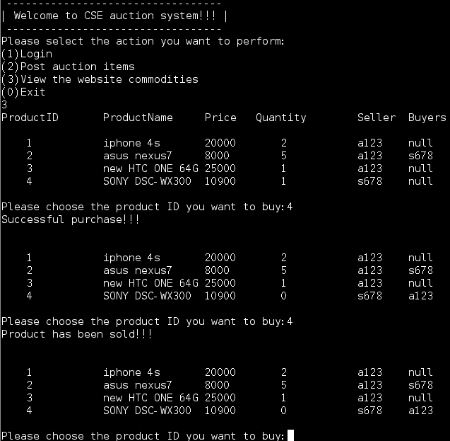
Final Project

Slide 15
Final Project
ifstream inFile( “project.dat", ios::binary );
Open an existing file; if the file doesn't exit, fail
ofstream outFile( "project.dat", ios::binary );
Create a file; if the file have existed, the data in it will be deleted.
ofstream outFile( "project.dat", ios::app | ios::binary );
Create a file; if the file have existed, the data in it will be keep
fstream ioFile( "project.dat", ios::in | ios::out | ios::binary );
Open an existing file; if the file doesn't exit, fail

