Slide 1
程式設計實習(二)
江秋紜
2015/04/15

Slide 2
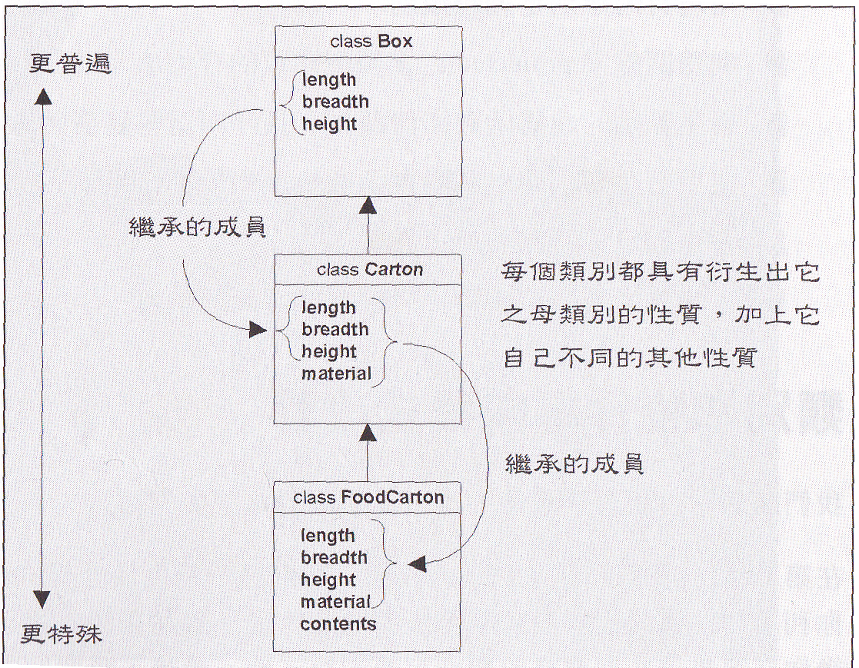
Inheritance

Slide 3
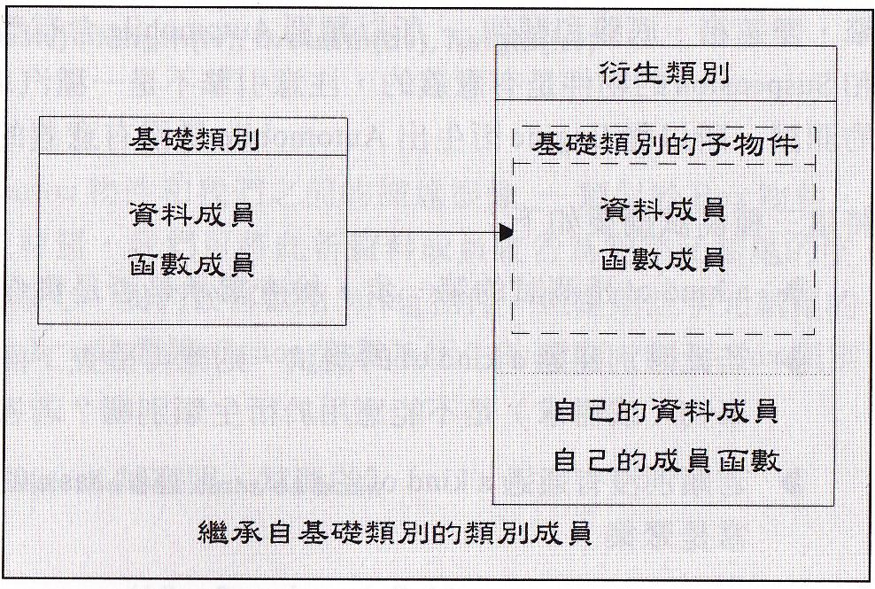
Inheritance

Slide 4
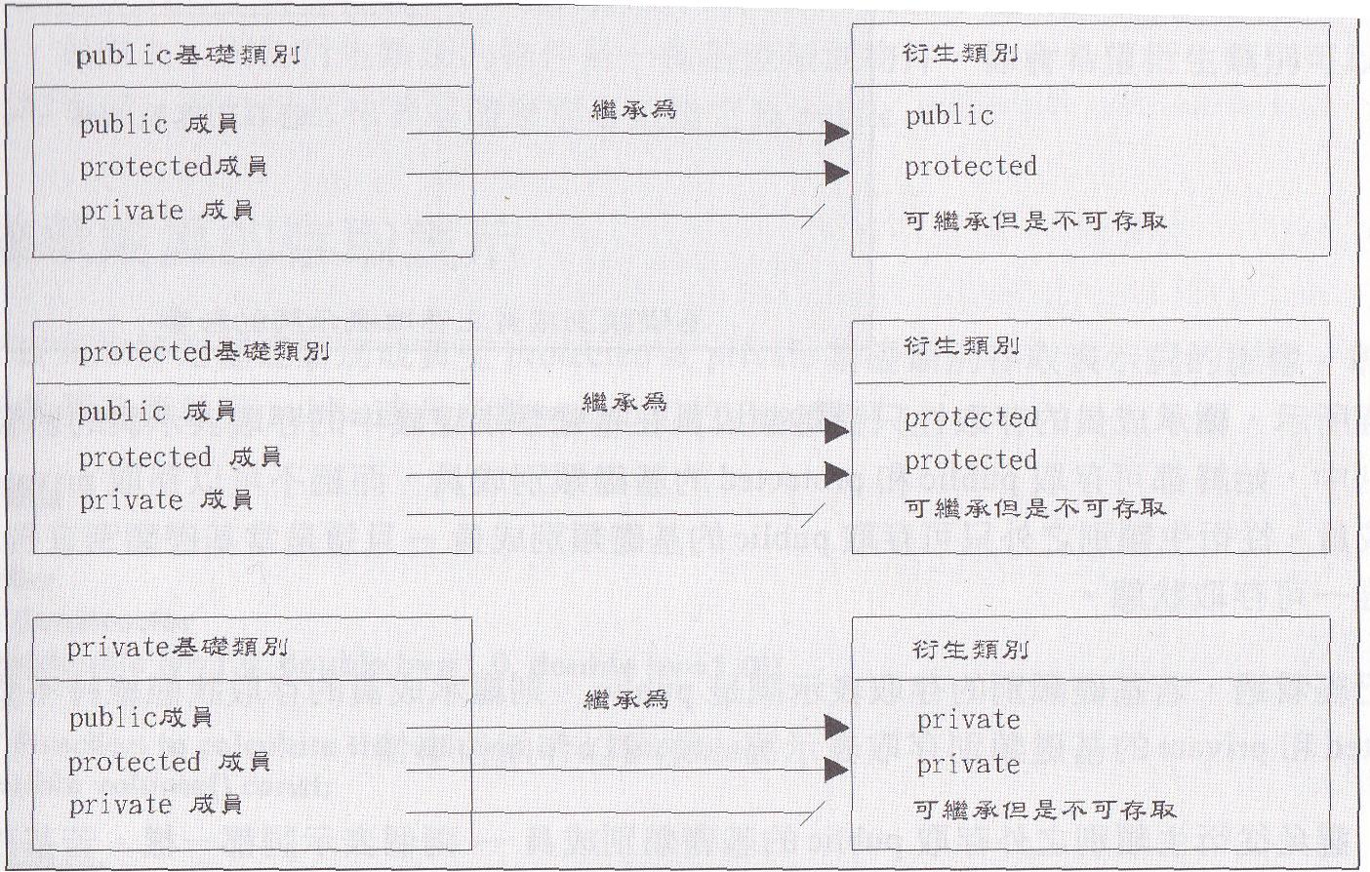
Inheritance

Slide 5
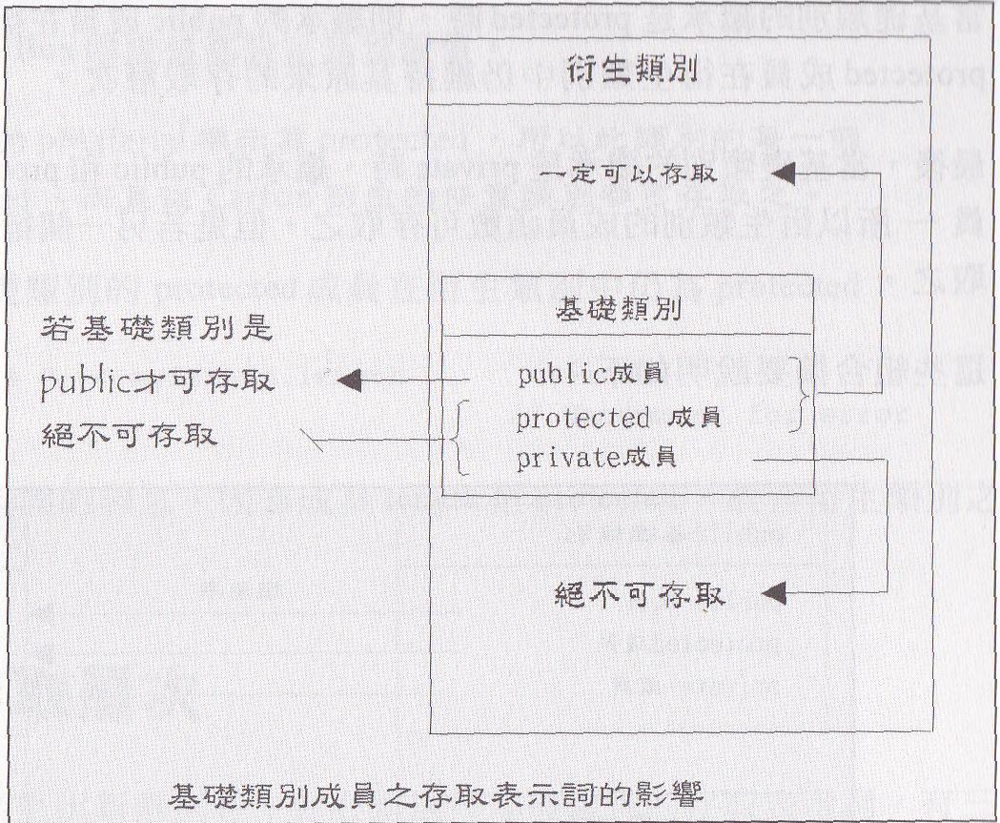
Inheritance

Slide 6
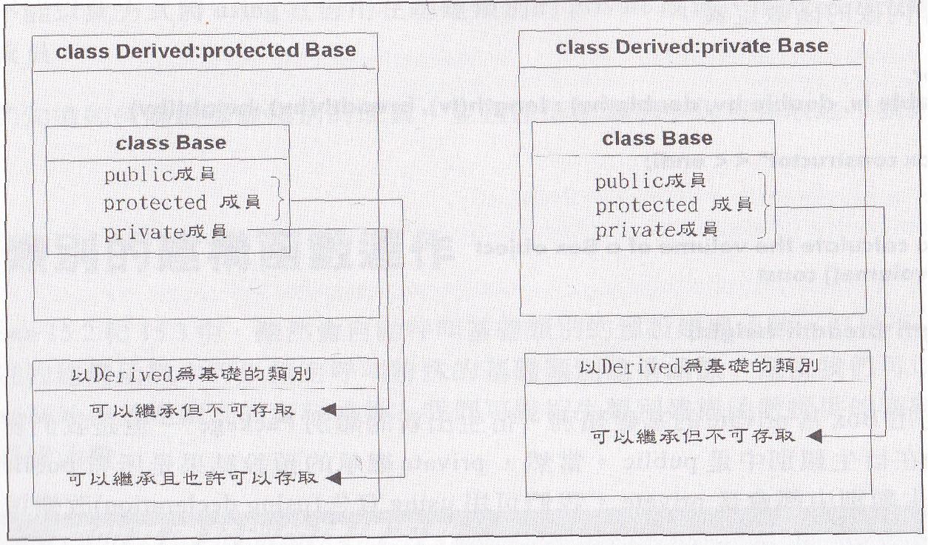
Inheritance

Slide 7
hw5
class Point
to initialize point coordinates ( x , y )
class Figure
to initialize area is 0
class Line
Inheritance Figure
to initialize Line using Point and to compute area

Slide 8
hw5
class Rectangle
Inheritance Figure
to initialize Rectangle using Point and to compute area
class Triangle
Inheritance Figure
to initialize Triangle using Point and to compute area
class Circle
Inheritance Figure
to initialize Circle using Point and to compute area
to initialize PI = 3.1415926

Slide 9
hw5
#include <iostream>
#include "Point.h"
using namespace std;
int main()
{
Line line(1,1, 10, 10);//(x1,y1,x2,y2)
Rectangle rect(10, 10, 90, 50);//(topLeftX,topLeftY,bottomRightX,bottomRightY)
Triangle triangle(2,0,0,10,4,18);//(x1,y1,x2,y2,x3,y3)
Circle circle(0, 0, 6, 8);//(x1,y1,x2,y2)
cout<< "Line area = " << line.area()<< endl;
cout<< "Rectangle area = " << rect.area()<< endl;
cout<< "Triangle area = " << triangle.area()<< endl;
cout<< "Circle area = " << circle.area()<< endl;
system("pause");
return 0;
}

Slide 10
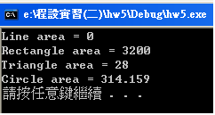
hw5

