Slide 1
程式設計實習(二)
江秋紜
2015/03/18

Slide 2
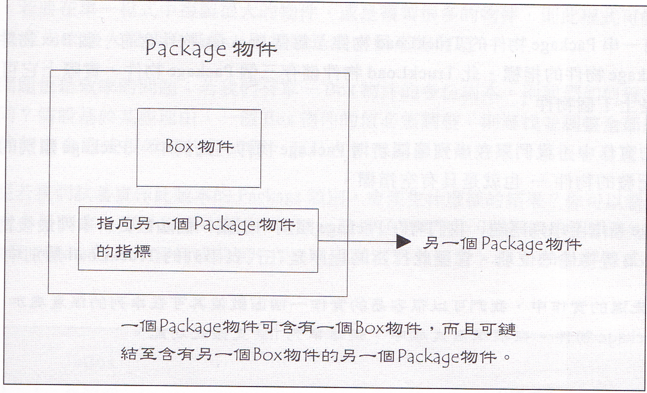

Slide 3
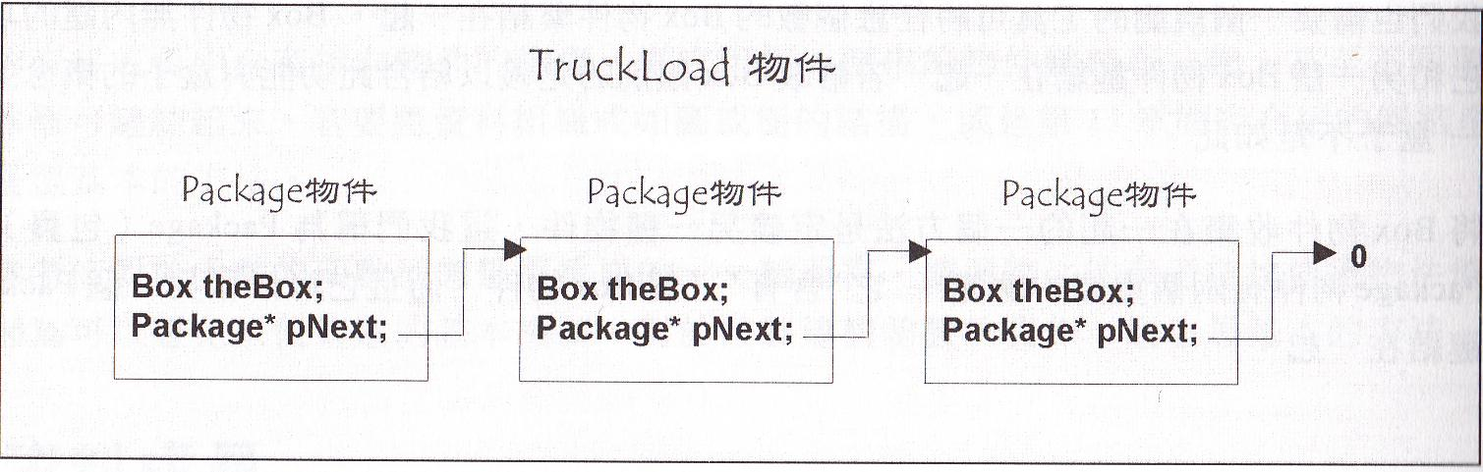

Slide 4
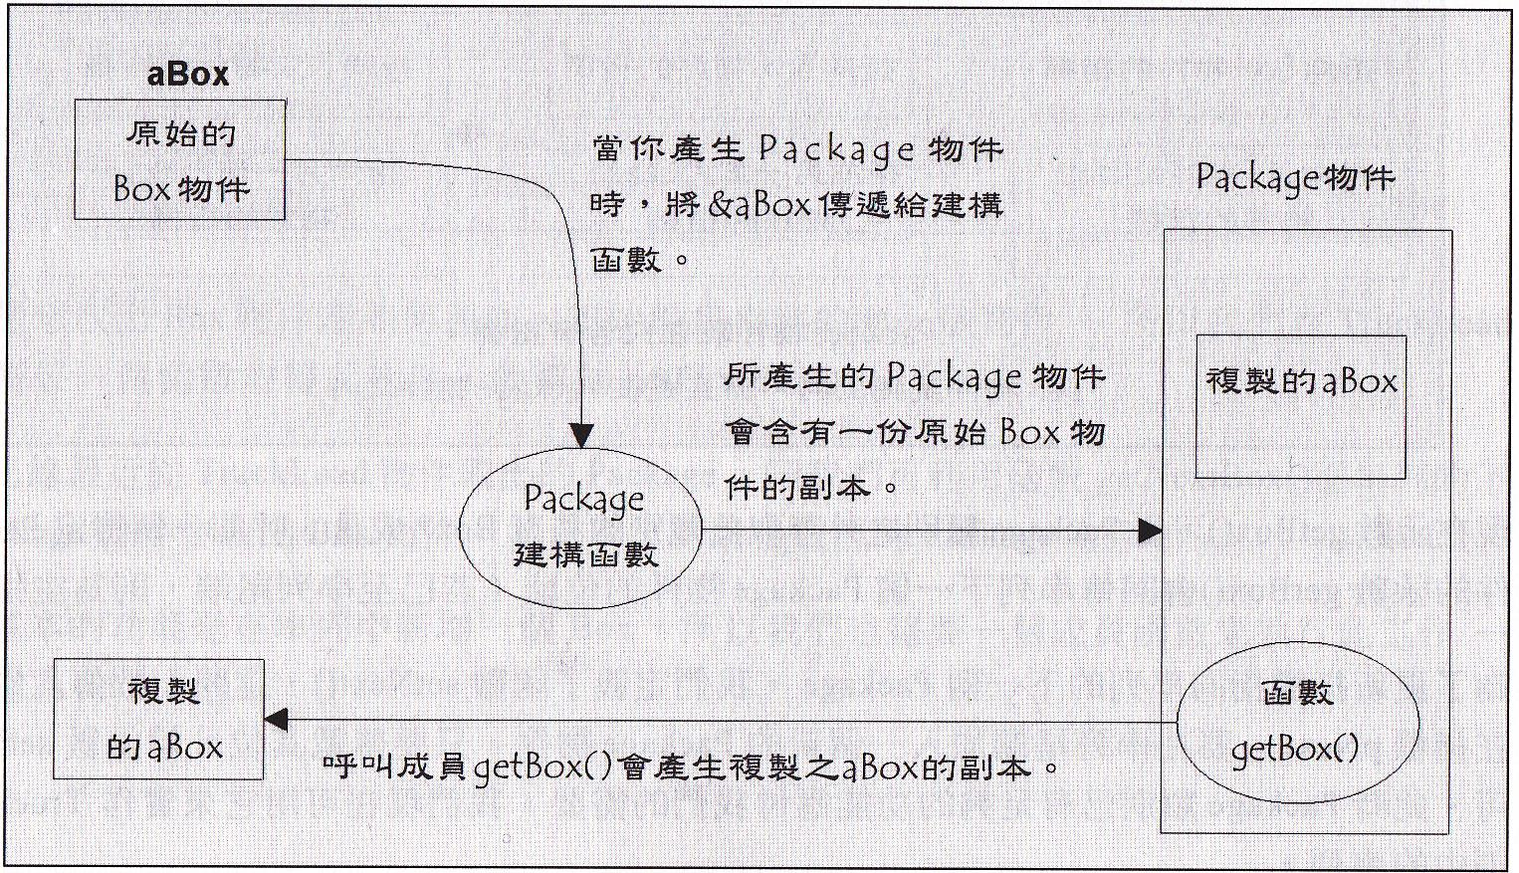

Slide 5
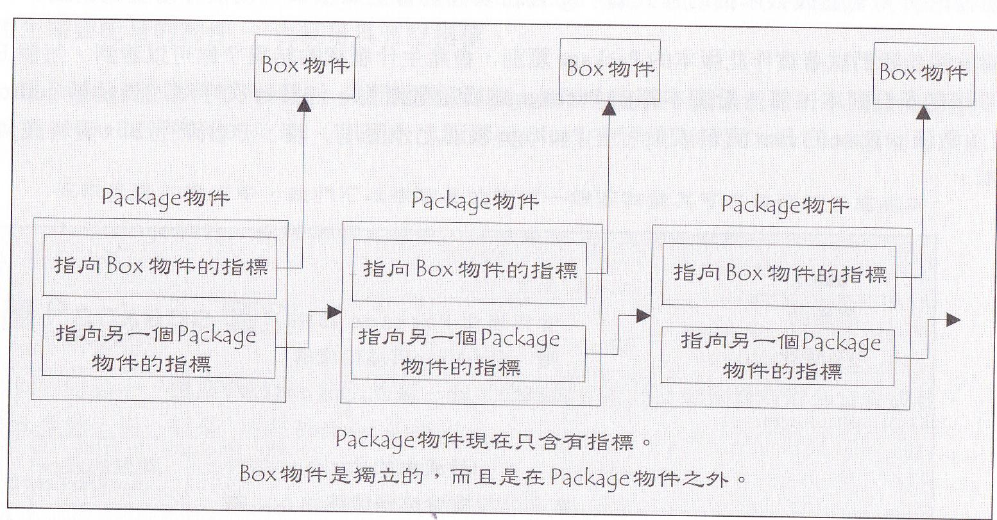

Slide 6
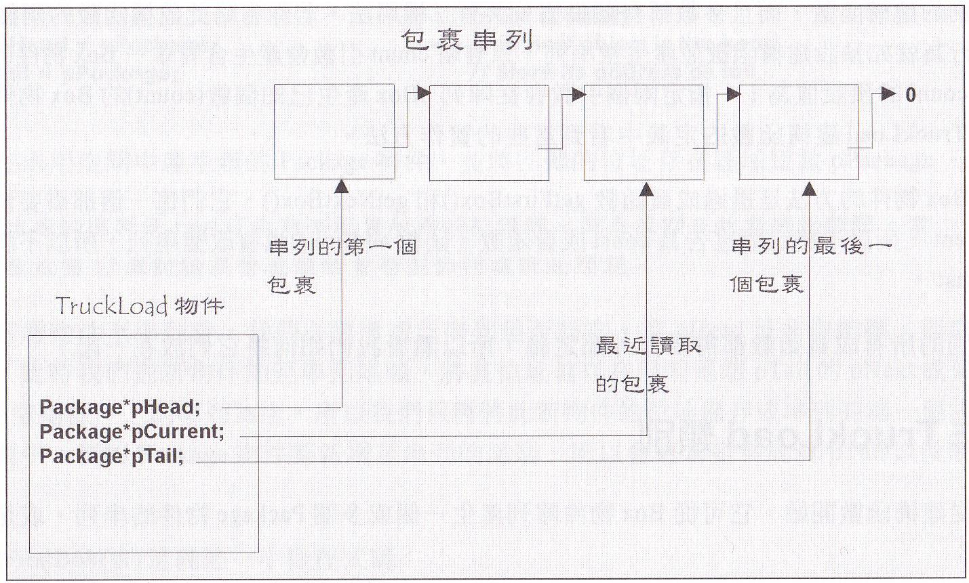

Slide 7
hw3
#ifndef BOX_H
#define BOX_H
class Box
{
public:
Box(double lengthValue = 1.0, double breadthValue = 1.0, double heightValue = 1.0);
double volume();
int compareVolume(Box& otherBox);
double getLength();
double getBreadth();
double getHeight();
private:
double length;
double breadth;
double height;
};
#endif

Slide 8
List.h
#ifndef LIST_H
#define LIST_H
#include "Box.h"
class Package
{
public:
Package(Box* pNewBox);
Box* getBox() const;
Package* getNext() const;
void setNext(Package* pPackage);
private:
Box* pBox;
Package* pNext;
};

Slide 9
List.h
class TruckLoad
{
public:
TruckLoad(Box* pBox = 0, int count = 1);
Box* getFirstBox();
Box* getNextBox();
void addBox(Box* pBox);
private:
Package* pHead;
Package* pTail;
Package* pCurrent;
};
#endif

Slide 10
Mian.cpp
#include <iostream>
#include <cstdlib>
#include <ctime>
#include "Box.h"
#include "List.h"
using namespace std;
inline int random(int size)
{
return 1 + static_cast<int>((size*static_cast<long>(rand()))/(RAND_MAX + 1));
}
Box* maxBox(TruckLoad& Load)
{
Box* pBox = Load.getFirstBox();
Box* pNextBox;
while(pNextBox = Load.getNextBox())
if(pBox->compareVolume(*pNextBox) < 0)
pBox = pNextBox;
return pBox;
}

Slide 11
Mian.cpp
int main()
{
const int limit = 100;
srand((unsigned)time(0));
TruckLoad load1;
for(int i = 0; i < 10; i++)
load1.addBox(new Box(random(limit),random(limit),random(limit)));
Box* pBox = maxBox(load1);
cout << "The largest box in the first list is " << pBox->getLength() << "*" << pBox->getBreadth() << "*" << pBox->getHeight() << endl;
const int boxCount = 20;
Box box2[boxCount];
for(int i = 0; i < boxCount; i++)
box2[i] = Box(random(limit),random(limit),random(limit));
TruckLoad load2(box2, boxCount);
pBox = maxBox(load2);
cout << "The largest box in the second list is " << pBox->getLength() << "*" << pBox->getBreadth() << "*" << pBox->getHeight() << endl;
system("pause");
return 0;
}

Slide 12
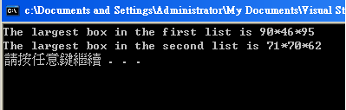
hw3

