Slide 1
Towards Robustness of Tensor Fusion Networks
Presented by Qinlin He

Slide 2
Overview
Problem formulation
Background
Tensor fusion
Robustness certification
Workflow
Choose a task
Networks
Parallel adversarial attack
Result

Slide 3
Problem Formulation
How tensor fusion operation influence the robustness of a network (increase, decrease, remain the same)?
Increase
Why does the tensor fusion operation influence the robustness that way?

Slide 4
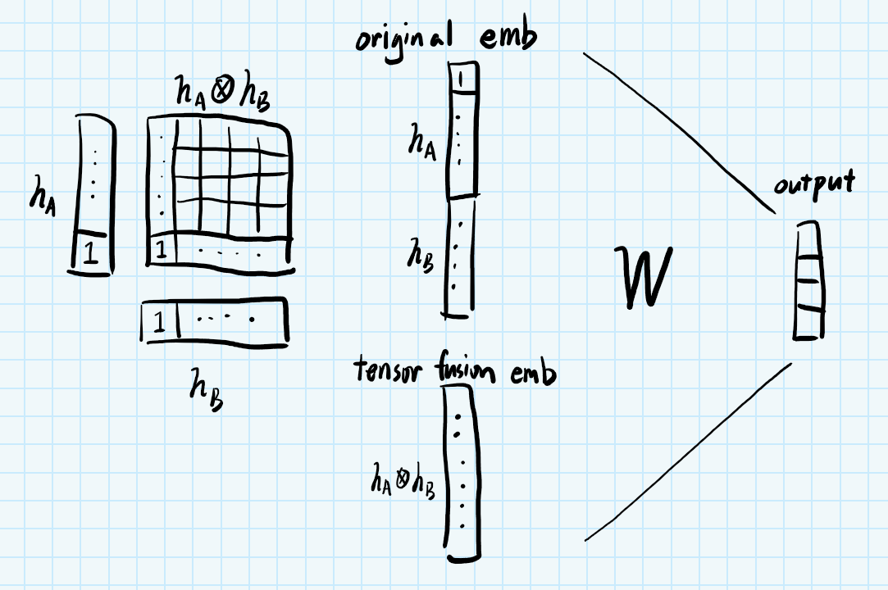
Background – Regular tensor fusion

Slide 5
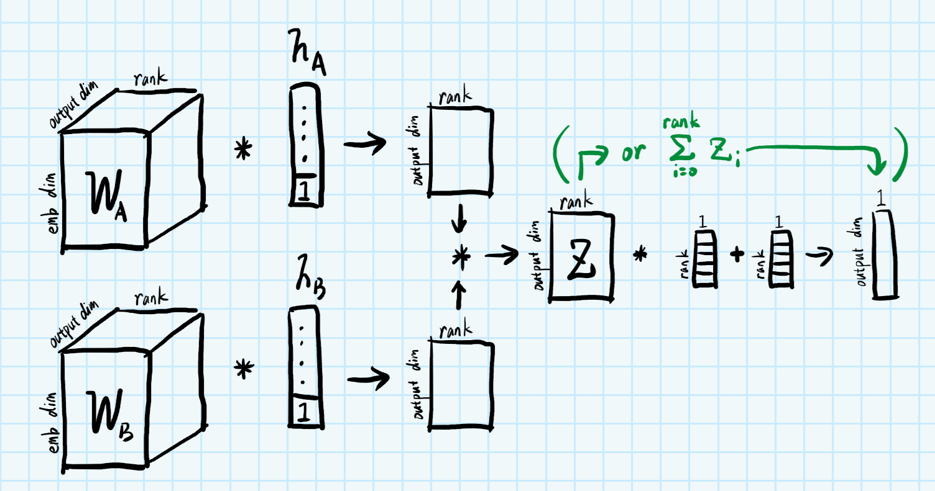
Background – Efficient tensor fusion

Slide 6
Background – Robustness Certification
Try to attack all samples
Depending on your attack algorithm, you may miss the optimal perturbation
(Fuzz)
Discrete optimization
Accurate estimation of robust radius, very slow
Convex optimization
Vague estimation of robust radius, very fast
Accuracy depends on the relaxation method

Slide 7
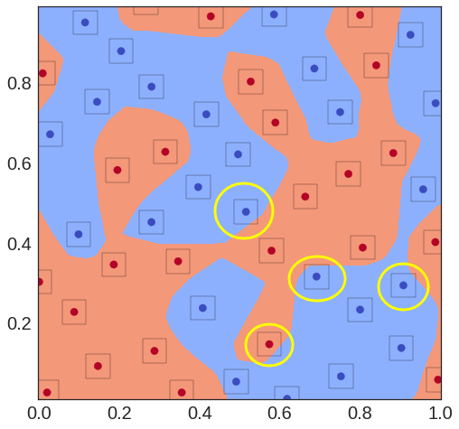
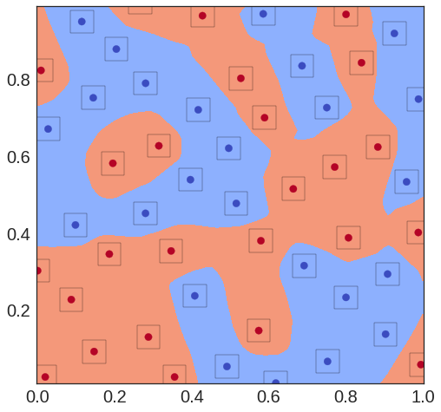
Background – Robust Radius
Not robust under this radius
Robust under this radius

Slide 8
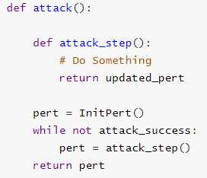
Background – How to attack
There are many attack methods

Slide 9
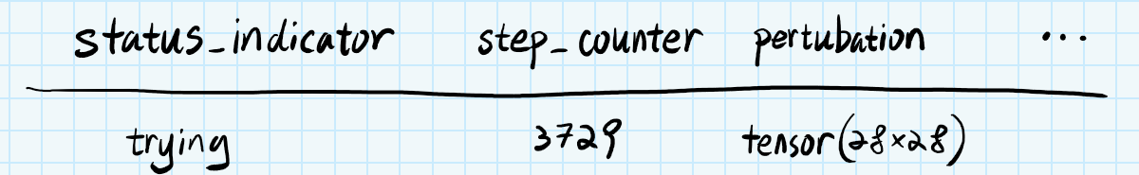

Workflow – Parallel Adversarial Attack

Slide 10
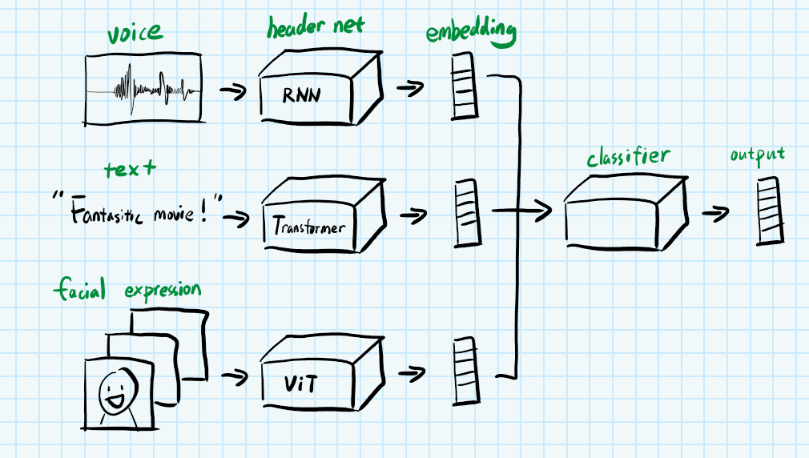
Workflow – Task

Slide 11
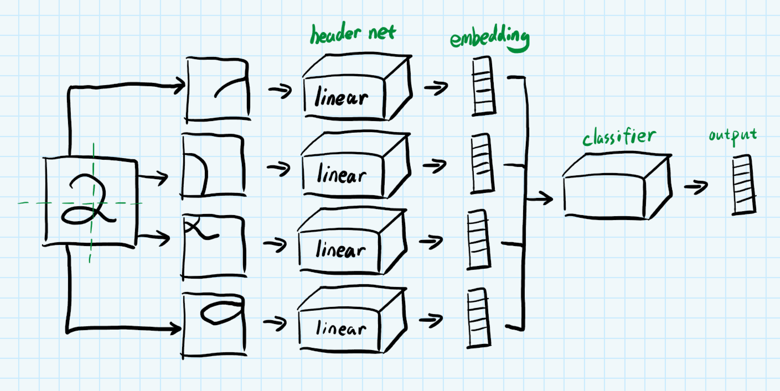
Workflow – Task

Slide 12
Workflow - Models
Tensor fusion network
Efficient tensor fusion network
Concat model (large and small)
Multi-concat model (to verify similar model arch without coupling)
Multiply model (to verify feature coupling)

Slide 13
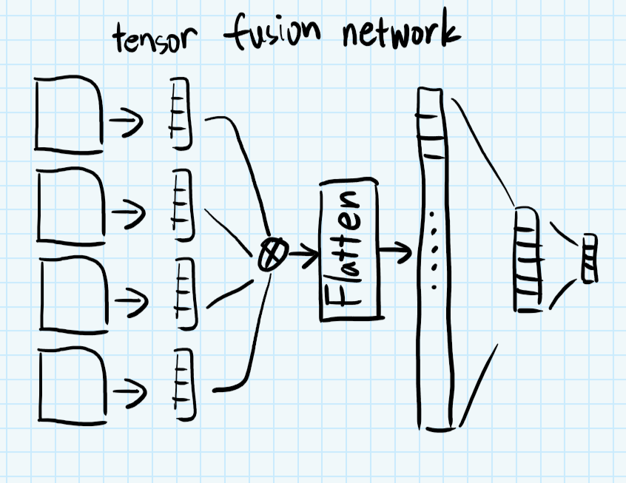
Workflow – Tensor fusion network

Slide 14
Workflow – ETF model
Just replace the tensor fusion part with efficient method
(Same figure as before)

Slide 15
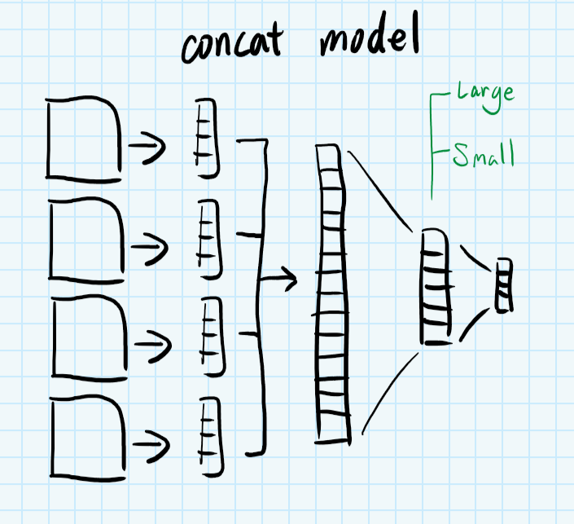
Workflow – Concat Model

Slide 16
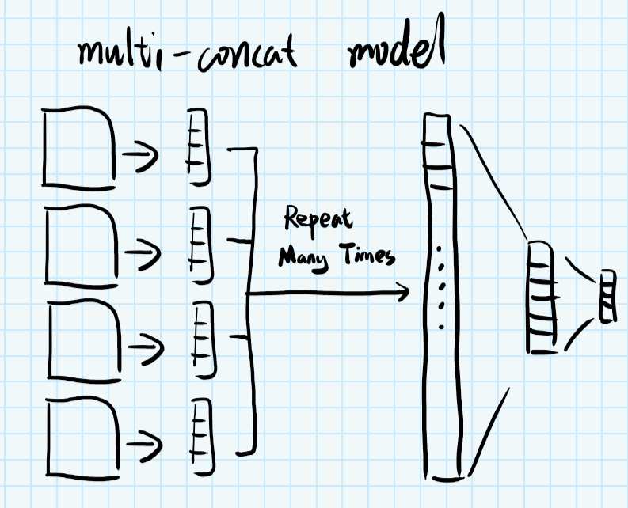
Workflow – Multi-Concat Model

Slide 17
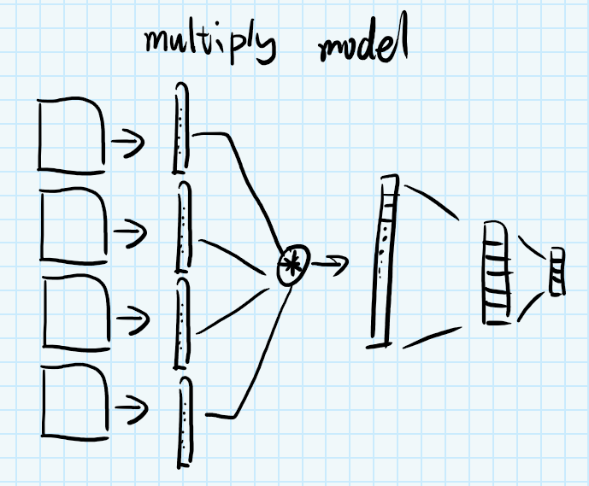
Workflow – Multiply Model

Slide 18
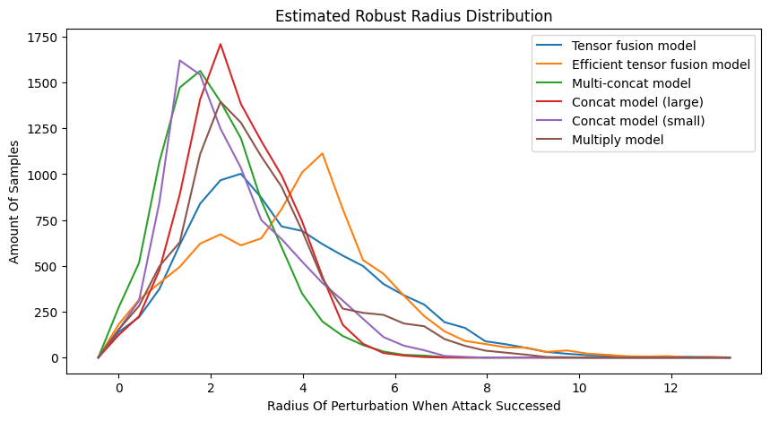
Result – Perturbation Radius Comparison

Slide 19
Result – How to understand the figure?
Smaller area under curve means fewer samples can be attacked
The peak of the curve means most of the samples can be attacked within this radius

Slide 20
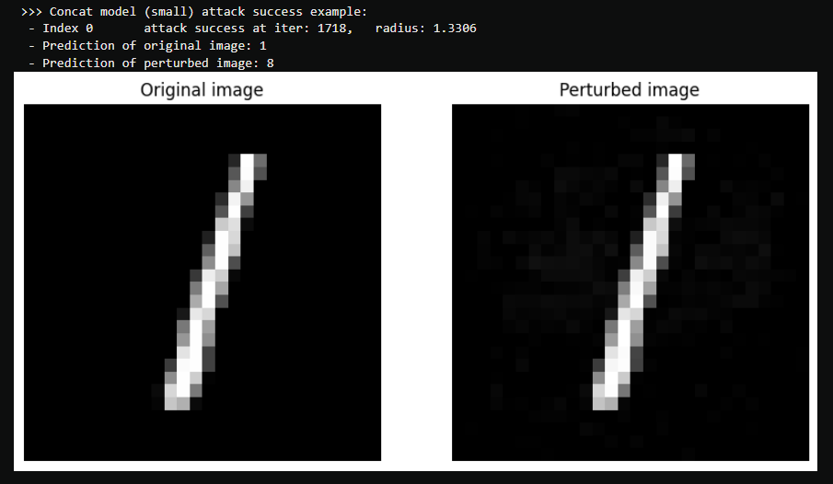
Result - Examples

Slide 21
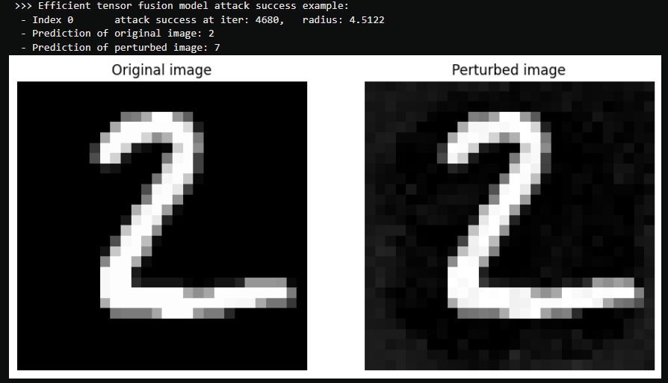
Result - Examples

Slide 22
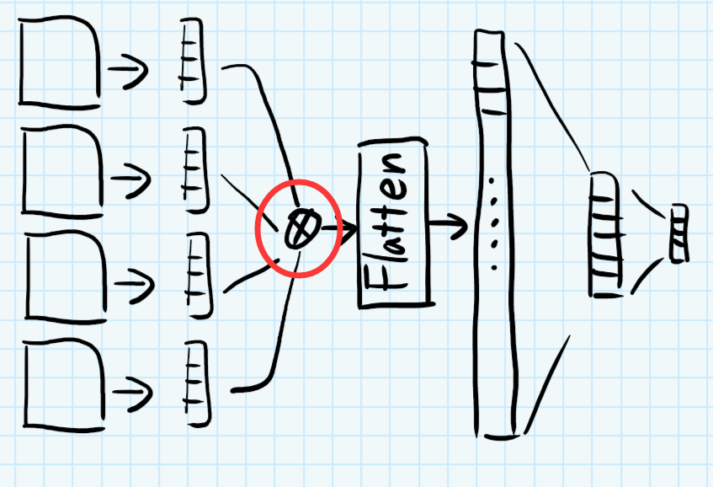
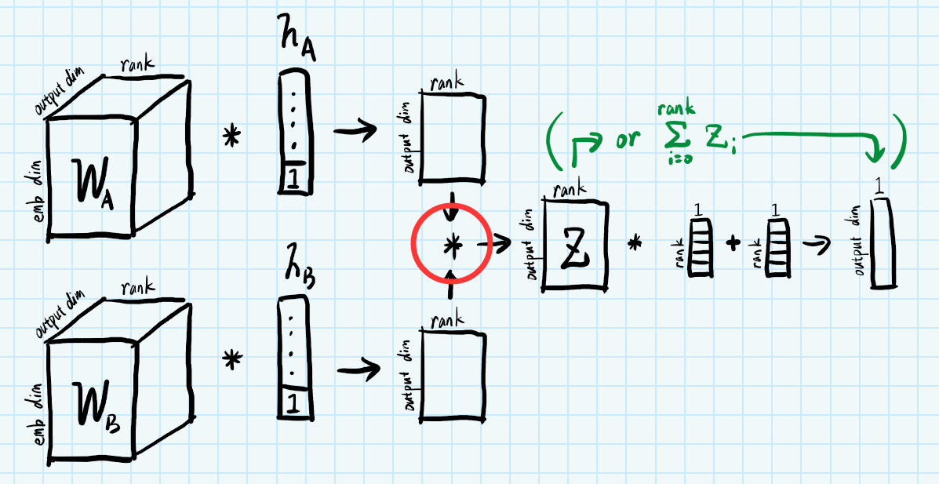
Why?
Feature coupling
Tensor fusion network
Efficient tensor fusion network

Slide 23
Thank you for you listening! Q&A time now

