Slide 1
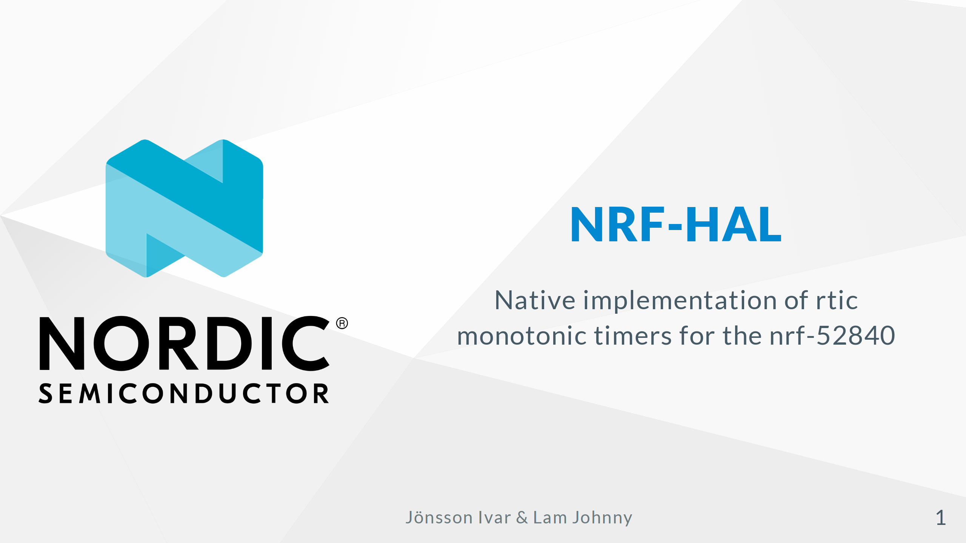

Slide 2
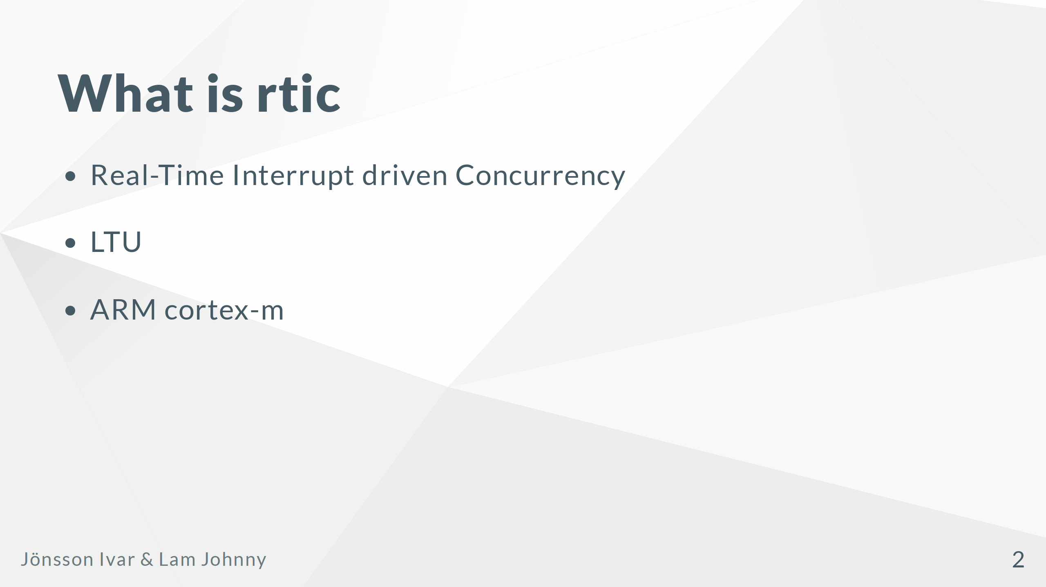
Notes:
In contrast to other RTOS implementations it has no real kernel or software task queue. It is managed in hardware and therefore has next to no task switching overhead, (real real-time) Fully open-source and used in real embedded projects, Some local examples: - Zparks EV-chargers - Mobilaris/Widefind positioning tags It started here at ltu as a research project. The only practically adoptable version of rtic currently is cortex-m-rtic Du to the NVIC ( Nested Vectorized Interrupt Controller ) which is responsible for the hardware managmanent of tasks. It can be implemented on Risc-v cores if the cores have a CLIC ( Core Local Interrupt Controller).

Slide 3
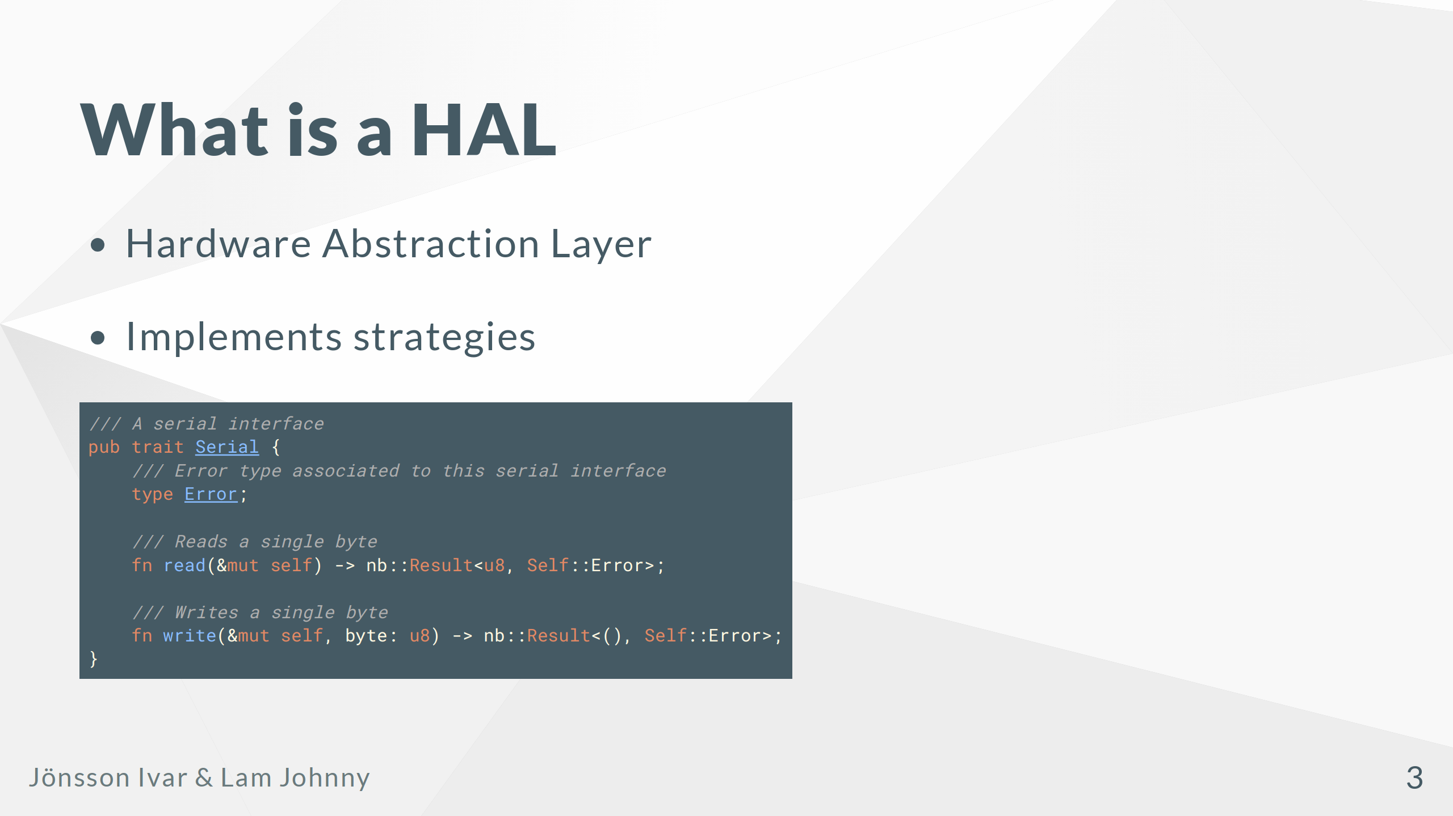
Notes:
It provides safe and tested interfaces for the hardware Ensures that register accesses are done as the hardware expects. In rust they typically use the type system to ensure that singletons of hardware peripherals as well as modes. Generally speaking a hal should not introduce run time overhead where ever it is avoidable. In rust the hals implement strategies defined in the embedded-hal crate allowing hardware agnostic drivers. example of such a strategy

Slide 4
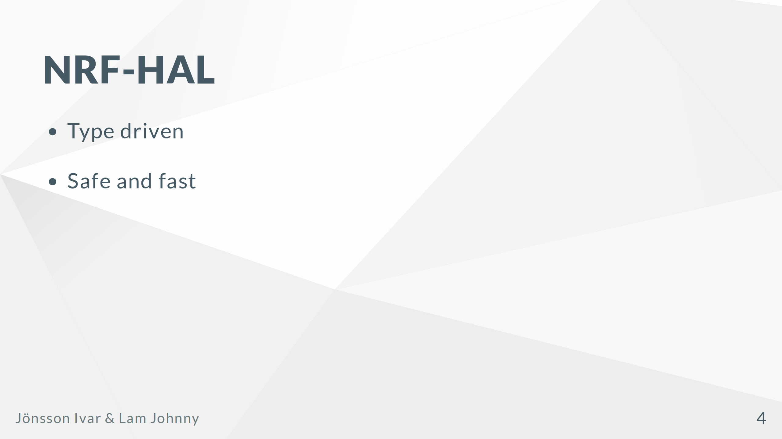
Notes:
Each hardware peripheral is represented as a type. This allows usage Uses the type system to ensure that hardware peripherals are used in a safe manner.

Slide 5
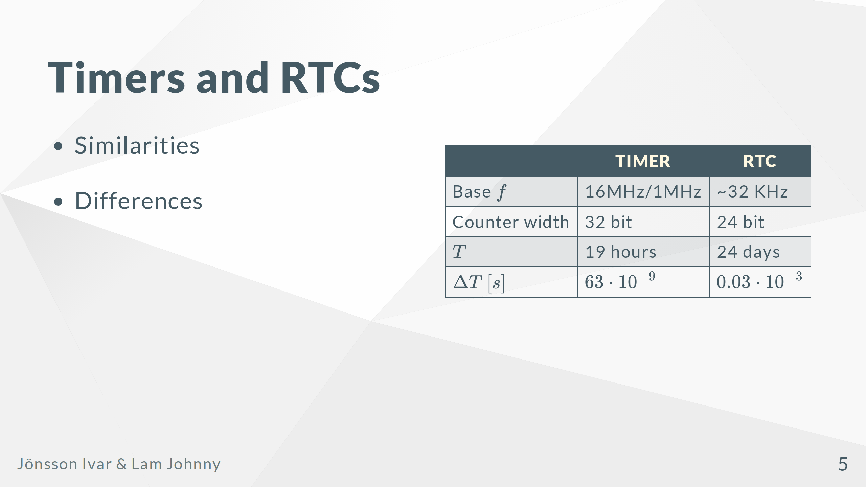
Notes:
Both the Timer and RTC are COUNTING peripherals They have a consistent rate of increase ( monotonic ) Describe the table I guess

Slide 6
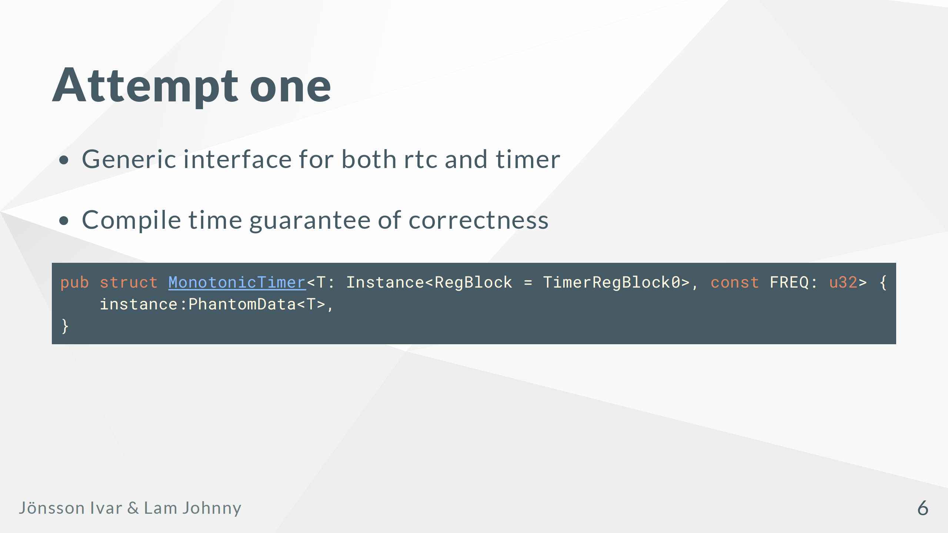
Notes:
Ease of use and modification Top level type disconnected from actual implementation ( strategy pattern ) Trait constrained construction to ensure that freq is valid.

Slide 7
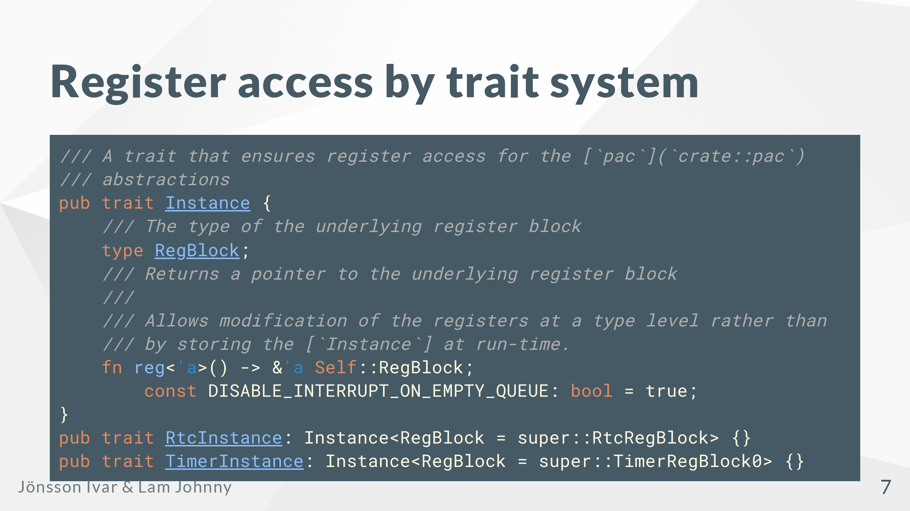
Notes:
The type level peripheral would be responsible for register access. No runtime space cost. This actually worked and is still present in the final version

Slide 8
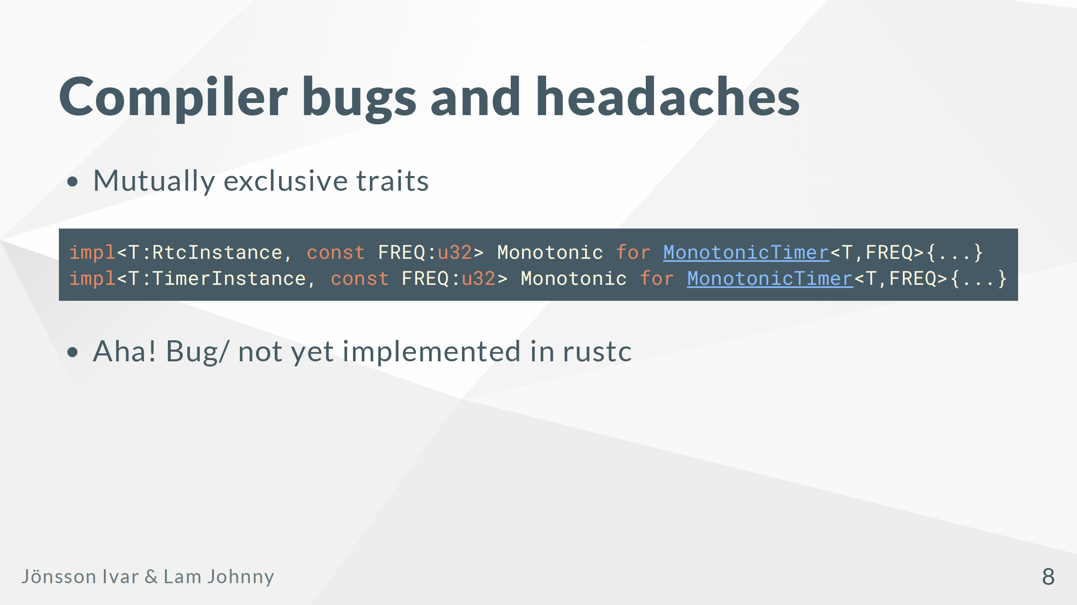
Notes:
When implementing the strategy for the hardware peripherals the trait system broke... These two $T$ types are not the same and can't be implemented on the same type. But the compiler cannot know this. Turns out that this is a well known bug in rustc. And there is work being done in the compiler to support mutually exclusive traits.

Slide 9
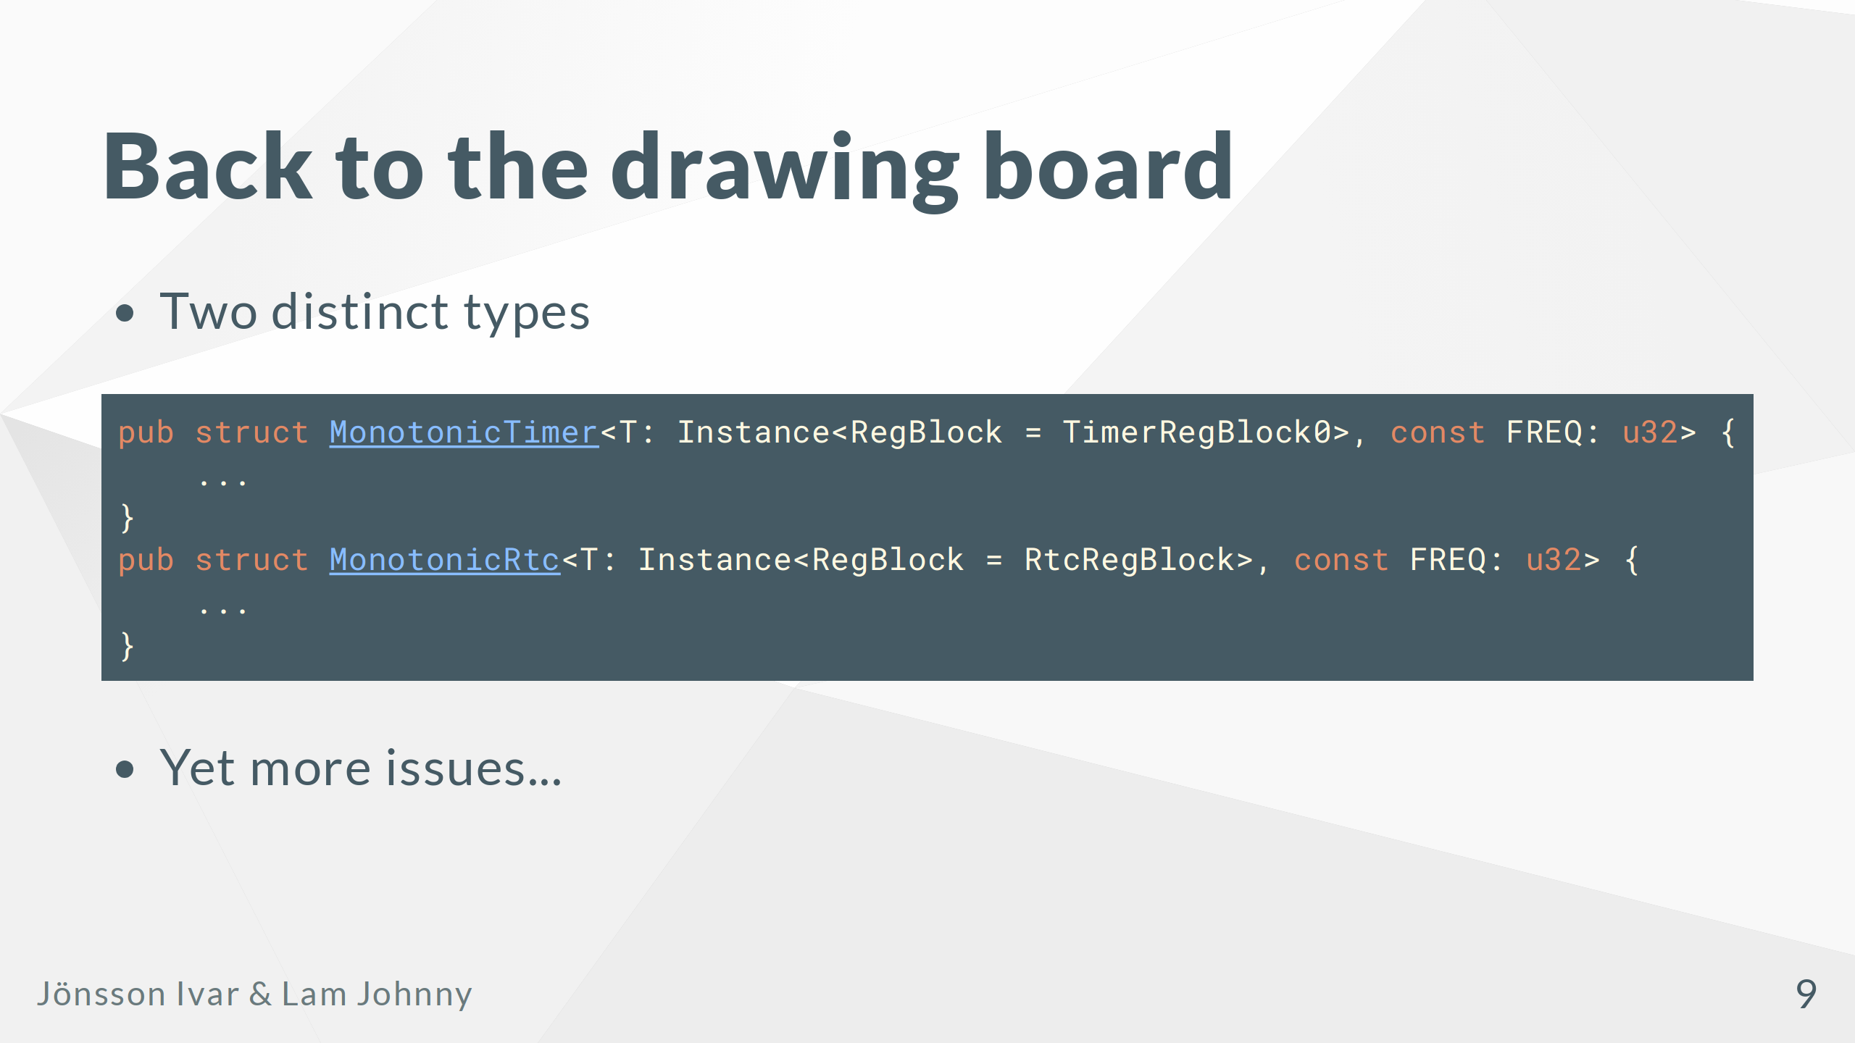
Notes:
Splitting the implementations to distinct types to help the compiler Implementation now works great!

Slide 10
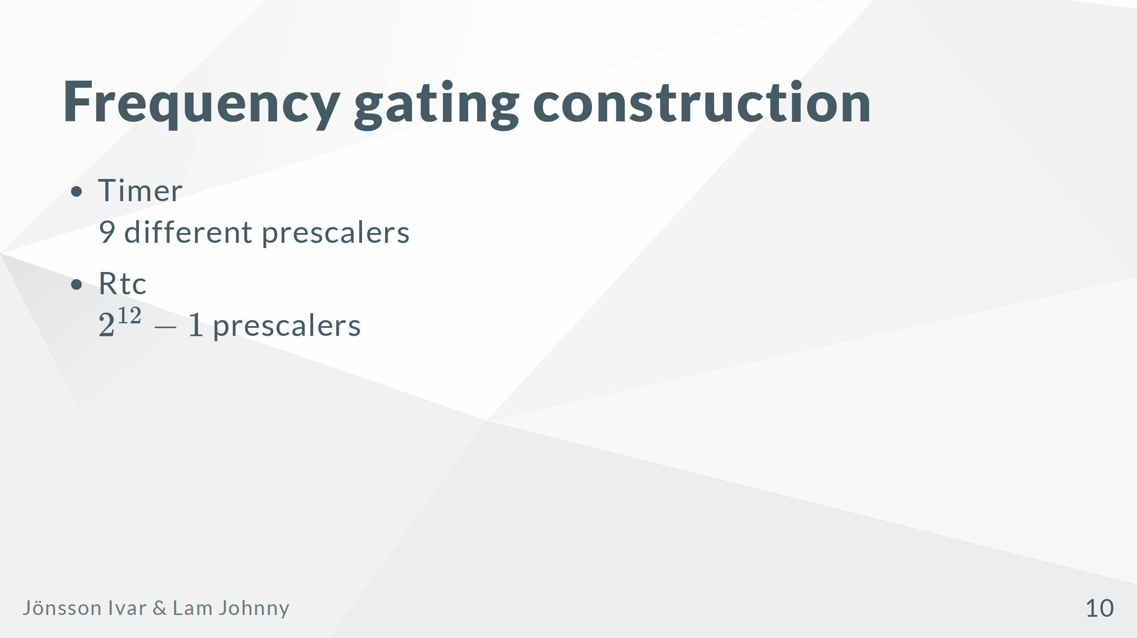
Notes:
Turns out that our initial idea of gating the construction of the abstraction is somewhat problematic While it is reasonable to do this for the timer it is not reasonable to have $2^{12}$ different new functions for the rtc abstraction. The solution to this problem is to at runtime, specifically init time the rtc throws an error if the frequency is invalid.

Slide 11
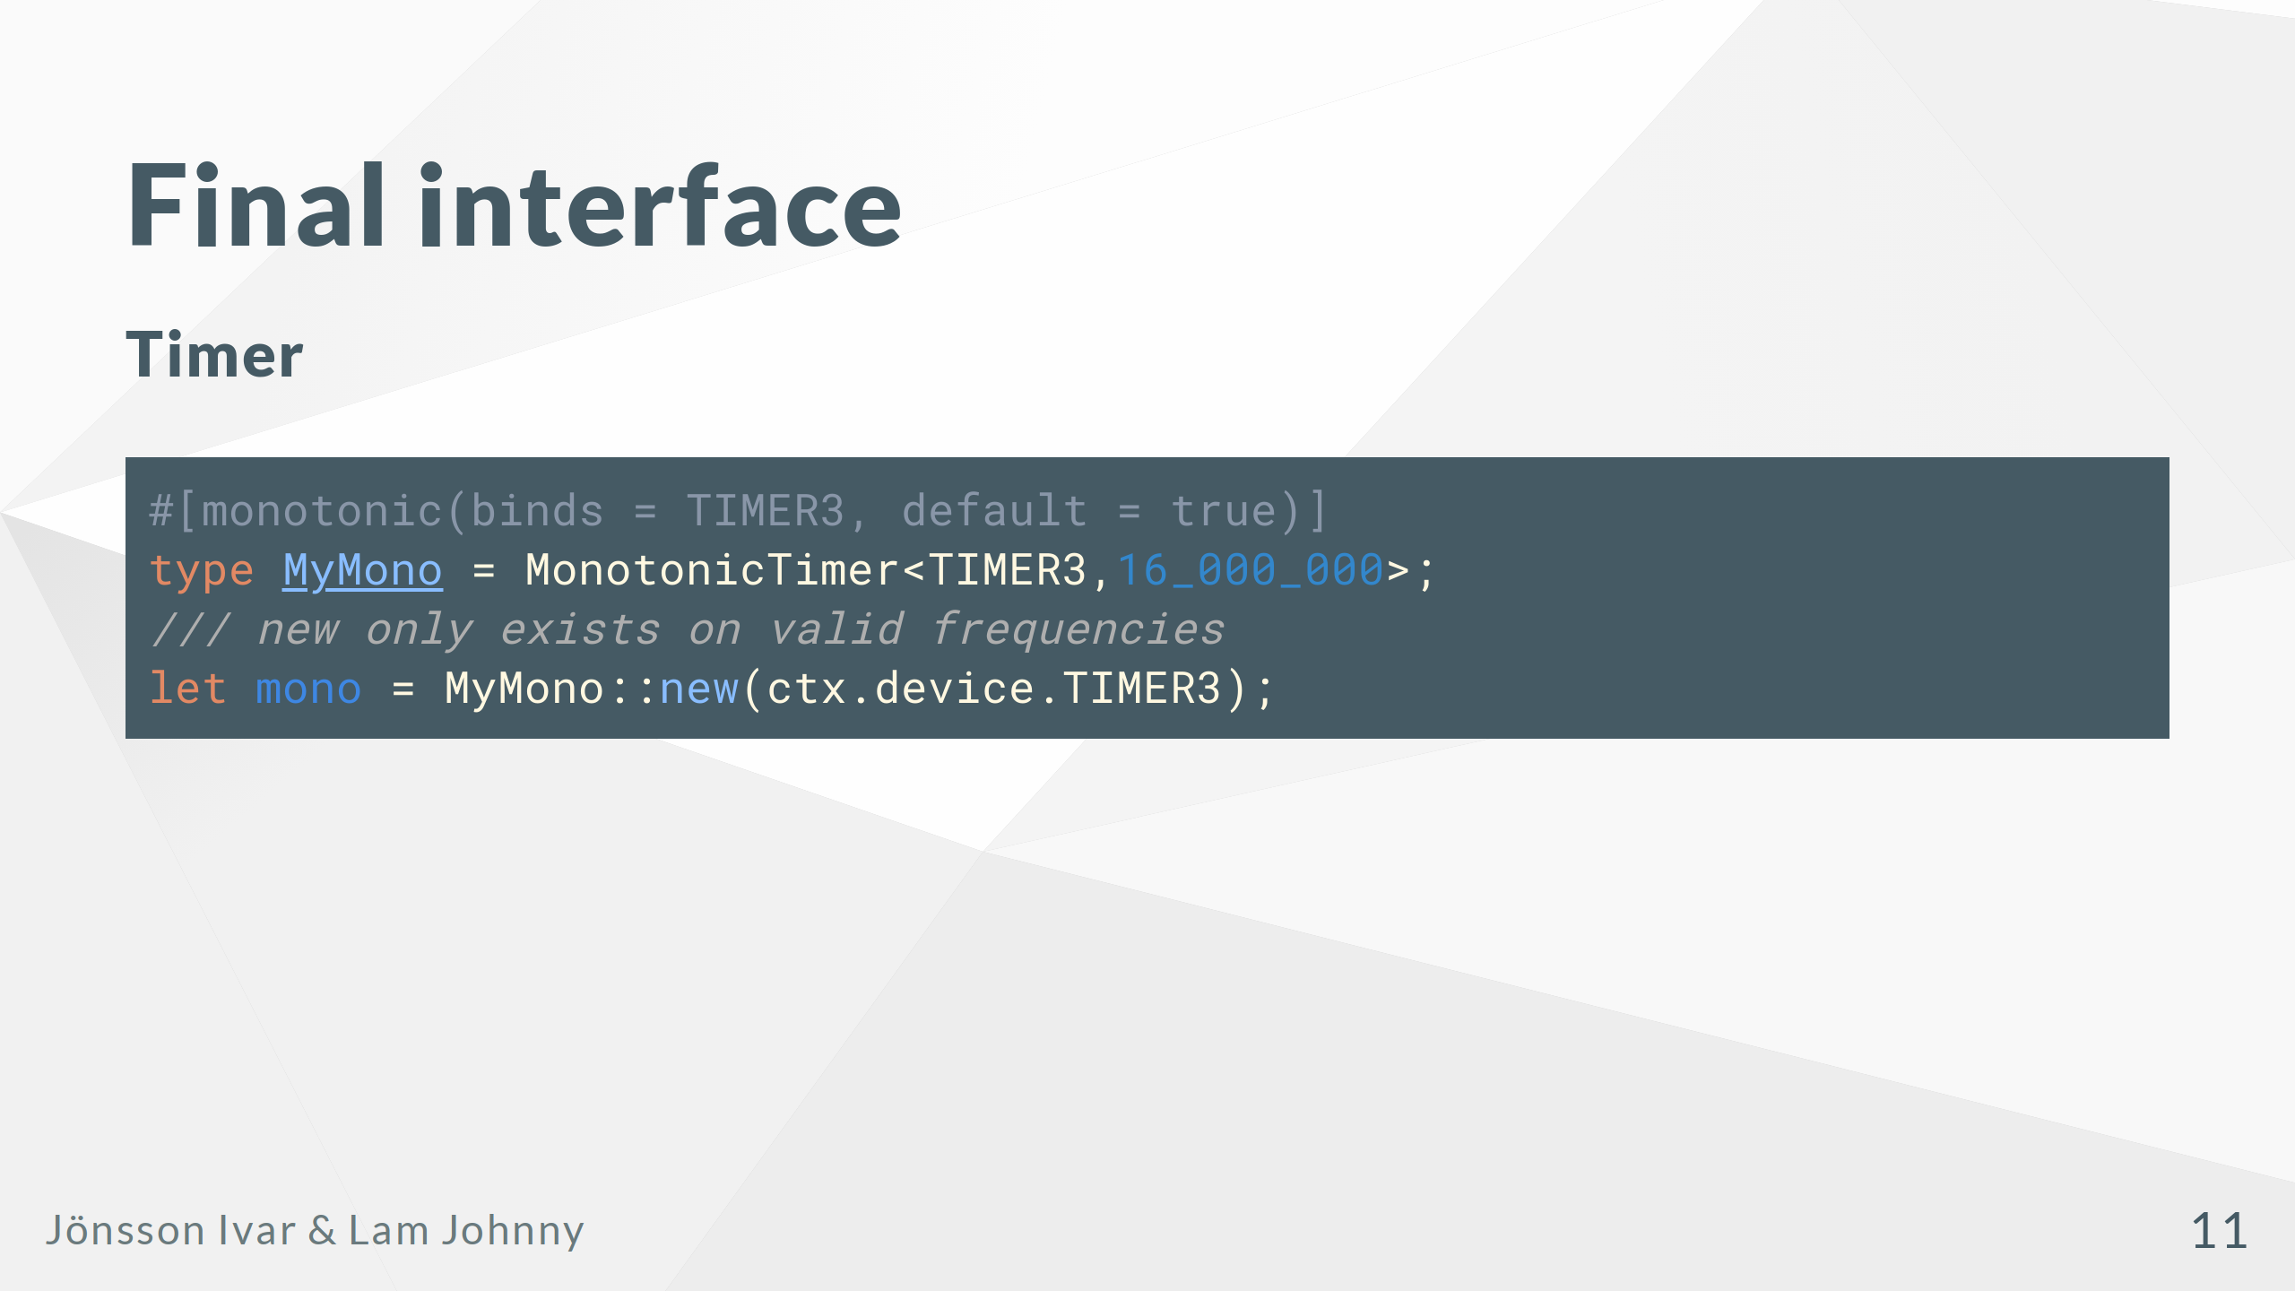
Notes:
Simple interface for any timer Compile time guaranteed correctness

Slide 12
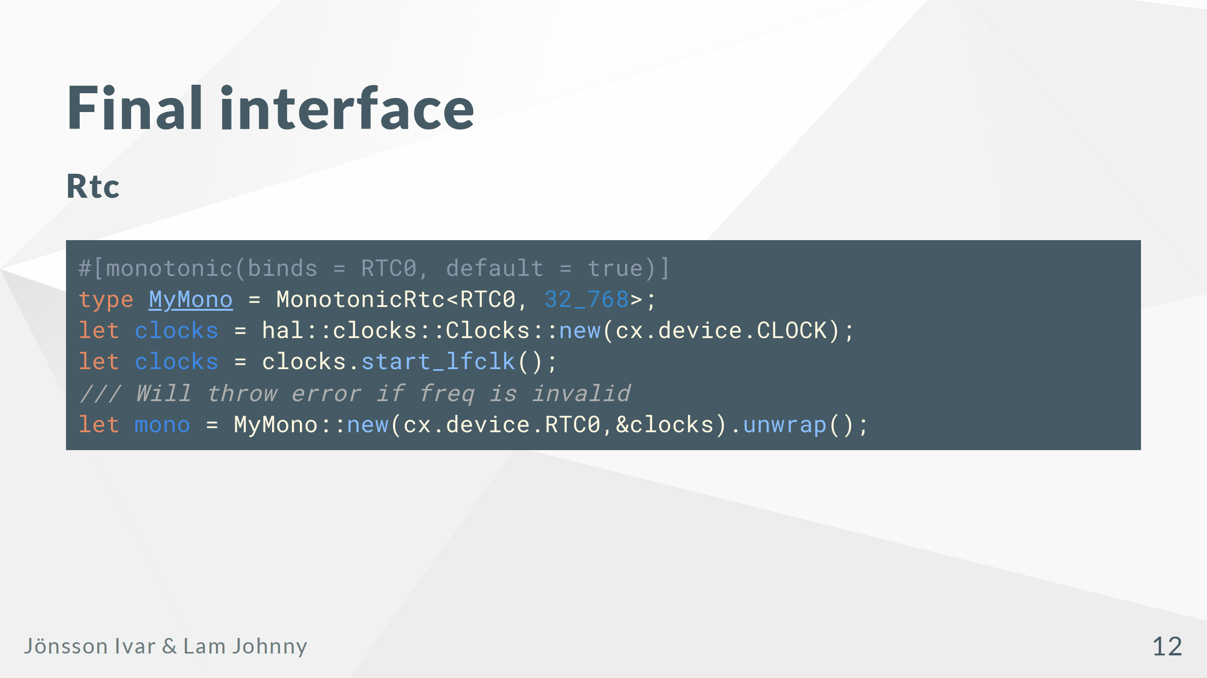
Notes:
This interface is equally simple, but it cannot guarantee that the rtc is correct at compile time. It can, however guarantee that the rtc is correct when the init function is completed.

Slide 13
