Slide 1
Gruppe 4 - LogMerge
Günes Aydin, Joey Zgraggen, Nikodem Kernbach

Slide 2
Unser Auftrag
Applikationsschicht
User - GUI –Projekte
Chat etc.
Datenbank
Gruppe 7
logMerge
Wir
feedCtrl
Gruppe 14
Transportschicht
Senden der .pcap-Pakete
(Gruppen 1 und 13)

Slide 3
Unser Auftrag ― Aktualisiert
Applikationsschicht
User - GUI –Projekte
Chat etc.
Applikationsschicht
Datenbank
Datenbank
Gruppe 7
logMerge
feedCtrl
Wir
feedCtrl
Gruppe 14
logMerge
Transportschicht
Senden der .pcap-Pakete
(Gruppen 1 und 13)
Transportschicht

Slide 4
Unser Auftrag ― Integration
Applikationsschicht
{
Datenbank
“Axis of BACnet”
feedCtrl
logMerge
Transportschicht

Slide 5
Unser Auftrag ― Integration
Applikationsschicht
EventCreationTool
Datenbank
feedCtrl
logMerge
Reguläre API
Transportschicht

Slide 6
Unsere API (an Transportgruppen)
pip install .
import LogMerge
lm = LogMerge.LogMerge()

Slide 7
Unsere API (an Transportgruppen)
pip install .
import LogMerge
lm = LogMerge.LogMerge()
database_status = lm.get_database_status()
lm.import_logs(path_to_pcap_files)
lm.export_logs(save_path, current_status) → .pcap files

Slide 8



Unsere API (an Transportgruppen)
pip install .
import LogMerge
lm = LogMerge.LogMerge()
database_status = lm.get_database_status()
lm.import_logs(path_to_pcap_files)
lm.export_logs(save_path, current_status) → .pcap files
Intern:

Slide 9

Unsere API (an Transportgruppen)
pip install .
import LogMerge
lm = LogMerge.LogMerge()
database_status = lm.get_database_status()
lm.import_logs(path_to_pcap_files)
lm.export_logs(save_path, current_status) → .pcap files
Intern:

Slide 10
Unser Tool (an Applikationsgruppen)
pip install .
import EventCreationTool
ef = EventCreationTool.EventFactory()

Slide 11
Unser Tool (an Applikationsgruppen)
pip install .
import EventCreationTool
ef = EventCreationTool.EventFactory()
first_event = ef.first_event(app_name, master_feed_id)
new_event = ef.next_event(identifier, content_dictionary)
ef = EventCreationTool.EventFactory(most_recent_event)

Slide 12
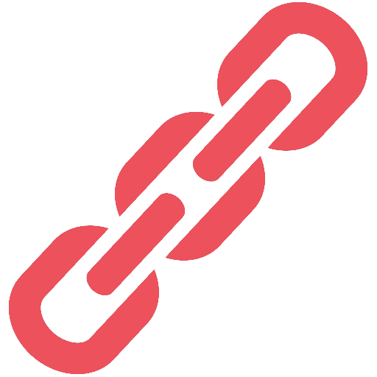


Unser Tool (an Applikationsgruppen)
pip install .
import EventCreationTool
ef = EventCreationTool.EventFactory()
first_event = ef.first_event(app_name, master_feed_id)
new_event = ef.next_event(identifier, content_dictionary)
ef = EventCreationTool.EventFactory(most_recent_event)
Intern:

Slide 13
Unser Tool (an Applikationsgruppen)
pip install .
import EventCreationTool
ef = EventCreationTool.EventFactory()
first_event = ef.first_event(app_name, master_feed_id)
new_event = ef.next_event(identifier, content_dictionary)
ef = EventCreationTool.EventFactory(most_recent_event)
Intern:

Slide 14
Thanks for your cooperation
Group 4 ― LogMerge

