Slide 1
Feed Management
Yannik Rummele
Wilson Ailen Eghonghon
Damian knuchel

Slide 2

Our Project
Feed Controller
Application

Slide 3
Feed Controller
Following
Whitelist

Slide 4

Following

Slide 5

Whitelist

Slide 6
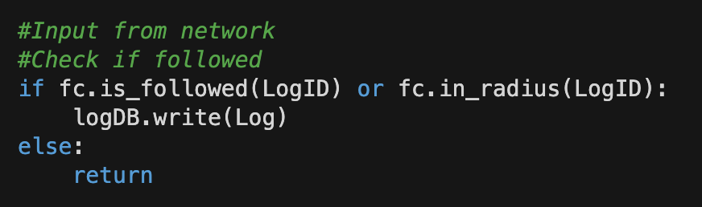
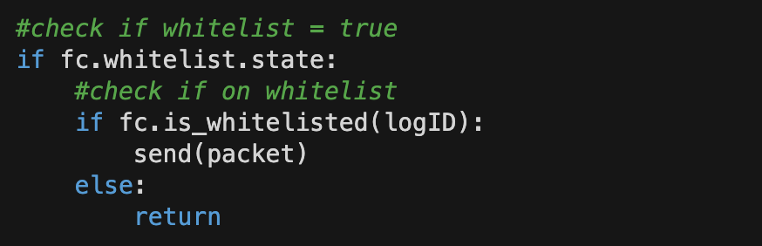
Example
Receive
Send

Slide 7

Radius

Slide 8
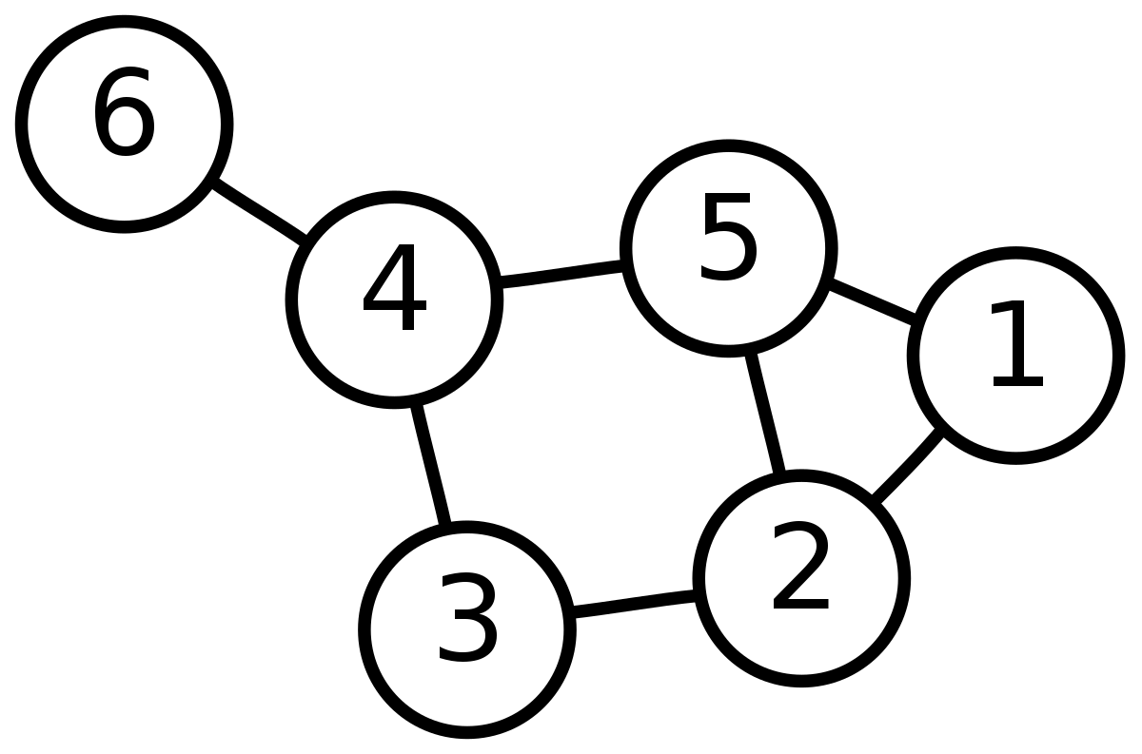
Radius

Slide 9
Application

