Slide 1
Project the doom drone
by Donov Kyrilo, Shehab Adam , Melis Riccardo, Molinari Simone, Beneventi Tommaso.

Slide 2
Tools for the software
Use of Git and Gitlab of the school to track the progress of the project
Java language for programming the software
Java swing for the visual part
Usage of REST calls to interface with the server that contains the maze
Agile method that shows all of the functionalities of the software.

Slide 3
Analytic structure of the project
Definition
Team
User Stories
Sequence of the program
Mockup sketch
UML
Sprint definition

Slide 4
Definition of the project
The purpose of this project is to create a software that gives commands to a drone in a maze, so that it finds the trophy in the maze and with the least moves possible the software has to take out the trophy.
On this link there is deeper description of the project:
GitLab Definition

Slide 5
The team
Melis Riccardo(owner): advanced programming skills and team leader skills
Donov Kyrylo (developer): advanced programming skills and GitLab knowledge
Shehab Adam(developer): english knowledge and teamwork skills
Molinari Simone(developer): advanced english skills and good programming skills
Beneventi Tommaso(developer): teamwork skills and all-around skills.
The work distribution is better explained here:
GitLab Work

Slide 6
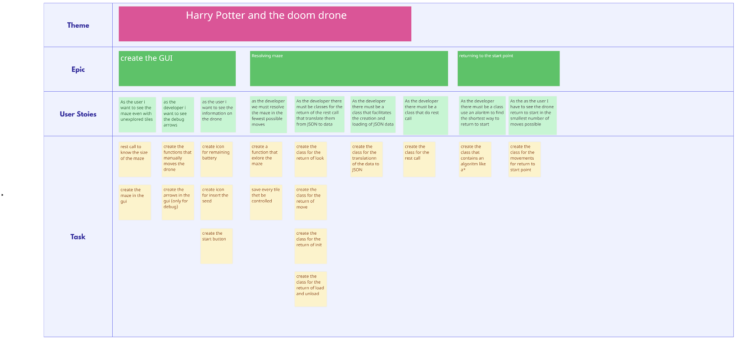
User Stories
The user Story are the specifications that must be shared with the development to establish what must be developed,
those specifications help the team during all the development of the project.

Slide 7
Sequence of the program
Program Initialization
Start button
Movement buttons
Load button
Unload button
Maze exploration algorithm
the sequence is better explained here:
GitLab Sequence

Slide 8
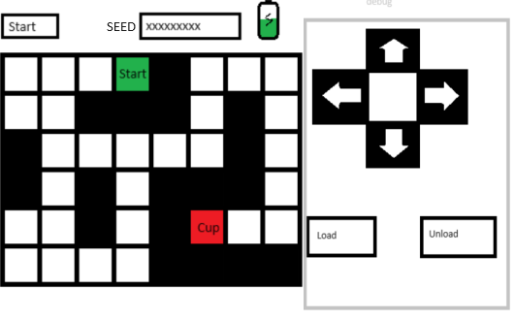
Sketch of the maze
Sketch of the visual maze of the project,obviously it will not be the final visual interface.

Slide 9
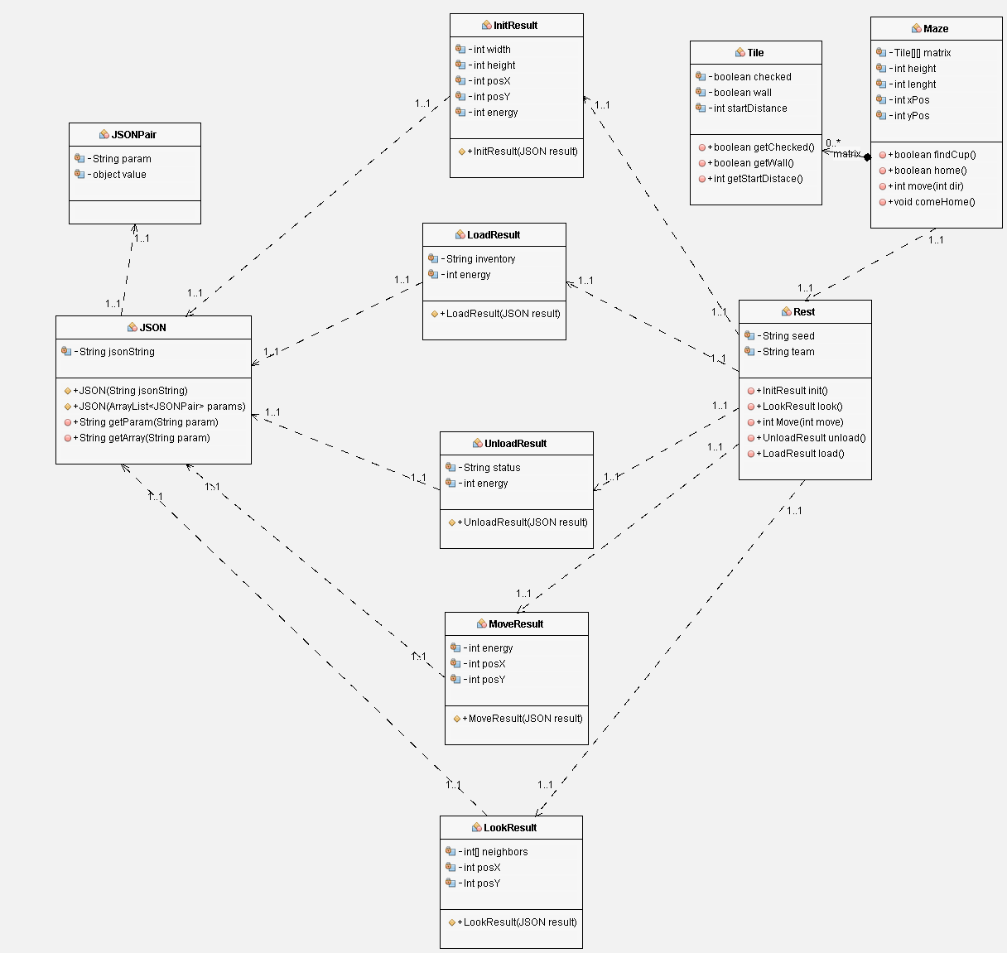
Unified Modeling Language
UML is a scheme that represents the visual model of the classes and how they interact with each other.

Slide 10
Definition of the sprints
The sprint we planned are linked here:
GitLab Sprints
The Sprint is a session of development that close an issue.
The sprint must not be violated, and they permit a good planning in the course of the time

