Slide 1
Employee Evaluation for Promotion
Project By : Ronak Vimal
Guided By : Prof.Aparajita Ojha

Slide 2
Features used
Department
Education
Gender
Recruitment Channel
No. of Trainings
Age
Previous Year Rating
Length of Service
Awards Won
Average Training Score
Dataset used : https://www.kaggle.com/datasets/muhammadimran112233/employees-evaluation-for-promotion

Slide 3
Problems to be handled
Target Class Imbalance ( 92 % Not Promoted )
-> Used F1 Score as evaluation metric of model in place of accuracy
2 ) Categorical Columns
-> Ordinal Encoder ( education )
-> One Hot Encoder ( department , recruitment_channel , gender )

Slide 4
3 ) Missing Values
Missing at random ( education {4.4%} , avg_training_score {4.7%} )
-> Iterative Imputer
Previous_year_rating {7.5%} were missing when length_of_service=1,
i.e., employee in first year of service.
-> Added new feature first_year which works as a missing indicator and
removed few outlier samples where previous year rating was given.

Slide 5
Other processing steps :
80% / 20% train-test split for better evaluation of model.
Standard Scaler to standardize features by removing the mean and scaling to unit variance.
Randomized Grid Search to find the best parameters for XGBoost and LightGBM.

Slide 6
Hyperparameters used
XGBoost
subsample=0.8
n_estimators=400
max_depth=3
learning_rate=0.1
gamma=0.5
colsample_bytree=0.5
scale_pos_weight=3.5
LightGBM
subsample=1
n_estimators=400
learning_rate=0.1
colsample_bytree=0.4
reg_alpha=0.28
reg_lambda=0.6
boosting_type=‘dart’

Slide 7
Results
Model used : Soft Voting Ensemble of XGB , LGBM
F1 score : 0.54
Accuracy : 93.84 %
Precision : 0.79
Recall : 0.41
ROC_AUC score : 0.70

Slide 8
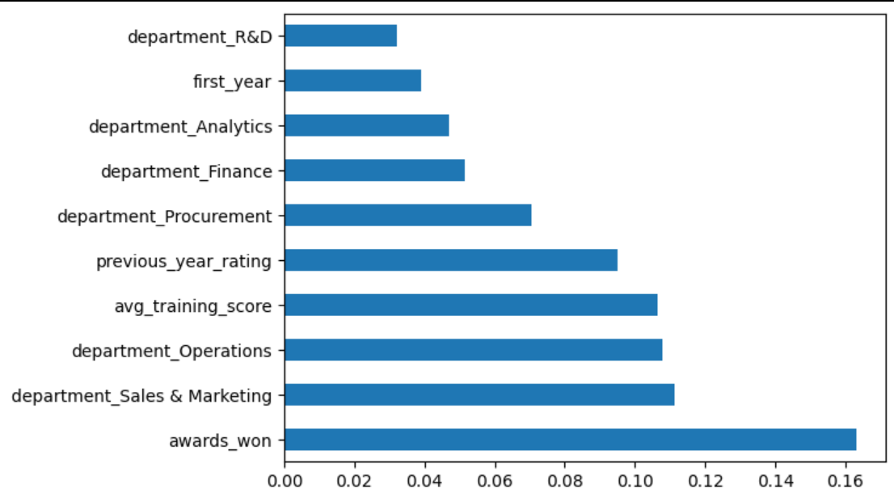
Feature Importance

