Slide 1
CABNfs
CMSC 621 - Fall 2020
Christian Badolato and Andre Nguyen

Slide 2
Agenda
Goals and Objectives - Christian
Design and Architecture - Christian
Resilience in the Presence of Node Failures - Christian
Replication - Christian
Tools Used - Christian
Demo - Andre
Experimental Results - Andre
Challenges and Lessons - Andre

Slide 3
Goals and Objectives
Design and implementation of a simple distributed file system
  Server / Client interaction
    Same node
  Fault Tolerance through replication
  Consistency
Operations
  Create
  Delete
  List Files
  Read
  Atomic Write
  Concurrent Write
Metric gathering and experimental validation

Slide 4
Design and Architecture
Linux Based
Designed for High read availability / Low write availability
  Assume the average use-case of the fs is to infrequently update widely accessed data
  Read is guaranteed if any node is active
  Create can be attempted if any node is active
  Write cannot be performed unless every node is active
  Possible use-case: Storing lab results where data is rarely if ever changed but frequently added to and accessed
Fully distributed
  No management node removes single point of failure for read/create
Uses a “primary server” designation for each file
  Primaries in charge of distributing replicas and de-conflicting concurrent writes
Replicates for fault tolerance and quick access
  Having local replicas removes the need to perform network-based modifications every change

Slide 5
RabbitMQ
CABNfs
Docker Container
FUSE
RabbitMQ
RabbitMQ
CABNfs
CABNfs
Docker Container
Docker Container
FUSE
FUSE
Client
Client
Client

Slide 6
Resilience in Presence of Node Failures
When a primary server is shutting down, it nominates a random replica-holder to become the new primary server
  This is fine given the assumption of all shutdowns being graceful
  If the chosen primary-elect is unable to promote itself, the primary will choose a different replica-holder to become the primary
  All servers are notified of any primary changes and update accordingly
In the event no primary-elect can be promoted or the shutting-down server is the last server alive
  Error written to logs
  All files on the server will remain in-tact, uncorrupted, and will be recovered upon server restart

Slide 7
Replication
Each file is replicated a configurable number of times across the servers
When reading, a local replica is copied down to the working server
  Reduces access time by having the file locally
Replicas ensure files are not lost on total disk failure
  As long as two or more nodes were running at any point since file creation, the failure of any one server will not cause the file to become permanently lost
Replication follows an “at least” replication factor
  The system will guarantee at least the configurable replication factor of replicas is present (if possible)
Replica rebalancing occurs whenever a new primary is selected for a file
  Rebalancing attempts to ensure only the replication factor number of file copies exist
  Servers with more disk space are prioritized

Slide 8
Tools Used
Several third-party free tools / APIs listed below were used within this filesystem
FUSE - Filesystem in Userspace
  An API within the Linux Kernel which allows filesystems to be written in userspace
  Drastically simplifies the hook-ins to Linux filesystem operations without using kernel drivers
pyFUSE
  A python module for creating a FUSE filesystem
RabbitMQ
  An open-source messaging API based on Advanced Message Queuing Protocol (AMQP) which provides simple messaging and health monitoring
Docker
  A containerization service which allows for consistent and predictable development and deployment images which can be recreated and expanded as needed with little effort

Slide 9
Demo

Slide 10
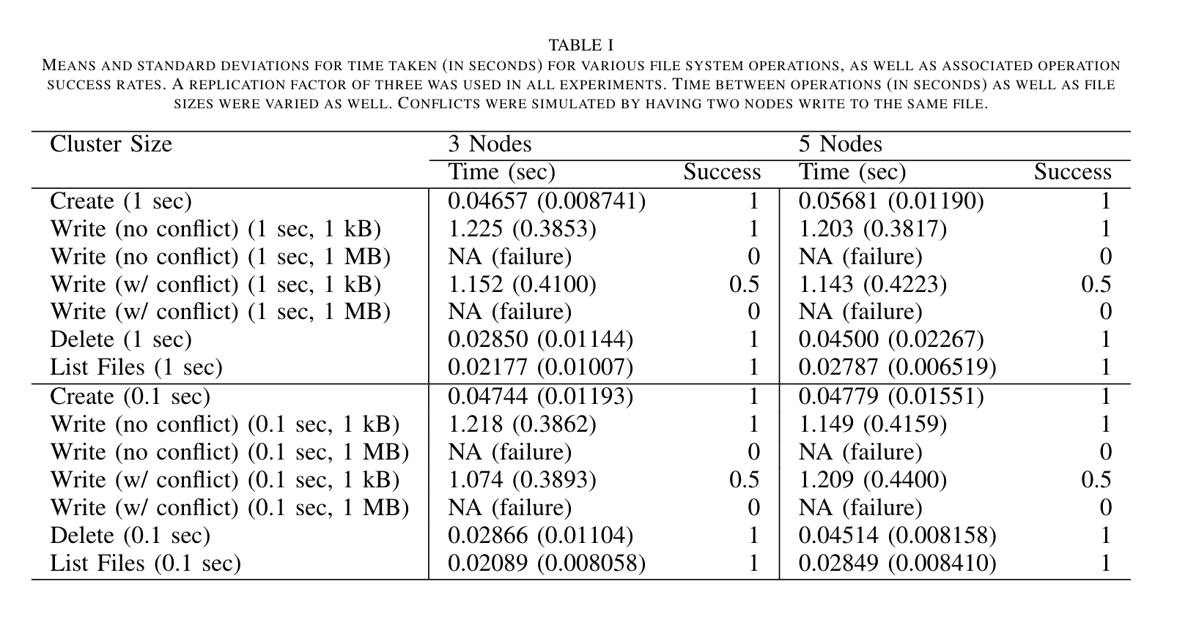
Experimental Results

Slide 11
Challenges, Lessons, and Next Steps
Challenges included:
Learning curves for the tools used, in particular FUSE and RabbitMQ.
Slow messaging and data transfer between nodes, and related messaging timeouts and TTL configuration.
Debugging in the context of a distributed system.
Docker greatly simplified our development process and iteration.
Next steps would focus on improving the design and configuration of the data transfer procedure to allow for a higher success rate of larger data size operations.

Slide 12
Thanks!

