Slide 1
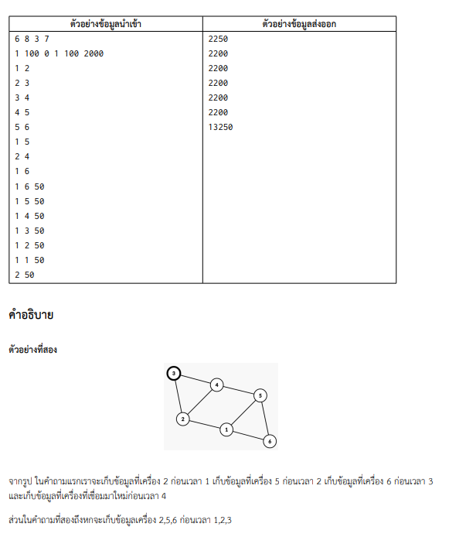

x
50
0
1
100
100
2000
1

