Slide 1
Human ICT Software Engineering
SIMPLE MERGE
Team11 강영은 김규리 김준성 박기철 이세영 이융

Slide 2
INDEX
Development
OS/Tool
Design
View
Process Model
Controller
MVC Pattern
Execution
Screen/Implementation
Test
Functional unit test

Slide 3
1
Development
OS/Tool
Process Model

Slide 4



Development
OS/Tool
Process Model
Development OS/Tool
Window8/10
JAVA/JDK-1.8.0_111version
GitHub

Slide 5

Development
OS/Tool
Process Model
Development Process Model – Waterfall Model
계획
요구조건
설계/구현
테스트
유지보수

Slide 6
2
Design
View
Controller

Slide 7
Design
View/Controller
MVC Pattern
Merge 기능
public void Copy_to_Left(ActionEvent e)
public void Copy_to_Right(ActionEvent e)
Compare 기능
public void Compare(ActionEvent e)
Left TextArea의 줄 이동 기능
Up_Arrow_Left.setOnMouseClicked( new EventHandler()
Down_Arrow_Left.setOnMouseClicked( new EventHandler()
Right TextArea의 줄 이동 기능
Up_Arrow_Right.setOnMouseClicked( new EventHandler()
Down_Arrow_Right.setOnMouseClicked( new EventHandler()
View/Controller
Merge left&right
Left
TextArea
Right
TextArea
Save 기능
private void saveFile(String content, File file) ---Left---> public void Save_Left(ActionEvent e)
--right--> public void Save_Right(ActionEvent e)
Edit 기능
public void Edit_Left(ActionEvent e)
public void Edit_Right(ActionEvent e)
Load 기능
public void openFile(File file,int choice) ---Left--> public void Load_Left(ActionEvent e)
---right-> public void Load_Right(ActionEvent e)
Left
Save Load Edit
Right
Save Load Edit
compare

Slide 8
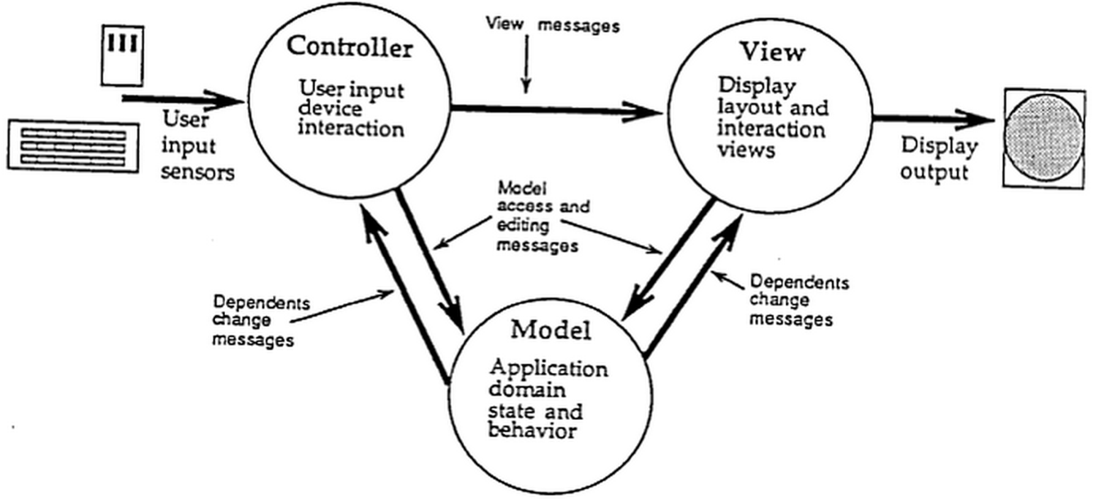
Design
View/Controller
MVC Pattern
MVC Pattern

Slide 9
3
Execution
Screen/Implementation

Slide 10
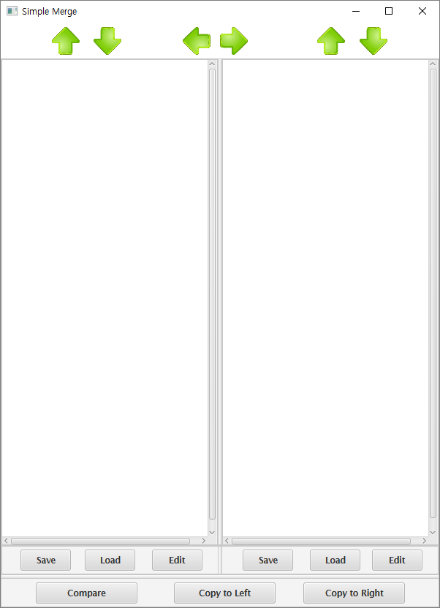
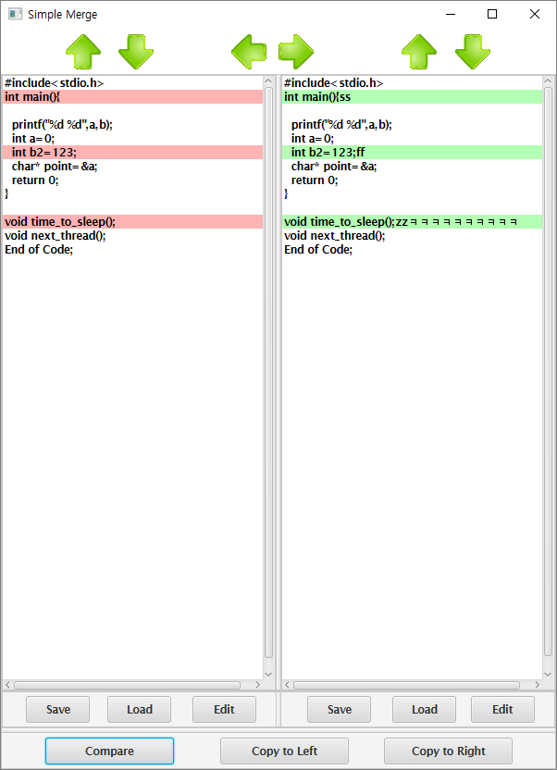
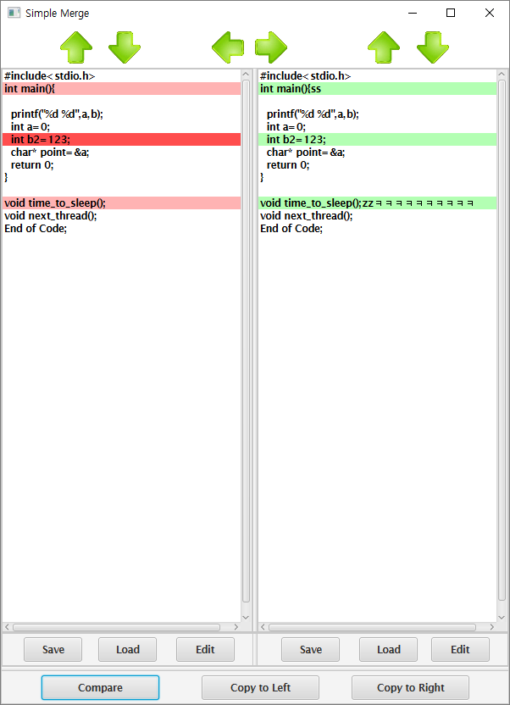
Execution
Screen/Implementation
Implementation

Slide 11
4
Test
Functional unit test

Slide 12


Test
Functional unit test
Functional unit test
Controller Test

Slide 13
Q&A

Slide 14
THANK
YOU!

