Slide 1
Deep Learning Practice Lab 0 – Pytorch Basics
Hyemi Jang & Jisoo Mok

Slide 2

Colab
Colab allows users to write and execute Python in browser
Jupyter notebook
Google drive
Free GPU resources (12 hours)
Source files are saved in Google drive
Variable and data on runtime are not saved in Google drive

Slide 3

Pytorch Basics
Pytorch
Framework developed by Facebook
Dynamic graph generation
Simple and intuitive to program and debug
Data parallelism
Link : https://pytorch.org/tutorials/
Notes:
Pytorch tutorial link add

Slide 4
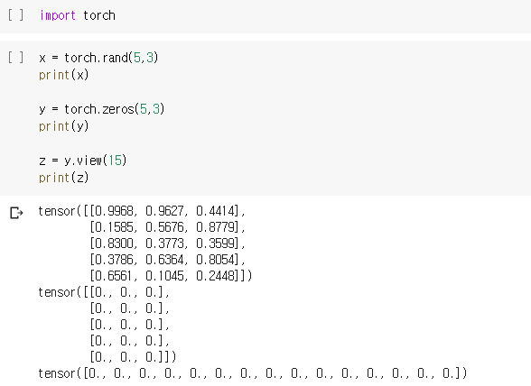
Pytorch Basics
Tensor
N-dimensional array

Slide 5
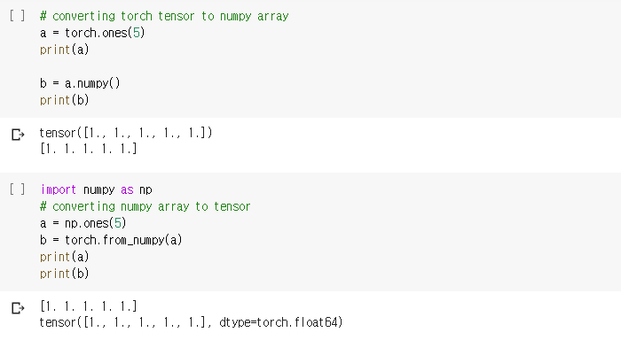
Pytorch Basics
Converting type between numpy array and torch tensor

Slide 6
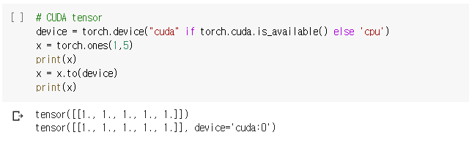
Pytorch Basics
CUDA tensor
Upload variable to GPU
“cuda” : GPU environment
“cpu” : CPU envirionment

Slide 7
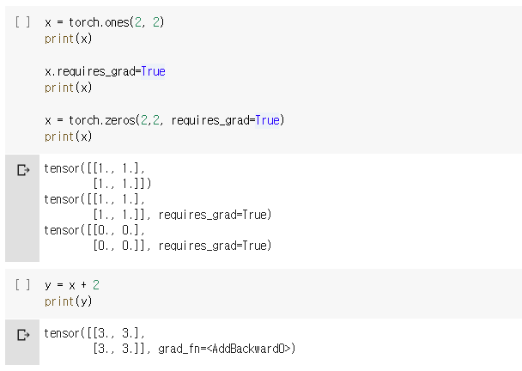
Pytorch Basics
Autograd
requires_grad : flag for gradient computation

Slide 8
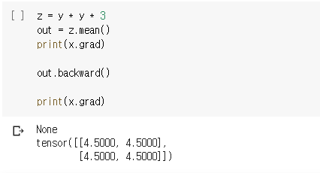
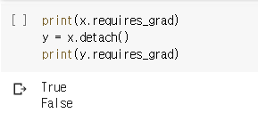
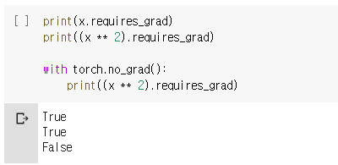
Pytorch Basics
detach()
Autograd
backward()
torch.no_grad()

Slide 9
실습 #0
Linear Regression with PyTorch
Logistic Regression with PyTorch

