Slide 1
Session 1
Introduction to Web Programming

Slide 2
Contents
History and Evolution of Internet
Difference between Internet & WWW
Invention of www
Rise of HTML, HTTP & Browser
Web Server & Web Client
Browser Technology
Various Technologies on Web
Advantages of www
Reference Book:
HTML 5 covers CSS3, Java Script, XML, XHTML, Ajax, PHP and jQuery-
Black Book: Dreamtech Press
HTML 5.0 in Simple Steps : Kogent Learning Solutions Inc/Wiley India

Slide 3
History and Evolution of Internet
Internet is a network born in 1969.
Millions of private, public, academic, business, and government networks are connected.
All use the standard Internet protocol suite.
Connected through cables.

Slide 4
Difference between Internet & www
www= World Wide Web
Internet is a network but www is an application over the internet.
Internet =1969 | www= 1991
Some more applications that run on internet are :Email, Chat, File Transfer etc.

Slide 5
Invention of www
www was invented by Sir Tim Berners Lee in 1991.
He successfully demonstrated the concept of server and client.
www was invented for information sharing.
He invented three things: HTML, HTTP and the Browser.

Slide 6
Rise of HTML, HTTP & Browser
HTML : The language of communication
HTTP: The rules of communication
Browser: The client
Earlier Browser was only text-based.

Slide 7
Web Server & Web Client
Web Server is a computer that has a web server software installed on it.
Most common web servers are Apache and Microsoft IIS (Internet Information Server).
All the web pages are stored on Web servers.
Internet Information Services(IIS) is an extensible web server created by Microsoft for use with Windows NT family.
IIS supports HTTP, HTTPS, FTP, SMTP and NNTP.
New technology
Network New Transfer Protocol
Simple Mail Transfer Protocol
Notes:
New technology
Network New Transfer Protocol
Simple Mail Transfer Protocol

Slide 8
Web Server & Web Client
The term web server can refer to either the hardware (the computer) or the software (the computer application ) that helps to deliver web content that can be accessed through the internet.
Web servers are computers that deliver (serves up) web pages. Every web server has an IP address and possibly a domain name.
For example, if you enter URL http://www.xyzsite.com/index.html in your browser, this sends a request to the web server whose domain name xyzsite.com. The server fetches the page named index.html and sends it to your browser.
Any computer can be turned into a Web server by installing server software and connecting the machine to the Internet.
Notes:
There are many Web server software applications, including public domain
software from NCSA and Apache, and commercial packages from Microsoft, Netscape and others.

Slide 9
Web Server & Web Client
A client is a piece of computer hardware or software that accesses a service made available by a server.
The server is often (but not always) on another computer system, in which case the client accesses the service by the way of a network.
Types: Client computers and devices are either fat clients, thin clients or hybrid clients.
Fat : A fat client also known as a rich client or thick client, is a client that performs the bulk of any data processing operation itself, and does not necessarily rely on the server.
For example, a computer running a CAD program (such as AutoCAD or CATIA) that ultimately shares the result of its work on a network is a fat client.
Notes:
There are many Web server software applications, including public domain
software from NCSA and Apache, and commercial packages from Microsoft, Netscape and others.

Slide 10
Web Server & Web Client
Thin: A thin client is a minimal sort of client. Thin clients use the resources of the host computer.
A thin client generally only presents processed data provided by an application server, which performs the bulk of any required data processing.
Programming environments for thin clients include JavaScript, ASP.NET, JSP, Ruby on Rails, Django, PHP and others.
Hybrid: A hybrid client is a mixture of the above two client models. Similar to a fat client, it processes locally, but relies on the server for storing persistent data.
A device running the video game Diablo III is an example of hybrid client.
Notes:
There are many Web server software applications, including public domain
software from NCSA and Apache, and commercial packages from Microsoft, Netscape and others.
A thin client is software that is primarily designed to communicate with a server. Its features are produced by servers such as a cloud platform. A thick client is software that implements its own features.

Slide 11
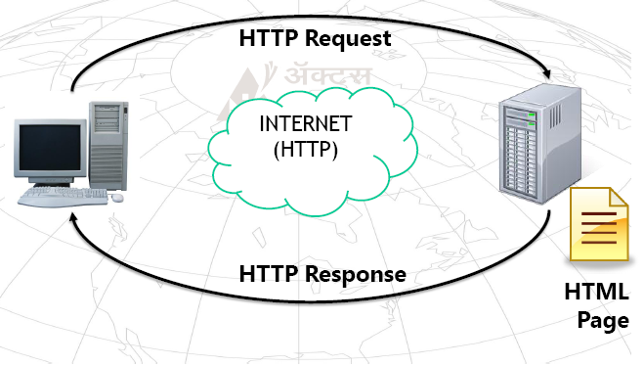
Communication on www

Slide 12
Browser Technology
A web browser is the web client.
It is built upon a rendering engine.(is used to display the requested content on the user interface)
Most well known rendering engines are:
Gecko, Webkit and Trident.
WebKit is a layout engine software component designed to allow web browsers to render web pages. It powers Apple's Safari web browser and Google's Chrome web browser versions up to 27 (except for iOS versions that still continue to use WebKit) applications. The Trident engine used by Internet Explorer, and the Gecko engine used by Firefox.
Notes:
Gecko is a free and open source layout engine used in many applications developed by Mozilla
Foundation and the Mozilla Corporation (notably the Firefox web browser), as well as in many other
open source software projects. Gecko is written in C++ and is cross‐platform, and runs on various operating
systems including BSDs, Linux, OS X, Solaris, OS/2, AIX, OpenVMS, and Microsoft Windows. Its
development is now overseen by the Mozilla Foundation and is licensed under version 2 of
the Mozilla Public License.
WebKit is a layout engine software component designed to allow web browsers to render web
pages. It powers Apple's Safari web browser and Google's Chrome web browser versions up to 27
(except for iOS versions that still continue to use WebKit) applications. As of September
2013WebKit browser market share[4] is ahead of both the Trident engine used by Internet Explorer,
and the Gecko engine used by Firefox.

Slide 13
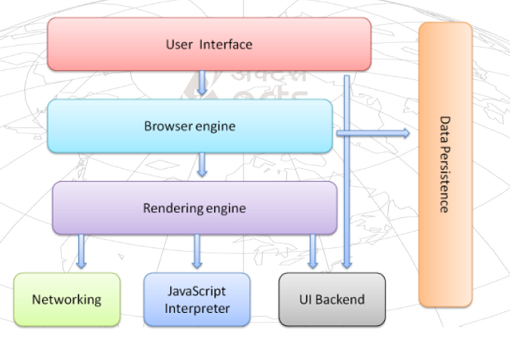
Browser Layers

Slide 14
Layout Engine
A web browser engine, (sometimes called layout engine or rendering engine), is a software component that takes marked up content (such as HTML, XML, image files, etc.) and formatting information (such as CSS, XSL, etc.) and displays the formatted content on the screen.
A layout engine is typically embedded in web browsers, e‐mail clients, e‐book readers, on‐line help systems or other applications that require the displaying (and editing) of web content.
Engines may wait for all data to be received before rendering a page, or may begin rendering before all data is received.
Notes:
Gecko is a free and open source layout engine used in many applications developed by Mozilla
Foundation and the Mozilla Corporation (notably the Firefox web browser), as well as in many other
open source software projects. Gecko is written in C++ and is cross‐platform, and runs on various operating
systems including BSDs, Linux, OS X, Solaris, OS/2, AIX, OpenVMS, and Microsoft Windows. Its
development is now overseen by the Mozilla Foundation and is licensed under version 2 of
the Mozilla Public License.

Slide 15
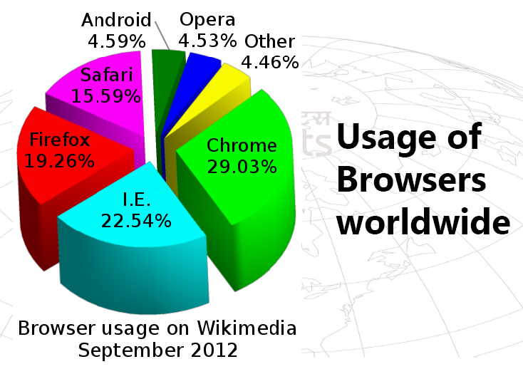
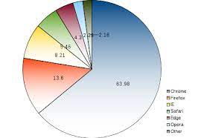
Usage of Browsers
2022

Slide 16
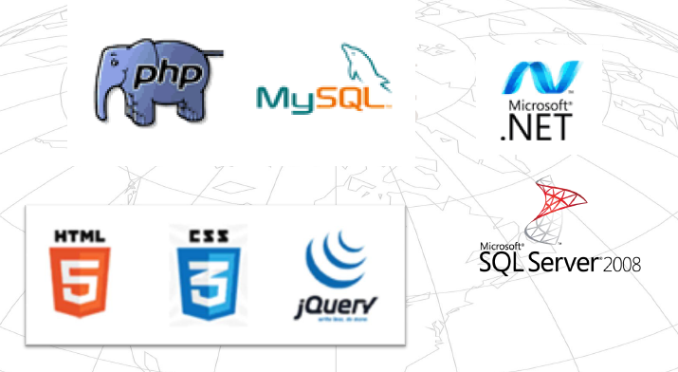
Various Technologies on Web

Slide 17
Various Technologies on Web
HTML-HTML or HyperText Markup Language is the standard markup language used to create web pages.
CSS-Cascading Style Sheets (CSS) is a style sheet language used for describing the look and formatting of a document written in a markup language.
jQuery -jQuery is a multi-browser JavaScript library designed to simplify the client-side scripting of HTML. jQuery is not a language, but it is a well written JavaScript code.
PHP- PHP (recursive acronym for PHP: Hypertext Preprocessor) is a widely-used open source general-purpose scripting language that is especially suited for web development and can be embedded into HTML.
Notes:
Jquery sampleS
<script src=“jquery-1.11.1.min.js">
</script>
<script>
function myFunction()
{
$("#h01").html("Hello jQuery");
}
$(document).ready(myFunction);
</script>
<h1 id="h01"></h1>

Slide 18
Various Technologies on Web
MySQL is a freely available open source Relational Database Management System (RDBMS) that uses Structured Query Language (SQL). SQL is the most popular language for adding, accessing and managing content in a database. It is most noted for its quick processing, proven reliability, ease and flexibility of use.
The Microsoft .NET Framework is a software framework developed by Microsoft that runs primarily on Microsoft Windows. It includes a large library and provides language interoperability across several programming languages.
Microsoft SQL Server is a relational database management system developed by Microsoft.

Slide 19
Domain Names
A name of the website. e.g.,www.google.com->Goole Inc.
Domain names serve as more easily memorable names for Internet resources such as computers, networks, and services. A domain name represents an Internet Protocol (IP) resource.
IP address: A unique identity of the web servers

Slide 20
Domain Names
Domain names are formed by the rules Domain Name System (DNS). Any name registered in the DNS is a domain name.
Domain Name System (DNS) is the name resolution protocol for TCP/IP networks, such as the Internet. Client computers query a DNS server to resolve memorable, alphanumeric DNS names to the IP addresses that computers use to communicate with each other.
Go to command prompt : cmd
E.g., ping www.google.com, ping www.facebook.com

Slide 21
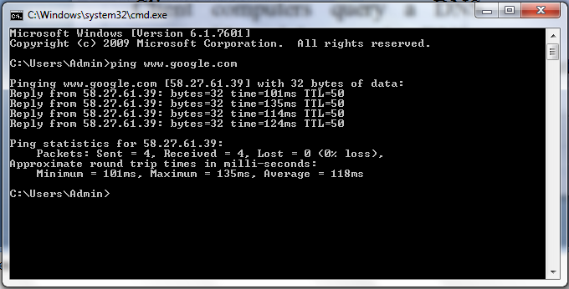
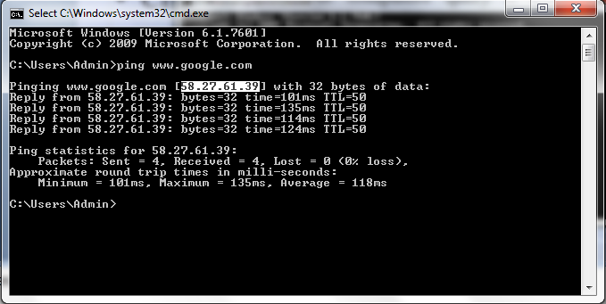
ping www.google.com
Notes:
Packet internet grouper

Slide 22
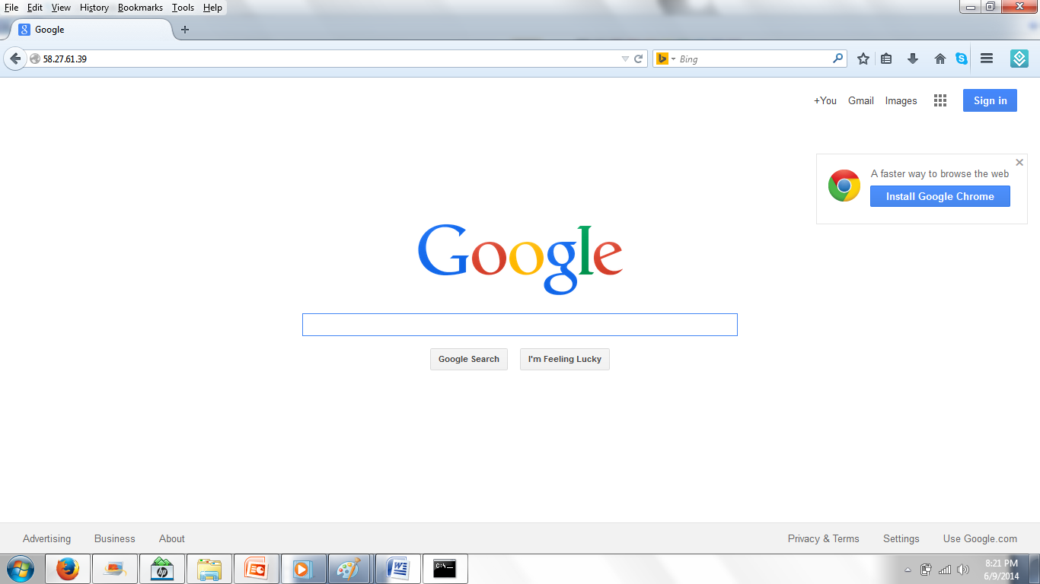

Slide 23
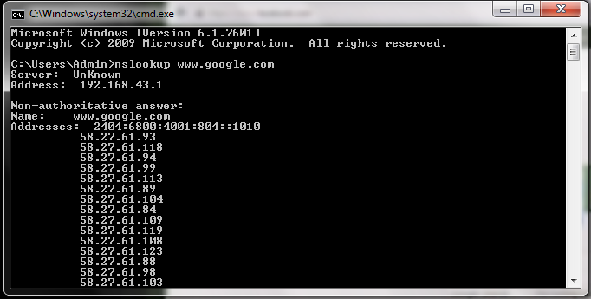
Different DNS servers of www.google.com
nslookup www.google.com
Notes:
Name server -ns

Slide 24
Internet Assigned Numbers Authority
IANA- Internet Assigned Numbers Authority
IANA is responsible for global coordination of the Internet Protocol addressing systems, as well as the Autonomous System Numbers used for routing Internet traffic.
Two types of Internet Protocol (IP) addresses in active use:
IP version 4 (IPv4) and IP version 6 (IPv6).
IPv4 was initially deployed on 1 January 1983 and is still the most commonly used version. IPv4 addresses are 32-bit numbers often expressed as 4 octets in “dotted decimal” notation (for example, 192.0.2.53).
IPv6 protocol began in 1999. IPv6 addresses are 128-bit numbers and are conventionally expressed using hexadecimal strings (for example, 2001:0db8:582:ae33::29).

Slide 25
Regional Internet Registry
A Regional Internet Registry (RIR) is a not-for-profit international organization that deals with the allocation of Internet Protocol (IP) address space (IPv4 and IPv6) and the Autonomous System numbers within a geographical region.
Each RIR has the main task to create and develop local policy for managing the allocation of identity elements such as unique Internet protocol (IP) addresses and numbers which are used by routers, switches and computers over the Internet.
IANA (Internet Assigned Numbers Authority) is the institution that allocates IP addresses to each individual RIR upon request.
Each individual RIR is responsible for the allocation of addresses towards Internet Service Providers (ISPs), educational institutions, companies, government bodies and other such institutions.

Slide 26
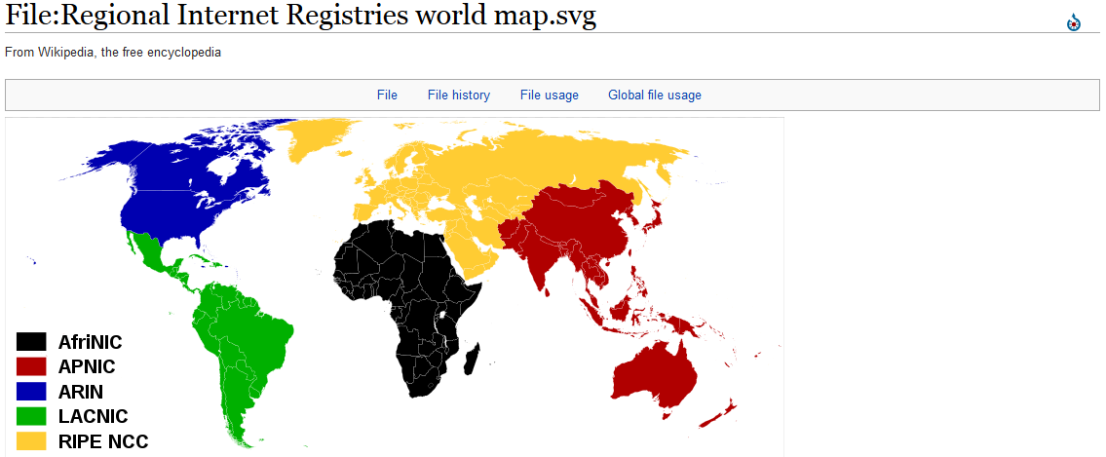
RIR

Slide 27
Internet Corporation for Assigned Names and Numbers
The IANA is a department of Internet Corporation for Assigned Names and Numbers (ICANN) responsible for managing the DNS Root and the numbering system for IP addresses.
ICANN is made up of a number of different groups, each of which represent a different interest on the Internet and all of which contribute to any final decisions that ICANN’s makes.
There are three “supporting organizations” that represent:
  The organizations that deal with IP addresses
  The organizations that deal with domain names
  The managers of country code top-level domains

Slide 28
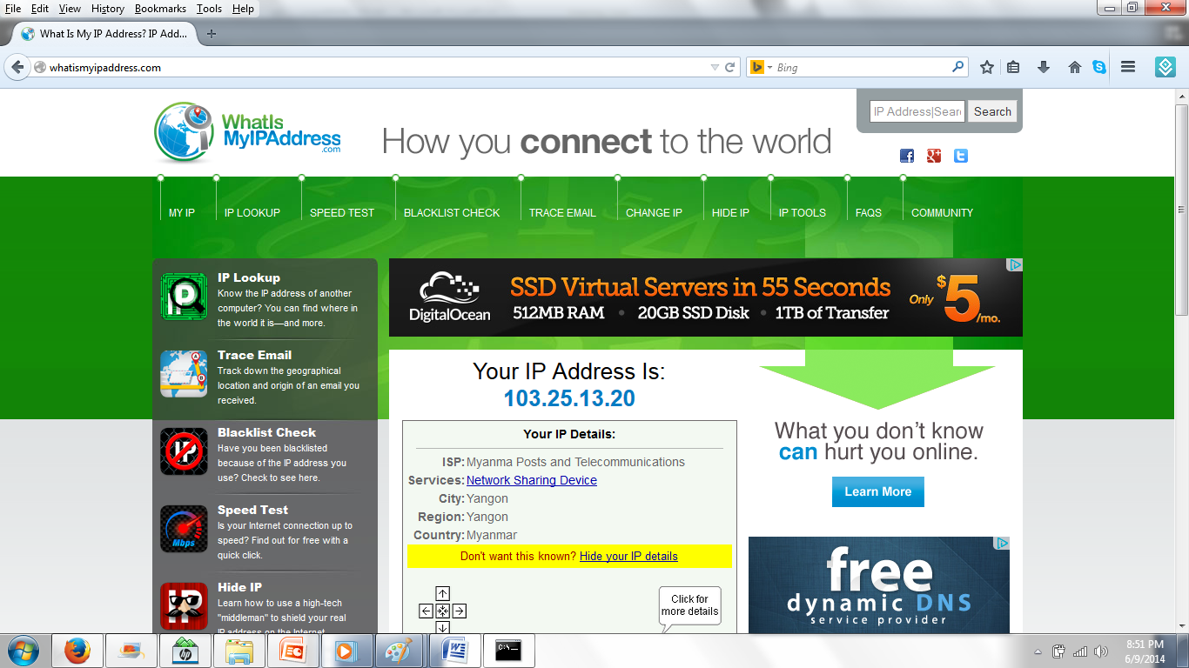
What is My IP Address

Slide 29
Port : 0 to 65535
A port is identified for each address and protocol by a 16-bit number, commonly known as the port number. The port number, added to a computer's IP address, completes the destination address for a communications session.
The port numbers are divided into three ranges: the well-known ports, the registered ports, and the dynamic or private ports.
The well-known ports (also known as system ports): from 0 through 1023. The registered ports : from 1024 through 49151. IANA maintains the official list of both ranges. The dynamic or private ports :from 49152 through 65535.
e.g., Firefox 9879, Chrome 7668, Antivirus 6556
  Web Server:80
Notes:
Well-known ports are numbered 0 through 1023, and include 25 for SMTP (Simple Mail Transfer Protocol), 80 for HTTP (HyperText Transport Protocol), and 107 for Remote TELNET Service.

Slide 30
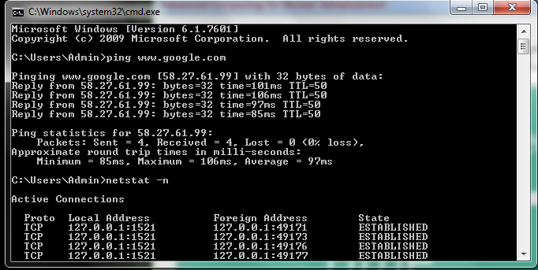
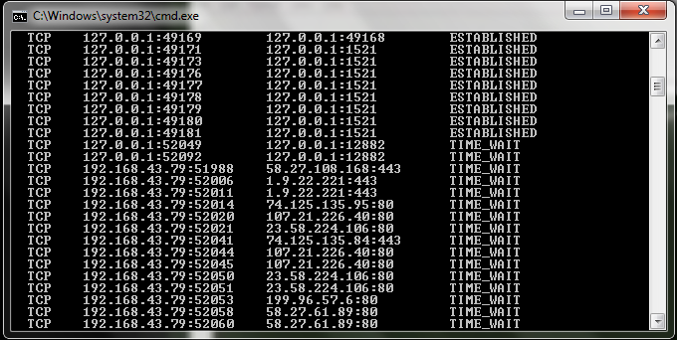
Notes:
The network statistics ( netstat ) command is a networking tool used for troubleshooting and configuration, that can also serve as a monitoring tool for connections over the network

Slide 31
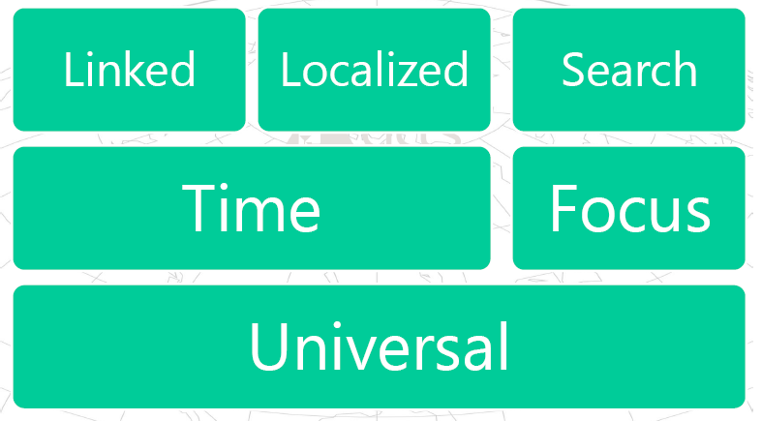
Advantages of www

Slide 32
Advantages of www
People are using the Web to get the news, weather forecasts, cooking recipes, medical diagnoses, book reviews and the like.
Universality: The Web is universal, and available anywhere in the World where people have access to it.
Time: With radio, newspapers and TV, the delay is hours to a day. With Web and mobile phones, people are reporting on (e.g., through twitter, crowd-sourcing, etc) and reading about as the events occur, and get pictures and information almost instantaneously.
Focus: The Web, by connecting people, enables those with shared interests to exchange their resources independently of their respective locations.
Notes:
Localization: Media such as newspapers, radio and TV report information relevant to a
relatively large geographical region: a district, a country, etc. It is more difficult to find
localized information, at the community level.

Slide 33
Advantages of www
Search: On the Web, search engines, as well as easier access to guides and reviews, facilitate the quest for information.
Localization: With the Web, a village, independent of its size, and any community (even one that is separated geographically) can share information relevant to their members and citizens wherever Web access is possible.
Linking: On the Web, links allow people to move easily from one Web page to related information elsewhere on the same page, on the same site or one a different site half‐way around the world.
Notes:
Universality: Radio, TV, and newspapers usually cover a relatively large geographic area,
and they are typically available only to people living in that area. It is difficult for people
outside of the area to access those media. This allows people today to, for example, book a
hotel and prepare vacations on the other side of the planet.
Focus: Localization and scope of media mentioned above concerned geographical aspects.
This is also true for thematic aspects. There are today millions of communities specialized on
specific themes (languages, hobby, nature,…). While there are thematic radio, newspaper,
TV, and magazines, their diffusion is geographically limited, while these communities are
spread over the Web.
Search: Mechanisms such as libraries, guides, reviews and word‐of‐mouth, can help people
to find information they seek in traditional media. The volume of
information on the Web and the ability to assess the quality of information are issues
requiring further work.
Linking: A person can change channels on the radio or TV, or pickup one newspaper and
then move to another. The emergence of the Semantic Web promises to extend this
capability to linking data and ascribing greater meaning to data and relationships across the
Web.

Slide 34
Thank you!

