Slide 1
Session 2.2 HTML 5 Text Elements

Slide 2
Contents
Necessary Elements in HTML5
What is required attributes
Text Elements
Heading Elements
Paragraph Elements
Formatting Elements
Links in HTML
Creating a Website

Slide 3
Necessary Elements in HTML5
HTML
Head
Meta
Title
Body

Slide 4
HTML
HTML
Browser/Platform Independent
Not Case Sensitive
<FONT>, <Font> and <font> are all equivalent.
Different from other Programming Languages
So, it has no variable, function.
Comments in HTML
<!-- This is a comment -->

Slide 5
HEAD
Enclosed in <HEAD> </HEAD> tag
The following tags can be added to the head section:
<base>, <link>, <meta>, <script>, <style>, and <title>.
Tags that can go in the document head
<title>Indicates the title of the document that is used as the window caption. It is only valid in the head section.
<title> Title Sample! </title>
<base> specifies the absolute URL address
<link> specifies the relationship between the current document and other documents.
<meta> element can be used to specify name/value pairs describing various properties of the document
Notes:
The <link> tag defines the relationship between a document and an external resource.
The <base> tag specifies a default address or a default target for all links on a page.
The <link> tag defines the relationship between a document and an external resource.
Metadata is information about data.
The <meta> tag provides metadata about the HTML document. Metadata will not be displayed on the page, but will be machine parsable.
Meta elements are typically used to specify page description, keywords, author of the document, last modified, and other metadata.
<BASE> element specifies an absolute URL address that is used to provide server and directory information for partially specified URL address called relative address.
e.g: <BASE HREF ="http://www.inf.com/file.html“>
Specifies the base URL of the document. This is used when dereferencing relative URLs in the page.
<META> element uses name value pairs to provide meta information about the document. It often provides descriptive information that is targeted by search engines.
Eg: .
To have your page automatically reloaded every X seconds <META HTTP-EQUIV="REFRESH" CONTENT=X >
To have a different page automatically loaded after X seconds <META HTTP-EQUIV="REFRESH" CONTENT="X; URL= http://address/file.html">
To specify an expiration date for the page so that it will be reloaded after a certain date.
<META HTTP-EQUIV="Expires" CONTENT="Mon, 23 Sep 2001 01:21:00 GMT">
To specify keywords for certain search services to use. <META HTTP-EQUIV="Keywords" CONTENT="keyword1, keyword2, ...">
To specify a description of your page for certain search services to use
<META HTTP-EQUIV="Description" CONTENT="Describe your site here....“
<LINK> element is used in linking style which will be discussed in later chapters.

Slide 6
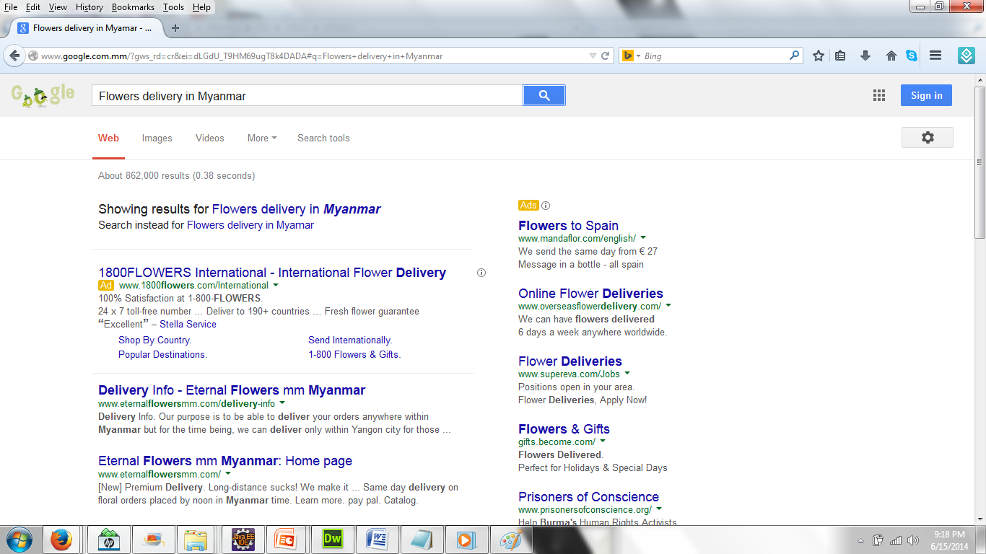
Understand Google Search Engine
Advertisement
Description

Slide 7

Understand Google Search Engine
title tag of the page
url or domain name of the page
Description of the page in Meta Element of Meta Element

Slide 8
Title of Web Page
Title of web page:
Primary Keyword | Secondary Keyword - Name of Web site
Word Length: 11 words
Characters:70
Description at least 2 lines (each web site)
characters 100 or 120 words in Description

Slide 9
<base> element in HTML
A base element must have either an href attribute, a target attribute, or both.
The href content attribute, if specified, must contain a valid URL potentially surrounded by spaces.
<head>
<title>This is an example for the &lt;base&gt; element</title>
<base href="http://www.example.com/news/index.html">
</head>
<body>
<p>Visit the <a href="archives.html">archives</a></p>
</body>

Slide 10
Creating of Meta Element
<title>Web Programming tutorial | Free Web Courses - Web Programmers</title>
<meta name="description" content="This website provides free training on Web programming along with live examples. Click to view the tutorials.">
<meta name="keywords" content="Web Programming tutorial, Free Web Courses">
<meta name="author" content="John Doe">
(Test with www.validator.w3.org)

Slide 11
Required Attributes
Form element requires ACTION
Img element requires ALT
Textarea element requires COLS
Meta element requires CONTENT
And so on….

Slide 12
BODY
Enclosed in <body> </body> tag.
Some important attributes of the BODY tag
bgcolor = “color” / “#rrggbb”
bgproperties=fixed
background= “url of the image”
text = “color” / “#rrggbb”
leftalign = n
topmargin= n
bottommargin=n
leftmargin=n
rightmargin=n
link = “color” / “#rrggbb”
alink = “color” / “#rrggbb”
vlink = “color” / “#rrggbb”
Notes:
http://www.w3schools.com/TAGS/ref_colornames.asp
http://www.utexas.edu/learn/html/colors.html
http://www.w3schools.com/html/html_colornames.asp
http://www.tizag.com/htmlT/htmlcolorcodes.php

Slide 13
BODY Attributes
background=x.jpg Eg.<body background=“bg_star1.gif”>
Specifies an image to be tiled as background.
bgcolor= color Eg. <body bgcolor=“Blue”>
Specifies the background color
bgproperties=fixed
Fixes the background image so that it doesn't scroll.
rightmargin/leftmargin= n
Specifies the left/right margin for the entire page
text= color
Specifies the color of text in the page
topmargin/bottommargin=n
Specifies the top /bottom margin for the entire page

Slide 14
TEXT elements in HTML5
Text elements in HTML5 are:
a, abbr, address, center, code, del, ins
em, strong, p, pre, span, sub, sup, q etc…..
Heading Elements
The hgroup element represents a group of headings.
H1,h2, h3, …..,h6
H1: Heading Level 1
H2: Heading Level 2
H3: Heading Level 3
H4…H6

Slide 15
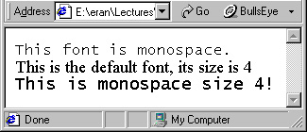
Text Formatting- Examples
For example:
<FONT FACE="monospace">This font is
monospace.</FONT><BR>
<FONT SIZE="+1">This is the default font, its size is 4</FONT><BR>
<FONT SIZE="4" FACE="monospace">This is monospace size 4!</FONT><BR>

Slide 16
Paragraph Elements
<p>: paragraph element changes paragraph automatically
blank <p> element is neglected
<span> is a small part of a paragraph
<abbr>: used to denote abbreviated text
<ins> and <del> : used to demote correction in web page
<em> and <strong> is for making text italic and bold.
Notes:
Lorem50 (enter)

Slide 17
Paragraph Elements(Contd..)
<pre> is for writing pre-formatted text
<sub> & <sup> for subscript and superscript text.
<center> is used for center aligning elements inside it.
<q> is used to mark up quotations is entirely optional;

Slide 18
p element
Paragraphs
<P> </P> - used to create new paragraphs.
Main attributes:
ID - Labels the element with a unique identifier.
ALIGN - Aligns the paragraph content to the left, right or center or justified. The default is left alignment.
Line Breaks
<BR> - to insert returns or blank lines in the document.
e.g. <P>This <BR> is a para<BR>graph with line breaks</P>
Notes:
The p element automatically creates some space before and after itself. The space is automatically applied by the browser, or you can specify it in a style sheet.
Line breaks in HTML code are interpreted by browsers as spaces.
Tags such as <P> <DIV> and <BR> enable us to force new lines.
Paragraphs
Unlike documents in most word processors, HTML document ignore multiple spaces, tabs and carriage returns. Word wrapping can happen any time in your source file and multiple spaces are collated into a single space. To preserve some text formatting we use the <p> tag which created paragraphs. Normally the browser places a blank line before the paragraph
<BR> is an empty tag used when you want to end a line, but don't want to start a new paragraph. The <BR> tag forces a line break wherever you place it.
e.g. : <P>This <BR> is a para<BR>graph with line breaks</P>
<P> tag has a ALIGN attribute which aligns the paragraph to LEFT, RIGHT, CENTER or JUSTIFY (justified)
Horizontal rules
The <HR> tag draws a horizontal line across the page. It is useful to separate different sections of a single page.
Some attributes are
SIZE - Set’s the line thickness
WIDTH - Set’s the width of the of the line
ALIGN - sets the alignment to LEFT,RIGHT or CENTER.
NOSHADE – renders the bar without surrounding shadow.

Slide 19
pre element
<PRE> Tag
Different than other text formatting tags.
Does not ignore spaces.
Can display data in tabular format using <PRE> </PRE> tag.
Too much cumbersome if frequent changes are required.
Example: <HTML>
<BODY>
<PRE> Let's make a marksheet Sr. Student ID CHSSC PF RDBMS 1 1234 A B C 2 5645 B C A 3 6837 C B B 4 9874 D C C
</PRE>
</BODY>
</HTML>
Notes:
The <pre> tag defines preformatted text.
Text in a pre element is displayed in a fixed-width font (usually Courier), and it preserves both spaces and line breaks.
Did you see that the output looks identical to the HTML source?? However, it is not
advisable to use the PRE tag for various reasons.
Example: <HTML>
<BODY>
<PRE> Let's make a marksheet Sr. Student ID CHSSC PF RDBMS 1 1234 A B C 2 5645 B C A 3 6837 C B B 4 9874 D C C
</PRE>
</BODY>
</HTML>

Slide 20
span element
<span> Tag
The <span> tag defines a division or a section in an HTML document.
The HTML code for a paragraph demonstrating use of the STYLE
attribute along with the SPAN element.
Main attributes:
ID - Specifies a unique id for an element.
Class - Specifies a classname for an element
Style (inline style)- Specifies an inline style for an element
Notes:
In standard HTML, a div is a block-level element whereas a span is an inline element. The div block visually isolates a section of a document on the page, in the same way as a paragraph. The span element contains a piece of information inline with the surrounding text. In practice, even this feature can be changed by the use of Cascading Style Sheets (CSS).
The primary difference between the <span> and <div> tags is that <span> doesn't do any formatting of it's own.
The <div> tag acts includes a paragraph break, because it is defining a logical division in the document.
The <span> tag simply tells the browser to apply the style rules to whatever is within the <span>.
But without any style attributes, the <span> tag won't change the enclosed items at all.
You can add a background image to your text.
<SPAN STYLE="background-image: url(plainbgrnd.jpg)">You can add a background image to your text.</SPAN>
<p style="color: #0000FF; font-size: 12pt">This is a paragraph with a defined style</p> <p>And this is another text without style.</p>
<a title="HTMLQuick.com" href="http://www.htmlquick.com">HTML code</a>
<p lang="en">This is a paragraph in english.</p> <p lang="es">Este es un p&aacute;rrafo en espa&ntilde;ol.</p>

Slide 21
Formatting Elements in HTML
Tag | Description
<b> | Defines bold text
<em> | Defines emphasized text
<i> | Defines a part of text in an alternate voice or mood
<small> | Defines important text
<strong> | Defines important text
<sub> | Defines subscripted text
<sup> | Defines superscripted text
<ins> | Defines inserted text
<del> | Defines deleted text
<mark> | Defines marked/highlighted text
Notes:
mark –use in HTML 5

Slide 22
Formatting- Headlines
Header Tags
HTML has six level of headings, numbered 1 through 6, with 1 being the largest.
Displayed in larger and bolder fonts.
HTML automatically adds an extra blank line before and after a heading
The font size of the heading will go on decreasing from H1 to H6.
For example: <BODY>
This is normal size text.
<hgroup>
<H1>This is the largest headline. </H1>
<H3>This is the size of headline H3</H3>
<H5>While this is H5</H5>
</hgroup>
</BODY>
Notes:
Headings
HTML has six levels of headings, numbered 1 through 6, with 1 being the largest.
Headings are typically displayed in larger and/or bolder fonts than normal body text.
The first heading in each document should be tagged <H1>. The syntax of the heading
element is: <Hy>Text of heading </Hy> where y is a number between 1 and
specifying the level of the heading.
HTML automatically adds an extra blank line before and after a heading
Eg:
<HTML>
<HEAD>
<TITLE>Header tag demo</TITLE>
</HEAD>
<BODY>
<H1>Welcome to My Home Page !</H1>
<H2>Welcome to My Home Page !</H2>
<H3>Welcome to My Home Page !</H3>
<H4>Welcome to My Home Page !</H4>
<H5>Welcome to My Home Page !</H5>
<H6>Welcome to My Home Page !</H6>
</BODY>
</HTML>

Slide 23
Void elements in HTML
A void element is an element whose content model never allows it to have contents under any circumstances.
Void elements can have attributes.
Void elements only have a start tag; end tags must not be specified for void elements.
area
base
br
col
command
embed
hr
img
input
keygen
link
meta
param
source
track
wbr

Slide 24
Links in HTML
<a> = anchor element
Important Attributes = href, titile, target
Significance: Linking multiple web pages or
websites: Also SEO significance
Internal and External Links
Notes:
SEO- search engine optimization

Slide 25
Links in HTML
Internal Links
E.g.,<a href="#image">Go to Image</a>
<a href="aboutus.html">About Us</a>
<a name="image">
<center><img src="images/icon.png"></center> </a>
External Links
<a href="index.html">Go to Home</a>
<a href="https://www.google.co.in" target="_blank" title="You will open Google">Go to Google</a>

Slide 26
Links in HTML
The body tag allows for the specification of colors to mark links within a page.
LINK – specifies the default color of unvisited links in a document.
VLINK – Specifies the color of the visited links in a document.
ALINK – specifies the color of an active link in a document (a link is activated when it is clicked).
For example: <BODY LINK="BLUE" ALINK="CYAN“ VLINK="YELLOW">
In this example, links will be colored blue. When they are clicked they will change to cyan, from that point on (once they have been clicked), they will be colored yellow.
Value | Description
color_name | Specifies the link color with a color name (like "red")
hex_number | redSpecifies the link color with a hex code (like "#ff0000")
rgb_number | Specifies the link color with an rgb code (like "rgb(255,0,0)")
Notes:
RGB stands for Red, Green, Blue. Each can have a value from 0 (none of that color) to 255 (fully that color). The format for RGB is - rgb(RED, GREEN, BLUE), just like the name implies.
bgcolor="rgb(255,255,255)" White
bgcolor="rgb(255,0,0)" Red
bgcolor="rgb(0,255,0)" Green
bgcolor="rgb(0,0,255)" Blue
Bgcolor=“rgb(0,0,0)” Black
The alink attribute specifies the color of an active link in a document (a link is activated when it is clicked).

Slide 27
Creating a Website
Multiple HTML pages are linked together to create a website.
<a> element is used to link pages.
Demo

Slide 28
Attributes with <a> element in HTML5
href = URL potentially surrounded by spaces
A URL that provides the destination of the hyperlink. If the href attribute is not specified, the element represents a placeholder hyperlink.
target = browsing-context name or keyword
Any string that is either of the following:
a browsing-context name
any case-insensitive match for one of the following literal strings: "_blank", "_self",
"_parent", or "_top".
Default target is "_self".
Notes:
The target attribute specifies where to open the linked document.
The target attribute can have one of the following values:
_self - Default. Opens the document in the same window/tab as it was clicked
_blank - Opens the document in a new window or tab
_parent - Opens the document in the parent frame
_top - Opens the document in the full body of the window
Example

Slide 29
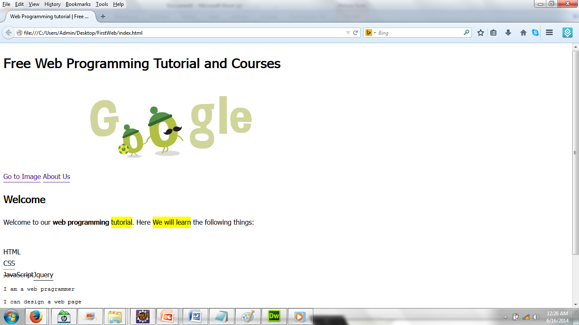
Creating a Website

Slide 30
Thank you!

