Slide 1
Session 2.3 Forms, Box Elements & Media in HTML 5

Slide 2
Contents
Form Elements
Creating a Signup and Login Form
Box Elements
Style Element and Styling of a page
New Elements introduced in version 5
Media Elements in HTML 5

Slide 3
Forms
Set of fields that can record information
To interact with the client
FORM by itself really cannot do anything
Forms become powerful when connected to a server application
A single HTML page can have multiple forms.
Can be designed using <FORM></FORM> tag
The form is constructed from the input elements defined within its tags. All values from these input elements are sent at the time the form is submitted.
Notes:
A form is an area that can contain form elements.
Form elements allow the user to enter information (like text fields, textarea fields, drop-down menus, radio buttons, checkboxes, etc.) in a form.
Forms become a powerful tool when connected to a server application. When the clicks on the submit button the web browser transmits all the information in the fields to the Common Gateway Interface or CGI script.
The <FORM> tag must have a corresponding </FORM> ending tag.
The form is constructed from the input elements defined within its tags. All values from these input elements are sent at the time the form is submitted.
FORM’s main attributes are as follows:

Slide 4
Form elements in HTML
<form> is used to take user input
action attribute is required
Collects information from user and sends to server for processing.

Slide 5
Form Elements Cont’d….
Tags | Description
<form> | Defines an HTML form for user input
<input> | Defines an input control
<textarea> | Defines an multiline input control (text area)
<button> | Defines a clickable button
<select> | Defines a drop-down list
<optgroup> | Defines a group of related options in a drop-down list
<option> | Defines an option in a drop-down list
<label> | Defines a label for an <input> element
<fieldset> | Groups related elements in a form
<legend> | Defines a caption for a <fieldset> element

Slide 6
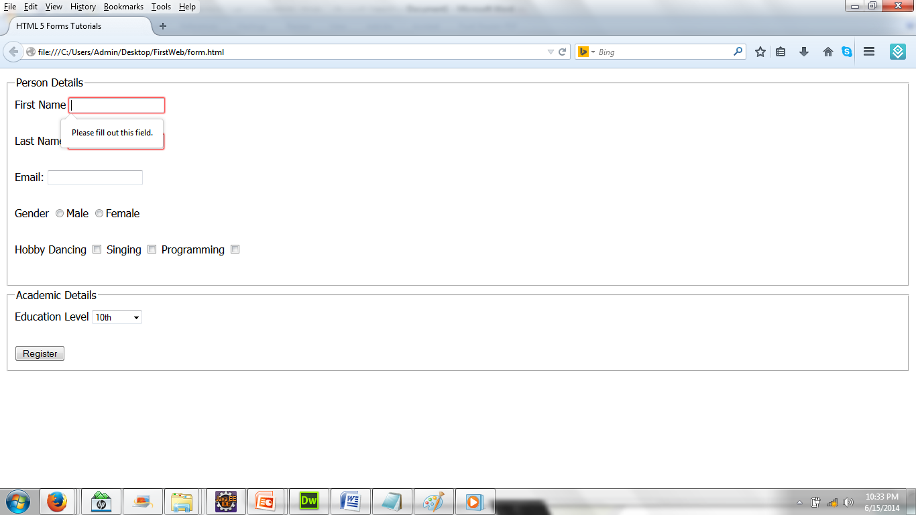
Creating a Signup and Login Form
Demo

Slide 7
<input> element
The <input> element is empty, it contains attributes only.
<input> tag attributes are:
type
name
value
size
maxlength
src
align
placeholder
autocomplete
autofocus
checked
disable
form
form action
form method
form novalidate
pattern
readonly
required
width
height
multiple
List
etc…

Slide 8
<input> tag attributes
label:
The <label> tag defines a label for an <input> element.
type:
The type attribute specifies the type of <input> element to display.
The default type is: text.
type=text|password|checkbox|radio|submit|reset|file|hidden|image|
button
Eg, <form>
<label>First Name</label> <input type=“text”>
</form>

Slide 9
<input> tag attributes
value:
The value attribute specifies the value of an <input> element.
For "button", "reset", and "submit" - it defines the text on the button.
For "text", "password", and "hidden" - it defines the initial (default) value of the input field.
For "checkbox", "radio", "image" - it defines the value associated with the input (this is also the value that is sent on submit)

Slide 10
<input> tag attributes
name:
The name attribute specifies the name of a form.
The name attribute is used to reference elements in a JavaScript, or to reference form data after a form is submitted.
Example; <input type=“checkbox” name=“ch1”>
<input type=“radio” name=“rad1”>
The value attribute cannot be used with <input type="file">

Slide 11
<input> tag attributes
size:
This attribute tells the user agent the initial width of the control.
The width is given in pixels except when type attribute has the value "text" or "password". In that case, its value refers to the (integer) number of characters.
maxlength:
When the type attribute has the value "text" or "password", this attribute specifies the maximum number of characters the user may enter.
src:
When the type attribute has the value "image", this attribute specifies the location of the image to be used to decorate the graphical submit button.

Slide 12
<input> tag attribute ‘type’
Text Fields
<input type="text"> defines a one-line input field that a user can enter text into:
Eg:<form>
First name: <input type="text" name="firstname"><br>
Last name: <input type="text" name="lastname">
</form>
Password Field
<input type="password"> defines a password field:
Eg;<form>
Password: <input type="password" name="pwd">
</form>

Slide 13
<input> tag attribute ‘type’
Radio Buttons
<input type="radio"> defines a radio button. Radio buttons let a user select ONLY ONE of a limited number of choices:
Eg;<form>
<input type="radio" name="sex" value="male">Male<br>
<input type="radio" name="sex" value="female">Female
</form>
Checkboxes
<input type="checkbox"> defines a checkbox. Checkboxes let a user select ZERO or MORE options of a limited number of choices.
Eg;<form>
<input type="checkbox" name="vehicle" value="Bike">I have a bike<br>
<input type="checkbox" name="vehicle" value="Car">I have a car
</form>

Slide 14
<input> tag attribute ‘type’
Submit Button
<input type="submit"> defines a submit button.
A submit button is used to send form data to a server. The data is sent to the page specified in the form's action attribute. The file defined in the action attribute usually does something with the received input:
Eg;
<form name="input" action="html_form_action.html" method="get">
Username: <input type="text" name="user">
<input type="submit" value="Submit">
</form>

Slide 15
<textarea> tag attributes
The <textarea> tag defines a multi-line text input control.
A text area can hold an unlimited number of characters, and the text renders in a fixed-width font (usually Courier).
The size of a text area can be specified by the cols and rows attributes, or even better; through CSS' height and width properties.
Example,
<textarea rows="4" cols="50">
This is an html text.
</textarea>

Slide 16
<select> tag attribute in HTML
The <select> element is used to create a drop-down list.
The <option> tags inside the <select> element define the available options in the list.
The <select> element is a form control and can be used in a form to collect user input.
Example,
<select>
<option value="volvo">Volvo</option>
<option value="saab">Saab</option>
<option value="opel">Opel</option>
<option value="audi">Audi</option>
</select>

Slide 17
Newly Added <select> tag attributes in HTML 5
HTML5 has added some new attributes regarding <select> tag.
Attribute | Value | Description
Autofocus | autofocus | Specifies that the drop-down list should automatically get focus when the page loads
disabled | disabled | Specifies that a drop-down list should be disabled
form | form_id | Defines one or more forms the select field belongs to
multiple | multiple | Specifies that multiple options can be selected at once
name | name | Defines a name for the drop-down list
required | required | Specifies that the user is required to select a value before submitting the form
size | number | Defines the number of visible options in a drop-down list

Slide 18
<nav> tag introduced in HTML5
<nav> tag is newly introduced in HTML version 5.The <nav> tag defines a set of navigation links.
Not all links of a document must be in a <nav> element. The <nav> element is intended only for major block of navigation links.
Browsers, such as screen readers for disabled users, can use this element to determine whether to omit the initial rendering of this content.

Slide 19
<legend> tag in HTML
The <legend> element represents a caption for the rest of the contents of the legend element's parent <fieldset> element.
Example,
<fieldset name="userinfo">
<legend>User information</legend>
<label for="name">Name</label>
<input type="text" name="name" id="name" size="40">
<label for="address">Address</label>
<input type="text" name="address" id="address" size="40">
<label for="phone">Phone</label>
<input type="text" name="phone" id="phone" size="40">
</fieldset>
Notes:
White space =&nbsp; or &#160

Slide 20
Creating a box layout
Using <div>, <article>, <sections>, <header> and <footer>
Styling and positioning of boxes
Demo
Notes:
A <footer> element typically contains:
authorship information
copyright information
contact information
sitemap
back to top links
related documents

Slide 21
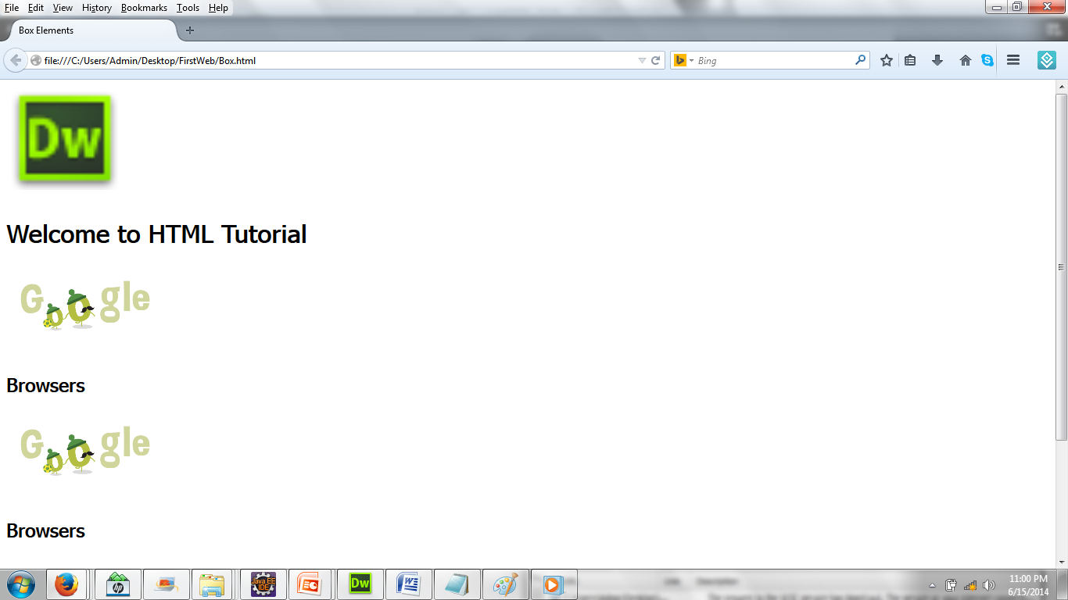
Box Elements in HTML 5 (header, section, article)

Slide 22
div element
<div> Tag
The <div> tag defines a division or a section in an HTML document.
The <div> tag is often used to group block-elements to format them with styles.
Main attributes:
id - Specifies a unique id for an element.
align - Aligns the paragraph content to the left, right or center. The default is left alignment.
class - Specifies a classname for an element
style (inline style) - Specifies an inline style for an element
Notes:
The <div> tag defines a division or a section in an HTML document.
The <div> tag is often used to group block-elements to format them with styles.
Line breaks in HTML code are interpreted by browsers as spaces.
Tags such as <P> <DIV> and <BR> enable us to force new lines.
Paragraphs
Unlike documents in most word processors, HTML document ignore multiple spaces, tabs and carriage returns. Word wrapping can happen any time in your source file and multiple spaces are collated into a single space. To preserve some text formatting we use the <p> tag which created paragraphs. Normally the browser places a blank line before the paragraph
<BR> is an empty tag used when you want to end a line, but don't want to start a new paragraph. The <BR> tag forces a line break wherever you place it.
e.g. : <P>This <BR> is a para<BR>graph with line breaks</P>
<P> tag has a ALIGN attribute which aligns the paragraph to LEFT, RIGHT, CENTER or JUSTIFY (justified)
Horizontal rules
The <HR> tag draws a horizontal line across the page. It is useful to separate different sections of a single page.
Some attributes are
SIZE - Set’s the line thickness
WIDTH - Set’s the width of the of the line
ALIGN - sets the alignment to LEFT,RIGHT or CENTER.
NOSHADE – renders the bar without surrounding shadow.

Slide 23
hr element
Horizontal Lines
<hr> - used to draw a horizontal line across the web page.
Main Attributes:
size - set’s the line thickness (in pixels or percent).
width - set’s the width of the of the line
align - sets the alignment to left, right or center.
noshade - renders the bar without surrounding shadow .
Turns line into 2D rule instead of 3D rule.
Notes:
In HTML, the <hr> tag has no end tag.
In XHTML, the <hr> tag must be properly closed, like this: <hr />.
<HR> - Results in a horizontal line (rule, being drawn across the screen).
Main attributes:
SIZE - Indicates the line’s thickness.
May be measured in pixels or percent.
WIDTH - Indicates line’s length. May be measured in pixels or percent.
ALIGN - Indicates the way a line will be aligned within a document. May be: left, right or center.
NOSHADE - Turns line into 2D rule instead of 3D rule.
For example:
<HR SIZE="3" WIDTH="250" ALIGN="LEFT" NOSHADE>

Slide 24
Style Elements
Inline styles and embedded styles
Basic Style properties
Styling page using box elements

Slide 25
Style Elements
<style type="text/css">
article
{ float:left;
margin-left:20px;
background-color:#9C0;
text-align:center;
border:solid #333;
}
</style>

Slide 26
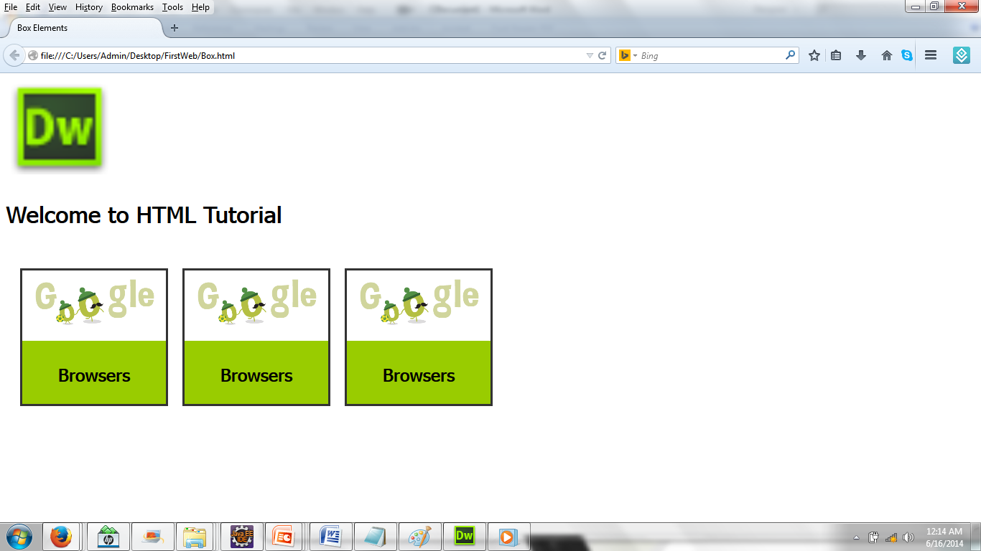
Use Style Elements

Slide 27
New Elements in HTML
Audio/ Video Elements
Navigation
Section wise elements
Canvas and figure
Mark, progress and meter

Slide 28
Audio element
The <audio> tag is supported in Internet Explorer 9+, Firefox, Opera, Chrome and Safari.
Currently, there are 3 supported file formats for the <audio> element: MP3, Wav and Ogg

Slide 29
Audio element
<section id="music">
<article id="clip">
<audio src="Kalimba.mp3" controls></audio>
</article>
</section>
<section id="music1">
<audio controls>
<source src="Kalimba.mp3" type="audio/mpeg">
Your browser does not support the audio element
</audio>
</section>

Slide 30
Video Element
The <video> tag is supported in Internet Explorer 9+, Firefox, Opera, Chrome and Safari.
Currently, there are 3 supported video formats for the <video> element: MP4, WebM and Ogg.

Slide 31
Video element
<section id="video">
<video width="320" height="240" src=“video.mp4" controls>
</video>
</section>

Slide 32
Nav element
The <nav> tag defines a set of navigation links.
The <nav> tag is new in HTML 5.

Slide 33
Nav element
<style type="text/css">
nav{
background-color:#36F;
color:white;
}
a{color:white;
};
</style>
<nav>
<a href="/html/">HTML</a>
<a href="/css/">CSS</a>
<a href="/js/">Java Script</a>
<a href="/jquery/">JQuery</a>
</nav>

Slide 34
Header element
The <header> tag specifies a header for a document or section.
The <header> element should be used as a container for introductory content or set of navigational links.
A <header> element typically contains:
one or more heading elements (<h1> - <h6>)
logo or icon
authorship information

Slide 35
Header element
<header>
<img src="images/icon.png" width="150" alt="Web Programming | Tutorial">
<h1>Welcome to HTML Tutorial</h1>
</header>

Slide 36
Footer element
The <footer> tag defines a footer for a document or section.
A <footer> element should contain information about its containing element.
A footer typically contains the author of the document, copyright information, links to terms of use, contact information, etc.

Slide 37
section and article
The <section> tag defines sections in a document such as chapters, headers, footers or any other sections of the document.
<article> element is used for:
Forum post
Blog post
News story
Comment

Slide 38
section and article
<section id="itemlist">
<article id="item">
<img width="200" src="images/banner_image.gif" alt="">
<h2>Browsers</h2>
</article>
<article id="item">
<img width="200" src="images/banner_image.gif" alt="">
<h2>Browsers</h2>
</article>
<article id="item">
<img width="200" src="images/banner_image.gif" alt="">
<h2>Browsers</h2>
</article>
</section>

Slide 39
canvas
The <canvas> tag is used to draw graphics, on the fly, via scripting (usually JavaScript).
Internet Explorer 9, Firefox, Opera, Chrome, and Safari support <canvas> and its properties and methods.
However, the <canvas> element has no drawing abilities of its own (it is only a container for graphics) - you must use a script to actually draw the graphics.
Attribute | Value | Description
width | pixels | Specifies the height of the canvas
height | pixels | Specifies the width of the canvas

Slide 40
<!DOCTYPE html>
<html>
<body>
<h1>HTML5 Canvas</h1>
<canvas id="myCanvas" width="300" height="150" style="border:1px solid grey"></canvas>
</body>
</html>

Slide 41
mark, progress and meter
The <mark> tag defines marked/ highlighted text.
The <progress> tag represents the progress of a task. Javascript is used to display progress.
The <meter> tag defines a scalar measurement within a known range, or a fractional value. This is also known as a gauge.

Slide 42
progress and meter
<progress value="50" max="100"></progress>
<br>
<meter value="2" min="0" max="10"> 2 out of 10</meter>
</meter>

Slide 43

HTML 5 Compatibility
Internet Explorer 9+, Firefox, Opera, Chrome, and Safari latest versions
www.html5test.com
Browser support

Slide 44
New elements in HTML5
New <canvas> Element
Tag | Description
<canvas> | Used to draw graphics, on the fly, via scripting (usually JavaScript)
New Media Elements
Tag | Description
<audio> | Defines sound content
<video> | Defines a video or movie
<source> | Defines multiple media resources for <video> and <audio>
<embed> | Defines a container for an external application or interactive content (a plug-in)
<track> | Defines text tracks for <video> and <audio>

Slide 45
New elements in HTML5
New Form Elements
Tag | Description
<datalist> | Specifies a list of pre-defined options for input controls
<keygen> | Defines a key-pair generator field (for forms)
<output> | Defines the result of a calculation
New Semantic/Structural Element
Tag | Description
<article> | Defines an article
<aside> | Defines content aside from the page content
<bdi> | Isolates a part of text that might be formatted in a different direction from other text outside it
<command> | Defines a command button that a user can invoke
<details> | Defines additional details that the user can view or hide

Slide 46
New elements in HTML5
New Semantic/Structural Element
Tag | Description
<dialog> | Defines a dialog box or window
<summary> | Defines a visible heading for a <details> element
<figure> | Specifies self-contained content, like illustrations, diagrams, photos, code listings, etc.
<figcaption> | Defines a caption for a <figure> element
<footer> | Defines a footer for a document or section
<header> | Defines a header for a document or section
<mark> | Defines marked/highlighted text
<meter> | Defines a scalar measurement within a known range (a gauge)
<nav> | Defines navigation links
<progress> | Represents the progress of a task

Slide 47
New elements in HTML5
New Semantic/Structural Element
Tag | Description
<ruby> | Defines a ruby annotation (for East Asian typography)
<rt> | Defines an explanation/pronunciation of characters (for East Asian typography)
<rp> | Defines what to show in browsers that do not support ruby annotations
<section> | Defines a section in a document
<time> | Defines a date/time
<wbr> | Defines a possible line-break

Slide 48
Deprecated elements in HTML5
Tags (Elements) | Description
<acronym> | Defines an acronym
<applet> | Defines an applet
<basefont> | Defines an base font for the page.
<big> | Defines big text
<center> | Defines centered text
<dir> | Defines a directory list
<font> | Defines text font, size, and color
<frame> | Defines a frame
<frameset> | Defines a set of frames
<isindex> | Defines a single-line input field
<noframes> | Defines a noframe section
<s> | Defines strikethrough text
<strike> | Defines strikethrough text
<tt> | Defines teletype text
<u> | Defines underlined text

Slide 49
Thank you!

