Slide 1
Session 2.4 HTML 5 Table – Lists – Image & Form Elements

Slide 2
Contents
Tables in HTML 5
Table Based Layout
Lists in HTML
Creating Menu Using Lists
Image Element in HTML
Creating an Image Map

Slide 3
Tables in HTML 5
Tags | Description
<table> | Defines a table
<caption> | Defines a table caption
<th> | Defines a header cell in a table
<tr> | Defines a row in a table
<td> | Defines a cell in table
<thead> | Groups the header content in a table
<tbody> | Groups the body content in a table
<tfoot> | Groups the footer content in a table
<col> | Specifies column properties for each column within a <colgroup> element
<colgroup> | Specifies a group of one or more columns in a table for formatting

Slide 4
Table Importance
Most significant element
Used for layout of web page
Display different data based content
Forms are designed using table

Slide 5
Table Based Layout
Demo of designing a table based page
Demo of designing an HTML Email

Slide 6
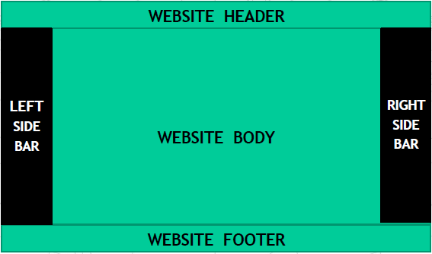
Table Based Layout Structure

Slide 7
Lists in HTML
Tags | Description
<ul> | Defines an unordered list
<ol> | Defines an ordered list
<li> | Defines a list item

Slide 8
Creating Site Menu
HTML 5 has got new mechanism for navigation
But lists are traditional way to create menu
Demo

Slide 9
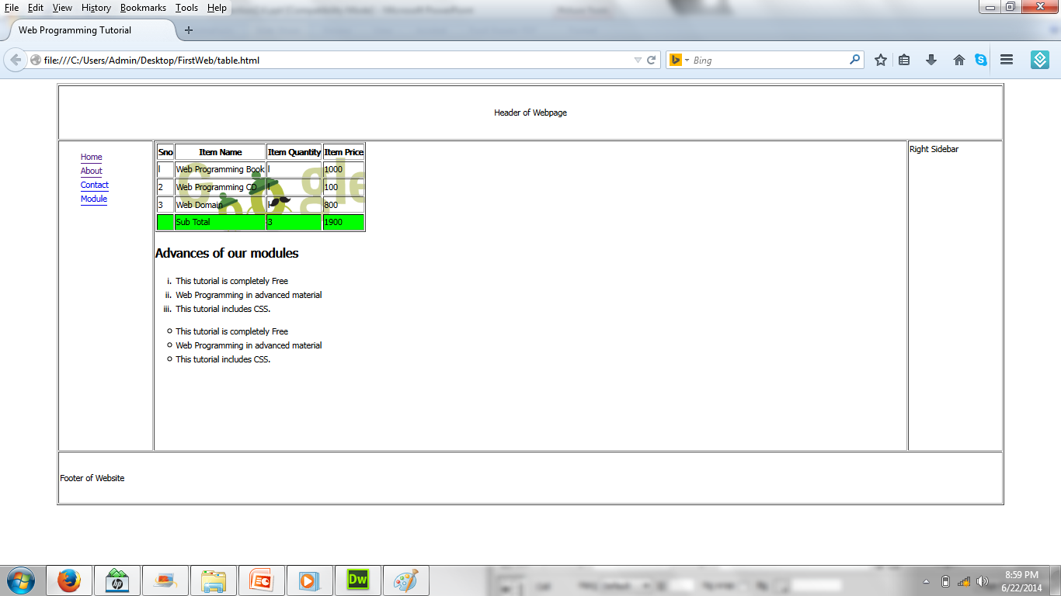
Creating Site Menu

Slide 10
The Image Element
<img> element is used for images
src and alt are required attributes
SEO significance
Image optimization is necessary
Demo

Slide 11
The Image Element
<td>
<a href="images/image.gif" target="_blank">
<img src="images/image.gif" width="200">
</a>
</td>

Slide 12
Image map in HTML
Image map is used for plotting coordinates on image
Creative websites use image map
https://www.imagemap.org
https://www. image-map.net
http://www.maschek.hu/imagemap

Slide 13
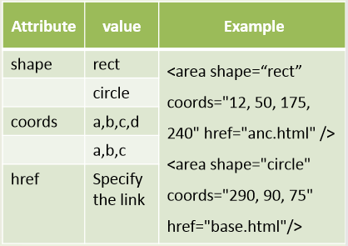
1. Multiple links can be set up in one image by the use of image map function
<img src=“image file name” usemap=“#name of the map”
alt=“….” width=“…” height=“…”>
2. <map>…</map> used for setting link in the map.
<map name=“name of the map” >
<area ………. >
</map>

Slide 14
<!DOCTYPE html>
<html> <head>…</head>
<body>
<img src="workplace.jpg" alt="Workplace" usemap="#workmap" width="400" height="379">
<map name="workmap">
<area shape="rect" coords="34,44,270,350" alt="Computer" href="computer.html">
<area shape="rect" coords="290,172,333,250" alt="Phone" href="phone.html">
<area shape="circle" coords="337,300,44" alt=“Coffee" href="coffee.html">
</map>
</body>
</html>
Computer.html
<html> <body>
<img src=“computer.jpg” height=“200” width=“500” alt=“Computer”>
</body> </html>
phone.html
<html> <body>
<img src=“phone.jpg” height=“200” width=“500” alt=“Phone”>
</body> </html>
coffee.html
<html> <body>
<img src=“coffee.jpg” height=“200” width=“500” alt=“Coffee”>
</body> </html>

Slide 15
Image map in HTML
<img usemap="#browser" src="images/browser.jpg">
<map id="browser" name="browser">
<area shape="circle" alt="Opera" title="" coords="113,42,39" href="http://www.opera.com" target="" />
<area shape="circle" alt="Mozila" title="" coords="178,101,36" href="http://www.mozila.com" target="_blank" />
<area shape="circle" alt="Google" title="" coords="45,104,36" href="http://www.google.com" target="_blank" />
<area shape="circle" alt="Safari" title="" coords="69,186,35" href="http://www.safari.com" target="_blank" />
<area shape="circle" alt="Safari" title="" coords="153,182,41" href="http://safari.com" target="_blank" />
<!-- Created by Online Image Map Editor (http://www.maschek.hu/imagemap/index) -->
</map>

Slide 16
Thank you!

