Slide 1
Session 5.2 Creating CSS for XML, JavaScript for XML and XSLT
Notes:
This talk introduces the JavaScript language.
© Netskills, University of Newcastle
Copyright in the whole and every part of this Courseware whether in the form of a written manual,document, software program, service or otherwise belongs to the University of Newcastle upon Tyne ("the Owner") and may not be used, sold, licensed, transferred, copied or reproduced in whole or in part in any manner or form or in or on any media to any person other than in accordance with the terms of the Owner's Licence Agreement or otherwise without the prior written consent of the Owner.
All use of this material is governed by the Owner's Standard Licence Agreement together with the appropriate Schedule. The following are available:
A Standard Licence Schedule to cover all use including all for-profit use by any type of organisation and all use by non-educational establishments
An Educational Licence Schedule for not-for-profit internal use only by a recognised educational establishment
The Netskills logo and this copyright notice must be included in any copy or adaptation.
Netskills is a trademark of Netskills, University of Newcastle

Slide 2
Contents
Creating CSS for XML
JavaScript for XML
Introduction to XSLT
XSLT Elements

Slide 3
Creating CSS for XML
/* bookstore.xml */
<?xml version="1.0" encoding="utf-8"?>
<?xml-stylesheet href="bookstore.css" type="text/css"?>
<bookstore name="ABC BOOK Junction">
<!--This is my store-->
<book><!--This is a book-->
<isbn>ISBN473268742</isbn>
<title>The Woad Raider</title>
<author>John Doe</author>
<year>1989</year>
</book>
</bookstore>

Slide 4
Creating CSS for XML
@charset "utf-8";
/* bookstore.css */
bookstore
{background-color:#4b09e6;
}
book
{display:block;
margin-bottom:30pt;
margin-left:0;
background-color:rgb(7, 241, 113);
height:50pt;
width: 25%;
}

Slide 5
AJAX
By Using AJAX, we can do that
Update a web page without reloading the page
Request data from a server - after the page has loaded
Receive data from a server - after the page has loaded
Send data to a server - in the background

Slide 6
JavaScript for XML
What is AJAX?
AJAX = Asynchronous JavaScript And XML.
AJAX is not a programming language.
AJAX just uses a combination of:
A browser built-in XMLHttpRequest object (to request data from a web server)
JavaScript and HTML DOM (to display or use the data)
AJAX is not a programming language.
AJAX is a technique for accessing web servers from a web page.
AJAX stands for Asynchronous JavaScript And XML.

Slide 7
Creating XMLHttpRequest object
Syntax:
xmlhttp=new XMLHttpRequest();
The XMLHttpRequest object can be used to exchange data with a server behind the scenes.
This means that it is possible to update parts of a web page, without reloading the whole page.

Slide 8
XMLHttpRequest Object Methods
Method | Description
new XMLHttpRequest() | Creates a new XMLHttpRequest object
abort() | Cancels the current request
getAllResponseHeaders() | Returns header information
getResponseHeader() | Returns specific header information
open(method,url,async,user,psw) | method: the request type GET or POST url: the file location async: true (asynchronous) or false (synchronous) user: optional user name psw: optional password
send() | Sends the request to the server Used for GET requests
send(string) | Sends the request to the server. Used for POST requests
setRequestHeader() | Adds a label/value pair to the header to be sent

Slide 9
XMLHttpRequest Object Properties
Property | Description
onreadystatechange | Defines a function to be called when the readyState property changes
readyState | Holds the status of the XMLHttpRequest. 0: request not initialized 1: server connection established 2: request received 3: processing request 4: request finished and response is ready
responseText | Returns the response data as a string
responseXML | Returns the response data as XML data
status | Returns the status-number of a request 200: "OK" 403: "Forbidden" 404: "Not Found"
statusText | Returns the status-text (e.g. "OK" or "Not Found")

Slide 10
Display XML Data in HTML Page
<!DOCTYPE html> <!- - CDexample.html- ->
<html>
<style>
table,th,td {
border : 2px solid rgb(127, 77, 185);
border-collapse: separate;
background: lightsalmon;
}
th,td {
padding: 5px;
}
</style>
<body>
<h1>The XMLHttpRequest Object</h1>
<button type="button" onclick="loadDoc()">Get CD collection </button><br><br> <table id="demo"></table>

Slide 11
<script>
function loadDoc() {
var xhttp = new XMLHttpRequest();
xhttp.onreadystatechange = function() {
if (this.readyState == 4 && this.status == 200) {
myFunction(this);
}
};
xhttp.open("GET", "cd_catalog.xml", true);
xhttp.send();
}

Slide 12
function myFunction(xml) {
var i;
var xmlDoc = xml.responseXML;
var table="<tr><th>Artist</th><th>Title</th></tr>";
var x = xmlDoc.getElementsByTagName("CD");
for (i = 0; i <x.length; i++) {
table += "<tr><td>" +
x[i].getElementsByTagName("ARTIST")[0].childNodes[0].nodeValue + "</td><td>" +
x[i].getElementsByTagName("TITLE")[0].childNodes[0].nodeValue +
"</td></tr>";
}
document.getElementById("demo").innerHTML = table;
}
</script></body></html>

Slide 13
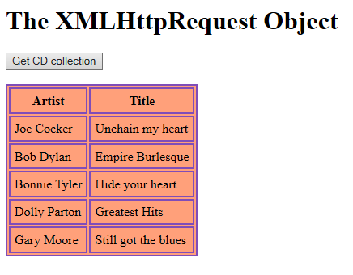
<!- -CDexample.xml- ->
<CATALOG>
<CD> <!--1 CD-->
<TITLE>Unchain my heart </TITLE>
<ARTIST>Joe Cocker</ARTIST>
<COUNTRY>USA</COUNTRY>
<COMPANY>EMI</COMPANY>
<PRICE>8.20</PRICE>
<YEAR>1987</YEAR>
</CD>
<CD> <!--2 CD-->
<TITLE>Empire Burlesque </TITLE>
<ARTIST>Bob Dylan</ARTIST>
<COUNTRY>USA</COUNTRY>
<COMPANY>Columbia</COMPANY>
<PRICE>10.90</PRICE>
<YEAR>1985</YEAR>
</CD>
</CATALOG>

Slide 14
Extracting info from XML to HTML (note.html)
<!doctype html>
<html>
<body>
<h1>W3Schools Internal Note</h1>
<div>
<b>To:</b> <span id="to"></span><br>
<b>From:</b> <span id="from"></span><br>
<b>Message:</b> <span id="message"></span>
</div>

Slide 15
<script>
if (window.XMLHttpRequest)
{// code for IE7+, Firefox, Chrome, Opera, Safari
xmlhttp=new XMLHttpRequest();
}
else
{// code for IE6, IE5
xmlhttp=new ActiveXObject("Microsoft.XMLHTTP");
}
xmlhttp.open("GET","note.xml",false);
xmlhttp.send();
xmlDoc=xmlhttp.responseXML;

Slide 16
document.getElementById("to").innerHTML=
xmlDoc.getElementsByTagName("to")[0].childNodes[0].nodeValue;
document.getElementById("from").innerHTML=
xmlDoc.getElementsByTagName("from")[0].childNodes[0].nodeValue;
document.getElementById("message").innerHTML=
xmlDoc.getElementsByTagName("body")[0].childNodes[0].nodeValue;
</script>
</body>
</html>

Slide 17
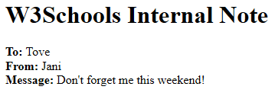
XML File (note.xml)
<?xml version="1.0" encoding="UTF-8"?>
<!-- Edited by XMLSpy -->
<note>
<to>Tove</to>
<from>Jani</from>
<heading>Reminder</heading>
<body>Don't forget me this weekend!</body>
</note>

Slide 18
What is XSLT?
XSLT stands for eXtensible StyleSheet Language Transformations.
XSLT is the most important part of XSL.
XSLT transforms an XML document into another XML document.
XSLT can be used to transform XML into HTML, before it is displayed by a browser:
XSLT uses XPath to navigate in XML documents.
XSLT is the recommended style sheet language of XML.
XSLT is a W3C Recommendation.

Slide 19
CSS = HTML Style Sheets
HTML uses predefined tags and the meaning of the tags are well understood.
The <table> element in HTML defines a table - and a browser knows how to display it.
Adding styles to HTML elements is simple. Telling a browser to display an element in a special font or color, is easy with CSS.

Slide 20
XSL = XML Style Sheets
XML does not use predefined tags and the meaning of these tags are not well understood.
A <table> element could mean an HTML table, a piece of furniture, or something else - and a browser does not know how to display it.
XSL describes how the XML document should be displayed!

Slide 21
XSL > Style Sheet Language
XSL consists of three parts:
XSLT - a language for transforming XML documents
XPath - a language for navigating in XML documents
XSL-FO - a language for formatting XML documents

Slide 22
XSLT = XSL Transformations
XSLT is the most important part of XSL.
transforms an XML document into another XML document, or another type of document that is recognized by a browser, like HTML and XHTML.
Normally XSLT does this by transforming each XML element into an (X)HTML element.
Uses of XSLT
Restructuring xml document
Presenting xml content

Slide 23
Using XSLT
can add/remove elements and attributes to or from the output file.
can also rearrange and sort elements, perform tests and make decisions about which elements to hide and display, and a lot more.
A common way to describe the transformation process is to say that XSLT transforms an XML source-tree into an XML result-tree.

Slide 24
XSLT - Transformation
Correct Style Sheet Declaration
The root element that declares the document to be an XSL style sheet is
<xsl:stylesheet version="1.0" xmlns:xsl="http://www.w3.org/1999/XSL/Transform">
(or)
<xsl:transform version="1.0" xmlns:xsl="http://www.w3.org/1999/XSL/Transform">
Notes:
Version and ns is mandatory

Slide 25
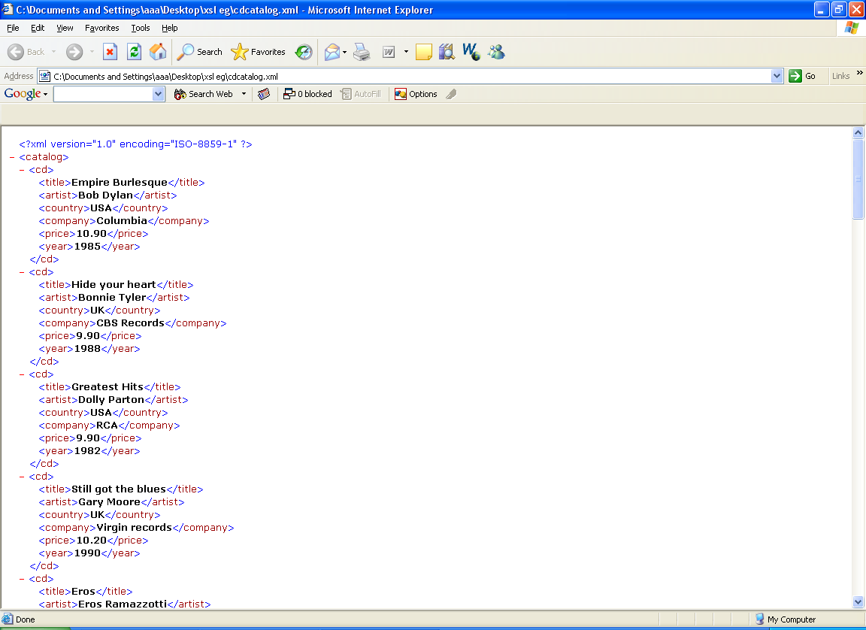
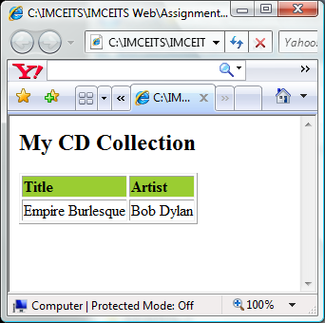
Create an XSL Style Sheet
<xsl:stylesheet version="1.0"
xmlns:xsl="http://www.w3.org/1999/XSL/Transform">
<xsl:template match="/">
<html> <body>
<h2>My CD Collection</h2>
<table border="1">
<tr bgcolor="#9acd32">
<th align="left">Title</th>
<th align="left">Artist</th>
</tr>
<tr>
<td><xsl:value-of select="catalog/cd/title"/></td>
<td><xsl:value-of select="catalog/cd/artist"/></td>
</tr>
</table> </body> </html>
</xsl:template> </xsl:stylesheet>

Slide 26
Link the XSL to the XML Document
<?xml version="1.0" encoding="ISO-8859-1"?>
<?xml-stylesheet type="text/xsl" href="cdcatalog.xsl"?>
<catalog>
<cd>
<title>Empire Burlesque</title>
<artist>Bob Dylan</artist>
<country>USA</country>
<company>Columbia</company>
<price>10.90</price>
<year>1985</year>
</cd>
</catalog>

Slide 27
XSLT <xsl:template> Element
An XSL style sheet consists of one or more set of rules that are called templates.
A template contains rules to apply when a specified node is matched.
The <xsl:template> element is used to build templates.
The match attribute is used to associate a template with an XML element.
The value of the match attribute is an XPath expression (i.e. match="/" defines the whole document).
Root element
<xsl:template match="/"> …. </xsl:template>
<xsl:template match=“catalog/cd"> …. </xsl:template>
cd element

Slide 28
XSLT <xsl:apply-templates> Element
The <xsl:apply-templates> element applies a template to the current element or to the current element's child nodes.
If we add a select attribute to the <xsl:apply-templates> element it will process only the child element that matches the value of the attribute.

Slide 29
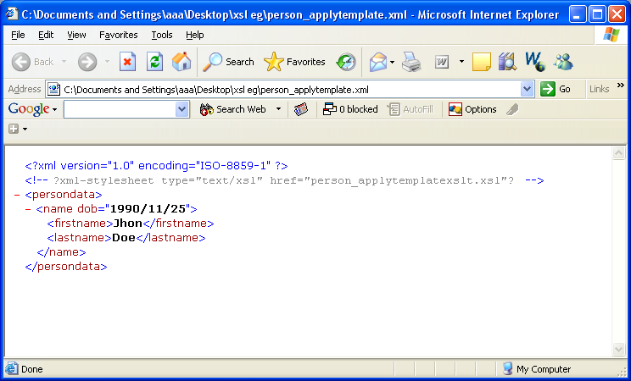
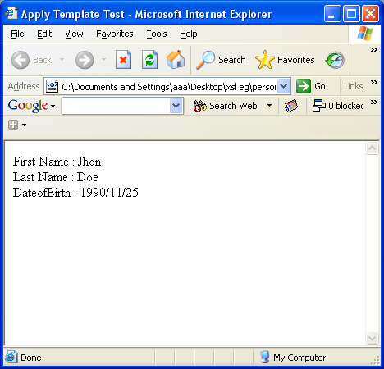
<xsl:apply-templates> Example
<?xml version="1.0" ?>
<xsl:stylesheet xmlns:xsl="http://www.w3.org/1999/XSL/Transform" version="1.0">
<xsl:template match="/">
<html> <head> </head>
<body>
<xsl:apply-templates select="/persondata/name"/>
</body>
</html></xsl:template>
<xsl:template match="/persondata/name">
<p> First Name : <xsl:value-of select="firstname" /> <br/>
Last Name : <xsl:value-of select="lastname" /> <br/>
DateofBirth : <xsl:value-of select="@dob" />
</p>
</xsl:template>
</xsl:stylesheet>

Slide 30
<xsl:apply-templates> Example
<?xml version="1.0" encoding="ISO-8859-1"?>
<xsl:stylesheet version="1.0"
xmlns:xsl="http://www.w3.org/1999/XSL/Transform">
<xsl:template match="/">
<html>
<body>
<h2>My CD Collection</h2>
<xsl:apply-templates/>
</body>
</html>
</xsl:template>

Slide 31
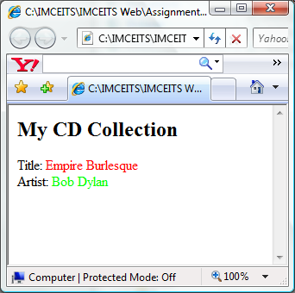
<xsl:apply-templates> Example
<xsl:template match="cd">
<p> <xsl:apply-templates select="title"/>
<xsl:apply-templates select="artist"/>
</p>
</xsl:template>
<xsl:template match="title">
Title: <span style="color:#ff0000">
<xsl:value-of select="."/></span> <br />
</xsl:template>
<xsl:template match="artist">
Artist: <span style="color:#00ff00">
<xsl:value-of select="."/></span><br />
</xsl:template> </xsl:stylesheet>

Slide 32
XSLT <xsl:value-of> Element
used to extract the value of an XML element and add it to the output stream of the transformation.
Has a mandatory attribute “select”.
The value of the select attribute is an XPath expression.
<xsl:value-of select=“person/firstname" />// return element text content
<xsl:value-of select=“." />// return current context node element
<xsl:value-of select="@dob" /> // return attribute value
<xsl:value-of select=“count(/persondata/person)" />
// return number of person elements
Note: if there is more than one node (element), value-of element uses the value of the first node in the document.

Slide 33
XSLT <xsl:if> Element
To put a conditional if test against the content of the XML file, add an <xsl:if> element to the XSL document.
<xsl:if> element tests whether a boolean condition is true or false. If it is true, content of xsl:if is instantiated.
Syntax
<xsl:if test="expression">
...some output if the expression is true... ...
</xsl:if>

Slide 34
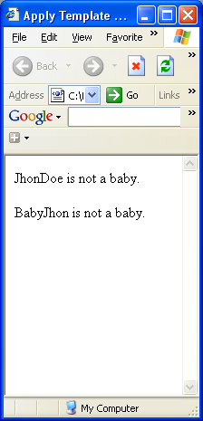
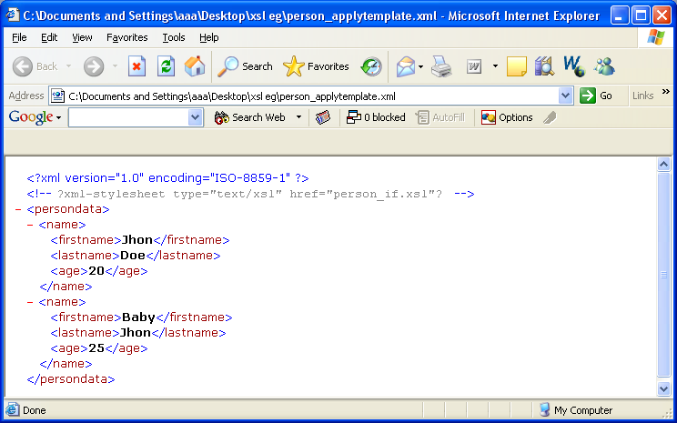
<xsl:if> Example
<?xml version="1.0" ?>
<xsl:stylesheet xmlns:xsl=http://www.w3.org/1999/XSL/Transform>
<xsl:template match="/">
<html>
<head><title>Apply Template Test</title></head>
<body>
<xsl:apply-templates select="/persondata/name"/>
</body>
</html></xsl:template>
<xsl:template match="/persondata/name">
<xsl:if test="age &gt; 5">
<p> <xsl:value-of select="firstname" />
<xsl:value-of select="lastname" />
is not a baby.
</p>
</xsl:if>
</xsl:template></xsl:stylesheet >

Slide 35
XSLT <xsl:choose> Element
xsl:if element either outputs something or output nothing, xsl:choose element intended to allow alternate output options.
The <xsl:choose> element is used in conjunction with <xsl:when> and <xsl:otherwise> to express multiple conditional tests.
xsl:choose element can have an arbitrary number or xsl:when elements as its child.
<xsl:choose>
<xsl:when test="expression">
... some output ...// if test is true, this part output
</xsl:when>
<xsl:otherwise>
... some output ....// if test is false, this part output
</xsl:otherwise>
</xsl:choose>

Slide 36

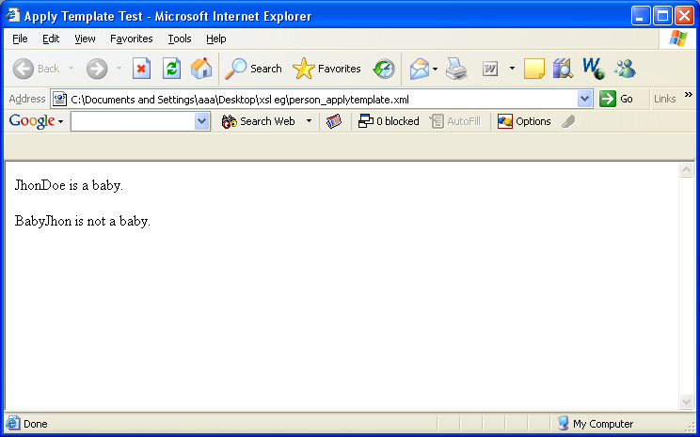
<xsl:choose> Example
<body>
<xsl:apply-templates select="/persondata/name"/>
</body>
</html></xsl:template>
<xsl:template match="/persondata/name">
<xsl:choose>
<xsl:when test="age &gt; 5">
<p><xsl:value-of select="firstname" />
<xsl:value-of select="lastname" /> is not a baby.
</p>
</xsl:when>
<xsl:otherwise>
<p><xsl:value-of select="firstname" />
<xsl:value-of select="lastname" /> is a baby.
</p>
</xsl:otherwise>
</xsl:choose>
</xsl:template>

Slide 37
XSLT <xsl:for-each> Element
The XSL <xsl:for-each> element can be used to select every XML element of a specified node-set.
xsl:for-each element can be used to iterate across the node-set and create some specified output for each node in the node-set.
<xsl:for-each select="catalog/cd">
<tr>
<td> <xsl:value-of select="title"/> </td>
<td> <xsl:value-of select="artist"/> </td>
</tr>
</xsl:for-each>
Notes:
Xsl:for-each element can be used to iterate across the node-set and create some specified output for each node in the node-set.

Slide 38
<xsl:for-each> Example
<?xml version="1.0" encoding="ISO-8859-1"?>
<xsl:stylesheet version="1.0“ xmlns:xsl="http://www.w3.org/1999/XSL/Transform">
<xsl:template match="/">
<html>
<body>
<h2>My CD Collection</h2>
<table border="1">
<tr bgcolor="#9acd32">
<th>Title</th>
<th>Artist</th>
</tr>

Slide 39
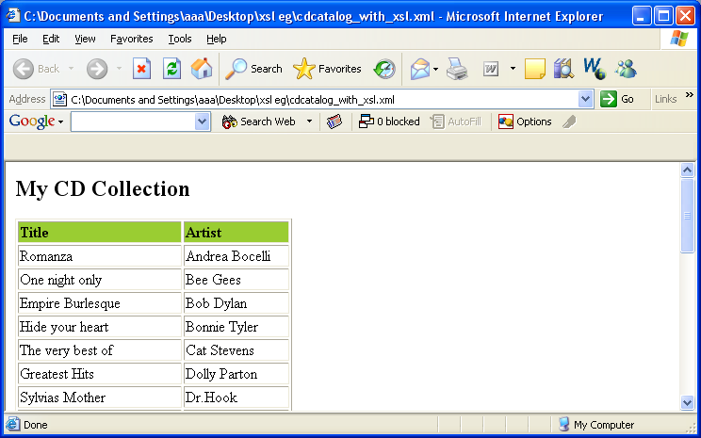
<xsl:for-each> Example
<xsl:for-each select="catalog/cd">
<tr>
<td><xsl:value-of select="title"/></td>
<td><xsl:value-of select="artist"/></td>
</tr>
</xsl:for-each>
</table>
</body>
</html>
</xsl:template>
</xsl:stylesheet>

Slide 40
Filtering the Output
By adding a criterion to the select attribute in the <xsl:for-each> element,
<xsl:for-each select="catalog/cd[artist='Bob Dylan']">
Legal filter operators are:
= (equal)
!= (not equal)
&lt; less than
&gt; greater than

Slide 41
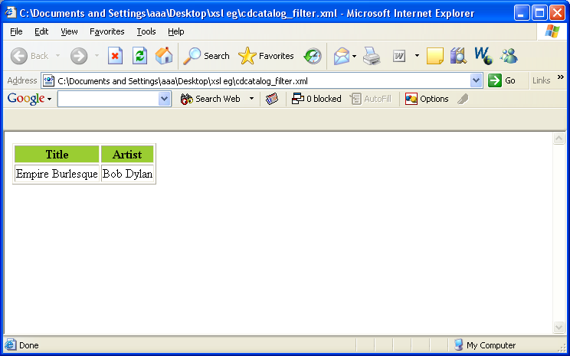
Filtering the Output
<xsl:template match="/">
<html> <body>
<table border="1">
<tr bgcolor="#9acd32">
<th>Title</th><th>Artist</th>
</tr>
<xsl:for-each select="catalog/cd[artist='Bob Dylan']">
<tr>
<td><xsl:value-of select="title"/></td>
<td><xsl:value-of select="artist"/></td>
</tr>
</xsl:for-each>
</table> </body> </html></xsl:template>

Slide 42
XSLT <xsl:sort> Element
To sort the output, simply add an <xsl:sort> element inside the <xsl:for-each> element in the XSL file:
Syntax
<xsl:for-each select="catalog/cd">
<xsl:sort select="artist"/>

Slide 43
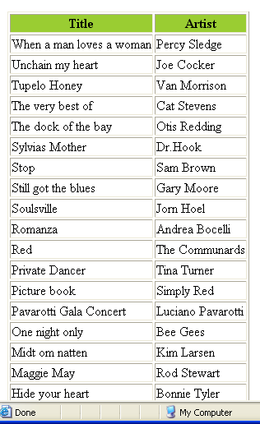
XSLT <xsl:sort> Element
<xsl:template match="/">
<html> <body> <table border="1">
<tr bgcolor="#9acd32">
<th>Title</th> <th>Artist</th>
</tr>
<xsl:for-each select="catalog/cd">
<xsl:sort select="title" order="descending"/>
<tr>
<td><xsl:value-of select="title"/></td>
<td><xsl:value-of select="artist"/></td>
</tr>
</xsl:for-each>
</table>
</body> </html></xsl:template>

Slide 44
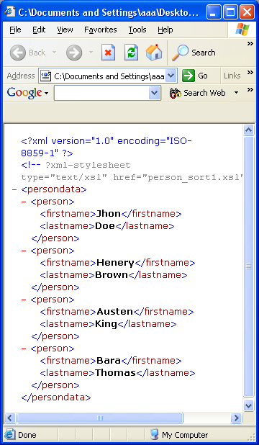
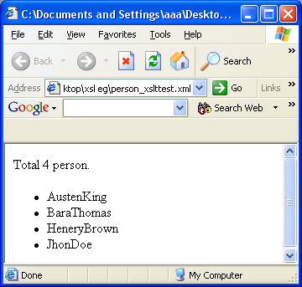
XSLT <xsl:sort> Element
<xsl:template match="/">
<html> <body>
Total <xsl:value-of select="count(persondata/person)"/> person.<br/>
<ul>
<xsl:for-each select="persondata/person">
<xsl:sort select="firstname" />
<li><xsl:value-of select="firstname"/>
<xsl:value-of select="lastname"/>
</li>
</xsl:for-each>
</ul>
</body>
</html></xsl:template>

Slide 45
Thank You!

