Slide 1
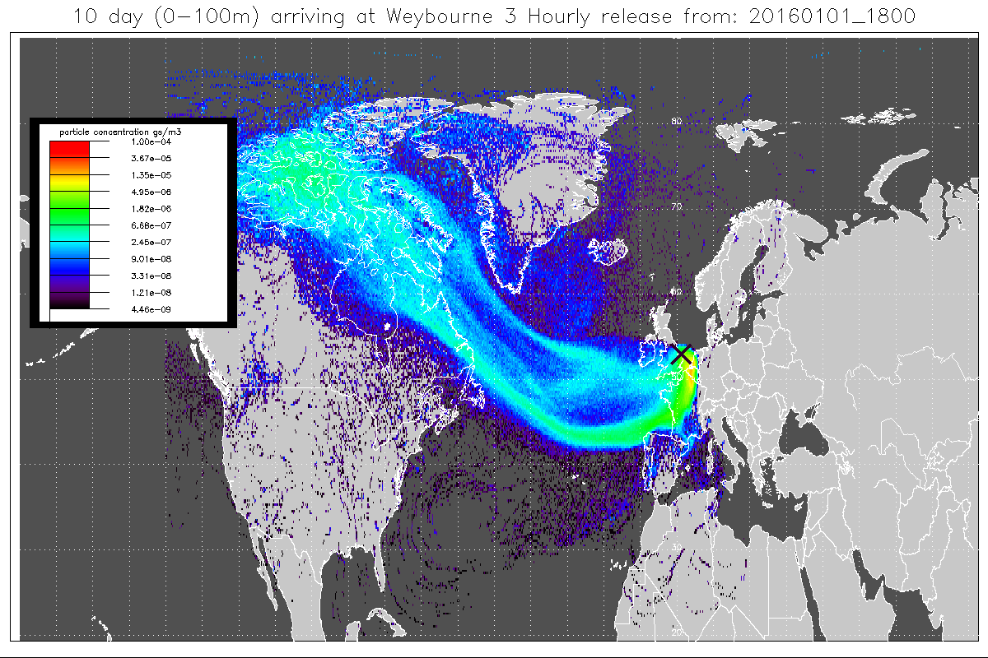
Using the NAME model to distinguish regional influences
Zoe Fleming, 24th January 2017

Slide 2
The NAME model
Run on STFC JASMIN computer
Output is air particle concentration at Latitude and longitude
I generally run a 10 day back release of particles from a station to see where the air has travelled in those last 10 days before arriving at the station
I do this every 3 hours so get a 10 day footprint at 00:00, 03:00,…., 21:00 (8 columns of particle counts per day and they get put in one output file per day)
This is the standard file that I want to use to pull out the regional influences

Slide 3
Regional analysis
From the 3 hourly NAME outputs, I want to see what % of the time the air spends in particular regions
I define the regions (with shape files or with grids) and then I get it to count how many air particles are in each region and divide that by the total to derive %s
The grid method is crude and I would prefer to define regions using country boundaries or geographical techniques (GIS)
I would like a method that could count particles in regions for any region in the world as long as I supply the regional divisions to the code
I would like this in Python so it is more adaptable

Slide 4
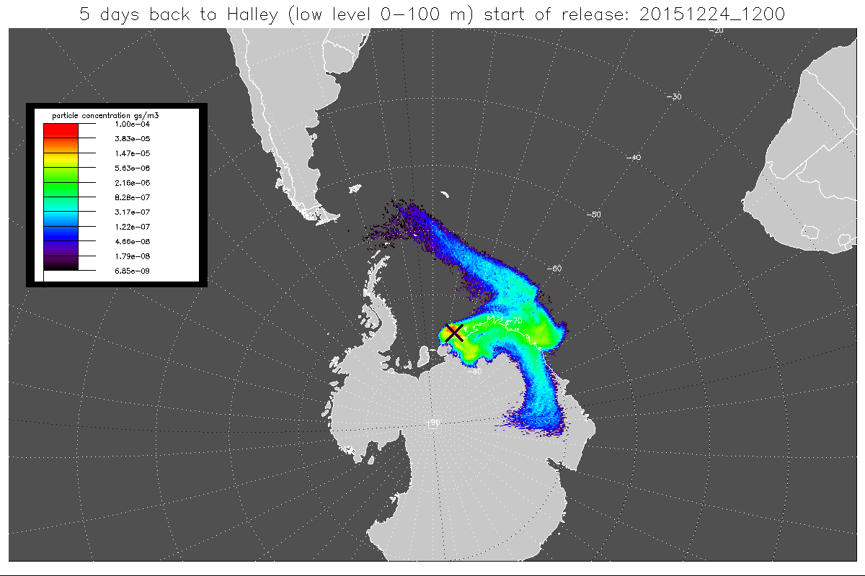
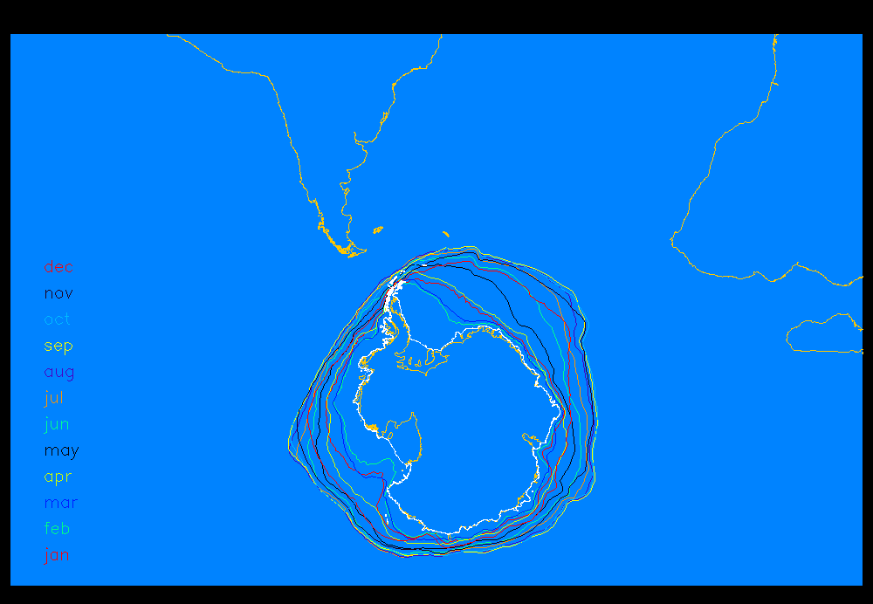
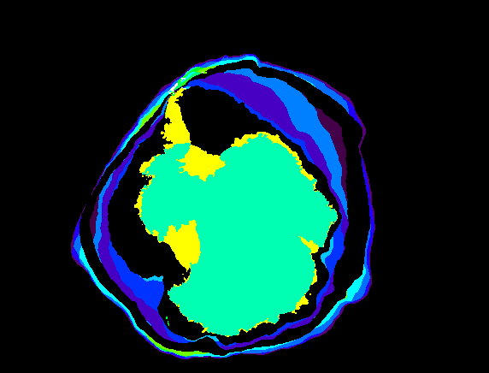
Antarctica- with shape files for monthly averaged sea ice extent
Shape files for monthly averaged sea ice extent
Shape files for:
Antarctic continent (the plateau)
winter sea ice and ice shelves
South Africa and South America
everything else is open Ocean

Slide 5
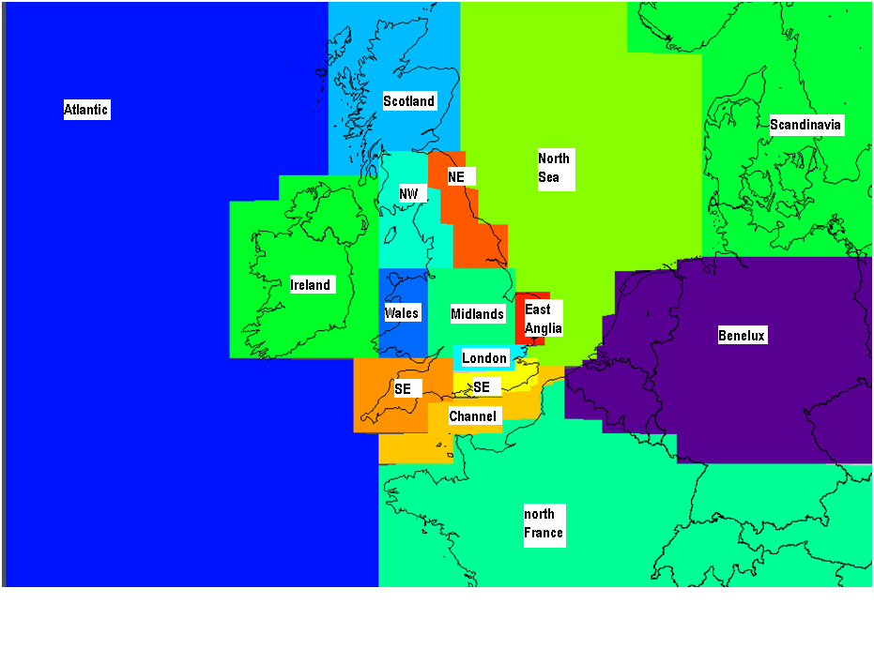
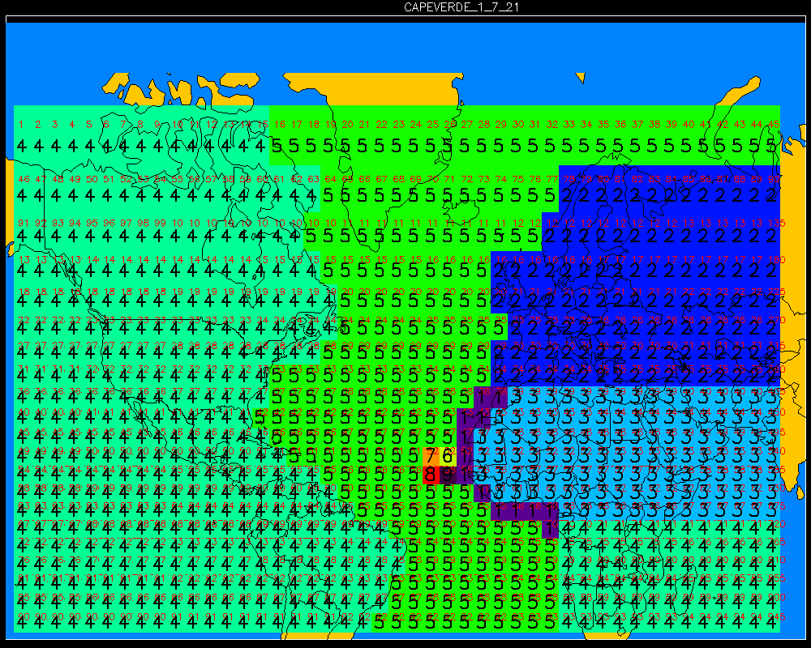
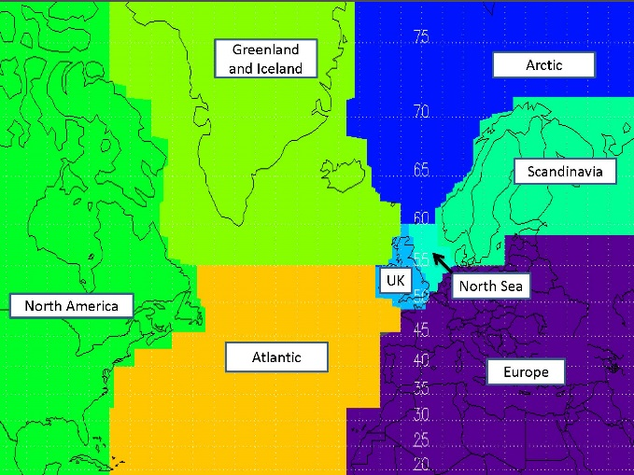
Cape Verde and Weyboure- code is linked to box numbers or specified grids

Slide 6
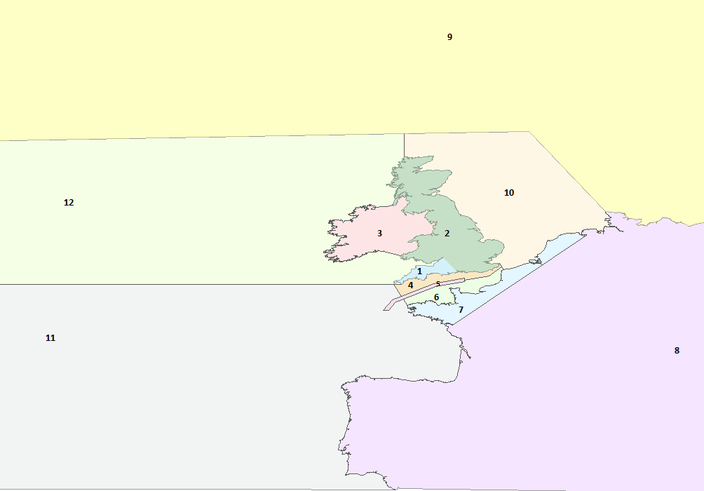
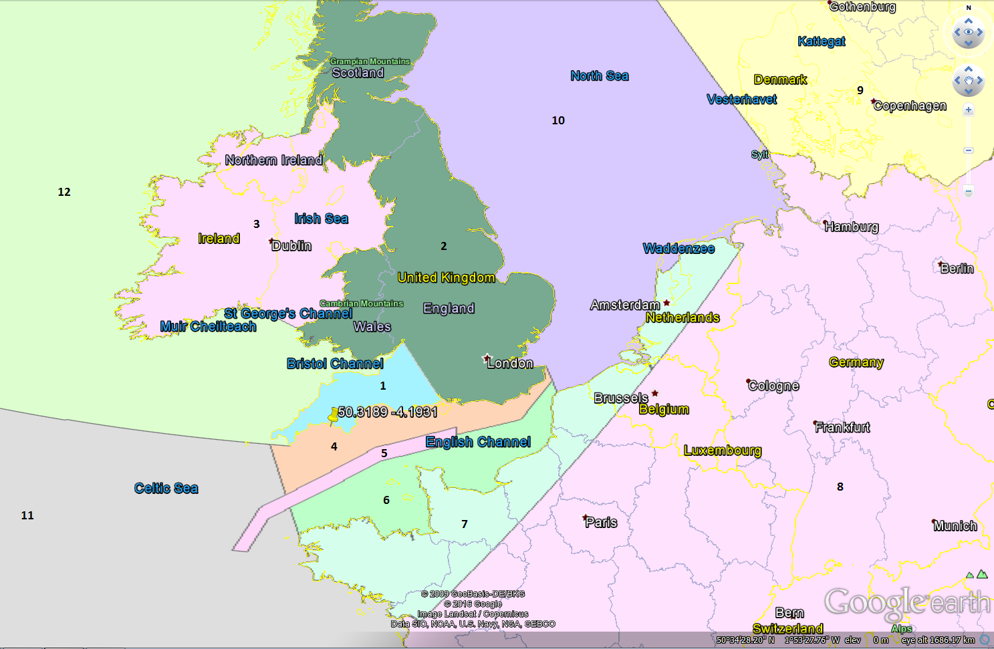
My PhD student, Marios has a regional division with shape files that he constructed in Arc GIS

