Slide 1
Chapter 2. End To End Machine Learning Project

Slide 2
Machine Learning Workflow
Look at the big picture.
Frame the Problem
Select a Performance Measure
Check the Assumptions
Get the data.
Create the Workspace
Download the Data
Take a Quick Look at the Data Structure
Create a Test Set
Discover and visualize the data to gain insights.
Visualizing Geographical Data
Looking for Correlations
Experimenting with Attribute Combinations
Prepare the data for Machine Learning algorithms.
Data Cleaning
Handling Text and Categorical Attributes
Custom Transformers
Feature Scaling
Transformation Pipelines
Select a model and train it.
Training and Evaluating on the Training Set
Better Evaluation Using Cross-Validation
Fine-tune your model.
Grid Search
Randomized Search
Ensemble Methods
Analyze the Best Models and Their Errors
Evaluate Your System on the Test Set
Present your solution.
Launch, monitor, and maintain your system.

Slide 3
Machine Learning Workflow
Look at the big picture.
Frame the Problem
Select a Performance Measure
Check the Assumptions
Get the data.
Create the Workspace
Download the Data
Take a Quick Look at the Data Structure
Create a Test Set
Discover and visualize the data to gain insights.
Visualizing Geographical Data
Looking for Correlations
Experimenting with Attribute Combinations
Prepare the data for Machine Learning algorithms.
Data Cleaning
Handling Text and Categorical Attributes
Custom Transformers
Feature Scaling
Transformation Pipelines
머신러닝 적용
문제 이해
Select a model and train it.
Training and Evaluating on the Training Set
Better Evaluation Using Cross-Validation
Fine-tune your model.
Grid Search
Randomized Search
Ensemble Methods
Analyze the Best Models and Their Errors
Evaluate Your System on the Test Set
Present your solution.
Launch, monitor, and maintain your system.
자료 준비

Slide 4
Machine Learning Workflow
Look at the big picture.
Frame the Problem
Select a Performance Measure
Check the Assumptions
Get the data.
Create the Workspace
Download the Data
Take a Quick Look at the Data Structure
Create a Test Set
Discover and visualize the data to gain insights.
Visualizing Geographical Data
Looking for Correlations
Experimenting with Attribute Combinations
Prepare the data for Machine Learning algorithms.
Data Cleaning
Handling Text and Categorical Attributes
Custom Transformers
Feature Scaling
Transformation Pipelines
머신러닝 적용
문제 이해
Select a model and train it.
Training and Evaluating on the Training Set
Better Evaluation Using Cross-Validation
Fine-tune your model.
Grid Search
Randomized Search
Ensemble Methods
Analyze the Best Models and Their Errors
Evaluate Your System on the Test Set
Present your solution.
Launch, monitor, and maintain your system.
자료 준비

Slide 5
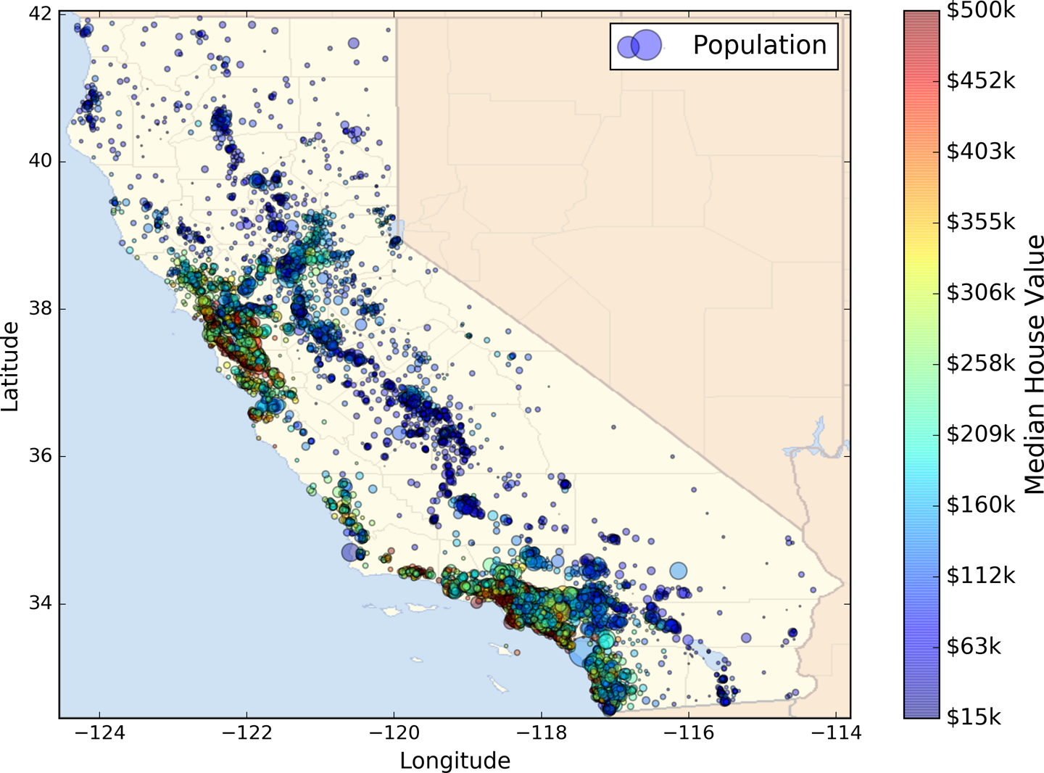
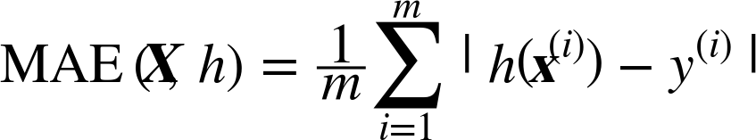
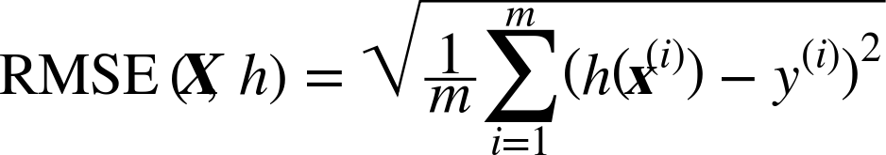
Look at the big picture
What is the problem?
To predict a district’s median housing price
What is the current solution looks like?
Estimation manually by experts
Costly and time-consuming
The error rate is about 15%
What is the objective?
Building a model better than the experts
What algorithms to select?
Labeled training example ➔ supervised learning
Predict a value of price, not categories of “cheap,” “medium,” or “expensive” ➔ regression
Small enough to fit in memory ➔ batch learning
What performance measure to use?
Root Mean Square Error or Mean Absolute Error?
How much effort to spend?
Performance measure

Slide 6
Machine Learning Workflow
Look at the big picture.
Frame the Problem
Select a Performance Measure
Check the Assumptions
Get the data.
Create the Workspace
Download the Data
Take a Quick Look at the Data Structure
Create a Test Set
Discover and visualize the data to gain insights.
Visualizing Geographical Data
Looking for Correlations
Experimenting with Attribute Combinations
Prepare the data for Machine Learning algorithms.
Data Cleaning
Handling Text and Categorical Attributes
Custom Transformers
Feature Scaling
Transformation Pipelines
머신러닝 적용
문제 이해
Select a model and train it.
Training and Evaluating on the Training Set
Better Evaluation Using Cross-Validation
Fine-tune your model.
Grid Search
Randomized Search
Ensemble Methods
Analyze the Best Models and Their Errors
Evaluate Your System on the Test Set
Present your solution.
Launch, monitor, and maintain your system.
자료 준비

Slide 7
Data Preprocessing
A | B | C
 |  | low
 |  | high
 |  | low
 |  | high
 | NaN | low
 | NaN | high
 | NaN | low
 |  | high
 |  | low
 | NaN | high

Slide 8
Data Preprocessing
Create a Test Set
A | B | C
 |  | low
 |  | high
 |  | low
 |  | high
 | NaN | low
 | NaN | high
 | NaN | low
 |  | high
A | B | C
 |  | low
 |  | high
 |  | low
 |  | high
 | NaN | low
 | NaN | high
 | NaN | low
 |  | high
 |  | low
 | NaN | high
A | B | C
 |  | low
 | NaN | high

Slide 9
Data Preprocessing
Create a Test Set
Add Attributes
A | B | C
 |  | low
 |  | high
 |  | low
 |  | high
 | NaN | low
 | NaN | high
 | NaN | low
 |  | high
A | B | C | A/B
 |  | low
 |  | high
 |  | low
 |  | high
 | NaN | low | NaN
 | NaN | high | NaN
 | NaN | low | NaN
 |  | high
A | B | C
 |  | low
 |  | high
 |  | low
 |  | high
 | NaN | low
 | NaN | high
 | NaN | low
 |  | high
 |  | low
 | NaN | high
A | B | C
 |  | low
 | NaN | high

Slide 10
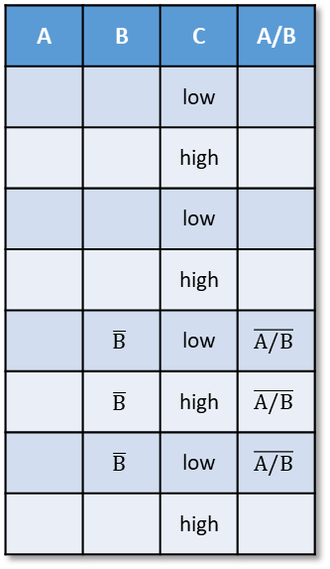
Data Preprocessing
Create a Test Set
Add Attributes
Data Cleaning
A | B | C
 |  | low
 |  | high
 |  | low
 |  | high
 | NaN | low
 | NaN | high
 | NaN | low
 |  | high
A | B | C | A/B
 |  | low
 |  | high
 |  | low
 |  | high
 | NaN | low | NaN
 | NaN | high | NaN
 | NaN | low | NaN
 |  | high
A | B | C | A/B
 |  | low
 |  | high
 |  | low
 |  | high
 | $$\overline{B}$$ | low | $$\overline{A/B}$$
 | $$\overline{B}$$ | high | $$\overline{A/B}$$
 | $$\overline{B}$$ | low | $$\overline{A/B}$$
 |  | high
A | B | C
 |  | low
 |  | high
 |  | low
 |  | high
 | NaN | low
 | NaN | high
 | NaN | low
 |  | high
 |  | low
 | NaN | high
A | B | C
 |  | low
 | NaN | high

Slide 11
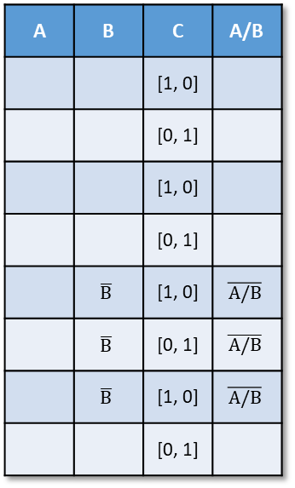
Data Preprocessing
Create a Test Set
Add Attributes
Data Cleaning
One Hot Encoding
A | B | C
 |  | low
 |  | high
 |  | low
 |  | high
 | NaN | low
 | NaN | high
 | NaN | low
 |  | high
A | B | C | A/B
 |  | low
 |  | high
 |  | low
 |  | high
 | NaN | low | NaN
 | NaN | high | NaN
 | NaN | low | NaN
 |  | high
A | B | C | A/B
 |  | low
 |  | high
 |  | low
 |  | high
 | $$\overline{B}$$ | low | $$\overline{A/B}$$
 | $$\overline{B}$$ | high | $$\overline{A/B}$$
 | $$\overline{B}$$ | low | $$\overline{A/B}$$
 |  | high
A | B | C | A/B
 |  | [1, 0]
 |  | [0, 1]
 |  | [1, 0]
 |  | [0, 1]
 | $$\overline{B}$$ | [1, 0] | $$\overline{A/B}$$
 | $$\overline{B}$$ | [0, 1] | $$\overline{A/B}$$
 | $$\overline{B}$$ | [1, 0] | $$\overline{A/B}$$
 |  | [0, 1]
A | B | C
 |  | low
 |  | high
 |  | low
 |  | high
 | NaN | low
 | NaN | high
 | NaN | low
 |  | high
 |  | low
 | NaN | high
A | B | C
 |  | low
 | NaN | high

Slide 12
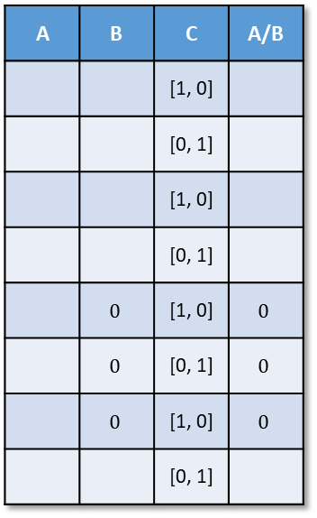
Data Preprocessing
Create a Test Set
Add Attributes
Data Cleaning
One Hot Encoding
Scaling
A | B | C
 |  | low
 |  | high
 |  | low
 |  | high
 | NaN | low
 | NaN | high
 | NaN | low
 |  | high
A | B | C | A/B
 |  | low
 |  | high
 |  | low
 |  | high
 | NaN | low | NaN
 | NaN | high | NaN
 | NaN | low | NaN
 |  | high
A | B | C | A/B
 |  | low
 |  | high
 |  | low
 |  | high
 | $$\overline{B}$$ | low | $$\overline{A/B}$$
 | $$\overline{B}$$ | high | $$\overline{A/B}$$
 | $$\overline{B}$$ | low | $$\overline{A/B}$$
 |  | high
A | B | C | A/B
 |  | [1, 0]
 |  | [0, 1]
 |  | [1, 0]
 |  | [0, 1]
 | $$\overline{B}$$ | [1, 0] | $$\overline{A/B}$$
 | $$\overline{B}$$ | [0, 1] | $$\overline{A/B}$$
 | $$\overline{B}$$ | [1, 0] | $$\overline{A/B}$$
 |  | [0, 1]
A | B | C | A/B
 |  | [1, 0]
 |  | [0, 1]
 |  | [1, 0]
 |  | [0, 1]
 | $$0$$ | [1, 0] | $$0$$
 | $$0$$ | [0, 1] | $$0$$
 | $$0$$ | [1, 0] | $$0$$
 |  | [0, 1]
A | B | C
 |  | low
 |  | high
 |  | low
 |  | high
 | NaN | low
 | NaN | high
 | NaN | low
 |  | high
 |  | low
 | NaN | high
A | B | C
 |  | low
 | NaN | high

Slide 13
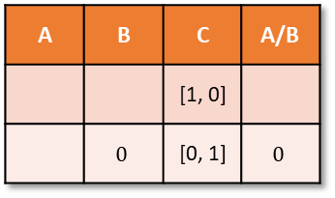
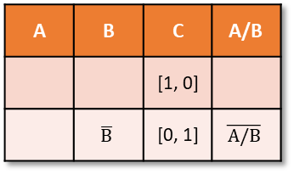
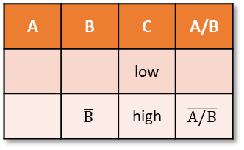
Data Preprocessing
Create a Test Set
Add Attributes
Data Cleaning
One Hot Encoding
Scaling
A | B | C
 |  | low
 |  | high
 |  | low
 |  | high
 | NaN | low
 | NaN | high
 | NaN | low
 |  | high
A | B | C | A/B
 |  | low
 |  | high
 |  | low
 |  | high
 | NaN | low | NaN
 | NaN | high | NaN
 | NaN | low | NaN
 |  | high
A | B | C | A/B
 |  | low
 |  | high
 |  | low
 |  | high
 | $$\overline{B}$$ | low | $$\overline{A/B}$$
 | $$\overline{B}$$ | high | $$\overline{A/B}$$
 | $$\overline{B}$$ | low | $$\overline{A/B}$$
 |  | high
A | B | C | A/B
 |  | [1, 0]
 |  | [0, 1]
 |  | [1, 0]
 |  | [0, 1]
 | $$\overline{B}$$ | [1, 0] | $$\overline{A/B}$$
 | $$\overline{B}$$ | [0, 1] | $$\overline{A/B}$$
 | $$\overline{B}$$ | [1, 0] | $$\overline{A/B}$$
 |  | [0, 1]
A | B | C | A/B
 |  | [1, 0]
 |  | [0, 1]
 |  | [1, 0]
 |  | [0, 1]
 | $$0$$ | [1, 0] | $$0$$
 | $$0$$ | [0, 1] | $$0$$
 | $$0$$ | [1, 0] | $$0$$
 |  | [0, 1]
A | B | C
 |  | low
 |  | high
 |  | low
 |  | high
 | NaN | low
 | NaN | high
 | NaN | low
 |  | high
 |  | low
 | NaN | high
use same mean, std
A | B | C
 |  | low
 | NaN | high
A | B | C | A/B
 |  | low
 | NaN | high | NaN
A | B | C | A/B
 |  | low
 | $$\overline{B}$$ | high | $$\overline{A/B}$$
A | B | C | A/B
 |  | [1, 0]
 | $$\overline{B}$$ | [0, 1] | $$\overline{A/B}$$
A | B | C | A/B
 |  | [1, 0]
 | $$0$$ | [0, 1] | $$0$$

Slide 14
Machine Learning Workflow
Look at the big picture.
Frame the Problem
Select a Performance Measure
Check the Assumptions
Get the data.
Create the Workspace
Download the Data
Take a Quick Look at the Data Structure
Create a Test Set
Discover and visualize the data to gain insights.
Visualizing Geographical Data
Looking for Correlations
Experimenting with Attribute Combinations
Prepare the data for Machine Learning algorithms.
Data Cleaning
Handling Text and Categorical Attributes
Custom Transformers
Feature Scaling
Transformation Pipelines
머신러닝 적용
문제 이해
Select a model and train it.
Training and Evaluating on the Training Set
Better Evaluation Using Cross-Validation
Fine-tune your model.
Grid Search
Randomized Search
Ensemble Methods
Analyze the Best Models and Their Errors
Evaluate Your System on the Test Set
Present your solution.
Launch, monitor, and maintain your system.
자료 준비

Slide 15
Create a Test Set - Stratified Split
Training Set
Training Data
Strata
Test Set

Slide 16
Machine Learning Workflow
Look at the big picture.
Frame the Problem
Select a Performance Measure
Check the Assumptions
Get the data.
Create the Workspace
Download the Data
Take a Quick Look at the Data Structure
Create a Test Set
Discover and visualize the data to gain insights.
Visualizing Geographical Data
Looking for Correlations
Experimenting with Attribute Combinations
Prepare the data for Machine Learning algorithms.
Data Cleaning
Handling Text and Categorical Attributes
Custom Transformers
Feature Scaling
Transformation Pipelines
머신러닝 적용
문제 이해
Select a model and train it.
Training and Evaluating on the Training Set
Better Evaluation Using Cross-Validation
Fine-tune your model.
Grid Search
Randomized Search
Ensemble Methods
Analyze the Best Models and Their Errors
Evaluate Your System on the Test Set
Present your solution.
Launch, monitor, and maintain your system.
자료 준비

Slide 17
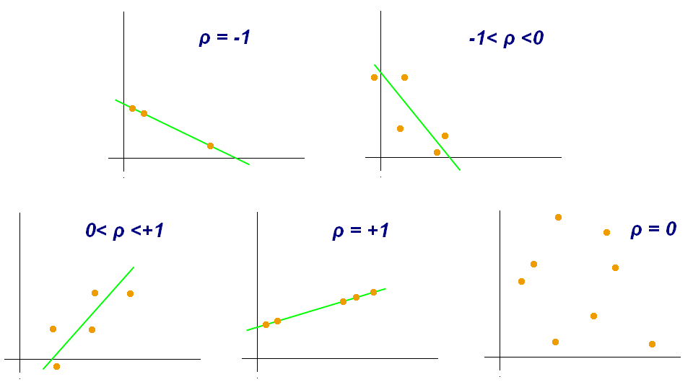
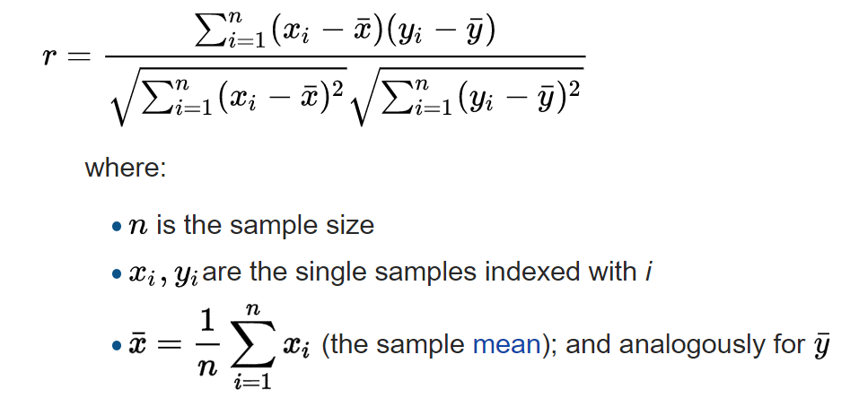
Looking for Correlations
Standard correlation coefficient (Pearson’s r):
A measure of the linear correlation between two variables X and Y.
It has a value between +1 and −1, where 1 is total positive linear correlation, 0 is no linear correlation, and −1 is total negative linear correlation.

Slide 18
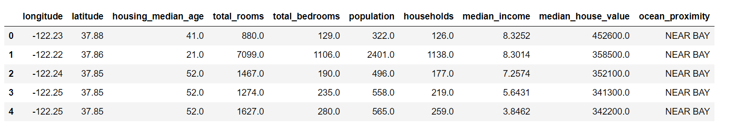
Experimenting with Attribute Combinations
Gain insights after exploring data
Try out various attribute combinations
room_per_household = total_rooms / households
bedrooms_per_room = total_bedrooms / total_rooms
population_per_household = polulation / households
➔ Check correlations

Slide 19
Machine Learning Workflow
Look at the big picture.
Frame the Problem
Select a Performance Measure
Check the Assumptions
Get the data.
Create the Workspace
Download the Data
Take a Quick Look at the Data Structure
Create a Test Set
Discover and visualize the data to gain insights.
Visualizing Geographical Data
Looking for Correlations
Experimenting with Attribute Combinations
Prepare the data for Machine Learning algorithms.
Data Cleaning
Handling Text and Categorical Attributes
Custom Transformers
Feature Scaling
Transformation Pipelines
머신러닝 적용
문제 이해
Select a model and train it.
Training and Evaluating on the Training Set
Better Evaluation Using Cross-Validation
Fine-tune your model.
Grid Search
Randomized Search
Ensemble Methods
Analyze the Best Models and Their Errors
Evaluate Your System on the Test Set
Present your solution.
Launch, monitor, and maintain your system.
자료 준비

Slide 20
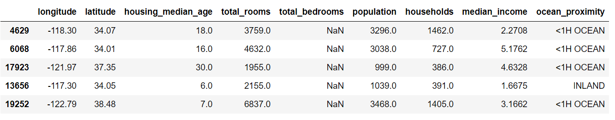
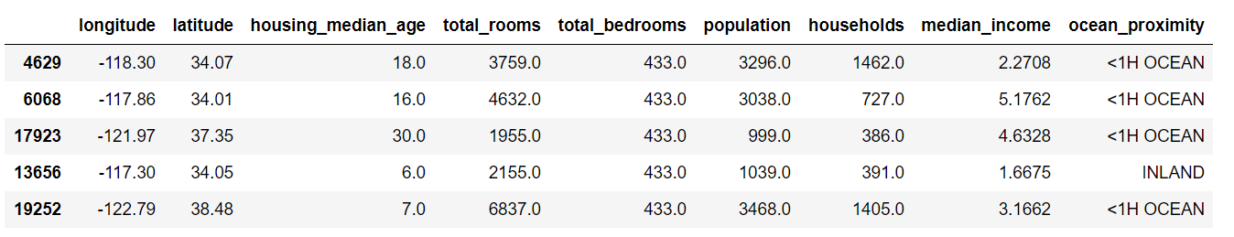
Data Cleaning
Example: set NaN to median
Handling missing values:
Get rid of the samples
Get rid of the whole attribute
Set the missing values to some values (zero, mean, median, etc)

Slide 21
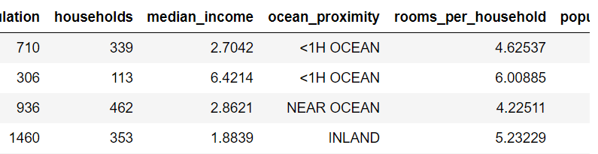
Handling Text and Categorical Attributes
Convert text labels to numbers:
Label Encoding:
One Hot Encoding:
Low
Medium
High
0
1
2
One Hot Encoding
1 | 0 | 0 | 0 | 0
1 | 0 | 0 | 0 | 0
0 | 0 | 0 | 0 | 1
0 | 1 | 0 | 0 | 0
Cat
Dog
Horse
1 | 0 | 0
0 | 1 | 0
0 | 0 | 1

Slide 22
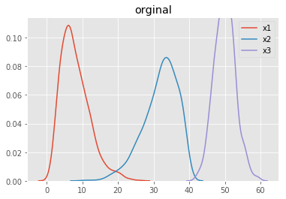
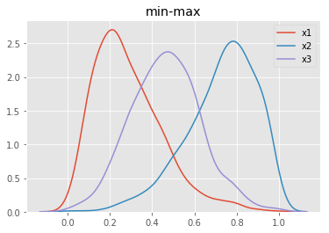
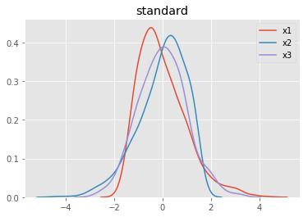


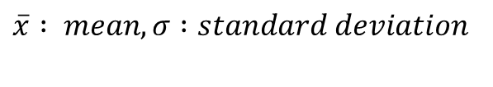
Feature Scaling
Min-max Scaling:
$$x^{′}=\frac{x−min⁡(x)}{\max\left(x\right)−min⁡(x)}$$
Standard Scaling:
$$x^{′}=\frac{x−\overline{x}}{σ}$$
$\overline{x} : mean, σ :standard deviation$

Slide 23
Machine Learning Workflow
Look at the big picture.
Frame the Problem
Select a Performance Measure
Check the Assumptions
Get the data.
Create the Workspace
Download the Data
Take a Quick Look at the Data Structure
Create a Test Set
Discover and visualize the data to gain insights.
Visualizing Geographical Data
Looking for Correlations
Experimenting with Attribute Combinations
Prepare the data for Machine Learning algorithms.
Data Cleaning
Handling Text and Categorical Attributes
Custom Transformers
Feature Scaling
Transformation Pipelines
머신러닝 적용
문제 이해
Select a model and train it.
Training and Evaluating on the Training Set
Better Evaluation Using Cross-Validation
Fine-tune your model.
Grid Search
Randomized Search
Ensemble Methods
Analyze the Best Models and Their Errors
Evaluate Your System on the Test Set
Present your solution.
Launch, monitor, and maintain your system.
자료 준비

Slide 24
Transformation Pipelines
Create a Test Set
Add Attributes
Data Cleaning
One Hot Encoding
Scaling
A | B | C
 |  | low
 |  | high
 |  | low
 |  | high
 | NaN | low
 | NaN | high
 | NaN | low
 |  | high
A | B | C | A/B
 |  | low
 |  | high
 |  | low
 |  | high
 | NaN | low | NaN
 | NaN | high | NaN
 | NaN | low | NaN
 |  | high
A | B | C | A/B
 |  | low
 |  | high
 |  | low
 |  | high
 | $$\overline{B}$$ | low | $$\overline{A/B}$$
 | $$\overline{B}$$ | high | $$\overline{A/B}$$
 | $$\overline{B}$$ | low | $$\overline{A/B}$$
 |  | high
A | B | C | A/B
 |  | [1, 0]
 |  | [0, 1]
 |  | [1, 0]
 |  | [0, 1]
 | $$\overline{B}$$ | [1, 0] | $$\overline{A/B}$$
 | $$\overline{B}$$ | [0, 1] | $$\overline{A/B}$$
 | $$\overline{B}$$ | [1, 0] | $$\overline{A/B}$$
 |  | [0, 1]
A | B | C | A/B
 |  | [1, 0]
 |  | [0, 1]
 |  | [1, 0]
 |  | [0, 1]
 | $$0$$ | [1, 0] | $$0$$
 | $$0$$ | [0, 1] | $$0$$
 | $$0$$ | [1, 0] | $$0$$
 |  | [0, 1]
A | B | C
 |  | low
 |  | high
 |  | low
 |  | high
 | NaN | low
 | NaN | high
 | NaN | low
 |  | high
 |  | low
 | NaN | high
use same mean, std
A | B | C
 |  | low
 | NaN | high
A | B | C | A/B
 |  | low
 | NaN | high | NaN
A | B | C | A/B
 |  | low
 | $$\overline{B}$$ | high | $$\overline{A/B}$$
A | B | C | A/B
 |  | [1, 0]
 | $$\overline{B}$$ | [0, 1] | $$\overline{A/B}$$
A | B | C | A/B
 |  | [1, 0]
 | $$0$$ | [0, 1] | $$0$$

Slide 25
Transformation Pipelines
Create a Test Set
A | B | C
 |  | low
 |  | high
 |  | low
 |  | high
 | NaN | low
 | NaN | high
 | NaN | low
 |  | high
A | B | C | A/B
 |  | [1, 0]
 |  | [0, 1]
 |  | [1, 0]
 |  | [0, 1]
 | $$0$$ | [1, 0] | $$0$$
 | $$0$$ | [0, 1] | $$0$$
 | $$0$$ | [1, 0] | $$0$$
 |  | [0, 1]
A | B | C
 |  | low
 |  | high
 |  | low
 |  | high
 | NaN | low
 | NaN | high
 | NaN | low
 |  | high
 |  | low
 | NaN | high
Add Attributes
Data Cleaning
One Hot Encoding
Scaling
A | B | C
 |  | low
 | NaN | high
A | B | C | A/B
 |  | [1, 0]
 | $$0$$ | [0, 1] | $$0$$
Add Attributes
Data Cleaning
One Hot Encoding
Scaling

Slide 26
Machine Learning Workflow
Look at the big picture.
Frame the Problem
Select a Performance Measure
Check the Assumptions
Get the data.
Create the Workspace
Download the Data
Take a Quick Look at the Data Structure
Create a Test Set
Discover and visualize the data to gain insights.
Visualizing Geographical Data
Looking for Correlations
Experimenting with Attribute Combinations
Prepare the data for Machine Learning algorithms.
Data Cleaning
Handling Text and Categorical Attributes
Custom Transformers
Feature Scaling
Transformation Pipelines
머신러닝 적용
문제 이해
Select a model and train it.
Training and Evaluating on the Training Set
Better Evaluation Using Cross-Validation
Fine-tune your model.
Grid Search
Randomized Search
Ensemble Methods
Analyze the Best Models and Their Errors
Evaluate Your System on the Test Set
Present your solution.
Launch, monitor, and maintain your system.
자료 준비

