Slide 1

A Study on the Spatial Accessibility of Adult Day Care Centers in the Seoul Metropolitan Area
Kyunghee Rhyu

Slide 2
Research statement
The elderly population ratio in South Korea is 14.3%, and 37.5% of Korean elderly people live in the Seoul metropolitan area (Statistics Korea, 2018)
Senior care facilities are essential in the daily life of the elderly in the metropolitan area
Among senior care facilities, adult day care center (ADCC) differs from other senior care facilities in that old adults travel to the supply to receive services
Therefore, the location and accessibility of ADCCs should be considered for the elderly to use services

Slide 3
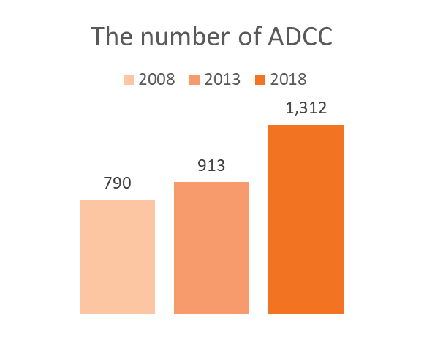
Research statement
Adult day care center (ADCC)
  Aging in Place
    “Remaining living in the community, with some level of independence, rather than in residential care” (Davey, Nana, de Joux, & Arcus, 2004, p. 133)
  Providing various social services to people over 65 of long-term care beneficiaries including dementia
  Supporting the elderly and to reduce the burden of family and caregivers for a period of time
Does ADCC are properly distributed?
Does ADCC help to decrease dementia symptoms?

Slide 4
Research statement
Measuring spatial accessibility to healthcare facilities related to dementia
Investigating socio-economic factors that are potentially associated to health outcome
Identifying whether dementia is slowed down
Emergency
Room
Elderly Day Care Center
Rehabilitation
Senile
Dementia
Neuro -
psychiatry
Cardiology
Neurosurgery

Slide 5
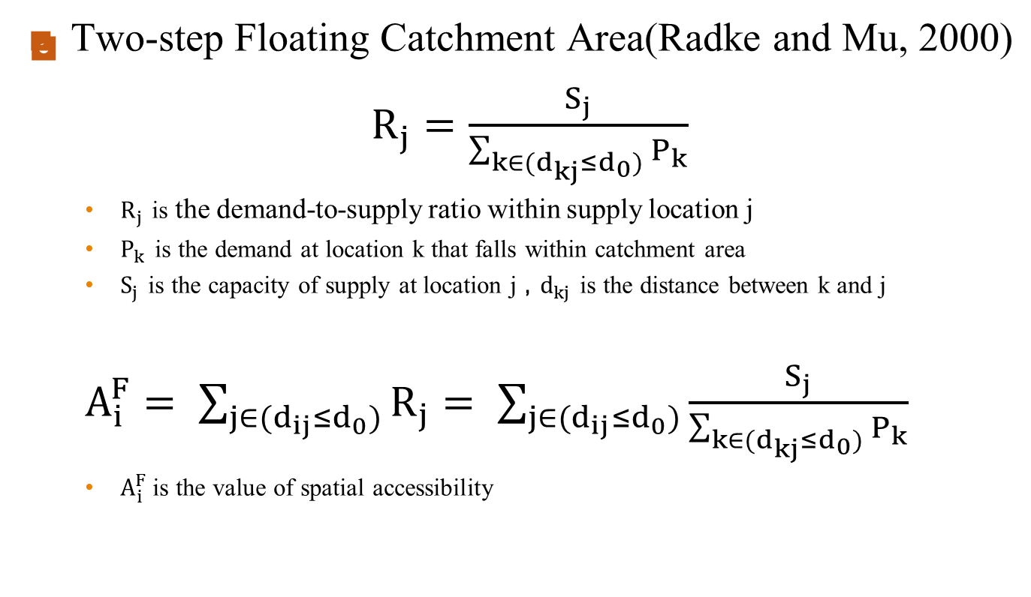
Method
(1)
(2)
Notes:
The method that I use in this research is two-step floating catchment area. Actually, 2SFAC is the widely used tool in health care field.
It repeats the process of floating catchment area twice, (once on supply locations and once on demand locations) and is therefore referred to as 2SFCA.
Let’s look at a mathematical formula.

Slide 6
Data
  Unit of Analysis
    77 cities (Eup·myeon·dong) 2013 & 2018
  Data
    Demographic and socio-economic variables
    Adult day care centers
    Road Network
  Analysis
    Spatial accessibility by using 2SFCA
    Regression analysis of ADCC accessibility
Notes:
Considering exhaustion of the elderly physical energy, maximum time to travel is 30 minutes based on literature review.

Slide 7
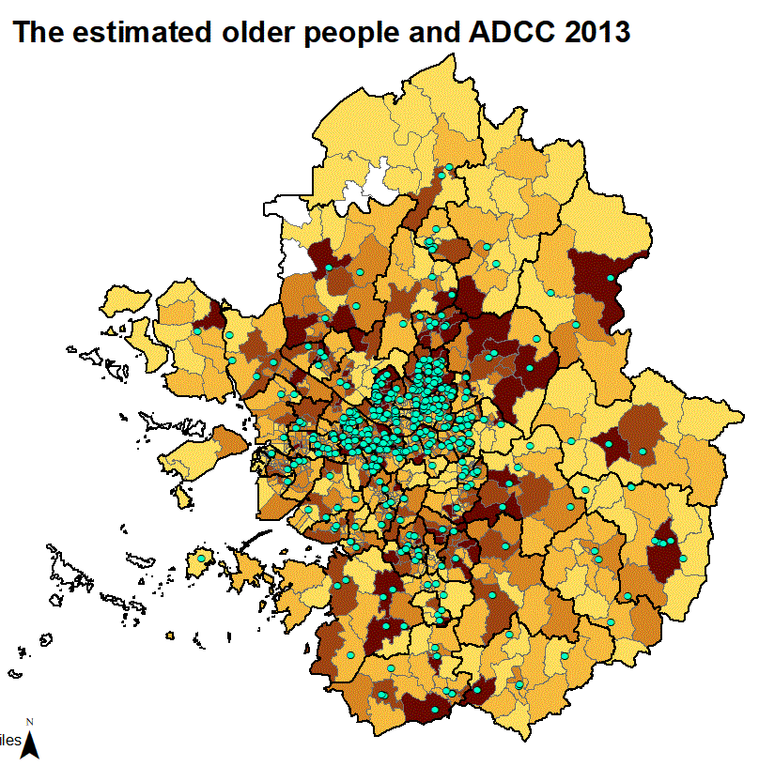
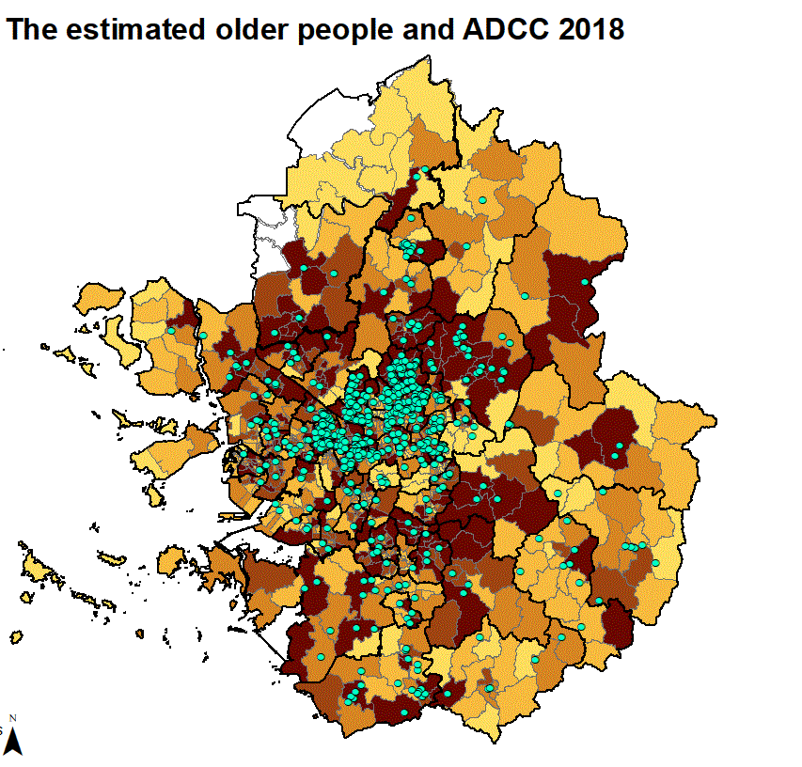
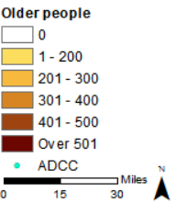
Pilot study
The estimated older people and ADCC in 2013
The estimated older people and ADCC in 2018
Notes:
When you see this map, you probably realized that high density of population that are estimated to use DNCC concentrate on seoul.
Seoul 44,316 (forty-four thousand) Kyeonggi 47,825(forty-eight thousand) Incheon 11,584(eleven thousand)
approximately 45% of the total DNCC in south korea locate in seoul metropolitan area.

Slide 8
Visualization methods
  spplot
  ggplot
  quantile method for setting class intervals
  mapColorRamp

Slide 9
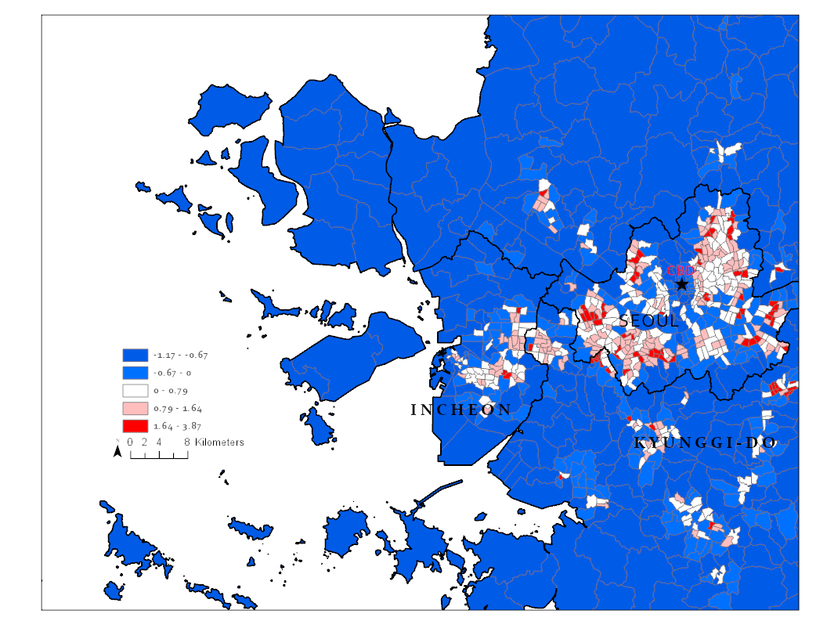
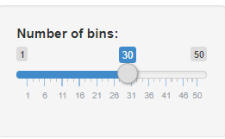
Layout

Slide 10


