Slide 1
기본 프로그래밍 05
자바에 삼 주만 빠져보자!
데이터융합SW과
김규석 교수
JAVA

Slide 2
Objective
Method
Calling a Method from the Same Class
Parameter
Declaring a static final variable
Returning a Value
Overloading
Recursive Function

Slide 3
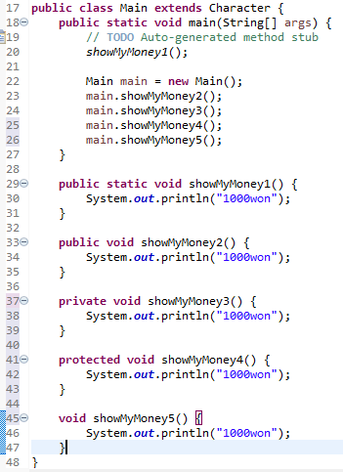
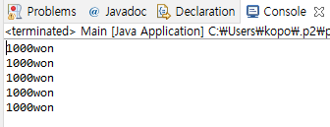
Method(Cont’d)
Calling a Method from the Same Class
A method is called in different ways as below
Keyword of Static and Access Modifiers

Slide 4
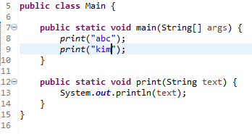
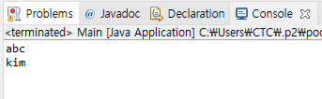
Method(Cont’d)
Method and Parameter
A method is a block code which runs when it is called.
Parameter
: Information can be passed to methods by this
Q1* : Explain the meaning of the 12nd line

Slide 5
P1
Printing a Name
User selects a number for a family member
Print the name of the family member
The program should include the following function
public void addition(int familyMember)
#Printing a Name
Father
Mother
Son
Daughter
-> 3
John

Slide 6
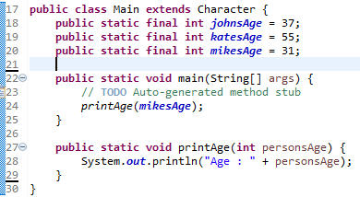

Method(Cont’d)
Declaring a static final Variable
A static final variable can’t be changed
P2 : Try changing the values for the static final variables in main function

Slide 7
P3
Printing a Name II
User selects a number for a family member
Print the name of the family member
The program should declare the static final variables for the names and include the function containing a parameter to print the name
#Printing a Name
Father
Mother
Son
Daughter
-> 3
John

Slide 8
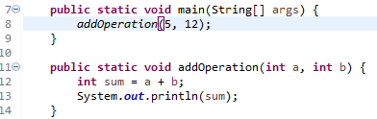

Method(Cont’d)
Multiple Parameters
Parameters can be separated by comma
Multiple Parameters

Slide 9
P4
Calculator
User inputs a formula including only one operator
The program calculates the formula by using the following 4 of functions
1) public static void addition(double num1, double num2)
2) public static void subtraction(double num1, double num2)
3) public static void multiplication(double num1, double num2)
4) public static void division(double num1, double num2)
3*7
21
6+9
15

Slide 10
P5
Multiplication Table
User inputs a number N
Print the N times table
(Use a separate method to print the N times table with a parameter)

Slide 11
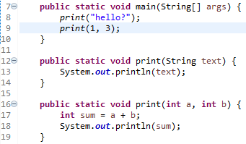

Method(Cont’d)
Overloading
A feature that allows a class to have many methods having the same name
The parameters are different from one another

Slide 12
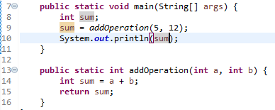
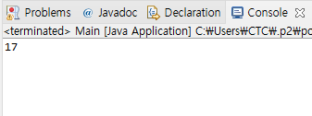
Method
Returning a Value
A method returns a value when reaching to a return statement, throwing an exception or completing all the statements in the method
Return Type
Return Value

Slide 13
P6
Calculator
User inputs a formula including only one operator
The program calculates the formula by using the following 5 of functions
1) public static double addition(double num1, double num2)
2) public static double subtraction(double num1, double num2)
3) public static double multiplication(double num1, double num2)
4) public static double division(double num1, double num2)
5) public static char getOperator(String formula)
3*7
21
6+9
15

Slide 14
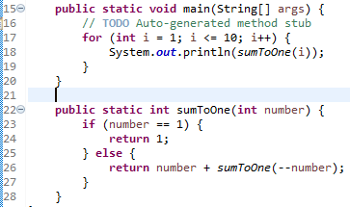
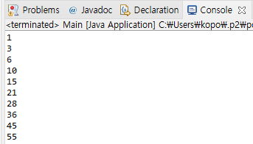
Recursive Function
Recursive Function
A function which calls itself

Slide 15
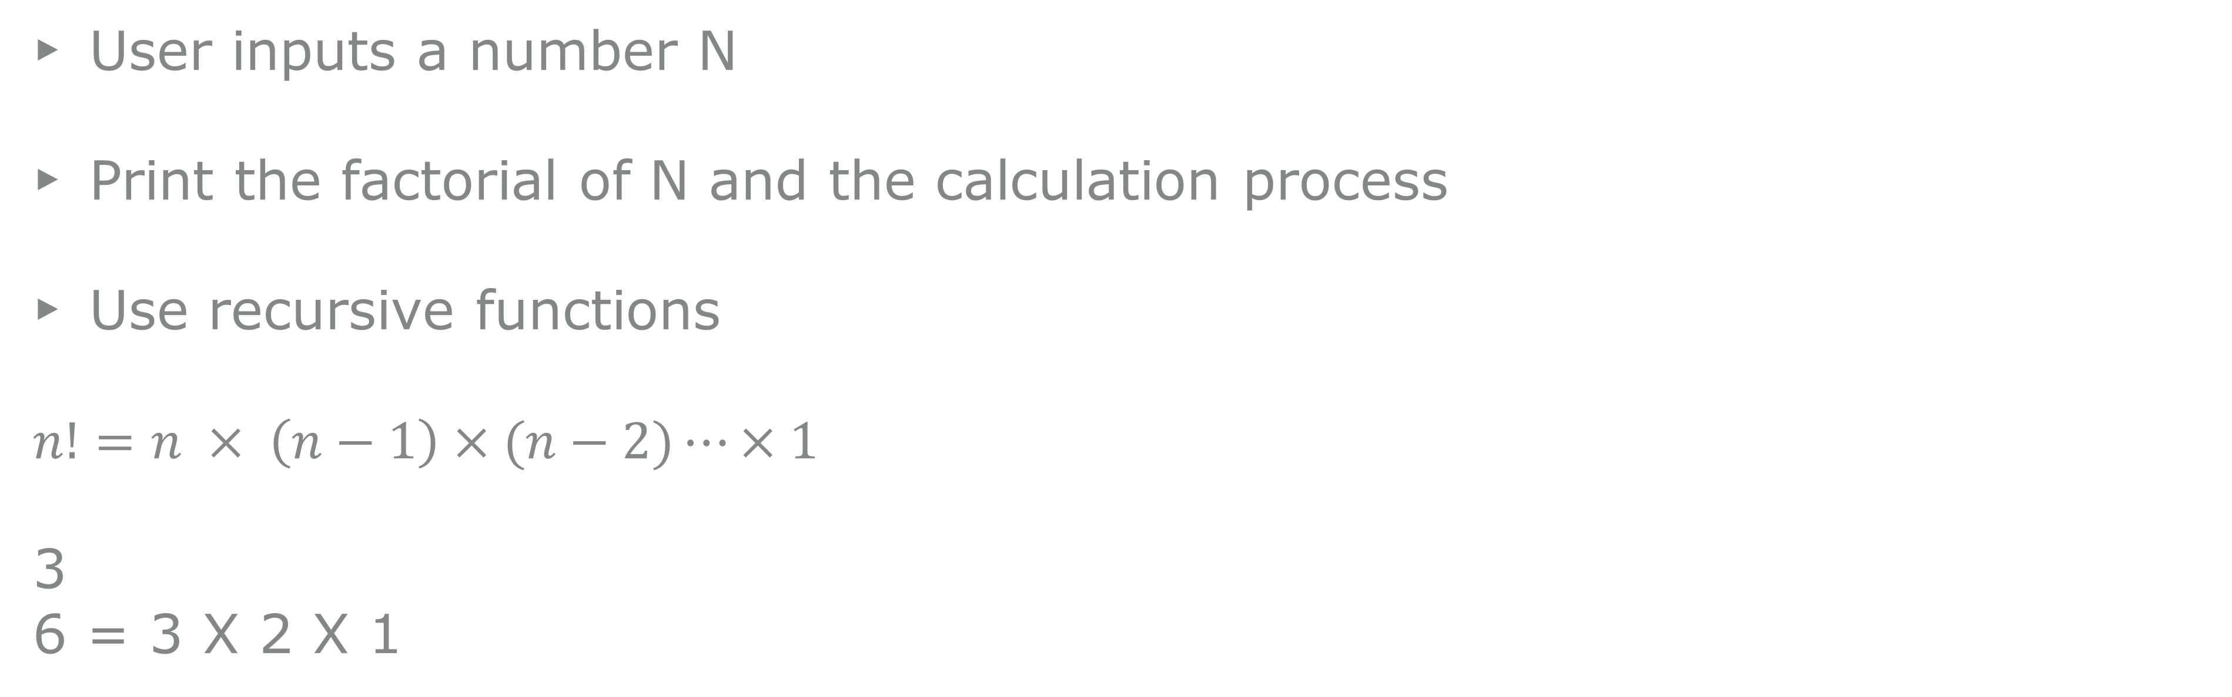
P7
Factorial
User inputs a number N
Print the factorial of N and the calculation process
Use recursive functions
$n!=n × \left(n−1\right)×(n−2)⋯×1$
3
6 = 3 X 2 X 1

