Slide 1
기본 프로그래밍 09
자바에 삼 주만 빠져보자!
데이터융합SW과
김규석 교수
JAVA

Slide 2
Objective
Collection
List
Set
Queue
Stack

Slide 3
Collection(Cont’d)
Java Collections Framework
A set of classes and interfaces that implement commonly reusable collection data structures
Collection
Set
List
Queue

Slide 4
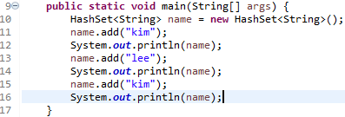
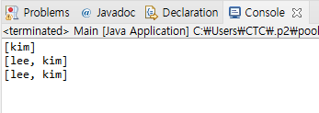
Set
Hashset
A collection of items and the items are unique

Slide 5
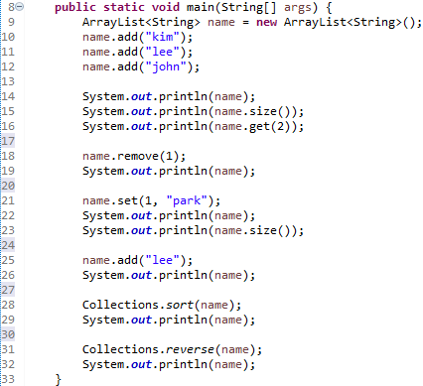
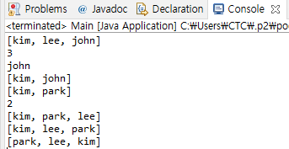
List(Cont’d)
ArrayList
A resizable array
Q1* : What’s the difference between “Hashset” and “ArrayList”?

Slide 6
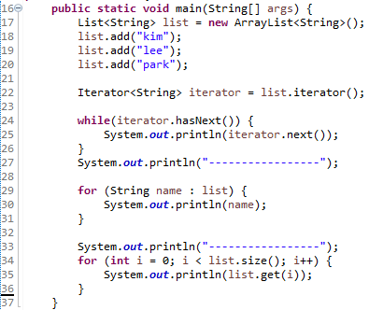
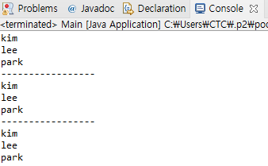
List
Iterator
An object that can be used to loop through collections

Slide 7
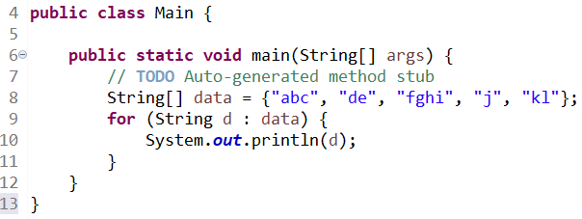
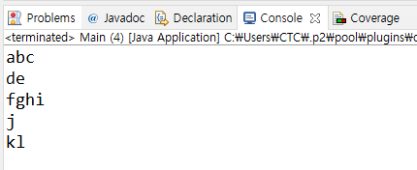
List
for-each loop
An array traversing Technique like for and while loops

Slide 8
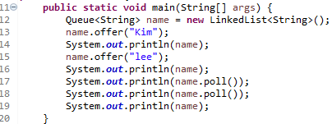
Queue
Queue
A data structure designed to have elements inserted at the end of the queue, and elements removed from the beginning of the queue
“Kim”
“Kim”
“lee”
“lee”
Q2* : Explain FIFO and FILO
Source : http://tutorials.jenkov.com/java-collections/queue.html#:~:text=The%20Java%20Queue%20interface%2C%20java,of%20the%20Java%20Collection%20interface.

Slide 9
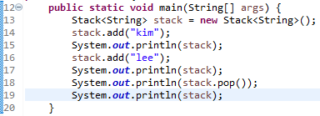
Collection+
Stack
A linear data structure that is used to store the collection of objects.
Based on LIFO(Last-In-First-Out)
“lee”
“kim”
“kim”
“kim”
Q3* : What’s the difference between “Queue” and “Stack”?
Source : https://www.javatpoint.com/java-stack#:~:text=The%20stack%20is%20a%20linear,store%20the%20collection%20of%20objects.&text=The%20stack%20data%
20structure%20has,the%20top%20of%20the%20stack.

Slide 10
P1
Split a String and Sort
User inputs a string
Print the words after splitting it against by a black(“ “)
Sort them by in descending order and print them again

Slide 11
P2
Numbering
User inputs a series of numbers and assign them to a queue
User input a number from the series of numbers
Print the number in order of output
Add exception statements
1 21 13 34 15 16
13
3

Slide 12
P3
Numbering II
User inputs a series of numbers and assign them to a stack
User input a number from the series of numbers
Print the number in order of output
Add exception statements
1 21 13 34 15 16
13
4

Slide 13
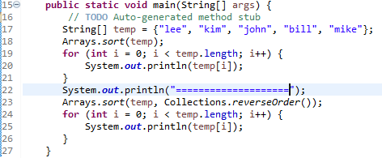
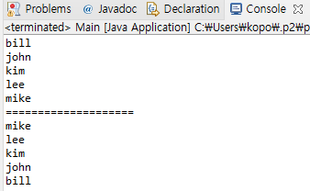
Sort
Sort

Slide 14
P4
Grade Card
User inputs more than 10 sets of names and scores
Print the list by name in ascending order
Print the list by name in descending order
Print the list by score in ascending order
Print the list by score in descending order
Add exception statements

