Slide 1
기본 프로그래밍 01(A1)
자바에 삼 주만 빠져보자!
데이터융합SW과
김규석 교수
JAVA

Slide 2
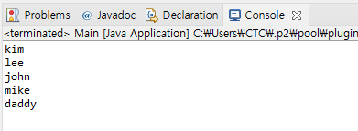
A1
Compose a program with the conditions below
Use the function, “System.out.println()” only once
And print the 5 lines of words as below

Slide 3
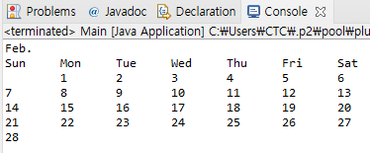
A2
Compose a program with the conditions below
Use the function, “System.out.println()” within 7 times
And print the calendar as below

Slide 4
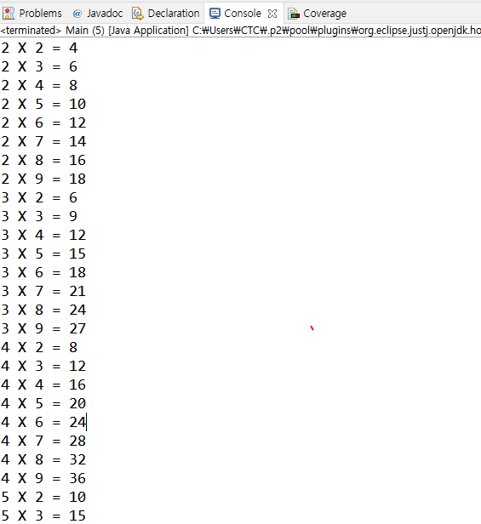
A3
Compose a program with the conditions below
Show the multiplication tables 2 – 9

Slide 5
A4
Let’s prepare what we will study tomorrow
Practice ‘Constant’ related examples
Practice ‘Variable’ related examples
Practice ‘Data type’ related examples
Practice ‘if’ and ‘switch’ related examples

