Slide 1
기본 프로그래밍 07
자바에 삼 주만 빠져보자!
데이터융합SW과
김규석 교수
JAVA

Slide 2
Objective
Array
Singledimensional Array
Multidimensional Array

Slide 3
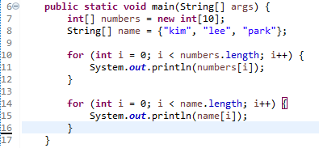
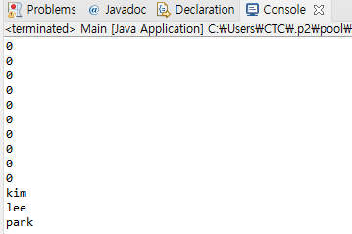
Array(Cont’d)
Singledimensional Array
Arrays are used to store multiple values in a single variable
int[] n = new int[3];
→ n[0], n[1], n[2]
[0]
[1]
[2]
P1 : Print “number[10]” and “name[3]”

Slide 4
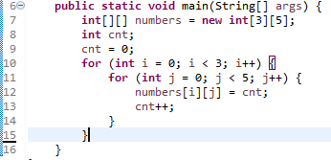
Array(Cont’d)
Multidimensional Array
Arrays are used to store multiple values in a single variable
int[][] n = new int[3][4];
→
[0][0]
[0][1]
[0][2]
[0][3]
[1][0]
[1][1]
[1][2]
[1][3]
[2][0]
[2][1]
[2][2]
[2][3]
P2 : Print the array “numbers[][]”

Slide 5

Array
Multidimensional Array II
Each Row could have different size of columns
P3 : Print the array “numbers[][]”

Slide 6
P4
Sort
Initialize an array with the elements below
{2, 33, 7, 5, 12, 34, 99, 25, 28, 53, 20}
Sort the array in ascending order and print
Sort the array in descending order and print

Slide 7
P5
Descriptive Statistics
Create a two dimensional string array
Calculate the summation, average, minimum, maximum of scores for each subject and person
Hint, Integer.parseInt();
Name | Korean | English | Math
Jeong | 70 | 80 | 100
Pyo | 60 | 70 | 86
Choi | 54 | 100 | 82
Mike | 87 | 95 | 79

Slide 8
P6
Counting a Specified Character
User inputs a string and assign it into an array
User inputs a word and assign it into an array
Count how many are the input words included in the string
I go to school. Where are you going?
o
6
I go to school. Where are you going?
go
3

Slide 9
P7
Encryption
User inputs a string
Print the encrypted string
To encrypt the string, use an array to match characters one to one
(ex, original = {1, 2, 3}, encrypted = {a, b, c})
Write a scenario and compose it
abcd
zyxw

Slide 10
P8
Decryption
Regarding as the previous practice, user inputs a string
Print the decrypted string
zyxw
abcd

Slide 11
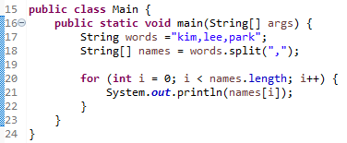
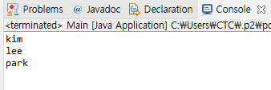
P9
split()
[Background]
split() is used to split the string against given regular expression
[Background]
The following is the example
User inputs a string
Split the input string against a black(“ “) and print the result

