Slide 1
기본 프로그래밍 06
자바에 삼 주만 빠져보자!
데이터융합SW과
김규석 교수
JAVA

Slide 2
Objective
Class
Object
Constructor
this
Function vs Method
Inner Class
Interface
Inheritance
super
Overriding
Polymorphism

Slide 3
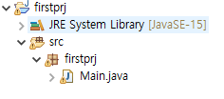
Class(Cont’d)
Object-Oriented Programming
Java is combined with Classes and Objects
Ex) A phone is an object, the functions such as Wi-Fi on it are methods
Class
Q1* : What’s the difference between PP and OOP?
Q2* : What’s the difference between “Class” and “Object”?

Slide 4
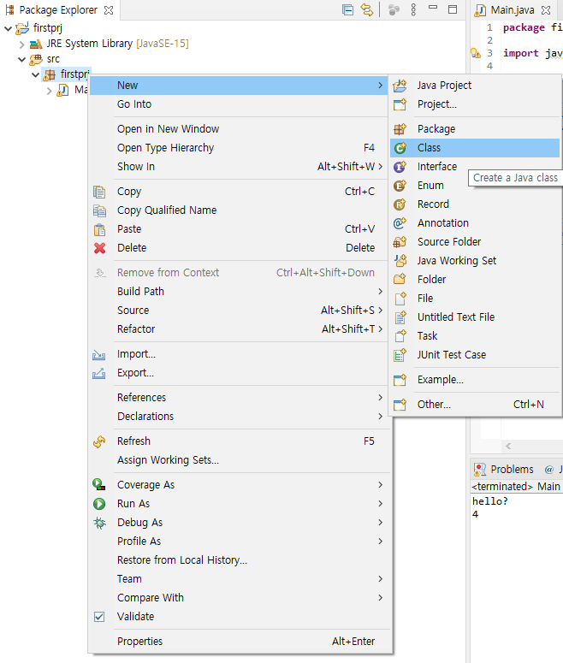
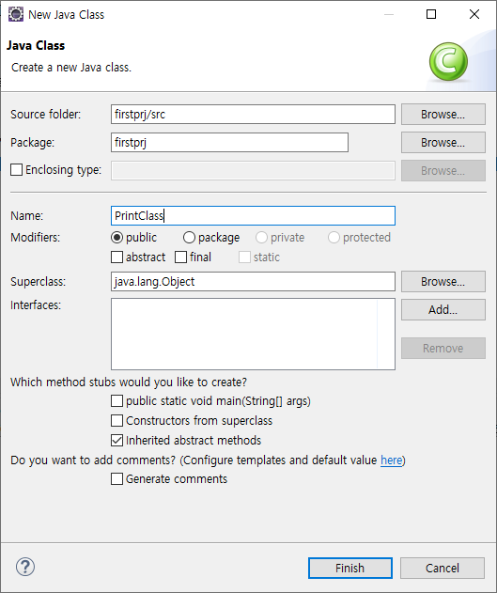
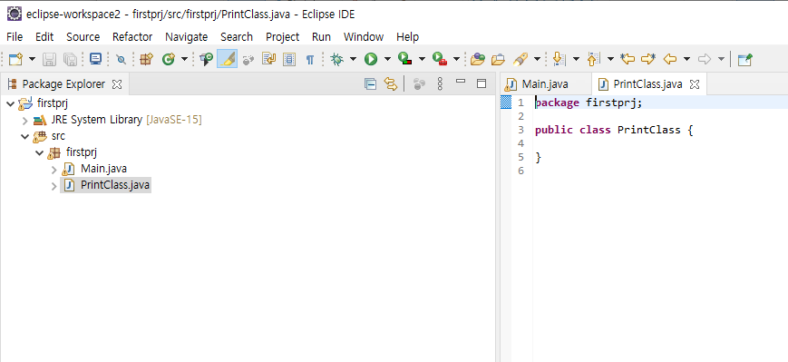
Class(Cont’d)
Create a New Class
Click on Package Name > Right-click > New > Class

Slide 5
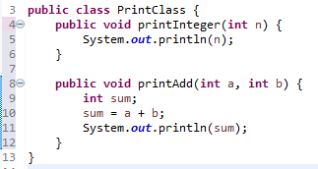
Class(Cont’d)
Create Methods
In the body of “PrintClass”, add some methods
Q3* : How do we call the functions?

Slide 6
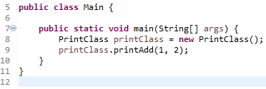
Class(Cont’d)
Create an Object and Call a Method of it
ClassName ObjectName = new ClassName();
Instance of a Class
A concrete occurrence of any object
Q4* : Explain “Class”, “Object” and “Instance”.
Q5* : Explain “Method” and “Function”.

Slide 7
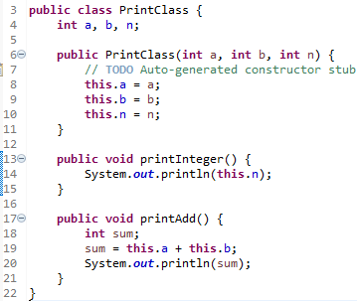
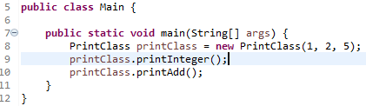

Class(Cont’d)
Constuctor
A block of code that initializes the newly created object
Return Type
Constructor

Slide 8
P1
Constructor Example
Price
1. Apple
2. Strawberry
3. Grape
4. Watermelon
User selects a number
The each operation should be done in separate functions
The name of the functions should be the same
The calculated value should be a return value

Slide 9
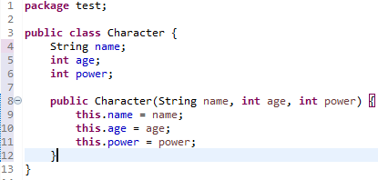
Class(Cont’d)
this
Refers to the current object in a method or constructor
Return Type

Slide 10
P2
Creating Game Characters
Refer to the example for “this”
Create a class which has a constructor
The constructor should have the parameters of “name”, “age”, “offense power” and “defense power”
Create more than 3 characters with using the character class above
Print the character introduction
A / 200 / 30.5 / 32.1
B / 123 / 47.1 / 18.9
C / 765 / 21.6 / 42.3

Slide 11
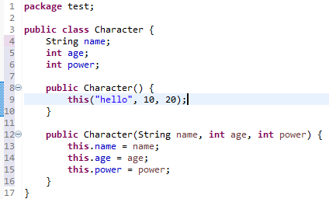
Class(Cont’d)
this()
Invoke the instructor of the current class
Return Type

Slide 12
P3
Creating Game Characters II
Adding some condition code block to P2
Add two more constructors which have one parameter and two parameters respectively
Print the character introduction
D / 260 / 35.5 / 42.1
E / 1213 / 46.1 / 38.9

Slide 13
Method
Access Modifiers
Public, Private, Protected
Public : Accessible from everywhere
Private : Accessible within the same class only
Protect : Accessible by the classes of the same package
P4 : Explain the meaning of the 12nd line

Slide 14
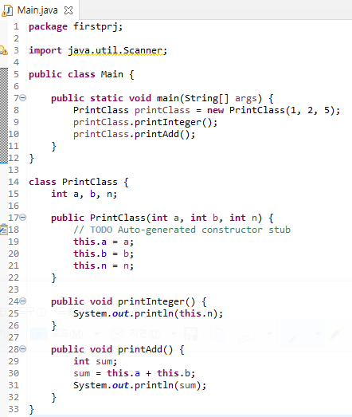

Class
Inner Class
Classes Nested in a Class
Return Type

Slide 15
P5
Inner Class Example
Compose a program without creating an object
(Hint, “static”)

Slide 16
P6
Regarding as P3
Change the created class of “P3” to an inner class
The other conditions are the same

Slide 17
P7
Descriptive Statistics
Make a record statistics for students
Format : Name, Korean Score, English Score, Math Score
Output : Number of students, average, minimum and maximum scores for each subject
#Menu
Input a record
Make descriptive statistics
Print all the records
1
Kim, 75, 100, 78
2
Number of Students : 5
Korean(Avg, Min, Max) : 75.5, 68.5, 100
…

Slide 18
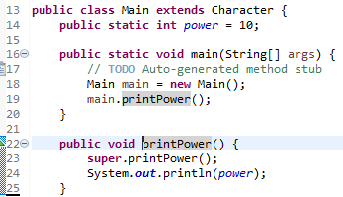
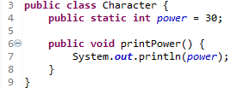

Interface(Cont’d)
Inheritance
Inherits attributes and method from one class to another
Superclass : the class being inherited from
Subclass : the class which inherits from another class
Return Type

Slide 19
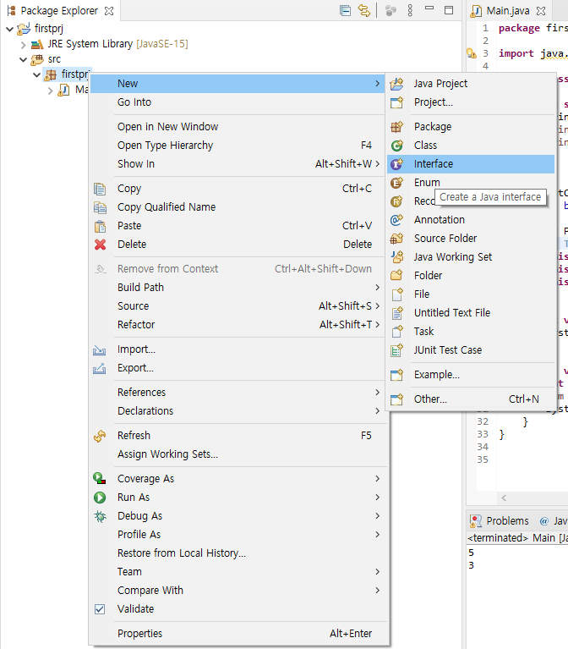
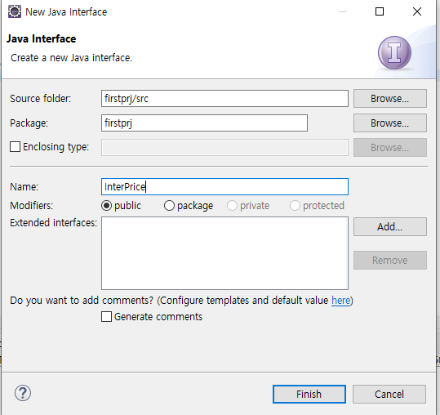
Interface(Cont’d)
Interfaces
Abstract class with empty bodies,
Return Type

Slide 20
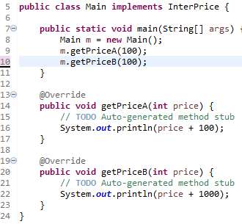


Interface(Cont’d)
Interfaces
A Group of Related Methods
Return Type
Q6* : Explain “Overload” and “Override”
Q7* : Explain the difference between “Abstract Class” and “Interface”

Slide 21
Interface
Polymorphism
Being able to be in many forms by inheritance
A
Draw()
Pen
Draw()
Pencil
Draw()
Highligher
Draw()
P8 : Compose a program as above

