Slide 1



STUDENT-DRIVEN GLOBAL HACKATHON
2026
Call for Hackers & Creators!
VENUE GYMLABO（Tobata Campus）
DATE Sep 25 (Fri) – 27 (Sun), 2026

Slide 2

What is JUNCTION?
JUNCTION is a global hackathon and tech community, spreading the word of empowering people to create with technology. JUNCTION X lets local tech communities around the world create their own hackathon, bringing together developers, designers, and all other techies.
JUNCTION X KYUTECH is an international hackathon organized by Kyutech's student community, officially supported by JUNCTION.
3 Days
International
Free Entry
Intensive building from Friday afternoon to Sunday night
English is the official language — a truly global experience
No fee. Meals and snacks provided during the event

Slide 3
2026 CONCEPT
INTERACTIVE WORLD
— Hack the World Interface —
Hack the interfaces between people and systems, and between systems and the real world. Build products that don't end on the screen — products that interact with the world.

Slide 4






CONCEPT 2026
Create Systems That Work in the Real World
Rather than focusing on developing standalone applications, the goal is to build systems that operate effectively in real-world environments by integrating multiple technologies.By combining sensors, communications, AI, and robotics, participants are expected to implement systems that can respond to human actions and changes in the environment, creating solutions that actually work in the real world.
→
→
→
→
Sense
Connectivity
Intelligence
Physical
Experience
Data Acquisition
Communication
Decision-Making
Action
User Experience
Connect × Decide × Act × Deliver Experiences
04

Slide 5



Tracks
Choose one of three tracks and build your product around it.
TRACK 01
TRACK 02
TRACK 03
Hack Extreme Environments
Hack Connected Everywhere
Hack the Physical World
Space as Constraint

Slide 6



Who We're Looking For (1/2)
These six roles are a guide, not a rule — one person can wear multiple hats in a team.
Frontend Engineer
Role: Design the interface connecting users and the system
Position: The touchpoint that lets users understand and operate the system
Backend Engineer
Role: Design internal processing and coordination between components
Position: The core that connects every element and makes the whole system work
AI Engineer
Role: Design the system's decision-making and judgment logic
Position: Decides how the system behaves based on its inputs

Slide 7



Who We're Looking For (2/2)
Robotics / Hardware Engineer
Role: Realize actions and effects in the physical world
Position: Turns system output into actual, physical motion
System Designer (Architect)
Role: Design the structure of the system as a whole
Position: Sees the big picture and makes everything work as one integrated system
UX / Experience Designer
Role: Design the end-to-end experience of the system
Position: Elevates the system from “something used” to “a valuable experience”

Slide 8

Language
English is the official language
In English
Any language OK
Announcements / demos / final presentations
Conversations within your team while developing don't have to be in English
Not fully confident in English? That's no reason to hold back — it's your chance to experience an international event.

Slide 9




Event Overview & Prizes
Dates
Sep 25 (Fri) 13:00 – Sep 27 (Sun) evening, 2026
PRIZES
Venue
GYMLABO — Kyushu Institute of Technology (Tobata Campus), Kitakyushu
Grand Prize
200,000 JPY
+ Golden Ticket
Who can join
University students, developers, designers, and planners interested in global hackathons
Teams
Up to 4 members per team. Solo applications welcome.

Slide 10
Schedule
DAY 1 | FRI 9.25
DAY 2 | SAT 9.26
DAY 3 | SUN 9.27
13:00–13:30
Registration
13:30
Opening Ceremony
14:00–15:00
Team Building
16:00
Hacking Starts
19:00–20:00
Dinner
All day
Hacking
Morning
Final Hacking Session
12:00
Lunch
13:00
Presentations & Demos / Judging
17:00
Award Ceremony
18:00
Networking Party
*Schedule is subject to change without prior notice

Slide 11

FAQ
Q
Is there a fee?
None — free to join. Meals and snacks are provided during the event.
Q
Is there a selection process?
Yes. Not first come, first served — participants are chosen based on application answers.
Q
Can I apply solo?
Yes! Team-building sessions will be held on the first day of the event.
Q
Travel & accommodation?
Self-funded. A rest zone is available inside the venue. No parking — public transport recommended.
Q
Who owns the project IP?
Your team does. JUNCTION X KYUTECH doesn't claim any rights.

Slide 12

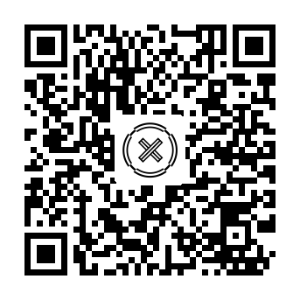
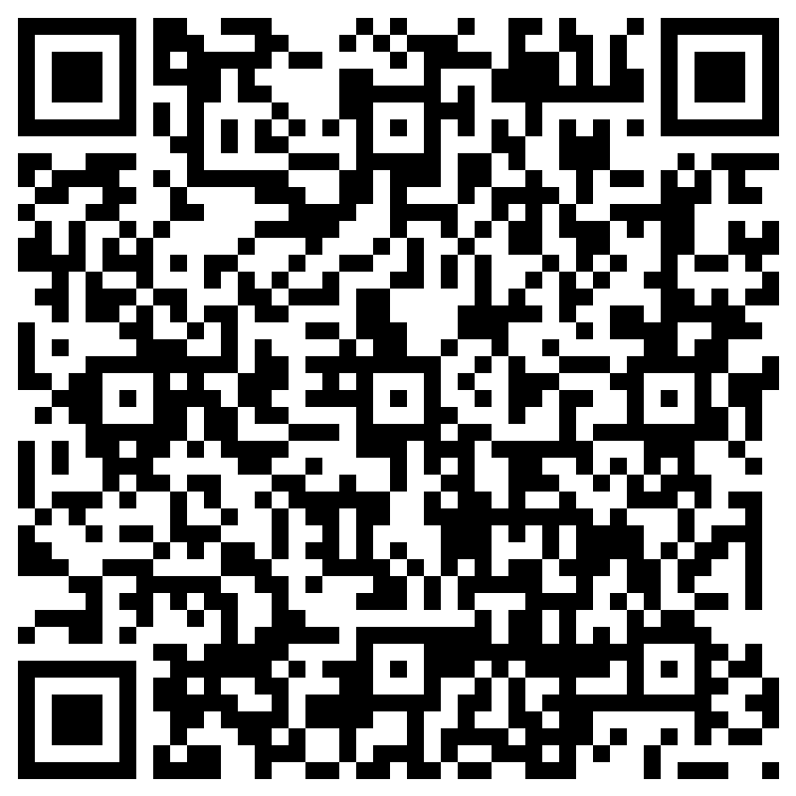
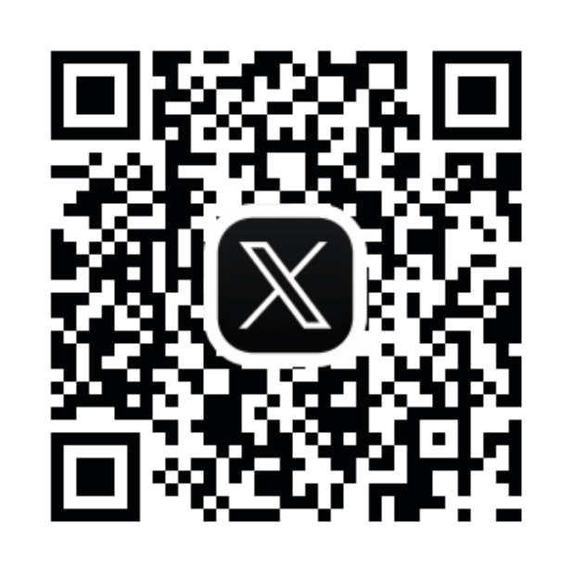

How to Apply
Apply now via the application form!
forms.office.com/r/gVQ48R3J75
Open the application
Answer a few questions and submit
Wait for the selection results
Latest info: kyutech.hackjunction.com / Follow us on X & Instagram
Three days connected to the world. We're waiting for what you'll create.

