Slide 1
Hotel Booking Website
Milestone 2 - Project Planning and System Design
Kyle Wayne Darjuan - Database Designer
Shiv Alpeshbhai Patel - Backend Planner
Daiju Saji - Frontend Designer
June 2026

Slide 2
Project Idea
Shiv
A website where travelers can book hotel rooms online
Search hotels by city, check-in/check-out dates and number of guests
See the rooms of a hotel with prices and book one
The total price is calculated automatically (price per night x nights)
Users can see all their bookings, change the dates or cancel
Biggest challenge: the same room should never be booked twice for the same dates (double booking).
2

Slide 3
Technology - Why MySQL?
Kyle
Database | MySQL
Backend | TypeScript + Express.js
Frontend | HTML, CSS, JavaScript
Our data is relational - users, hotels, rooms and bookings are all connected
Foreign keys (InnoDB engine): a booking always points to a real user and a real room
Transactions (InnoDB): availability check + insert happen in one step, so two people can't book the same room at the same time
CHECK constraints (MySQL 8): rules like check_out_date > check_in_date are checked by the database itself
MongoDB doesn't enforce relationships, we would have to code all the checks ourselves
3

Slide 4
Database - 5 Tables
Kyle
Table | What it stores | Important fields
users | customer accounts | user_id, name, email, password
hotels | the hotels | hotel_id, name, city, star_rating
rooms | room types of each hotel | room_id, hotel_id (FK), type, price_per_night
bookings | the reservations | booking_id, user_id (FK), room_id (FK), check_in/out, total_price, status
reviews (optional) | ratings and comments | review_id, user_id (FK), hotel_id (FK), rating
One hotel has many rooms, one user has many bookings
A booking belongs to one user and one room - with the date CHECK and transactions this stops double bookings
4

Slide 5
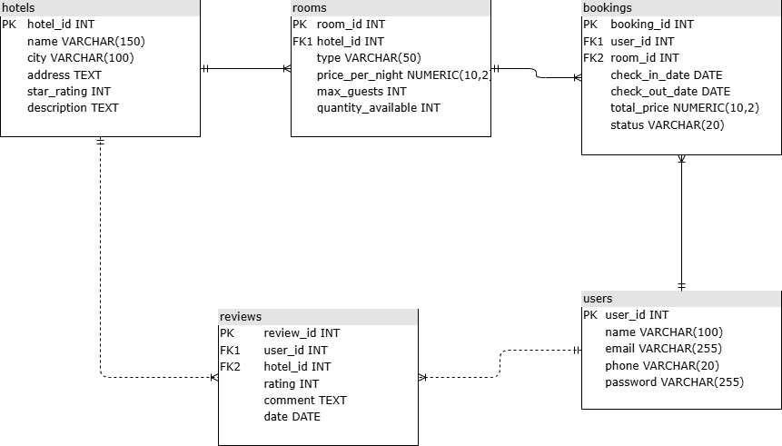
ERD
Kyle
Made in draw.io (source: database/hotel_booking.drawio)
5

Slide 6
Wireframes - 6 Pages
Daiju
Home - search with city, dates and guests
Hotel Listing - search results as cards (data listing)
Room Details - rooms of one hotel with prices
Booking Form - user info + total price before confirming (data entry)
My Bookings - all bookings with status, edit and cancel (data listing)
Edit Booking - change dates or cancel (edit/update)
Navigation: Home → Hotel Listing → Room Details → Booking Form → My Bookings ↔ Edit Booking
Made in Figma. The next two slides show the top of each page, the full pages are in the report.
6

Slide 7
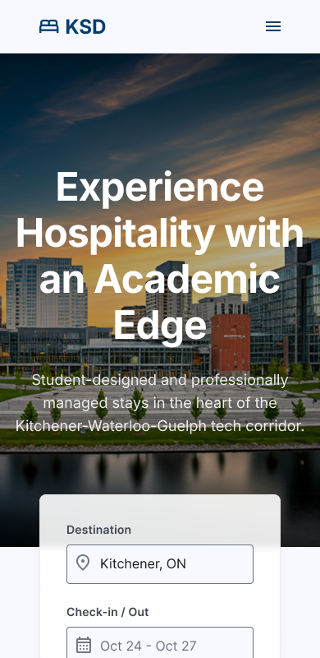
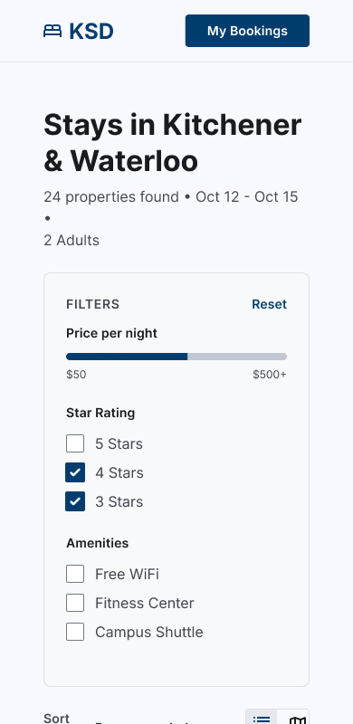
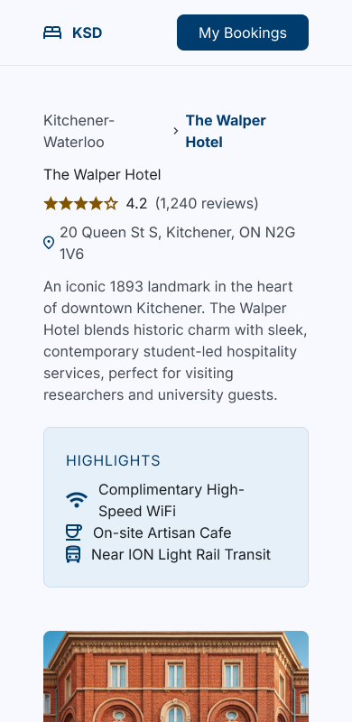
Wireframes (1/2)
Daiju
Home
Hotel Listing
Room Details
7

Slide 8
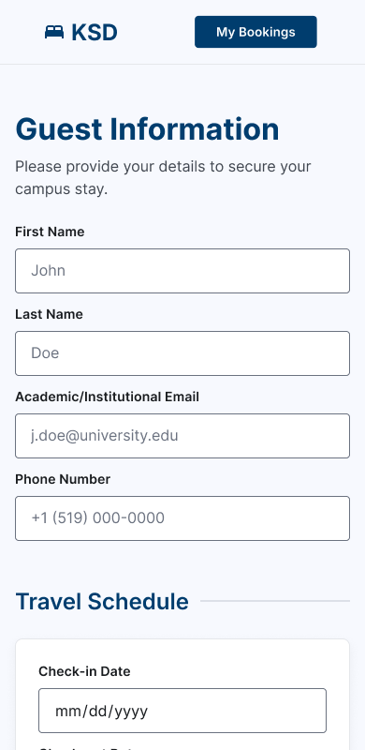
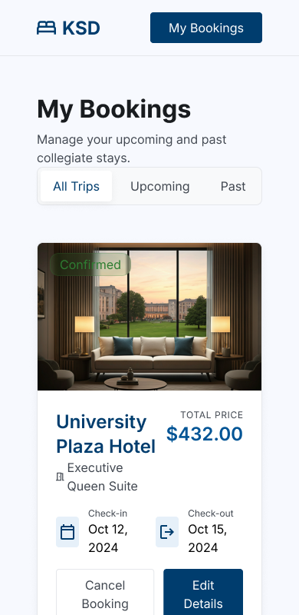
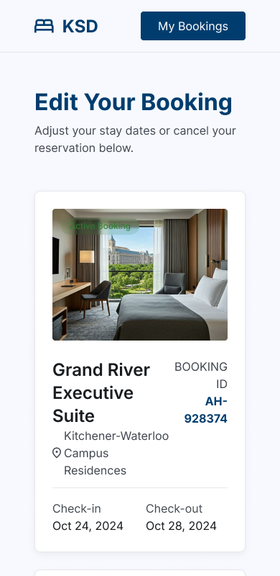
Wireframes (2/2)
Daiju
Booking Form
My Bookings
Edit Booking
8

Slide 9
Planned API Routes
Shiv
Method | Route | What it does
GET | /hotels | list of all hotels
GET | /hotels/:id | one hotel with its rooms
GET | /search?city=&checkin=&checkout=&guests= | search by city, dates, guests
GET | /rooms/:id | details of one room type
POST | /bookings | create a booking (in a transaction)
GET | /users/:userId/bookings | all bookings of one user
GET | /bookings/:id | one booking
PUT | /bookings/:id | change the dates
DELETE | /bookings/:id | cancel (status = cancelled)
Changed from Milestone 1: /bookings/:userId and /bookings/:id looked the same to Express, so the user list moved to /users/:userId/bookings.
9

Slide 10
Express Backend Structure
Shiv
src/
server.ts starts Express, loads the routes
db/pool.ts connection to MySQL
routes/ one file per resource
controllers/ handle the requests
models/ the SQL queries
middleware/ validation and errors
A request goes: route -> controller -> model (SQL) -> JSON answer
Everything is JSON, for example POST /bookings sends the userId, roomId and the dates
The frontend uses fetch() in JavaScript to call the routes (built in Milestone 3)
10

Slide 11
Team Responsibilities
Kyle Wayne Darjuan (Database Designer) - database choice, tables, ERD, documentation
Shiv Alpeshbhai Patel (Backend Planner) - API routes, Express structure, technical documentation
Daiju Saji (Frontend Designer) - wireframes, UI planning, navigation
GitHub:
11

