Slide 1

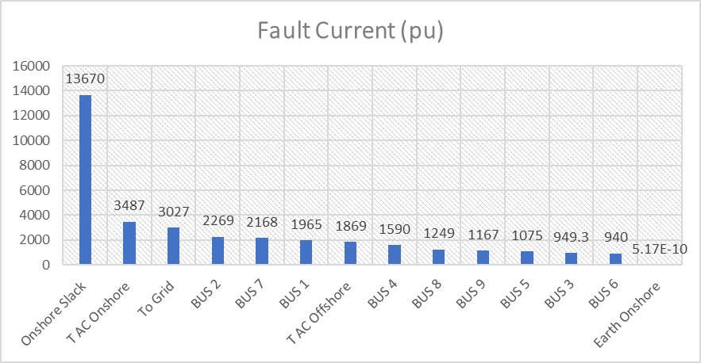
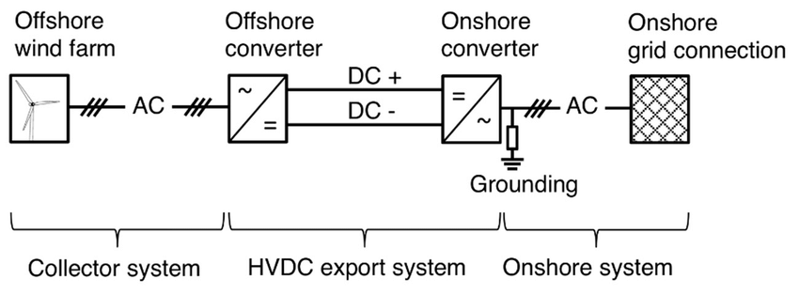
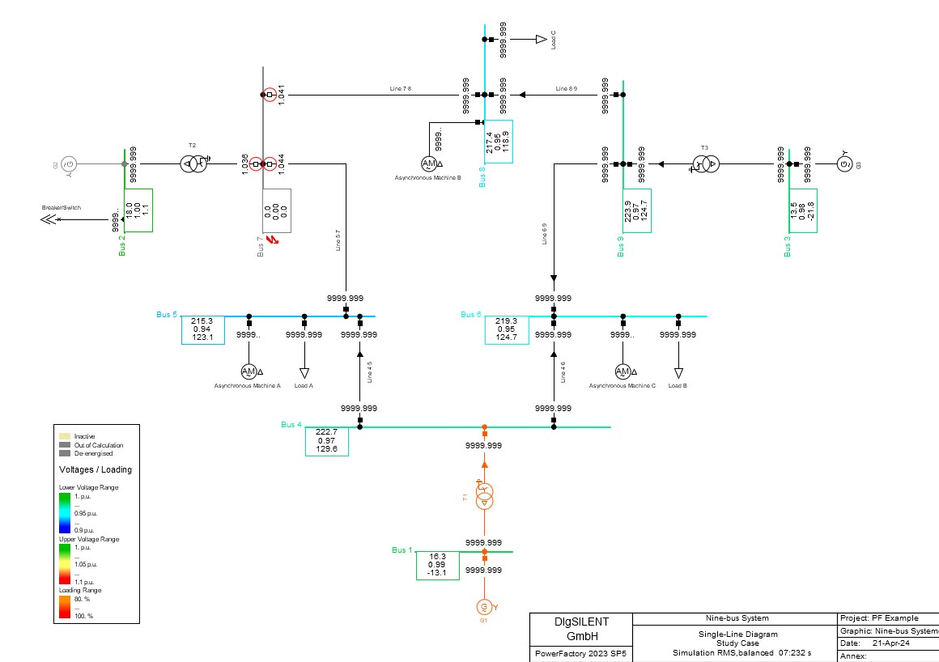
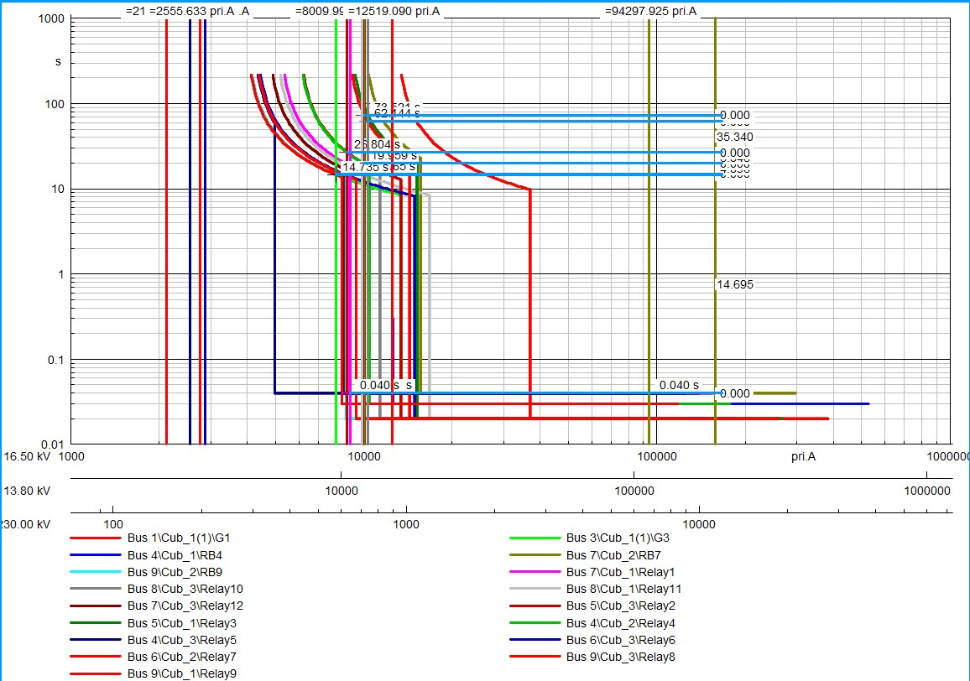
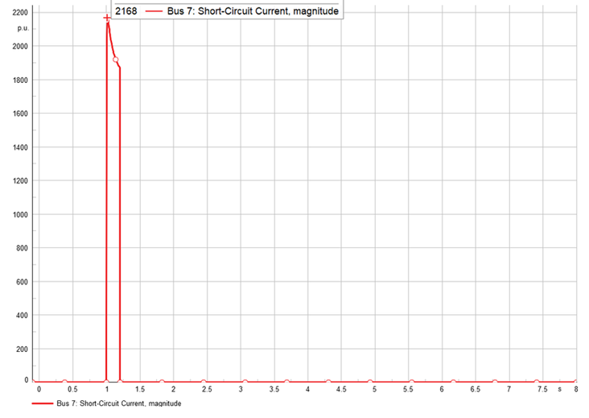
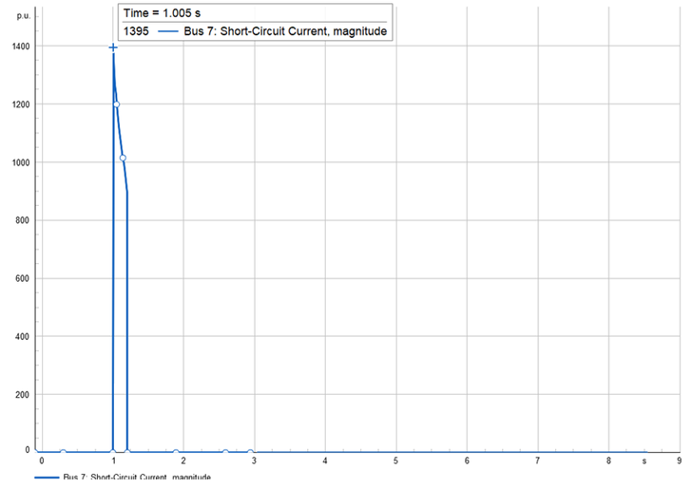

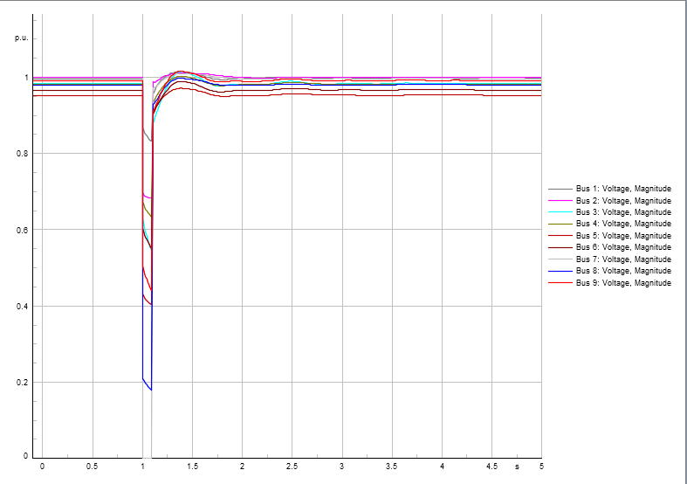
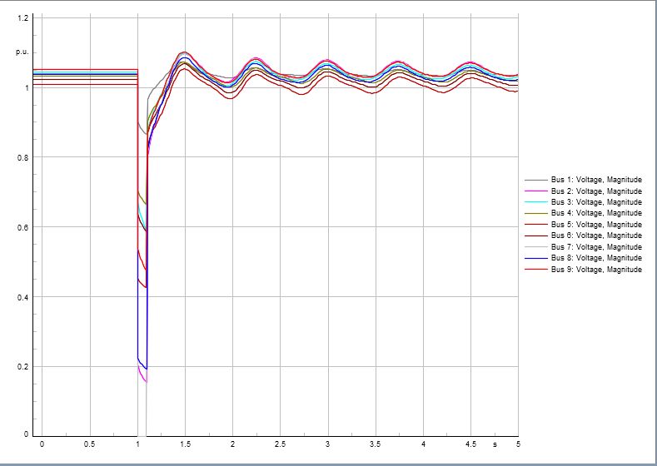
Study on faults and protection in AC grids connected with HVDC offshore wind farm
Authored By : Md. Khorsheduzzaman Sizan (190205088), Antor Roy (190205093),
S. M. Faisal Ahmed Pranto (190205161), Sharaf Joaher Khan (190205178)
Department of Electrical and Electronic Engineering, Ahsanullah University of Science and Technology
TIN:POW 8
Introduction
As the demand of renewable energy is increasing rapidly, offshore windfarm plays a crucial role to meet this demand. Here in this work the faults and protection of AC grids connected to HVDC offshore windfarm is studied and Observing the existing challenges and finding solutions we aim to enhance the reliability and efficiency of offshore wind energy systems.
Fig 6: Severity Index Of Fault Current Magnitude (Wind Connected)
Fig 7: Severity Index Of Fault Current Magnitude (Wind Disconnected)
Fig 1: Offshore Windfarm Integration With HVDC System And Eventually AC System
Fault
detection
Objective:
Fault Analysis Of Both HVDC and AC System.
Developing Index of Fault Severity
Optimizing Fault Protection
Fig 8: The Response Of All The Buses According To Voltage Dip When Fault is in Bus 7(Wind Connected)
Fig 9: The Response Of All The Buses According To Voltage Dip When Fault is in Bus 7(Wind Disconnected)
:
Protection Of AC System
Methodology
Stability
detection
Literature Review
Information Collection
Fault Analysis(Simulation using PowerFactory)
Identify The Best Protection
Protection System Analysis
Severity Indexing
Case Studies
Proposal of Modified Protection Strategies (If Possible)
Validation and Verification
Documentation and Reporting
Fig 10: Tripping Of Relays Associated With Bus 7 & Eventually Isolating Bus 7.
Fig 11: Relay Coordination Curves Of Overcurrent Relays in AC System
Results
Conclusion
In conclusion, the study on faults and protection in AC grids connected to offshore wind farms underscores the critical importance of robust protection schemes to ensure grid reliability and stability. By comprehensively analyzing fault scenarios and optimizing protection strategies, we can mitigate risks, enhance system performance, and pave the way for the efficient integration of offshore wind energy into the grid.
Achieved SDG Goal:
Fig 2: Fault Current Magnitude When Fault Is In Bus 7(Wind Connected)
Fig 3: Fault Current Magnitude When Fault Is In Bus 7(Wind Disconnected)
References
Lu, S., & Huang, T. (2019). Artificial intelligence in smart grid: A comprehensive review. Renewable and Sustainable Energy Reviews, 107, 569-582
A. F. Abokifa and E. F. El-Saadany, "Smart Grid: Challenges and Solutions," IEEE Transactions on Smart Grid, vol. 5, no. 4, pp. 1905-1912, July 2014.
S. M. Shahidehpour et al., "Smart Grid: Integrating Renewable, Distributed & Efficient Energy," Academic Press, 2019.
Nakabi, Taha Abdelhalim, and Pekka Toivanen. "Deep reinforcement learning for energy management in a microgrid with flexible demand." Sustainable Energy, Grids and Networks 25 (2021): 100413.
Mofleh, Ahmed F., Ahmed N. Shmroukh, and Nouby M. Ghazaly. "Fault detection and classification of spark ignition engine based on acoustic signals and artificial neural network." International Journal of Mechanical and Production Engineering Research and Development 10.3 (2020): 5571-5578
https://www.eia.gov/
Arzamasov,Vadim. (2018). Electrical Grid Stability Simulated Data . UCI Machine Learning Repository. https://doi.org/10.24432/C5PG66
Nakabi, Taha Abdelhalim, and Pekka Toivanen. "Deep reinforcement learning for energy management in a microgrid with flexible demand." Sustainable Energy, Grids and Networks 25 (2021): 100413.
Fig 4: Voltage Response Of Each BUS In AC System When Fault Is In Bus 7(Wind Connected)
Fig 5: Voltage Response Of Each BUS In AC System When Fault Is In Bus 7(Wind Disonnected)
Acknowledgements
The authors would like to express gratitude for the support from the Department of Electrical and Electronic Engineering,AUST.

