Slide 1
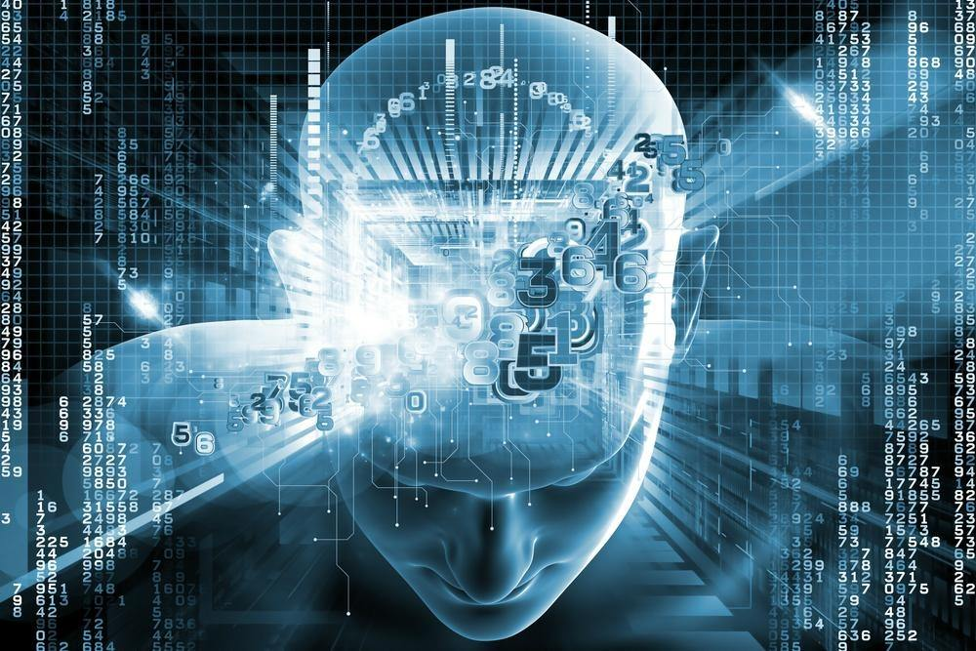
Machine Learning
Clustering
Pramote Kuacharoen

Slide 2

Unsupervised Learning
X₂
X₁
Training set: $\left\{x^{(1)},x^{(2)},…,x^{(m)}\right\}$

Slide 3
Applications of Clustering
Customer segmentation in CRM
Image compression: Color quantization
Bioinformatics: Learning motifs
Medical
Group news articles which are in the same categories
Social network analysis
Astronomical data analysis

Slide 4
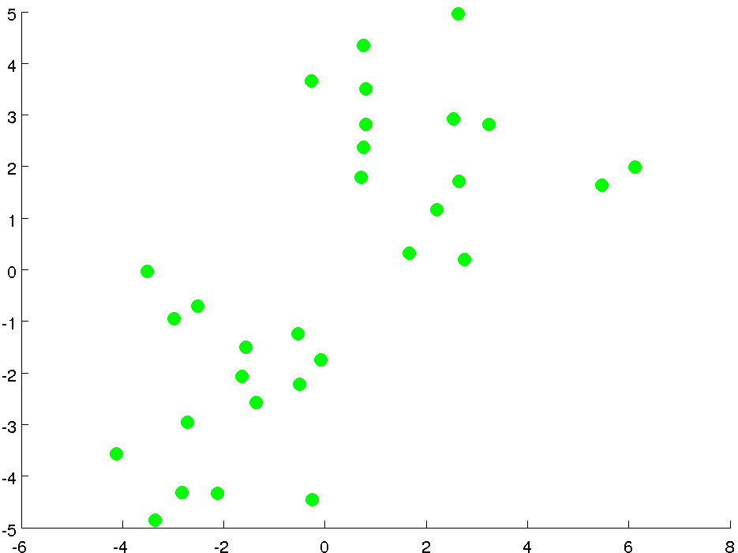
K-means Algorithm

Slide 5
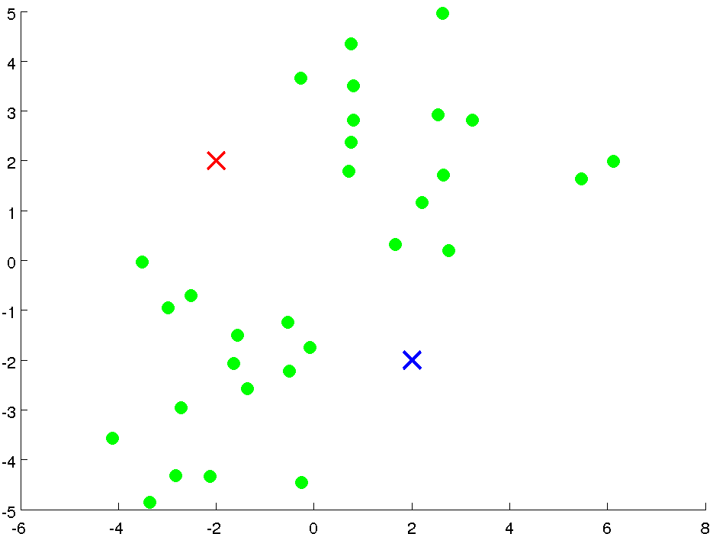

Slide 6
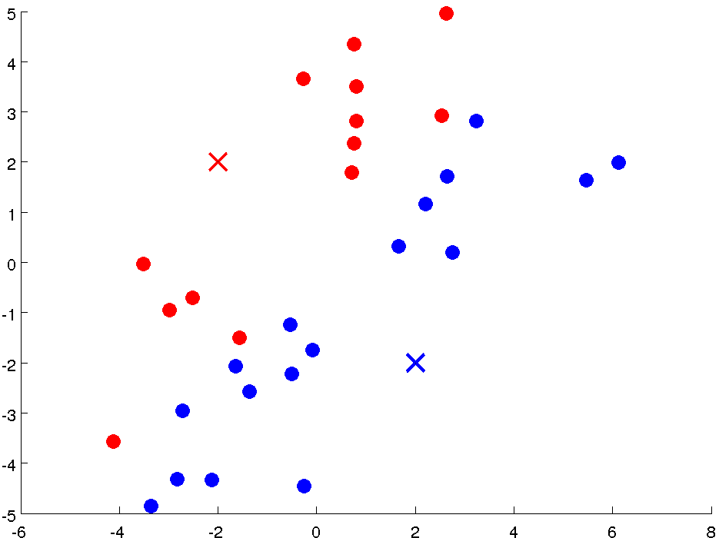

Slide 7
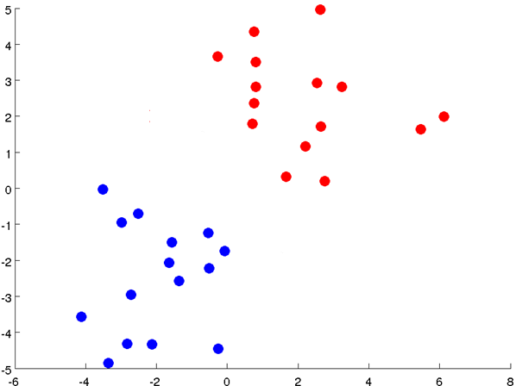

Slide 8
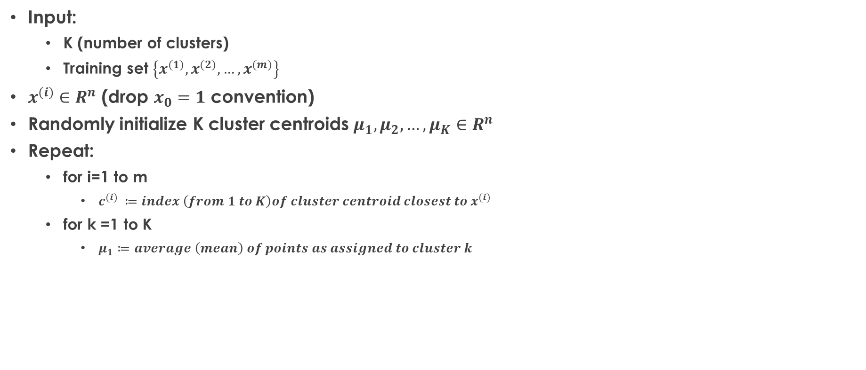
K-means Algorithm
Input:
K (number of clusters)
Training set $\left\{x^{(1)},x^{(2)},…, x^{(m)}\right\}$
$x^{(i)}∈R^{n}$ (drop $x_{0}=1$ convention)
Randomly initialize K cluster centroids $μ_{1}, μ_{2}, …, μ_{K}∈R^{n}$
Repeat:
for i=1 to m
$c^{(i)} ≔index \left(from 1 to K\right)of cluster centroid closest to x^{(i)}$
for k =1 to K
$μ_{1}≔average \left(mean\right) of points as assigned to cluster k$

Slide 9
K-means for Non-separated Clusters
T-shirt sizing
Weight
Height

Slide 10

K-means Optimization Objective
$c^{(i)}=index of cluster \left(1, 2, …, k\right)to which sample x^{\left(i\right)} is currently assigned$
$μ_{k}=cluster centroid k \left(μ_{k}∈ R^{n}\right)$
$μ_{c^{(i)}}=cluster centroid of cluster to which sample{ x}^{\left(i\right)} is currently assigned$
Optimization objective:
$J\left(c^{(1)}, …, c^{(m)}, μ_{1}, …, μ_{K}\right)=\frac{1}{m}\sum_{1}^{m}{{\left\|x^{(i)}−μ_{c^{(i)}}\right\|}^{2}}$
$\min_{c^{(1)}, …, c^{(m)}, μ_{1}, …, μ_{K}}{J\left(c^{(1)}, …, c^{(m)}, μ_{1}, …, μ_{K}\right)}$

Slide 11
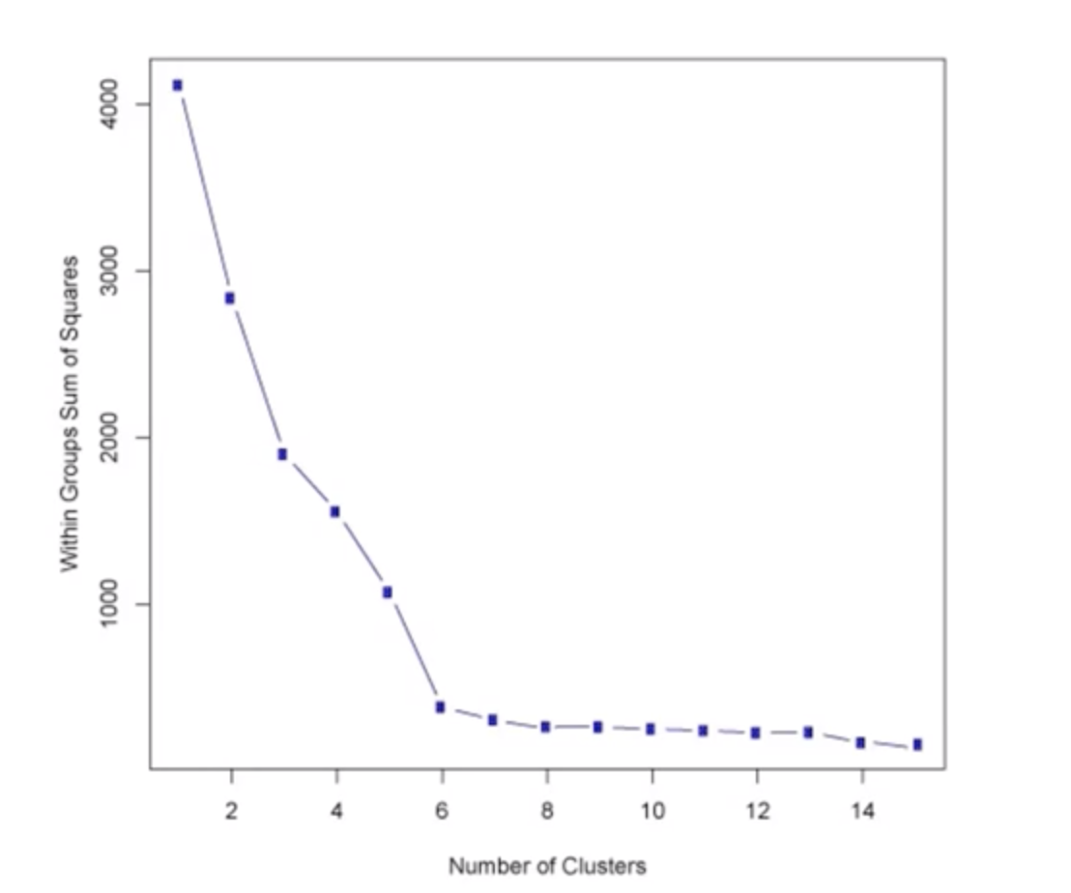
Choosing the Number of Clusters
Elbow method

Slide 12
Choosing the Number of Clusters
Evaluate K-means based on a metric for how well it performs for that later purpose
T-shirt sizing
T-shirt sizing
Weight
Weight

Slide 13
Question?
Insert Image

