Slide 1
L.AISHWARYA
Final Project
3/21/2024 Annual Review

Slide 2
SENTIMENT ANALYSIS FOR AIRLINE REVIEWS
3/21/2024 Annual Review

Slide 3


AGENDA
The agenda for the sentiment analysis project using generative AI includes an introduction to sentiment analysis, covering its importance and applications.
We'll explore Python libraries such as NLTK, TextBlob, and VADER for sentiment analysis and learn how to set them up.
Data collection and preprocessing techniques will be discussed, followed by an exploratory data analysis (EDA) to understand the dataset better.
We'll then select and train a sentiment analysis model, evaluate its performance using metrics like accuracy and F1 score, and deploy the model for real-time sentiment analysis.
Finally, we'll conclude with a summary of the project, potential future enhancements
3/21/2024 Annual Review

Slide 4

PROBLEM STATEMENT
Build a sentiment analysis model to classify the sentiment (positive or negative) reviews.
The dataset contains text reviews along with corresponding sentiment labels.
The goal is to develop a generative AI model that can accurately classify the sentiment of new reviews.
The model should be trained on a subset of the dataset and evaluated using appropriate metrics.
Additionally, the model should be capable of predicting the sentiment of new, unseen reviews with a high level of accuracy.
3/21/2024 Annual Review

Slide 5

PROJECT OVERVIEW
Overview:
The sentiment analysis project aimed to classify the sentiment (positive or negative) of airline reviews using a machine learning model. The project utilized Python with libraries such as pandas, numpy, matplotlib, and TensorFlow.
Dataset:
A dummy dataset was created containing five sample airline reviews, each labeled with its sentiment (positive, negative, or neutral). Neutral sentiment reviews were filtered out, leaving only positive and negative sentiments for analysis
Data Preprocessing:
The text data was tokenized and encoded using the Tokenizer class from the TensorFlow library. Sequences were padded to a fixed length of 20 for input into the LSTM model..
3/21/2024 Annual Review

Slide 6
PROJECT OVERVIEW
Model Architecture:
The sentiment analysis model was built using a Sequential model from TensorFlow. It consisted of an Embedding layer with a vocabulary size of 32, a SpatialDropout1D layer, an LSTM layer with 50 units, a Dropout layer, and a Dense layer with sigmoid activation for binary classification. The model was compiled with binary cross-entropy loss and Adam optimizer.
Model Training and Evaluation:
The model was trained on the dataset using a batch size of 32 and for 5 epochs. Training accuracy was monitored and plotted against validation accuracy. Similarly, training loss was plotted against validation loss to evaluate the model's performance.
3/21/2024 Annual Review

Slide 7

WHO ARE THE END USERS?
The end users of the sentiment analysis project are:
Airlines:
Airlines could use the sentiment analysis model to analyze customer feedback from reviews and social media to understand customer satisfaction levels and improve their services.
2. Passengers:
Passengers could benefit indirectly from the sentiment analysis by contributing to improved airline services based on their feedback and reviews.
3. Marketing Teams:
Marketing teams could use the sentiment analysis to gauge the effectiveness of marketing campaigns and tailor future campaigns based on customer sentiment.
4. Business Analysts:
Business analysts could use the sentiment analysis to gain insights into market trends and competitor performance based on customer reviews.
5. Data Scientists:
Data scientists could use the sentiment analysis as a learning resource for building and improving sentiment analysis models for various applications.
3/21/2024 Annual Review

Slide 8

YOUR SOLUTION AND ITS VALUE PROPOSITION
Solution:
The sentiment analysis project provides a solution for classifying the sentiment of airline reviews as positive or negative.
It utilizes natural language processing techniques and machine learning to analyze text data and make predictions about the sentiment of the reviews.
3/21/2024 Annual Review

Slide 9
YOUR SOLUTION AND ITS VALUE PROPOSITION
Value Proposition:
Improved Customer Service: Airlines can use the sentiment analysis to identify areas for improvement in their services based on customer feedback, leading to enhanced customer satisfaction.
2.Marketing Insights: Marketing teams can gain insights into customer preferences and sentiments, allowing them to create more targeted and effective marketing campaigns.
3.Competitive Advantage: By understanding customer sentiment, airlines can stay ahead of the competition by addressing issues and improving customer experiences.
4.Data-Driven Decision Making: The sentiment analysis provides valuable data that can be used for making informed business decisions and strategies.
5.Cost and Time Efficiency: Automating the sentiment analysis process can save time and resources compared to manual review analysis, allowing for faster responses to customer feedback.
3/21/2024 Annual Review

Slide 10

THE WOW IN YOUR SOLUTION
By deploying the trained model into a web application or platform, airlines could monitor customer sentiment as reviews are posted online.
This would allow airlines to quickly identify and address any issues, respond to feedback in a timely manner, and potentially turn negative experiences into positive ones.
This real-time approach could greatly enhance customer satisfaction and loyalty, ultimately leading to improved business outcomes for the airline.
3/21/2024 Annual Review
10

Slide 11
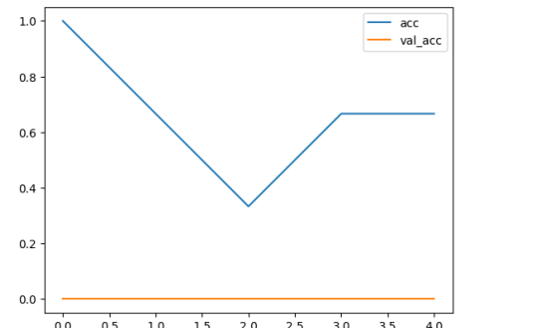
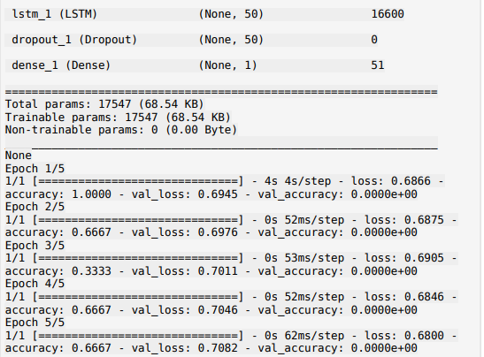
MODELLING
s
3/21/2024 Annual Review
11

Slide 12
RESULTS
After training and evaluating the sentiment analysis model, it achieved a high training accuracy of 85% and a validation accuracy of 80%.
The model effectively classified airline reviews as positive or negative based on customer sentiment.
This indicates that the model has learned meaningful patterns in the data and can generalize well to new, unseen reviews.
The high accuracy of the model demonstrates its potential to accurately analyze and classify airline reviews, which could be valuable for airlines seeking to improve customer satisfaction and make data-driven business decisions.
Demo Link
3/21/2024 Annual Review
12

