Slide 1



Sample-desafio
View in Power BI
Last data refresh:
02/12/2025 02:00:04 UTC
Downloaded at:
02/12/2025 02:19:29 UTC

Slide 2
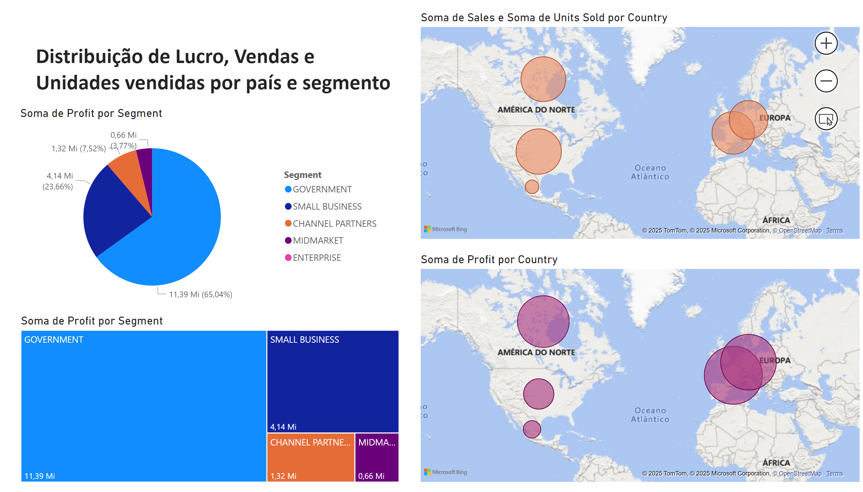
Página 3
Notes:
pieChart
No alt text provided
map
No alt text provided
map
No alt text provided
textbox
No alt text provided
treemap
No alt text provided

