Slide 1
Loan Prediction Problem
By: Luke Dibble
Project 2

Slide 2
The Data
Over 600 potential loan applicants reviewed
Features: Gender, Married, Dependants, Credit History, Income, Co-Applicant, Education, Self-Employed, Loan Amount and Term Length
Loan Approval

Slide 3
The Plan
The Goal
Who was most likely to seek out a loan
Who was most likely to be approved
Develop a process to increase predictability for who will be approved for a loan
Is there a specific categorical group of people to market too who will have a higher chance of approval?

Slide 4
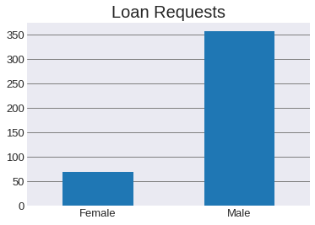
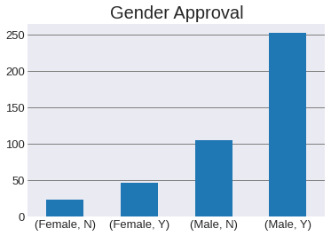
Far more men seek loans than women.
Even though more men seek loans, it’s roughly a 70% approval rate for both genders.

Slide 5
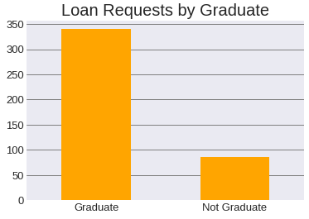
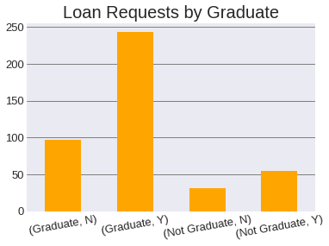
Graduates are more likely to seek loans than non grads.
Roughly 71% of graduates are eligible of approval, while only about 64% of non grads are.

Slide 6
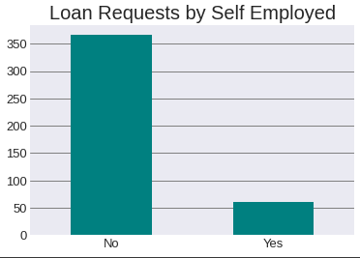
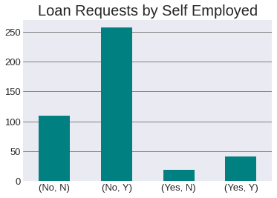
Those who are not self employed are more likely to seek loans than those that are..
Again we see roughly a 70% approval rating for both categories.

Slide 7
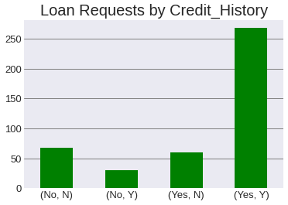
Having a credit history increases approval rating to 82%. No credit history is still about a 70% approval.

Slide 8
The Method
Looking at a baseline approach, if we were to approve every applicant, only about 70% of them should have been. Therefore we need to develop an approach to achieve a better % of accuracy.
After testing several machine learning models, we settled on Gradient Boosting as this gave us the greatest accuracy.

Slide 9
The Results
With the dataset we have, we were able to boost our baseline accuracy from ~70% to 78%. With more data this could be increased.

Slide 10
Conclusion
When seeking new clients, educated men who are not self-employed and have a credit history are going to be the most likely to not only seek out a loan, but also get approved.

