Slide 1
Project 2
Loan Determination
Luke Dibble
Coding Dojo

Slide 2
The Data
After researching several different dataset, I chose to take up the Loan Prediction Problem from Kaggle.
This dataset came in 2 pieces, a Train set and a Test set.
Features covered
Applicant and Co-Applicant Income
Gender and Married or not
Graduate or not, Self Employed
Number of Dependents
Loan Amount
Loan Term Length
Does applicant have Credit History
Property Area
I read in the data, using the Loan_ID column as the index.

Slide 3
Goal
Using this data I intend to create a predictive model to determine whether an applicant will be approved for a loan or not.
From the dataset the Target is Loan_Status

Slide 4
The Cleaning: Outliers
This data required a lot of cleaning, both the train and test data sets. Multiple Null values and outliers to deal with. As well as several Object type features to deal with. Any cleaning I did to one dataset I matched to the other to keep them consistent.
First step I took was cleaning outliers.
I determined the outliers in ApplicantIncome, CoapplicantIncome and LoanAmount would be the ones that needed dealing with and decided to drop to worst of the outliers. Anything over 30k in Applicant Income. Over 10k in Coapplicant Income. And under100 in LoanAmount.

Slide 5
The Cleaning: Nulls
I didn’t want to drop too much data as this data was only about 1k rows between both sets.
Cleaning Decisions by column
Gender: Replaced with majority. (Male)
Married: Replaced with No (determining a null was left blank because not married)
Dependents: Replaced with ‘0’ (Determining a null was no dependants, and matching dtype for later correction)
Self_Employed: Replaced with No (Determining a null was not self employed)
Loan_Amount_Term: Replaced with majority (360)
Credit_History: Replaced with No (Determining a null was no credit history)

Slide 6
Visualization and Evaluation
Questions I put forth to myself:
What percentage of loans were approved?
What correlations were there in the data?
Was there a strong gender bias in those that got approved?

Slide 7
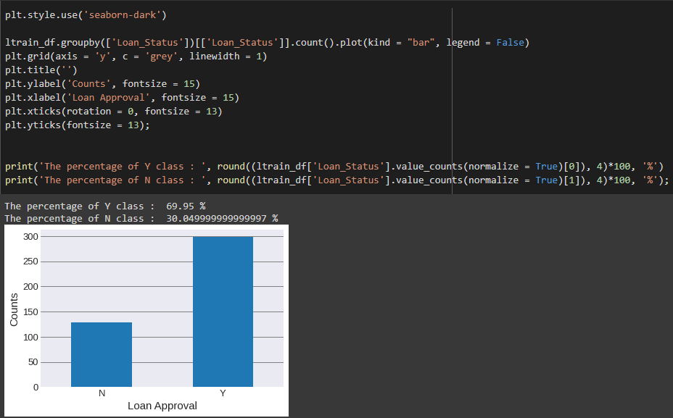

Slide 8
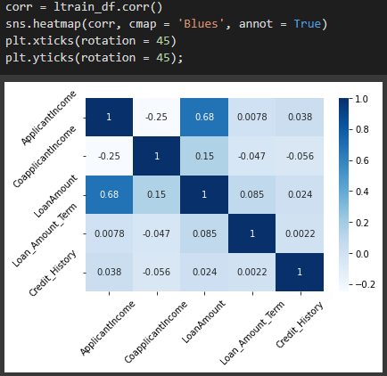

Slide 9
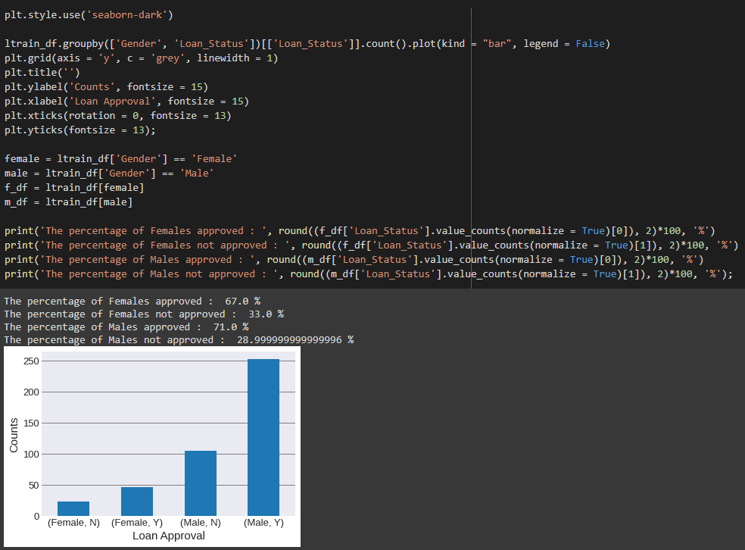

Slide 10
Visualization and Evaluation
What percentage of loans were approved? 70%
What correlations were there in the data? Applicant Income and Loan Amount
Was there a strong gender bias in those that got approved? More males applied than females, but there wasn’t a strong bias to approve males over female.

Slide 11
Next Steps:
Prepare the data for predictive modeling. Determine how best to handle dType Objects.
Will this be a supervised or unsupervised model?
Test and determine what type of predictive model to use (Regression / Classification / Clustering)
Determine which model to use. (Forests, Trees, KNN, KMeans…)
Test model with training data
Apply model to test data

Slide 12
Challenges
Only the train dataset had a target to work with. Figuring out how to create a predictive model with no test target data will be a new challenge for me to complete.
I feel this will be an excellent real world example. Using know data to create a model that can then take unknown data and give a result.

