Slide 1
Real-time detect recover classify defence Against Adversarial Attacks on Rf Modulation Classification
Presentator: 王彥凱 (Wang-Yan Kai)
Advisor: 葉宗泰 (Tsung-Tai Yeh)
Computer Architecture and System (CAS) Lab
Institute of Multi-Media Engineering
National Yang Ming Chiao Tung University
Hsinchu, Taiwan

Slide 2
Outline
Motivation
Related Work
Contributions
System Overview
Methodology
Evaluation
Conclusion

Slide 3
Outline
Motivation
Related Work
Contributions
System Overview
Methodology
Evaluation
Conclusion

Slide 4
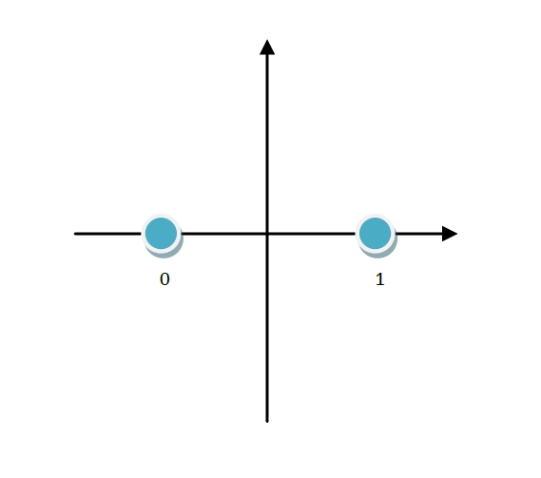
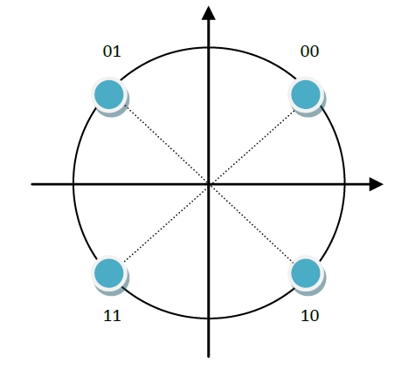
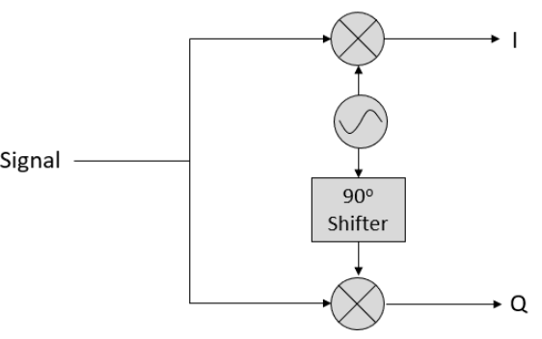
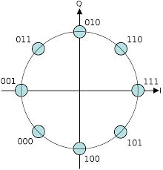
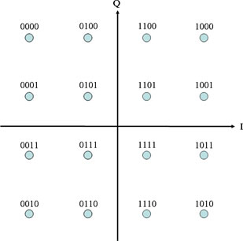
I/Q Signal Representation for Modulation Recognition
BPSK 1bit
QPSK 2bit
I = projection on cosine carrier
Q = projection on sine carrier
I/Q pair become one point in a plane
8PSK 3bit
16QAM 4bit
Notes:
I/Q 不是兩個不同訊號，而是同一個 RF signal 投影到兩個互相正交的 carrier。I 是 cosine 同相分量，Q 是 sine 正交分量。這兩個值合起來就是星座圖上的一個點
把 I 當 x 軸、Q 當 y 軸，就可以得到 constellation diagram。BPSK 只有兩個點，QPSK 有四個點，16QAM 有十六個點。AMC 的核心就是從 I/Q samples 學出這些 pattern，進而判斷 modulation type。

Slide 5
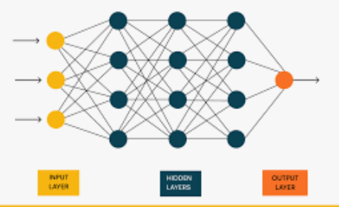
What is Automatic Modulation Classification
Raw I / Q Samples
AMC Classifier feature extractor + model
Output Modulation class
BPSK
QPSK
……
What AMC does
Recognizes modulation patterns from I / Q samples.
Can be used before full frame decoding is available

Slide 6



Motivation: Spectrum Sensing
wireless channel
Spectrum sensing system
energy detection
find occupied region
get occupied segment [2, 128]
AMC
SENSING = WHERE/ WHEN
Detect occupancy in time (and band), Is there a signal, and where? e.g., energy detection
AMC = WHAT
Classifies the modulation of the isolated segment

Slide 7
RF rx pipeline
Receiver spectrum sensing
wireless channel
rf rx pipeline
Antenna / RF Front-End
AGC
(gain normalization)
Energy / PSD monitor
AMC
Sketch / Blanker
DDC / Channelizer

Slide 8
Motivation
Traditional RF receivers already include synchronization, header decoding, lock detection, SNR estimation, EVM, and CRC checks. Therefore, AMC is not intended to replace a standard receiver pipeline.
In this work, AMC is considered as a pre-demodulation RF sensing task for unknown or partially known signals. It provides a coarse modulation-family estimate from raw I/Q samples, which can help signal classifier, decoder routing, and robustness evaluation under interference or adversarial perturbation.

Slide 9
Motivation
NASA Glenn: Why AMC
is useful (2017)
Satellite AMR AMC/AMR is activate in Satcom (2020)
Goal: using AMC for cognitive satellite communication
Why modulation classification helps ?
  Receiver path selection: Estimate PSK / APSK / QAM family before choosing a candidate demodulation chain.
  Interference / anomaly flagging: Low confidence or unstable predictions can indicate interference-like or abnormal RF behavior.
  Spectrum monitoring support: Convert raw I/Q observations into modulation-level metadata for logging and RF spectrum management.

Slide 10
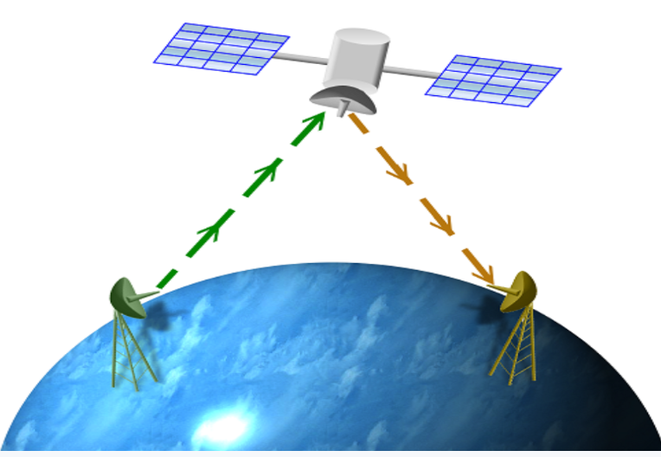
Motivation
NASA Glenn: Why AMC
is useful (2017)
Satellite AMC/AMR is activate in Satcom (2020)
if it can know modulation type by amc, it doesn’t do the rx pipeline? e.g., know the signal is qpsk, it can use qpsk rx demodulation directly.
Alarm system:
QPSK confidence = 0.94 → waveform stable
Unknown confidence = 0.35 → suspicious
Prediction jumps QPSK → 8PSK → Unknown → unstable
how to know modulation in rx pipeline?
  acquisition / synchronization
  detect PLHEADER
  read PLS code / MODCOD
  know modulation + coding rate
  configure demodulator + FEC decoder

Slide 11
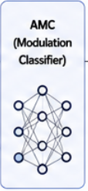


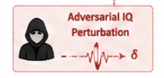

Threat model
Receiver observes superposition
wireless channel
wrong label BPSK->QPSK
Assumptions:
- Perturbation power is bounded.
- The perturbation is added over the air or injected into I/Q samples.
- The perturbation should remain signal-like and hard to detect.
- Goal: cause wrong AMC prediction or unstable confidence.
x_adv = h * s + n + δ
where:
s : transmitted RF signal
h : wireless channel
n : channel noise
δ : adversarial perturbation
false alarm
missed detection

Slide 12
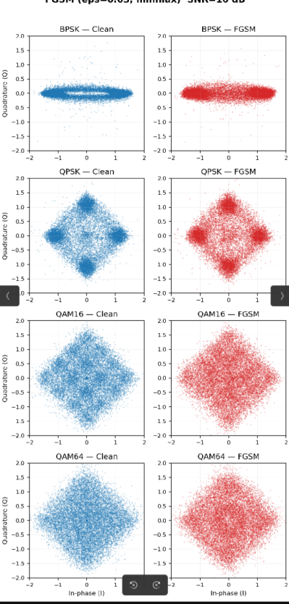
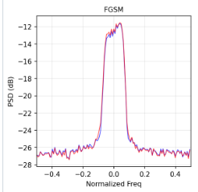
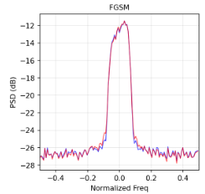
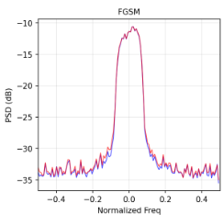
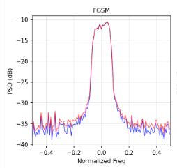
Threat model
iq distribution
frequency domain
Adversarial Attack
  Distort input data on the signal sender.
  fools ML Model, subtle perturbations, hard to detect
  Reported impact in AMC accurancy 90% -> 10%

Slide 13
Outline
Motivation
Related Work
Contributions
System Overview
Methodology
Evaluation
Conclusion

Slide 14
Related Work
Adversarial Attack
  FGSM — single-step gradient sign [Goodfellow+ '15]
  CW — L2-optimized minimal perturbation [Carlini-Wagner '17]
  PGD — iterative [Madry+ '18]
  EAD — elastic-net, sparse L1 perturbation [Chen+ '18]

Slide 15

FGSM
perturbation
backprogation loss
why it matters:
fast one-step attack
useful as a baseline vulnerability test
shows whether AMC is sensitive to small I/Q perturbations

Slide 16

CW: Carlini-Wagner Attack
minimal perturbation
optimization objective
why it matters:
Iterative optimization-based attack
Finds a small perturbation that changes the classifier output
often more subtle and stronger than FGSM

Slide 17
Related Work
SafeAMC / RF-specific Adversarial Training, 2021–2022
  Adversarial training fine-tunes AMC models with adversarially perturbed IQ samples. SafeAMC shows that RF modulation classifiers can benefit from adversarial training, and robust models tend to rely more on modulation-relevant signal statistics such as constellation structures.
  Limitation: Robustness is usually tied to the attack type and perturbation budget used during training. It may not generalize well to unseen adaptive attacks, new channel conditions, or different SNR regimes. It also requires retraining and increases training cost.

Slide 18
Related Work
MDPD — Mapping-based Data Processing Defense, 2023
  Applies RF-specific input mappings such as random split, time-domain flips, and phase rotations to disrupt adversarial perturbations before classification. It does not require fine-tuning or incremental training.
  Limitation: It is a heuristic input transformation. If the attacker knows the transformation distribution, they can perform expectation-over-transformation style attacks. Some mappings may also disturb phase-sensitive modulation features.

Slide 19
Related Work
FRS — Filtered Randomized Smoothing, 2024
  Combines spectral filtering + randomized smoothing. The paper observes that clean RF signals tend to be more frequency-localized, while FGSM / PGD perturbations are more spread out in frequency. FRS uses filtering plus Gaussian smoothing to provide certified robustness for modulation classification
  Limitation: Randomized smoothing requires multiple noisy inference samples, so runtime cost is high. Larger noise improves certification but reduces clean accuracy. The paper also notes that filtering may hurt some modulation types such as AM-SSB because the filter design may not match asymmetric spectral structures.

Slide 20
Outline
Motivation
Related Work
Contributions
System Overview
Methodology
Evaluation
Conclusion

Slide 21
Contributions
Adaptive-fft-k frequency-domain defense
  Failure analysis of knee-only Adaptive-K
CW attacks inflate spectral tails and cause K overestimation.
  SNR-aware Adaptive-FFT-K defense
Combines spectral-flatness routing, knee estimation, and SNR-bounded K.
  Systematic robustness evaluation
Evaluated on five attacks and multiple SNRs.
Improves CW / EAD robustness with negligible extra computation.

Slide 22
Outline
Motivation
Related Work
Contributions
System Overview
Methodology
Evaluation
Conclusion

Slide 23





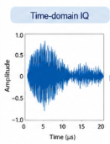
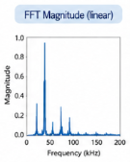
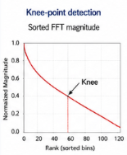
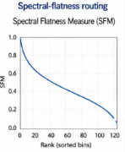
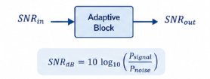
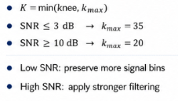
System overview
Input IQ
sample
One-pass
FFT
Spectral
Analysis
Adaptive K Selection
AMC
Classifier
1 ) One- Pass FFT
2) Spectral Analysis
3) Adaptive K Selection
Convert time-domain IQ samples to frequency-domain magnitude spectrum
Spectral statistics guide routing and analysis.
Adaptive selection of truncation length K based On SNR..
Provides the frequency-domain representation used for subsequent analysis
Find Knee point of the sorted magnitude curve.
Assess flatness to route of adapt analysis.

Slide 24
Outline
Motivation
Related Work
Contributions
System Overview
Methodology
Evaluation
Conclusion

Slide 25
Methodology
Problem:
AMC input can be adversarially perturbed Fixed preprocessing is not adaptive to SNR or modulation.
Solution:
Add lightweight preprocessing before AMC classification. Preserve dominant spectral component. Select K using knee point, spectral flatness and SNR bound

Slide 26
Methodology
Fixed filtering is not Enough
Low SNR QPSK
Same fixed filter gaussian / FIR / Wiener / Kalman
Limitations
may remove useful modulation features
Not adaptive to channel SNR
Not adaptive to modulation structure
High SNR 16 QAM
Risk: under-filter or over-filter
Different spectral shape

Slide 27
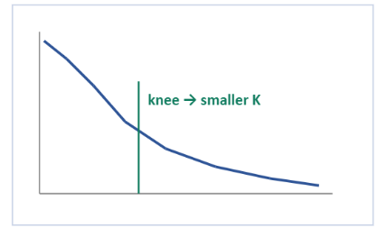
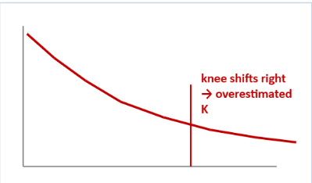
Methodology
Knee-only Adaptive-K Can Fail
Clean sorted spectrum
Cw / EAD tail-inflated spectrum
Attack Mechanism: Optimization attacks inflate weak spectral tails, causing the magnitude to decay less sharply.
Defense Failure: A "knee-only" selection mechanism misidentifies the cutoff, inadvertently preserving excess noisy bins.
Result: Residual adversarial components bypass the filter, rendering the defense ineffective.

Slide 28
Methodnology
K controls how many frequency components are preserved
K is too small
useful modulation features are removed
clean accurancy decreases.
Low-SNR signals are easily damaged
K is too large
weak spectral bins are preserved
Adversarial perturbations remain Defense becomes weak
adaptive-K

Slide 29
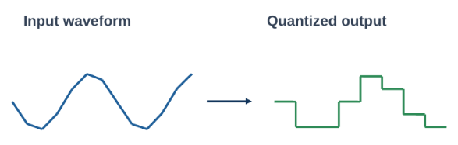

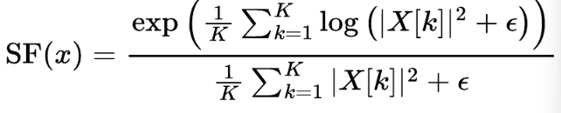
Methonology
Spectral flatness routing
Spectral flatness measures whether a signal spectrum is flat / noise-like or peaky / concentrated. In Adaptive-FFT-K, it is used to decide which defense path should be applied.
Definition
Given an input I/Q sample, compute the FFT and power spectrum:
spectral flatness is the geometric mean divided by the arithmetic mean of the power spectrum:
K = number of frequency bins = small constant to avoid log (0)
how to Interpret SF
SF 1, Flat spectrum
wideband / noise-like ->use quanization path
SF 0, peaky spectrum
narrowband/concentrated -> use SNR-aware Top - k filtering.
routing rule: SF > -> wideband path, quantization (32 level)

Slide 30
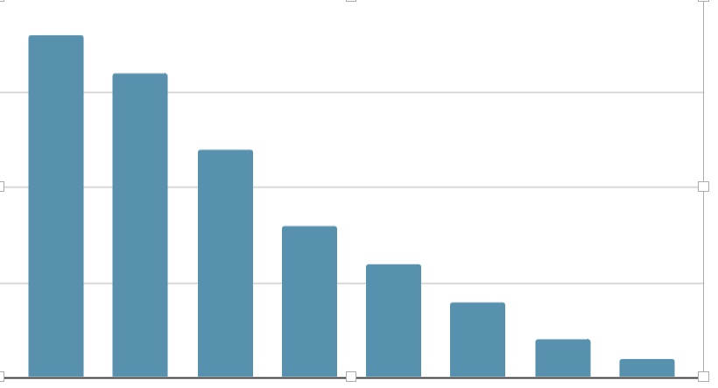
methodology
FFT magnitudes knee point -> Top-K Selection
knee = first k where | x[k] | / | x[1] | < Y
Final K : k i = min (knee_i , kmax), e.g., if knee = 11 and kmax >= 11 -> k = 11
Sorted FFT magnitudes
Top-11 means: keep the 11 strongest frequency bins
knee = 11
x[k]
cutoff
x[k] / x[1] < y

Slide 31
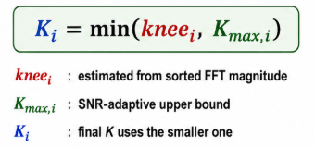
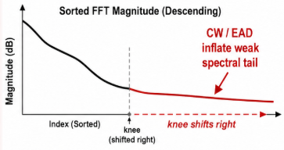
methodology
Why SNR-Bounded K is Needed
Low SNR | looser bound | preserve weak useful signal components
High SNR | tighter bound | suppress weak adversarial tail
Knee-only K depends only on spectrum shape
Inflated tails can overestimate K
Large K preserves adversarial weak bins

Slide 32
Outline
Motivation
Related Work
Contributions
System Overview
Methodology
Evaluation
Conclusion

Slide 33
Evaluation (crc pipeline)
Environment: SNR 18 db, 200 bursts/mod, cw c=1.0, 1000 steps, crc-8.
clean + oracle : no attack, true demodulation
Adv + Oracle : CW attack, but demod forced correct
Scanario | AMC Acc | CRC pass
Clean + Oracle | 98.1 % | 99.4 %
Adv + Oracle | 7.0 % | 97.3%

Slide 34
Evaluation (adversarial training)
env: Trained on FGSM+PGD＋ EAD
CW accuracy (SNR >= 0)
Config | no def
Base model | 35.4
Adv-trained | 53.7
+18.3 pp on unseen CW - robustness

Slide 35
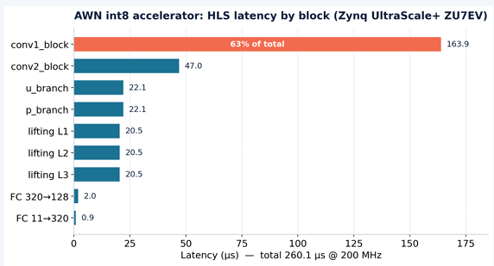
Evaluation (verilog software simulation)
env: Vitas HLS 2023.2, target xczu7ev - C-synthesis + RTL co-sum estimate
260 us latency @ 200 Mz
63% conv1 = bottleneck

Slide 36
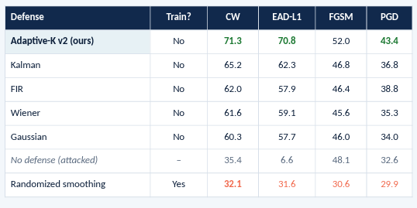
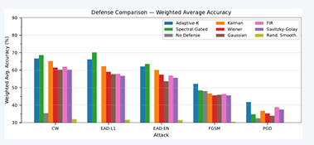
Evaluation (acc comparision)
randomized smoothing using σ=0.01 Gaussian, destroys fine IQ structure

Slide 37
Conclusion
SigGuard's recover→classify pipeline beats individual classical filters on optimization attacks (CW, EAD) on RML2016.10a.
Adaptive-K restores CW 35.4→71.3% and EAD-L1 6.6→70.8%, leading the best filter (Kalman) by 6–8 pp — while holding clean accuracy at 92.6%.
O(T log T) cost and int8 quantization make it feasible for real-time microcontroller deployment.
Project OKR4 — “AI adversarial-attack defense” — is ~85% complete.

Slide 38
Thanks for Listening

Slide 39
Q&A

