Slide 1
Adaptive-FFT-K: A Real-Time Recover-then-Classify Defense Against Adversarial Attacks on RF Modulation Classification
Presenter: 王彥凱 (Yan-Kai Wang)
Advisor: 葉宗泰 (Tsung-Tai Yeh)
Computer Architecture and System (CAS) Lab
Institute of Multi-Media Engineering
National Yang Ming Chiao Tung University
Hsinchu, Taiwan

Slide 2
Outline
Motivation
Related Work
Contributions
System Overview
Methodology
Evaluation
Conclusion

Slide 3
Outline
Motivation
Related Work
Contributions
System Overview
Methodology
Evaluation
Conclusion

Slide 4
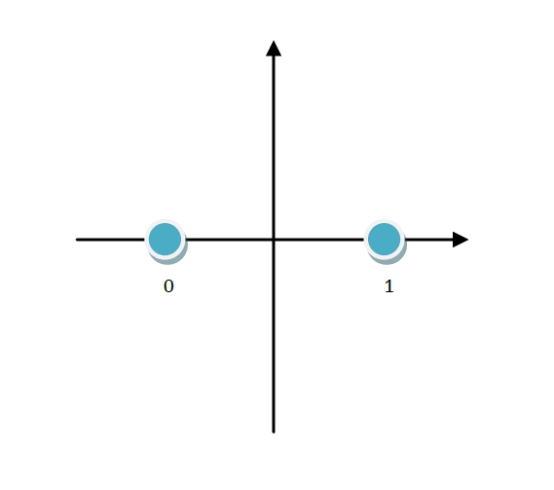
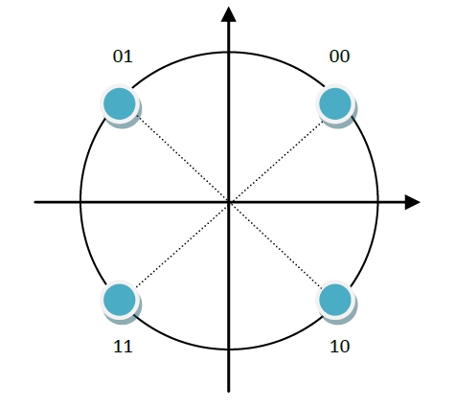
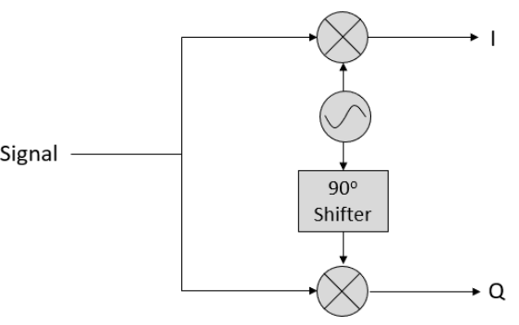
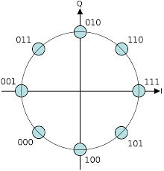
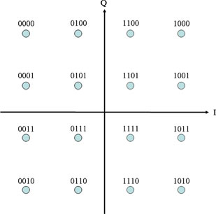
I/Q Signal Representation for Modulation Recognition
BPSK 1bit
QPSK 2bit
I = projection on cosine carrier
Q = projection on sine carrier
An I/Q pair becomes one point in a plane
8PSK 3bit
16QAM 4bit
Notes:
I/Q 不是兩個不同訊號，而是同一個 RF signal 投影到兩個互相正交的 carrier。I 是 cosine 同相分量，Q 是 sine 正交分量。這兩個值合起來就是星座圖上的一個點
把 I 當 x 軸、Q 當 y 軸，就可以得到 constellation diagram。BPSK 只有兩個點，QPSK 有四個點，16QAM 有十六個點。AMC 的核心就是從 I/Q samples 學出這些 pattern，進而判斷 modulation type。

Slide 5
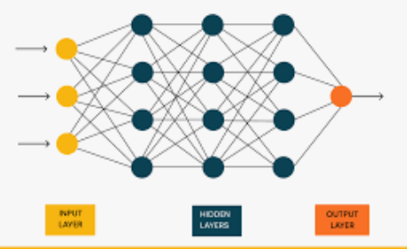
What Is Automatic Modulation Classification (AMC)?
Raw I / Q Samples
AMC Classifier feature extractor + model
Output Modulation class
BPSK
QPSK
……
What AMC does
Recognizes modulation patterns from I / Q samples.
Can be used before full frame decoding is available

Slide 6



Motivation: Spectrum Sensing
wireless channel
Spectrum sensing system
energy detection
find occupied region
get occupied segment [2, 128]
AMC
SENSING = WHERE / WHEN
Detect occupancy in time (and band), is there a signal, and where? e.g., energy detection
AMC = WHAT
Classifies the modulation of the isolated segment

Slide 7
RF Receiver Pipeline
Receiver spectrum sensing
wireless channel
RF RX pipeline
Antenna / RF Front-End
AGC
(gain normalization)
Energy / PSD monitor
AMC
Sketch / Blanker
DDC / Channelizer

Slide 8
Motivation: Where AMC Fits
Traditional RF receivers already include synchronization, header decoding, lock detection, SNR estimation, EVM, and CRC checks. Therefore, AMC is not intended to replace a standard receiver pipeline.
In this work, AMC is considered as a pre-demodulation RF sensing task for unknown or partially known signals. It provides a coarse modulation-family estimate from raw I/Q samples, which can help signal classifier, decoder routing, and robustness evaluation under interference or adversarial perturbation.

Slide 9
Motivation
NASA Glenn: Why AMC
is useful (2017)
Satellite AMR AMC/AMR is active in SatCom (2020)
Goal: using AMC for cognitive satellite communication
Why does modulation classification help?
  Receiver path selection: Estimate PSK / APSK / QAM family before choosing a candidate demodulation chain.
  Interference / anomaly flagging: Low confidence or unstable predictions can indicate interference-like or abnormal RF behavior.
  Spectrum monitoring support: Convert raw I/Q observations into modulation-level metadata for logging and RF spectrum management.

Slide 10
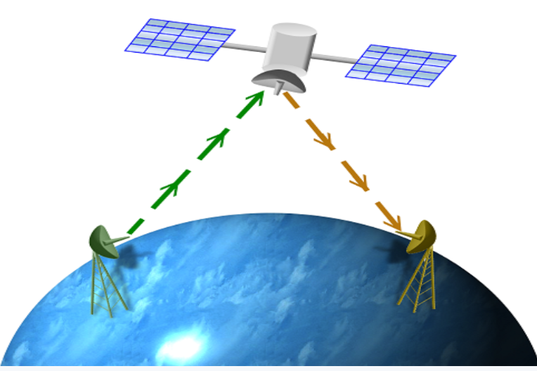
Motivation
NASA Glenn: Why AMC
is useful (2017)
Satellite AMC/AMR is active in SatCom (2020)
Can AMC shortcut this pipeline? e.g., if AMC says QPSK, the receiver can select the QPSK demodulator directly.
Alarm system:
QPSK confidence = 0.94 → waveform stable
Unknown confidence = 0.35 → suspicious
Prediction jumps QPSK → 8PSK → Unknown → unstable
How does a standard RX pipeline learn the modulation?
  acquisition / synchronization
  detect PLHEADER
  read PLS code / MODCOD
  know modulation + coding rate
  configure demodulator + FEC decoder

Slide 11
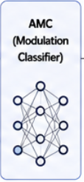


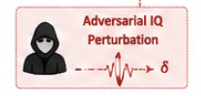

Threat Model
Receiver observes superposition
wireless channel
wrong label BPSK → QPSK
Assumptions:
- Perturbation power is bounded.
- The perturbation is added over the air or injected into I/Q samples.
- The perturbation should remain signal-like and hard to detect.
- Goal: cause wrong AMC prediction or unstable confidence.
x_adv = h * s + n + δ
where:
s : transmitted RF signal
h : wireless channel
n : channel noise
δ : adversarial perturbation
false alarm
missed detection

Slide 12
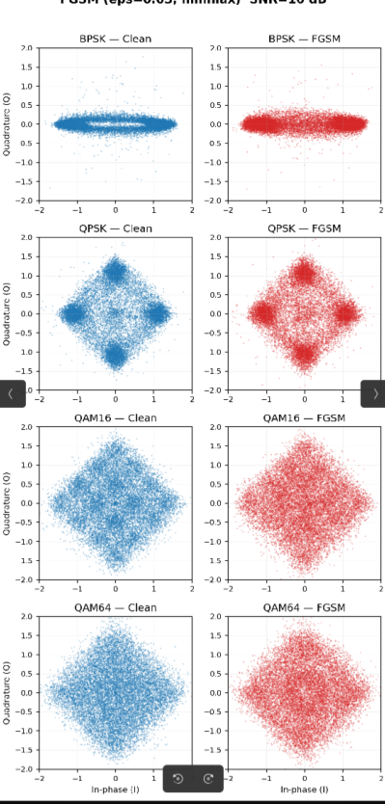
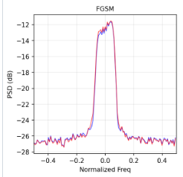
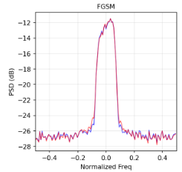
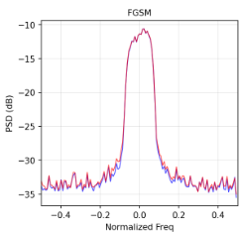
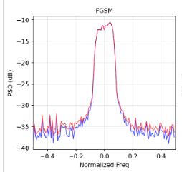
Threat Model
I/Q distribution
frequency domain
Adversarial perturbation
  Injected over the air or into the received I/Q samples.
  Fools the ML model with subtle, hard-to-detect perturbations
  Measured on our AWN model: EAD-L1 drops accuracy to 6.6%

Slide 13
Outline
Motivation
Related Work
Contributions
System Overview
Methodology
Evaluation
Conclusion

Slide 14
Related Work: Adversarial Attacks
Adversarial Attack
  FGSM — single-step gradient sign [Goodfellow+ '15]
  CW — L2-optimized minimal perturbation [Carlini-Wagner '17]
  PGD — iterative [Madry+ '18]
  EAD — elastic-net, sparse L1 perturbation [Chen+ '18]

Slide 15

FGSM: Fast Gradient Sign Method
perturbation
backpropagation loss
Why it matters:
fast one-step attack
useful as a baseline vulnerability test
shows whether AMC is sensitive to small I/Q perturbations

Slide 16

CW: Carlini-Wagner Attack
minimal perturbation
optimization objective
Why it matters:
Iterative optimization-based attack
Finds a small perturbation that changes the classifier output
often more subtle and stronger than FGSM

Slide 17
Related Work: SafeAMC
SafeAMC / RF-specific Adversarial Training, 2021–2022
  Adversarial training fine-tunes AMC models with adversarially perturbed IQ samples. SafeAMC shows that RF modulation classifiers can benefit from adversarial training, and robust models tend to rely more on modulation-relevant signal statistics such as constellation structures.
  Limitation: Robustness is usually tied to the attack type and perturbation budget used during training. It may not generalize well to unseen adaptive attacks, new channel conditions, or different SNR regimes. It also requires retraining and increases training cost.

Slide 18
Related Work: MDPD
MDPD — Mapping-based Data Processing Defense, 2023
  Applies RF-specific input mappings such as random split, time-domain flips, and phase rotations to disrupt adversarial perturbations before classification. It does not require fine-tuning or incremental training.
  Limitation: It is a heuristic input transformation. If the attacker knows the transformation distribution, they can perform expectation-over-transformation style attacks. Some mappings may also disturb phase-sensitive modulation features.

Slide 19
Related Work: FRS
FRS — Filtered Randomized Smoothing, 2024
  Combines spectral filtering + randomized smoothing. The paper observes that clean RF signals tend to be more frequency-localized, while FGSM / PGD perturbations are more spread out in frequency. FRS uses filtering plus Gaussian smoothing to provide certified robustness for modulation classification
  Limitation: Randomized smoothing requires multiple noisy inference samples, so runtime cost is high. Larger noise improves certification but reduces clean accuracy. The paper also notes that filtering may hurt some modulation types such as AM-SSB because the filter design may not match asymmetric spectral structures.

Slide 20
Related Work: Positioning
Method | Retraining | Inference cost | Certified | SNR-adaptive
SafeAMC (adv. training) | Yes | 1× | No | No
MDPD (input mapping) | No | 1× + mapping | No | No
FRS (filter + smoothing) | No | N× noisy samples | Yes | No
Adaptive-FFT-K (ours) | No | 1 FFT + 1 IFFT | No | Yes
• Gap: a training-free, single-pass defense whose filtering strength adapts to SNR and to the signal’s own spectrum.
• Trade-off we accept: no certified guarantee (FRS) in exchange for 1-pass cost.

Slide 21
Outline
Motivation
Related Work
Contributions
System Overview
Methodology
Evaluation
Conclusion

Slide 22
Contributions
Adaptive-FFT-K frequency-domain defense
  Failure analysis of knee-only Adaptive-K
CW attacks inflate spectral tails and cause K overestimation.
  SNR-aware Adaptive-FFT-K defense
Combines spectral-flatness routing, knee estimation, and SNR-bounded K.
  Systematic robustness evaluation
Five attacks (FGSM, PGD, CW, EAD-L1, EAD-EN), SNR 0–18 dB, RML2016.10a.
CW 35.4 → 71.3%, EAD-L1 6.6 → 70.8%; one shared FFT/IFFT, no retraining.

Slide 23
Outline
Motivation
Related Work
Contributions
System Overview
Methodology
Evaluation
Conclusion

Slide 24





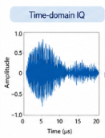
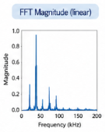
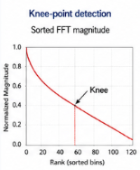
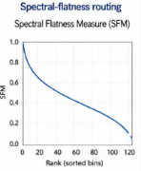
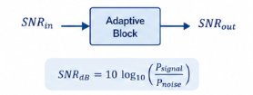
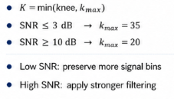
System Overview
Input IQ
sample
One-pass
FFT
Spectral
Analysis
Adaptive K Selection
AMC
Classifier
1) One-Pass FFT
2) Spectral Analysis
3) Adaptive K Selection
Convert time-domain IQ samples to frequency-domain magnitude spectrum
Spectral statistics guide routing and analysis.
Adaptive selection of truncation length K based on SNR.
Provides the frequency-domain representation used for subsequent analysis
Find Knee point of the sorted magnitude curve.
Assess flatness to route the adaptive analysis.

Slide 25
Outline
Motivation
Related Work
Contributions
System Overview
Methodology
Evaluation
Conclusion

Slide 26
Methodology: Problem and Approach
Problem:
AMC input can be adversarially perturbed, and fixed preprocessing does not adapt to SNR or modulation.
Solution:
Add lightweight preprocessing before AMC classification: preserve the dominant spectral components, and select K using the knee point, spectral flatness, and an SNR bound.

Slide 27
Methodology: Fixed Filtering Is Not Enough
Low SNR QPSK
Same fixed filter: Gaussian / FIR / Wiener / Kalman
Limitations
May remove useful modulation features
Not adaptive to channel SNR
Not adaptive to modulation structure
High SNR 16QAM
Risk: under-filter or over-filter
Different spectral shape

Slide 28
Methodology: What K Controls
K = number of frequency components preserved
K too small
useful modulation features are removed
clean accuracy decreases.
Low-SNR signals are easily damaged
K too large
weak spectral bins are preserved
adversarial perturbations remain; defense becomes weak
adaptive-K

Slide 29
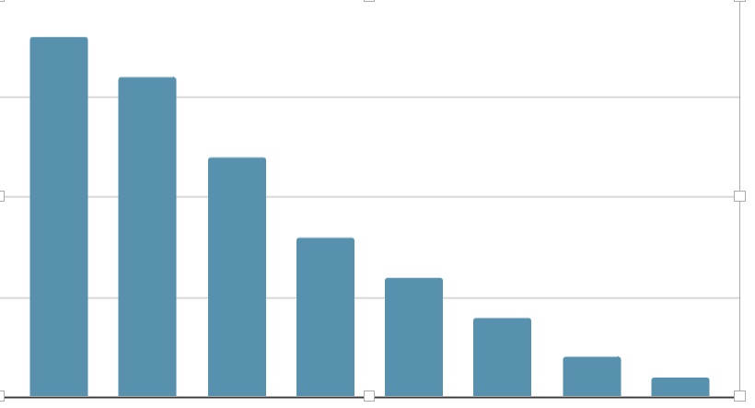
Methodology: Knee Point → Top-K Selection
knee = first k where |X[k]| / |X[1]| < γ (γ = 5%)
Final K: Kᵢ = min(kneeᵢ, K_max,ᵢ), e.g., knee = 11 and K_max ≥ 11 → K = 11; keep Top-K bins, zero the rest, IFFT
Sorted FFT magnitudes
Top-11 means: keep the 11 strongest frequency bins
knee = 11
x[k]
cutoff
ratio < γ

Slide 30
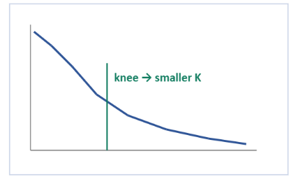
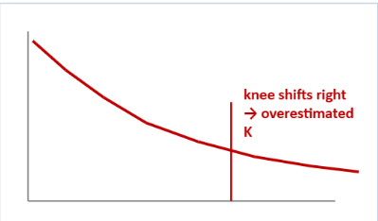
Methodology: Knee-Only Adaptive-K Can Fail
Clean sorted spectrum
CW / EAD tail-inflated spectrum
Attack Mechanism: Optimization attacks inflate weak spectral tails, causing the magnitude to decay less sharply.
Defense Failure: A "knee-only" selection mechanism misidentifies the cutoff, inadvertently preserving excess noisy bins.
Result: Residual adversarial components bypass the filter, rendering the defense ineffective.

Slide 31
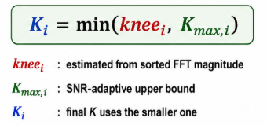
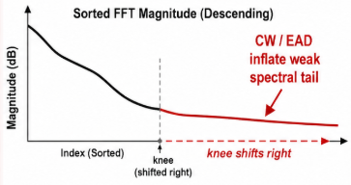
Methodology: Why Bound K by SNR?
Low SNR | looser bound | preserve weak useful signal components
High SNR | tighter bound | suppress weak adversarial tail
Knee-only K depends only on spectrum shape
Inflated tails can overestimate K
Large K preserves adversarial weak bins

Slide 32
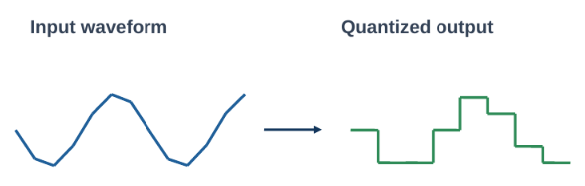

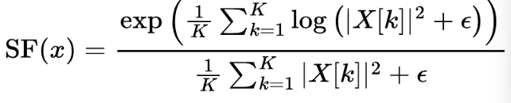
Methodology: SF Routing
Spectral-flatness (SF) routing
Spectral flatness measures whether a signal spectrum is flat / noise-like or peaky / concentrated. In Adaptive-FFT-K, it is used to decide which defense path should be applied.
Definition
Given an input I/Q sample, compute the FFT and power spectrum:
Spectral flatness is the geometric mean divided by the arithmetic mean of the power spectrum:
K = number of frequency bins; ε = small constant to avoid log(0)
How to interpret SF
SF ≈ 1: flat spectrum
wideband / noise-like → quantization path
SF ≈ 0: peaky spectrum
narrowband / concentrated → SNR-aware Top-K filtering
Routing rule: SF > 0.4 → wideband path, 32-level quantization

Slide 33
Outline
Motivation
Related Work
Contributions
System Overview
Methodology
Evaluation
Conclusion

Slide 34
Evaluation: Setup
Data and model
RML2016.10a: 11 modulations, 128 I/Q samples per frame
Classifier: AWN
Reported accuracy: weighted average over SNR 0–18 dB unless stated
Attacks (white-box on AMC)
FGSM, PGD, CW (L2), EAD-L1, EAD-EN
Defense hyper-parameters
Knee threshold γ = 5% of the largest bin
Routing: SF > 0.4 → 32-level quantization
SNR estimate = energy of top-10 bins / remaining bins
K_max: 35 (est. SNR ≤ 3) → 20 (est. SNR ≥ 10), linear in between
K = min(knee, K_max); keep Top-K bins, IFFT

Slide 35
Evaluation: CRC Pipeline
Setup: SNR 18 dB, 200 bursts/mod, CW (c = 1.0, 1000 steps), CRC-8.
Clean + Oracle: no attack, true demodulation
Adv + Oracle: CW attack, demodulator forced correct
Scenario | AMC Acc. | CRC pass
Clean + Oracle | 98.1 % | 99.4 %
Adv + Oracle | 7.0 % | 97.3%

Slide 36
Evaluation: Adversarial-Training Baseline
Trained on FGSM + PGD + EAD; tested on unseen CW
CW accuracy, SNR ≥ 0 dB
Config | CW acc. (%)
Base model | 35.4
Adv-trained | 53.7
+18.3 pp on unseen CW, still below Adaptive-FFT-K (71.3%) without any retraining

Slide 37
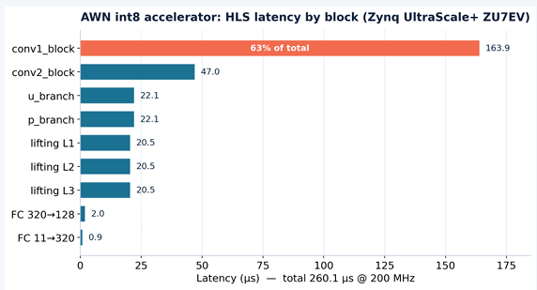
Evaluation: HLS Latency
Vitis HLS 2023.2, target XCZU7EV: C-synthesis + RTL co-simulation estimate
260 µs latency @ 200 MHz
conv1 = 63% of latency (bottleneck)

Slide 38
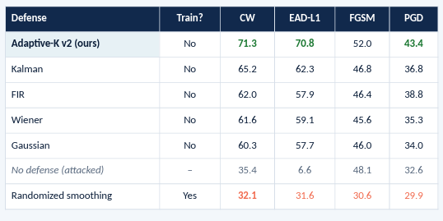
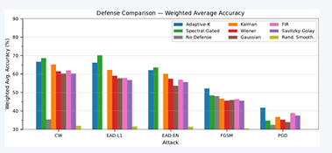
Evaluation: Accuracy Comparison
Randomized smoothing (σ = 0.01 Gaussian) destroys fine I/Q structure

Slide 39
Evaluation: Ablation of K Selection
Attack | No defense | Knee-only K (v1) | SNR-bounded K (ours) | Δ vs v1
CW | 35.4 | 66.6 | 71.3 | +4.7
EAD-L1 | 6.6 | 66.2 | 70.8 | +4.6
EAD-EN | 3.4 | 62.2 | 67.5 | +5.3
FGSM | 48.1 | 52.2 | 52.0 | −0.2
PGD | 32.6 | 41.8 | 43.4 | +1.6
• Accuracy (%), weighted over SNR 0–18 dB. Same FFT/IFFT cost for both variants.
• Gains concentrate on optimization attacks (CW, EAD), which inflate the spectral tail and push the knee right; FGSM spreads energy broadly, so K selection matters less.

Slide 40
Evaluation: CW Accuracy vs. SNR
+10.8 pp
at 0 dB over knee-only K
At low SNR the knee averages 91 bins (almost no filtering); the SNR bound caps it at ~33.
Ours is better at every SNR.

Slide 41
Limitations and Future Work
Known costs
Capping K at 20 costs wideband modulations 4–10 pp (BPSK, QPSK, 8PSK, CPFSK); spectral flatness cannot separate them from narrowband ones.
Small gains on FGSM / PGD (48.1→52.0, 32.6→43.4).
Open threats
Adaptive attacks aware of the defense (BPDA / EOT through Top-K) are not yet evaluated.
The SNR estimator is itself an attack surface: an attacker could bias it to loosen K_max.
Next steps
Adaptive-attack evaluation, RML2018.01a, over-the-air SDR validation.

Slide 42
Conclusion
Adaptive-FFT-K is a training-free recover→classify front end: one FFT, spectral-flatness routing, SNR-bounded Top-K, IFFT.
On RML2016.10a it restores CW 35.4→71.3% and EAD-L1 6.6→70.8%, leading the best classical filter (Kalman) by 6–8 pp while holding clean accuracy at 92.6%.
The SNR bound beats knee-only K at every SNR, by up to +10.8 pp at 0 dB.
O(T log T) defense cost; the int8 AWN accelerator runs at 260 µs/frame at 200 MHz on Zynq UltraScale+.

Slide 43
Thanks for Listening — Q&A

