Slide 1
Classification of Fishing Activities using ResNet Neural Network from AIS Data
Lorenzo Medici and Mirko Simoni

Slide 2
Outline
-Introduction
-AIS data overview
-Technologies adopted
-Dataset structure
-Multi-class time series structure
-Neural networks
-Conclusion

Slide 3
Introduction
The purpose of our project revolved around the studying of fishing ships activities in the Mediterranean Sea.
We wanted to design a computer system able to classify the different type of fishing techniques adopted by several vessel.
We did so by using the information gathered by the ships electronic equipment, also known as Automatic Identification System (AIS)

Slide 4
AIS data overview
The automatic tracking system uses transponders on ships and transmits every 5 minutes vessel’s position, identity, speed, course and many other relevant information to all other AIS equipped vessels within range
All this data is gathered in .csv files

Slide 5

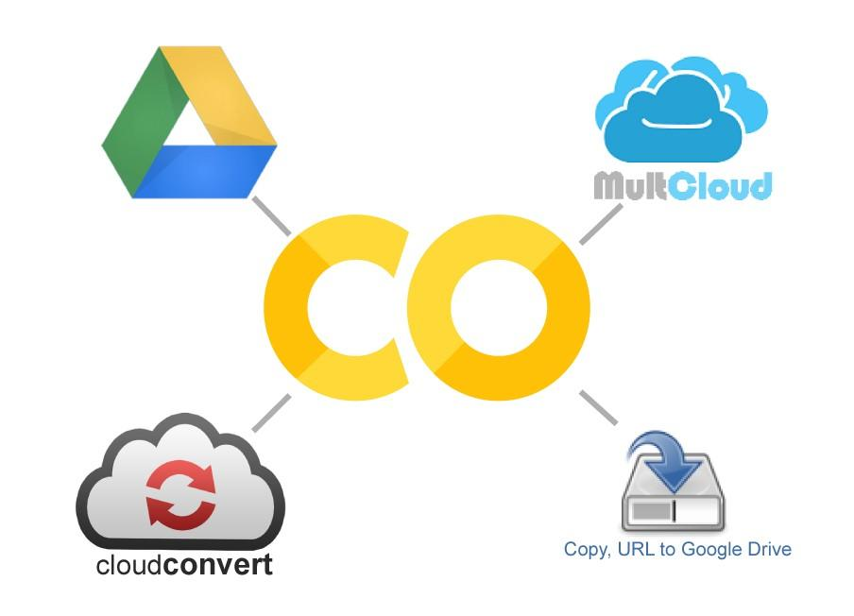

Technologies adopted
We used the following softwares for our goals:
pgAdmin 4
Matlab
Google Colab

Slide 6
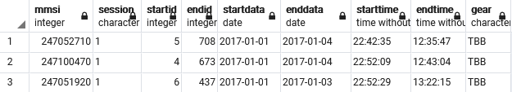
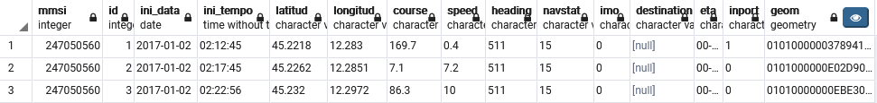
Dataset structure

Slide 7
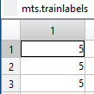

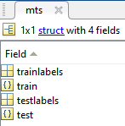


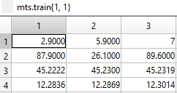
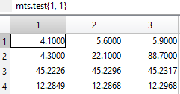
Multi-class time series structure
FULL TIME SERIES GROUND TRUTH
(training and testing sets)
FEATURES USED (SPEED-COURSE-LATITUD-LONGIT)
-Time series with different
lenght
-Needs 0 padding

Slide 8
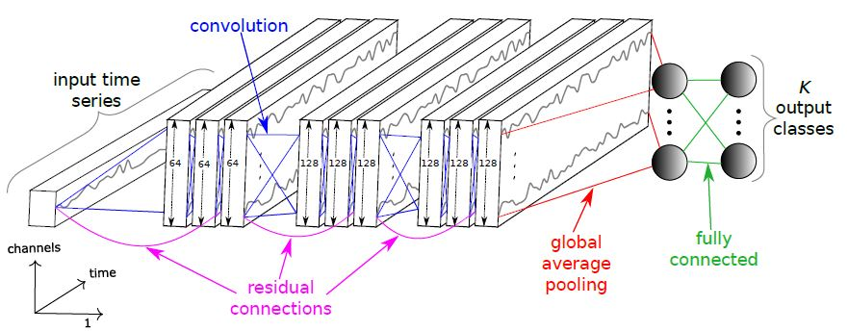
ResNet architecture

Slide 9
Conclusion and future works
ResNet neural network works brilliantly for classification of Multi-class time series, despite the nature of the dataset, reaching accuracies and precisions above 96%
The duration of the process is always low enough to suite as a perfect substitute of human work of recognition and labeling
The same network and data manipulation process can be adopted for solving different problems in other scientific fields of research concerning data recognition and forecast of repetitive human activities.
For example, it may also works as a way to anticipate and spot illegal fishing routes partake by fisherman even when they momentarily deactivate the ship’s equipment

Slide 10
Thank you for your attention

