Slide 1

Predicting Diabetes with Artificial Intelligence
Predicting Diabetes with Artificial Intelligence
Isabella Taylor
www.linkedin.com/in/isabellajade
Leah Nash
www.linkedin.com/in/leahnash05
Sandra Braun
www.linkedin.com/in/sandra-braun
Valerie Grannemann-Barber
www.linkedin.com/in/valerie-grannemann-barber

Slide 2
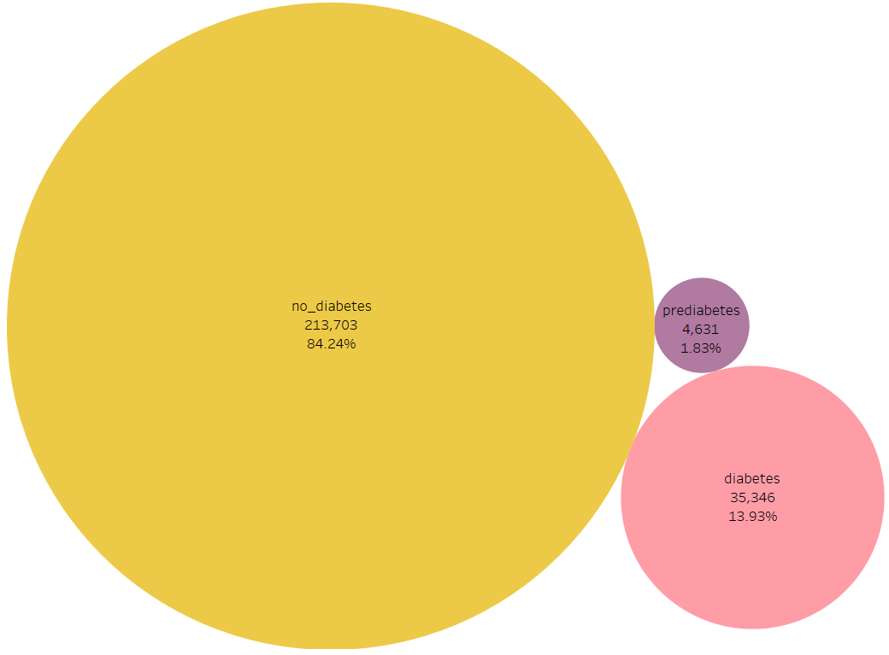
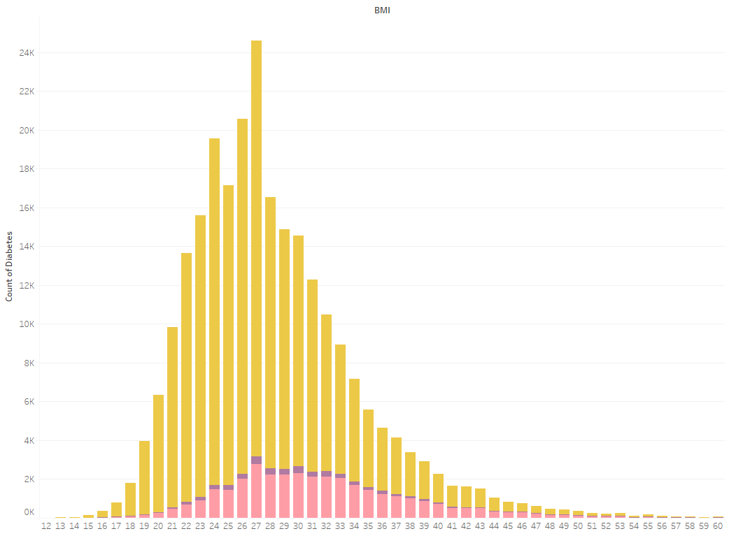
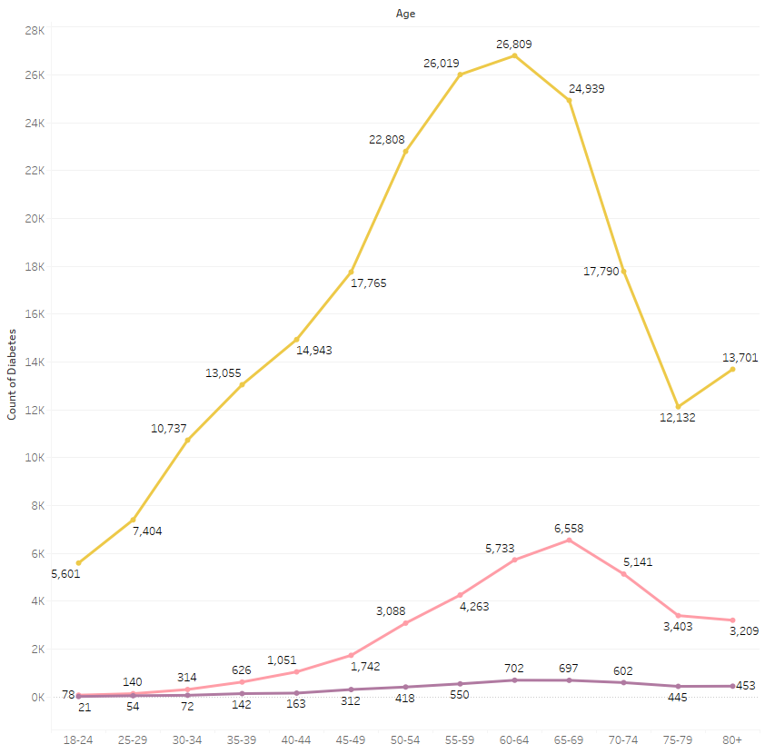

Data
The dataset we used was sourced from Kaggle.
The “Diabetes Health Indicators Dataset” is a subset of a larger dataset from the Behavioral Risk Factor Surveillance System (BRFSS), which is a US based annual telephone survey conducted by the US Centers for Disease Control and Prevention (CDC).
Diabetes is a chronic disease that affects how your body utilizes insulin to transport circulating blood glucose into cells for energy consumption
The three main types of diabetes are Type 1, Type 2, and Gestational Diabetes.
More than 133 million people in the United States have diabetes or prediabetes.

Slide 3
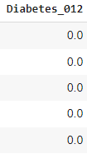
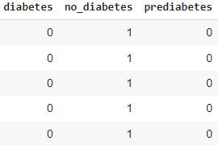
Method
PySpark was utilized to read in the raw data and exploratory data analysis was conducted by using SQL queries.
Descriptive statistics were then computed to gain insights into the characteristics of the dataset population.
Our Tableau visualizations:
Diabetic Status Comparison
To clean the data, we performed categorical column encoding.
This expanded our feature set by facilitating the removal of prediabetes from our target variables and including it as a feature, resulting in higher accuracy models later in our testing.
After cleaning the data, we evaluated a broader spectrum of models that exhibited significantly greater accuracy than those employed previously. We implemented techniques such as Synthetic Minority Over-sampling Technique (SMOTE) to address class imbalance in diabetes and pre-diabetes status populations and employed automated neural network models to identify optimal hyperparameters and improve the performance of our neural network models.
Before:
After:

Slide 4
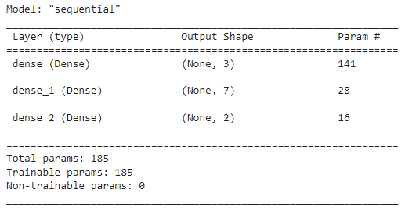
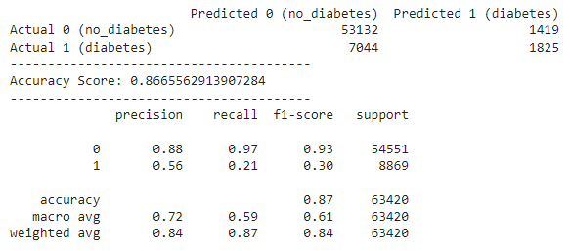
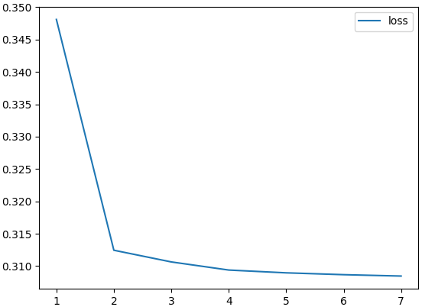
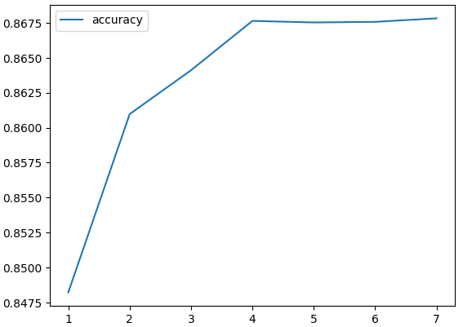
Results
Model Parameters:
By Leveraging an automated neural network model and employing the optimal hyperparameters identified, we attained the highest attainable accuracy score using the best available model.
Our evaluation yielded an accuracy rate of 87%, accompanied by a loss rate of 31%
Due to the existing imbalances in our data, the results obtained represent the best achievable outcome under these circumstances.
Results:

Slide 5
Sources
Teboul, A. (2021, November 8). Diabetes Health Indicators Dataset. Kaggle. Retrieved April 2023, from https://www.kaggle.com/datasets/alexteboul/diabetes-health-indicators-dataset
Centers for Disease Control and Prevention. (2016, August 23). Behavioral Risk Factor Surveillance System 2015 Codebook Report Land-Line and Cell-Phone data. Retrieved April 2023, from https://www.cdc.gov/brfss/annual_data/2015/pdf/codebook15_llcp.pdf
Centers for Disease Control and Prevention. (2022, October 25). Diabetes basics. Centers for Disease Control and Prevention. Retrieved April 2023, from https://www.cdc.gov/diabetes/basics/index.html

