Slide 1
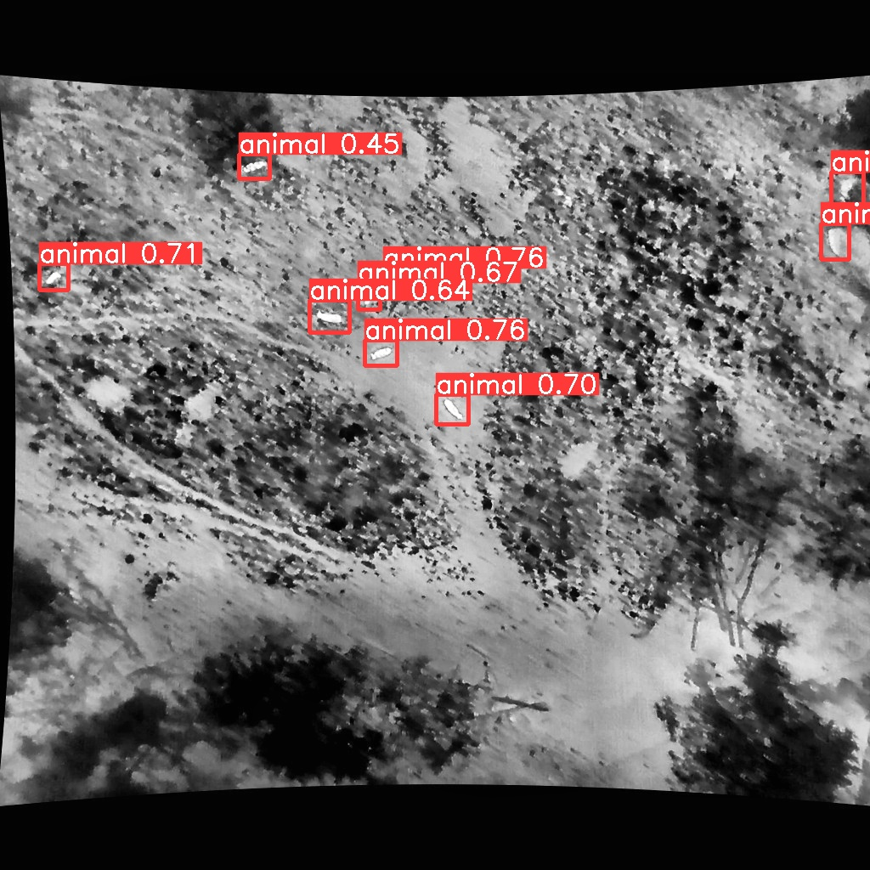
Project Presentation
Drone-based Wildlife Detection and Movement Analysis

Slide 2



Members of FLYING HIRSCH
Karim Ortner
Lorenz Schlosser
Jonas Welt

Slide 3
Task
“Develop a computer vision pipeline that classifies if there is an animal (species) and tracks their movement over time.“
“The system will produce bounding boxes (with class labels), assign unique IDs to each animal across frames and analyse movement patterns such as trajectories and spatial distribution.“

Slide 4
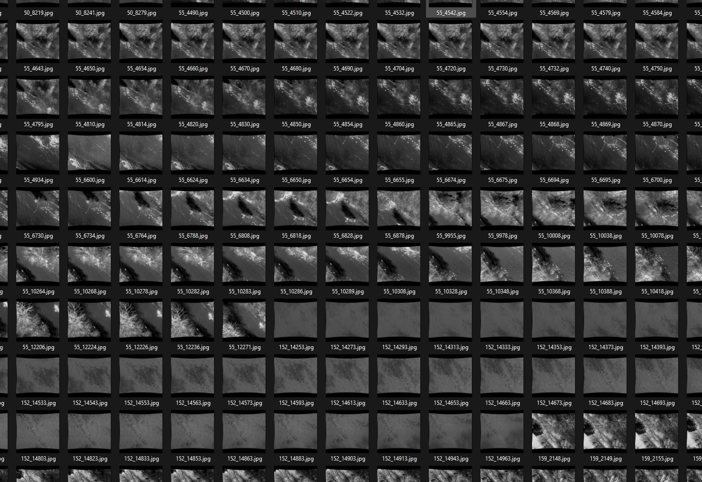
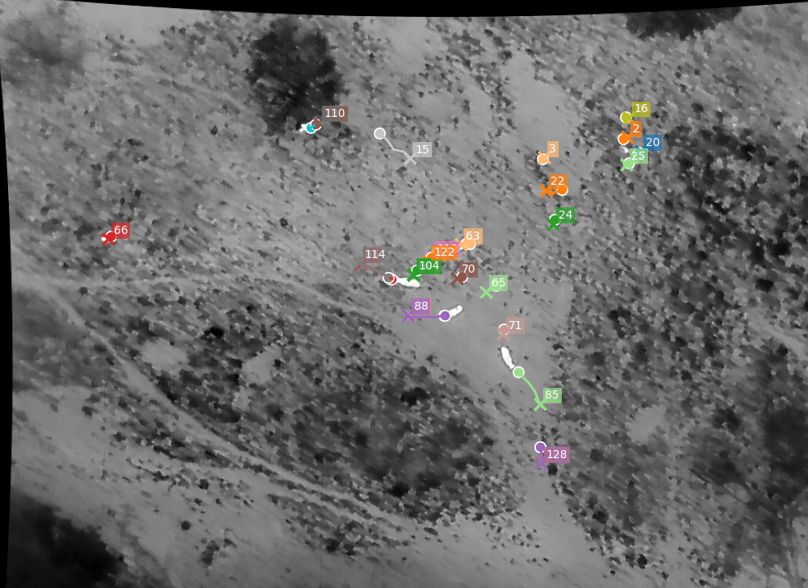
Approach - Overview
Choose & Explore Dataset
Data Preprocessing & Annotation
Train Object-detection
Train Object-tracking
Evaluate Model and create Statistics
Visualize Result

Slide 5
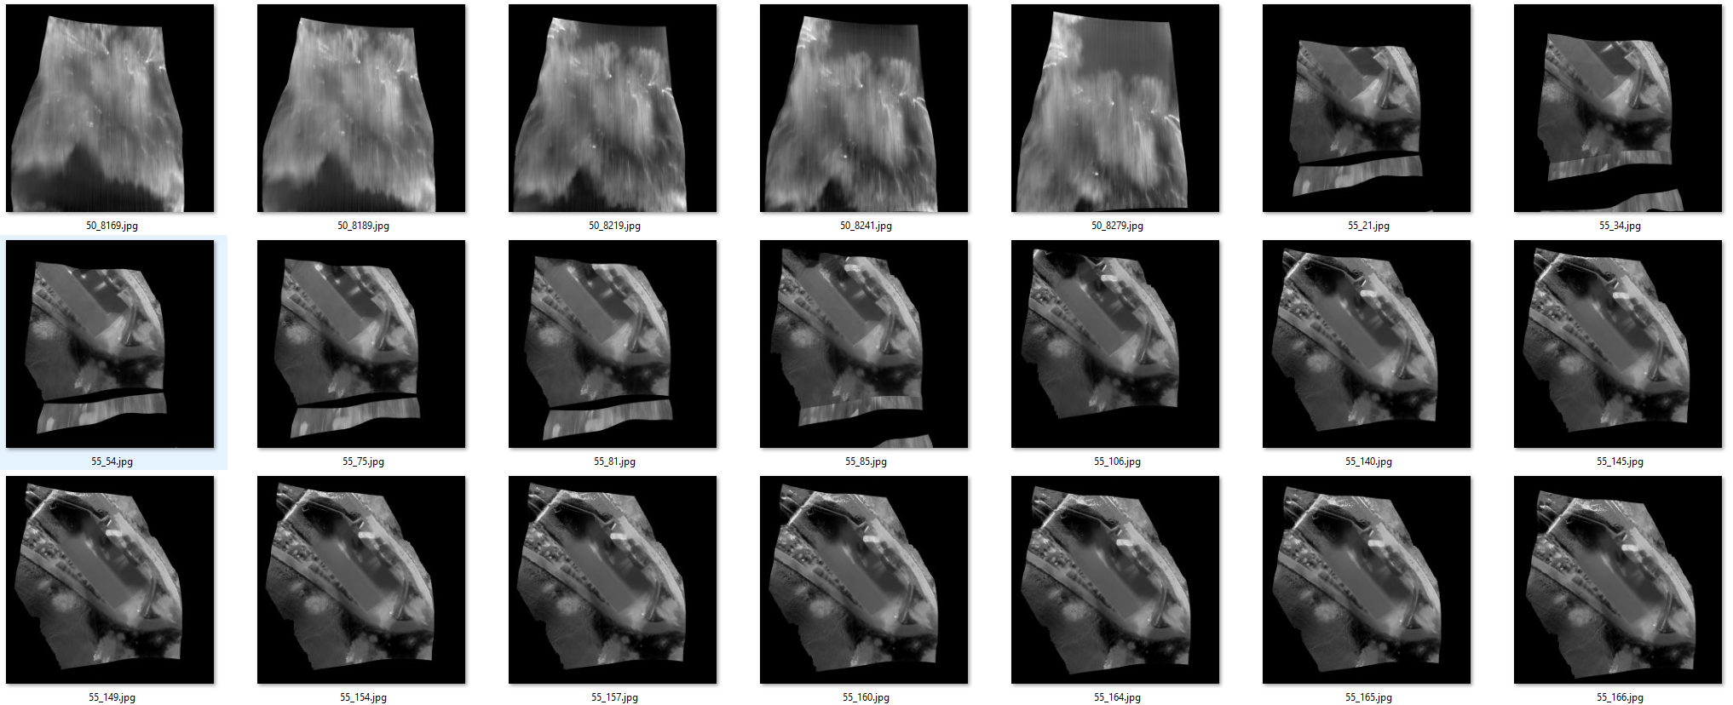
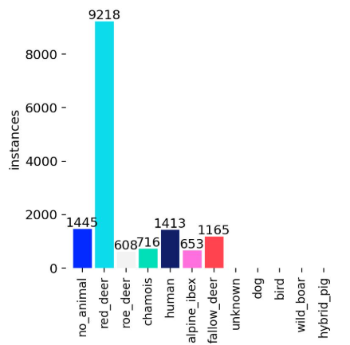
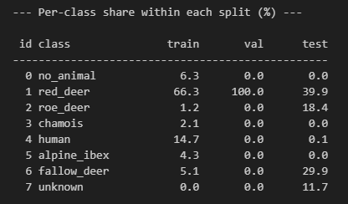
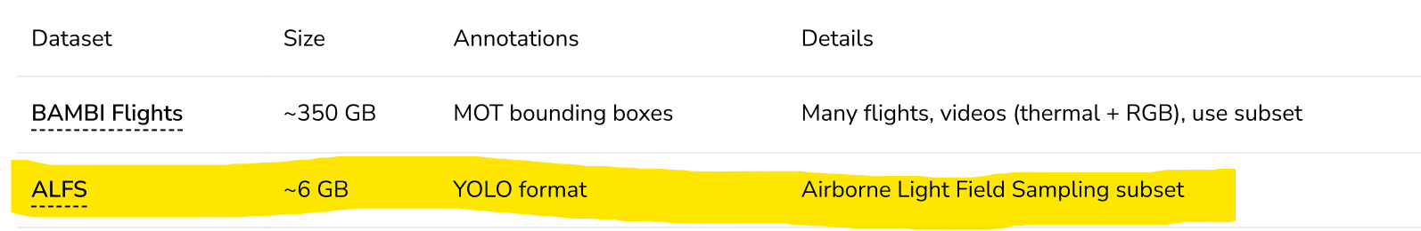
Dataset - ALFS
Advantage:
Annotated Animal species
Disadvantage:
very blurry
weird shapes
Huge class imbalance

Slide 6
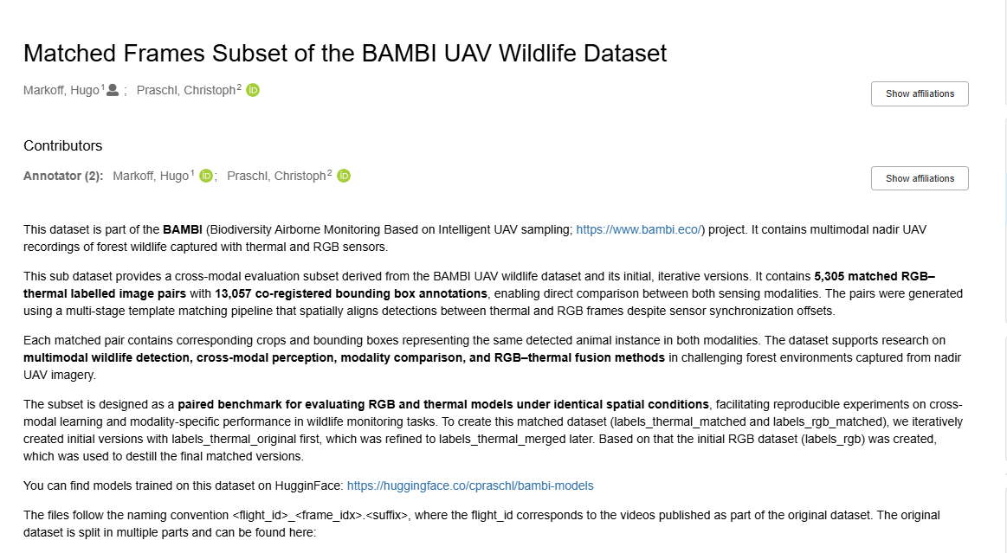
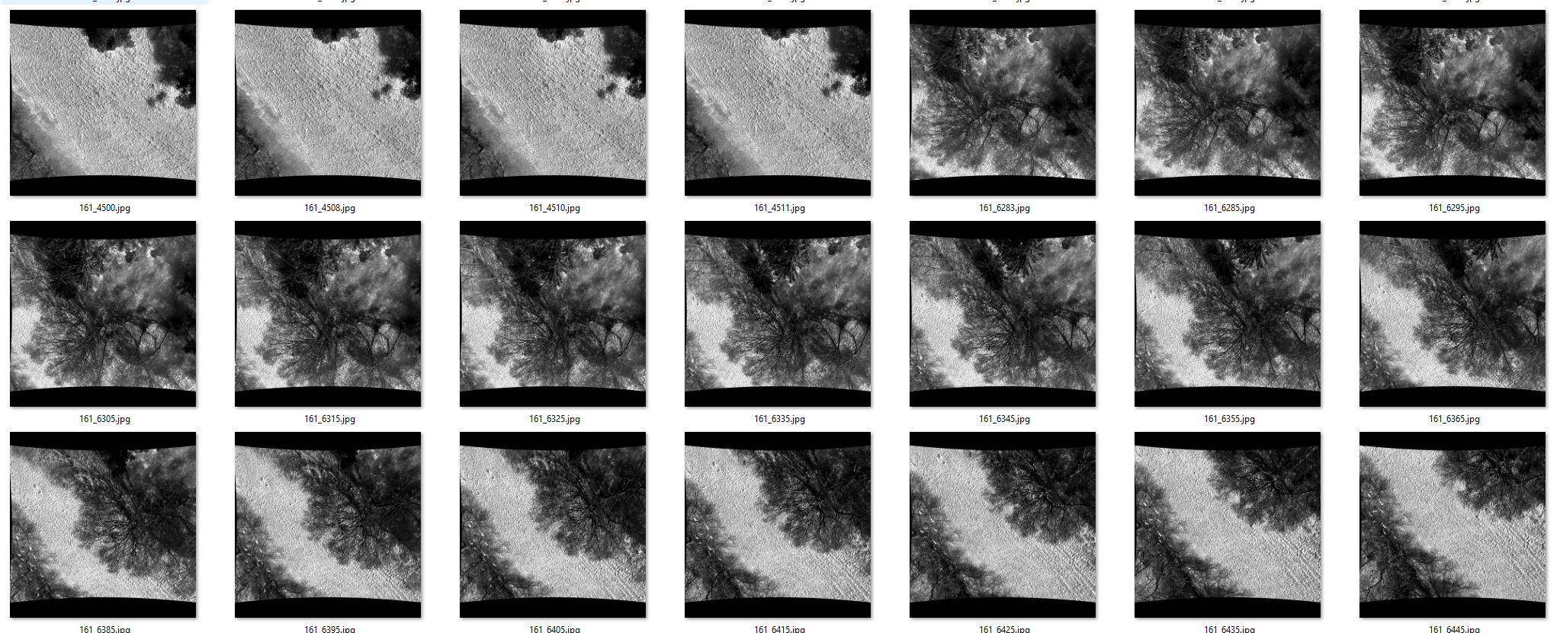
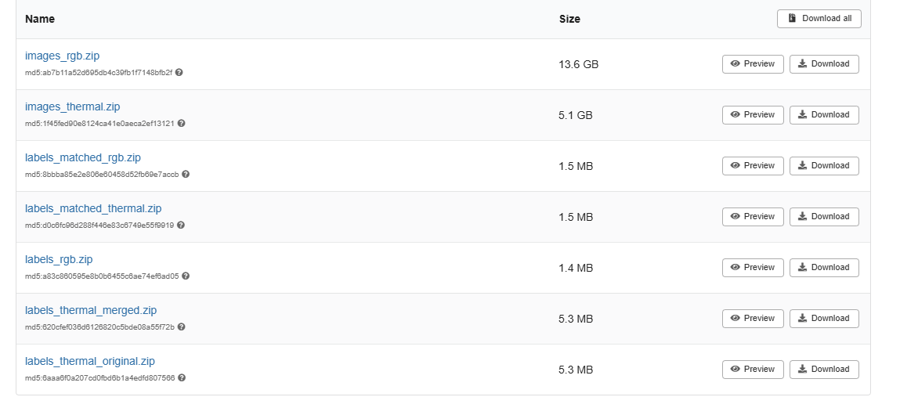


Dataset: Matched Frames Subset of the BAMBI UAV Wildlife Dataset
Better quality
Less labels
No species
Matched
Train/Val/Test Splits
Species (class imbalance)
https://zenodo.org/records/19034999

Slide 7
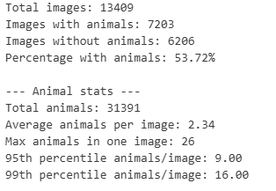
Explore Dataset
SPLIT:
TRAIN: 11.391
TEST: 01.934
VAL: 0.0084
Size / Labels:
Size: 1024 x 1024
Min area: 21.00 px²
Max area: 61620.40 px²
Avg area: 1922.42 px²
Huge class imbalance -> every animal = 1class

Slide 8
Approach - Overview
Choose & Explore Dataset
Data Preprocessing & Annotation
Train Object-detection
Train Object-tracking
Evaluate Model and create Statistics
Visualize Result

Slide 9
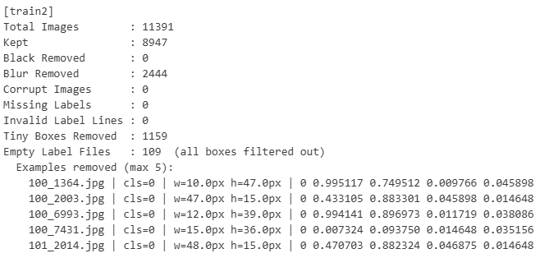


Data Preprocessing & Annotation
Clean dataset from
Blurry images (Laplacian)
Black images
Too small / invalid labels
Make Train/Val/Test split
Was given
Corrected Split (based on flight id)

Slide 10
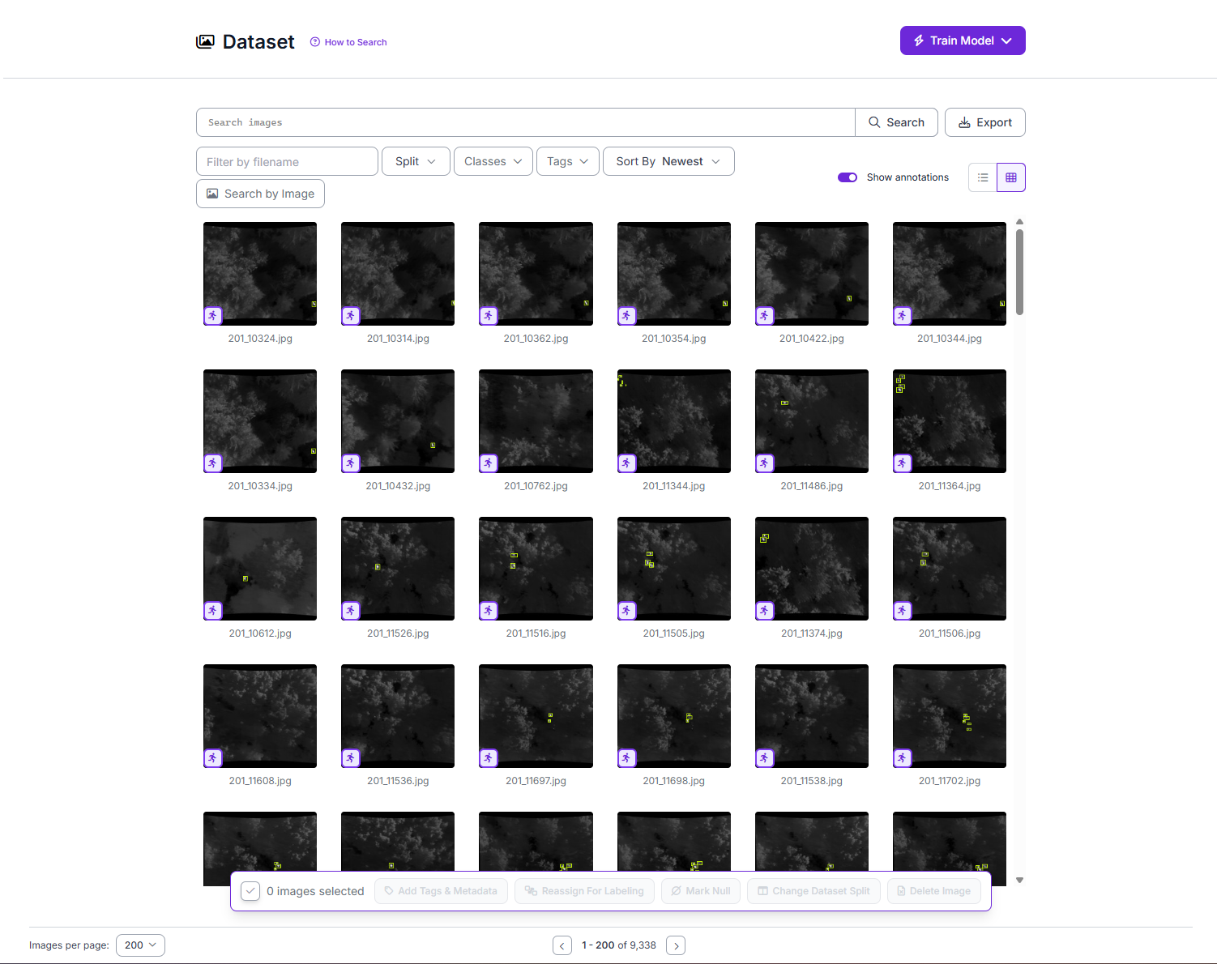
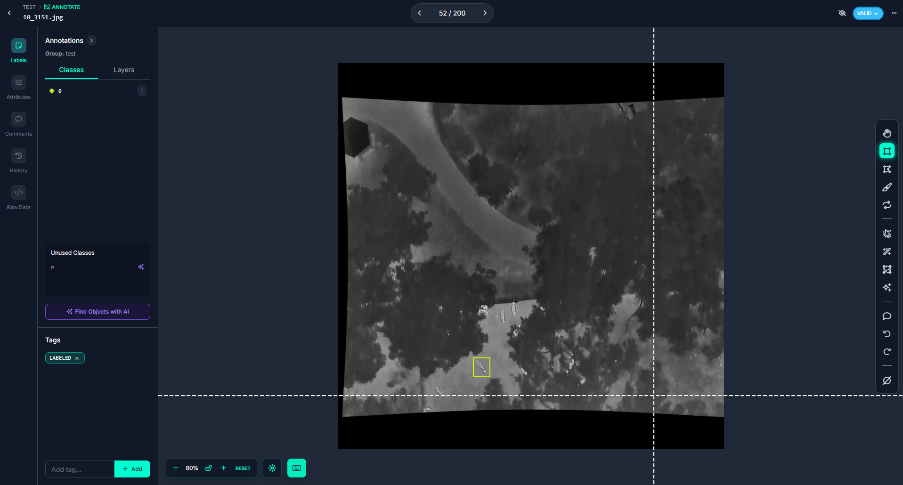
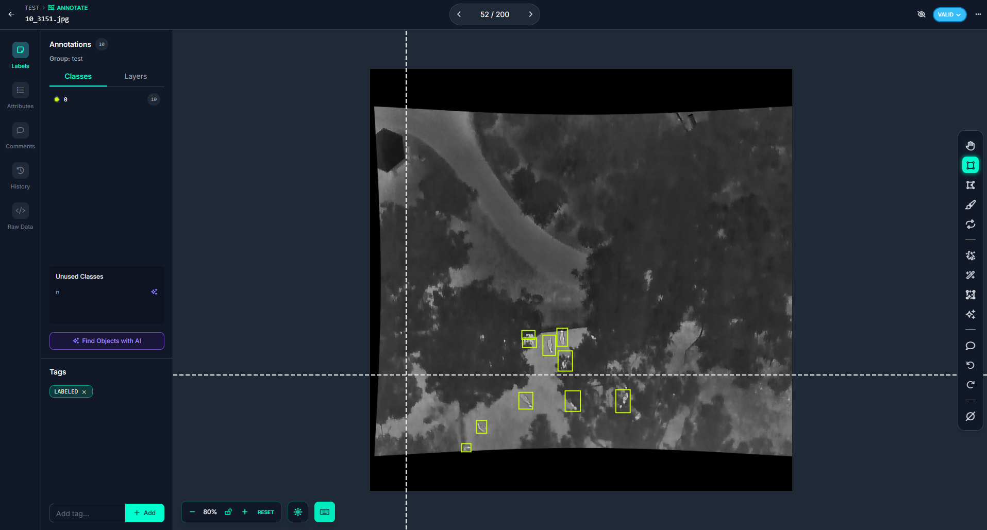
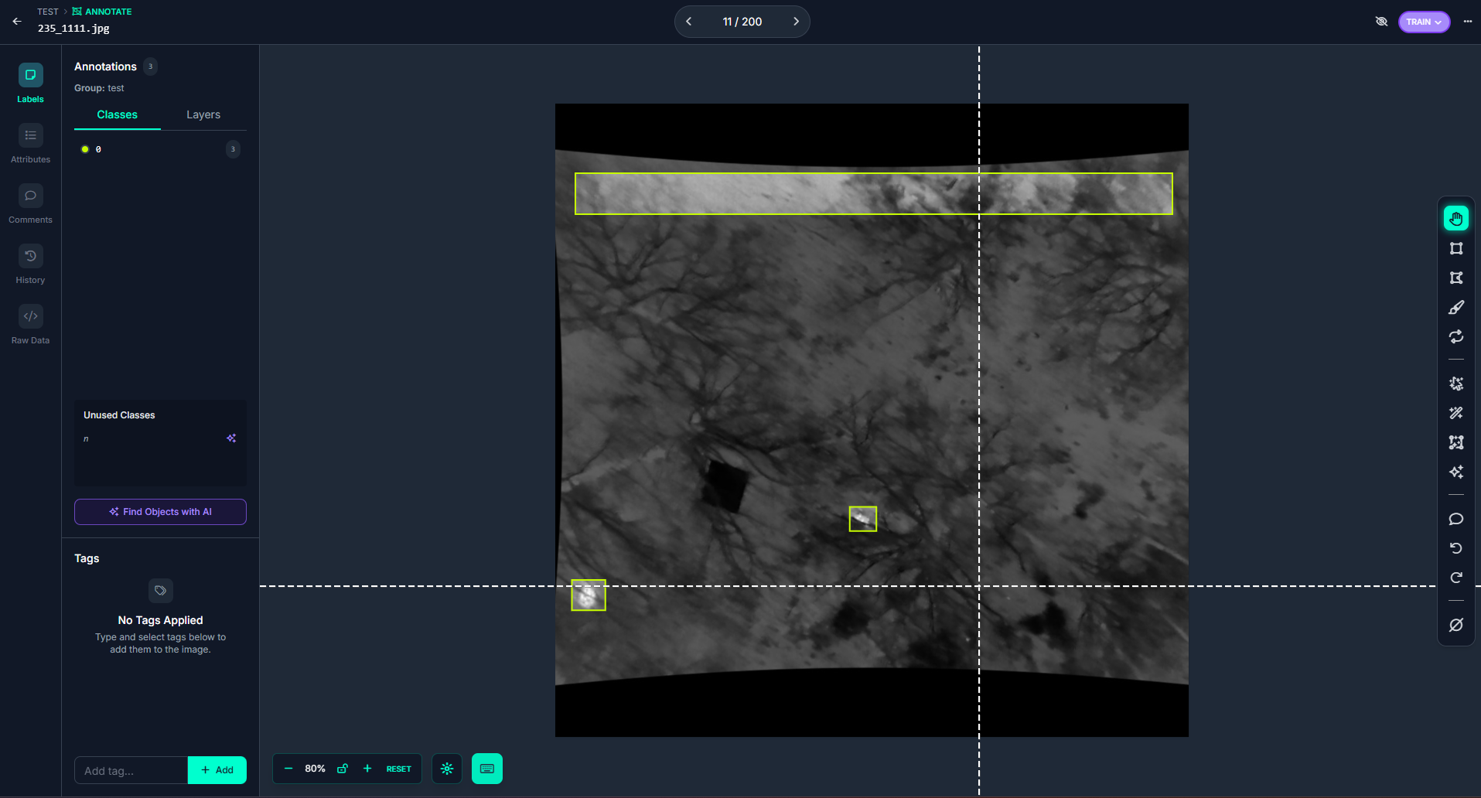
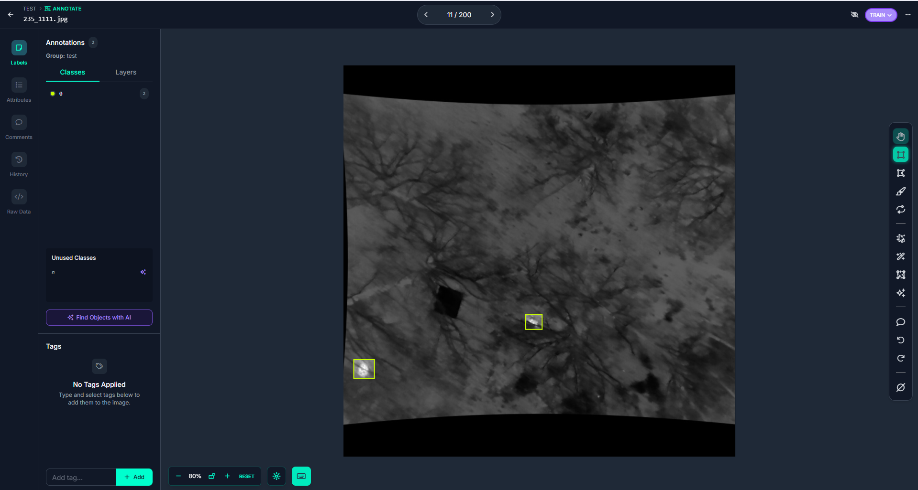

Data Preprocessing & Annotation
ROBOFLOW
Annotated 9.338 images (train & val)
Removed wrong annotations
Corrected sizes
Created new annotations
used RGB images for better insight

Slide 11
Approach - Overview
Choose Dataset
Explore Dataset
Data Preprocessing & Annotation
Train Object detection
Train Object Tracking
Evaluate Model and create Statistics
Visualize Result

Slide 12
Approach - Overview
Choose & Explore Dataset
Data Preprocessing & Annotation
Train Object-detection
Train Object-tracking
Evaluate Model and create Statistics
Visualize Result

Slide 13
Train Object detection
Goal: detect animals reliably in thermal drone images
Tried YOLO11 with different YOLO checkpoints
Used YOLO26 with different YOLO checkpoints and parameter profiles (fast, balanced, quality)
Changed HSV_H/S/V all to 0 due to thermal images
Used mosaic to make model more robust
Retrained with older best weights
Had multiple stages of training –> next slide
Image of train batch from run/

Slide 14

TRAINING APPROACHES
Take the raw dataset -> MAP: 2%
1
Preprocess and take yolo26 Model ->3,5 %
2
Remove blurry images -> 6 %
3
Limit to classes with enough data (8 classes) -> 8%
4
Only take 1 class (animal or no animal)
-> 35%
5
Correct / Add/ Delete Annotations from all ~8k Train samples and 1k Val samples -> ROBOFLOW -> 66%
6
Changed to other dataset? Between 3 and 4?

Slide 15
Approach - Overview
Choose & Explore Dataset
Data Preprocessing & Annotation
Train Object-detection
Train Object-tracking
Evaluate Model and create Statistics
Visualize Result

Slide 16
Train Object Tracking
Goal: keep object IDs stable over time while the drone is moving
Tracking method: YOLO detections + ByteTrack-based tracking
Used best weights from previous detection training
Sequence is stabilized for drone movement (on reference frame)
Implementation details ….
Some vis, but only small peak since rest on vis slides

Slide 17
Approach - Overview
Choose & Explore Dataset
Data Preprocessing & Annotation
Train Object-detection
Train Object-tracking
Evaluate Model and create Statistics
Visualize Result

Slide 18
Evaluate Model and create Statistics

Slide 19
Approach - Overview
Choose & Explore Dataset
Data Preprocessing & Annotation
Train Object-detection
Train Object-tracking
Evaluate Model and create Statistics
Visualize Result

Slide 20
Visualize Result
Stabilized frame sequence with overlaid IDs
Trajectory visualization
Heatmap of object movement
Video-like frame sequence for step-by-step inspection

Slide 21
HELPER SLIDES:

Slide 22
Thank you for your attention!

Slide 23
Tabel Of Contents
Members
Task
Dataset
Preprocessing
Training
Evaluations / Statistics
Result / Visualizations

