Slide 1
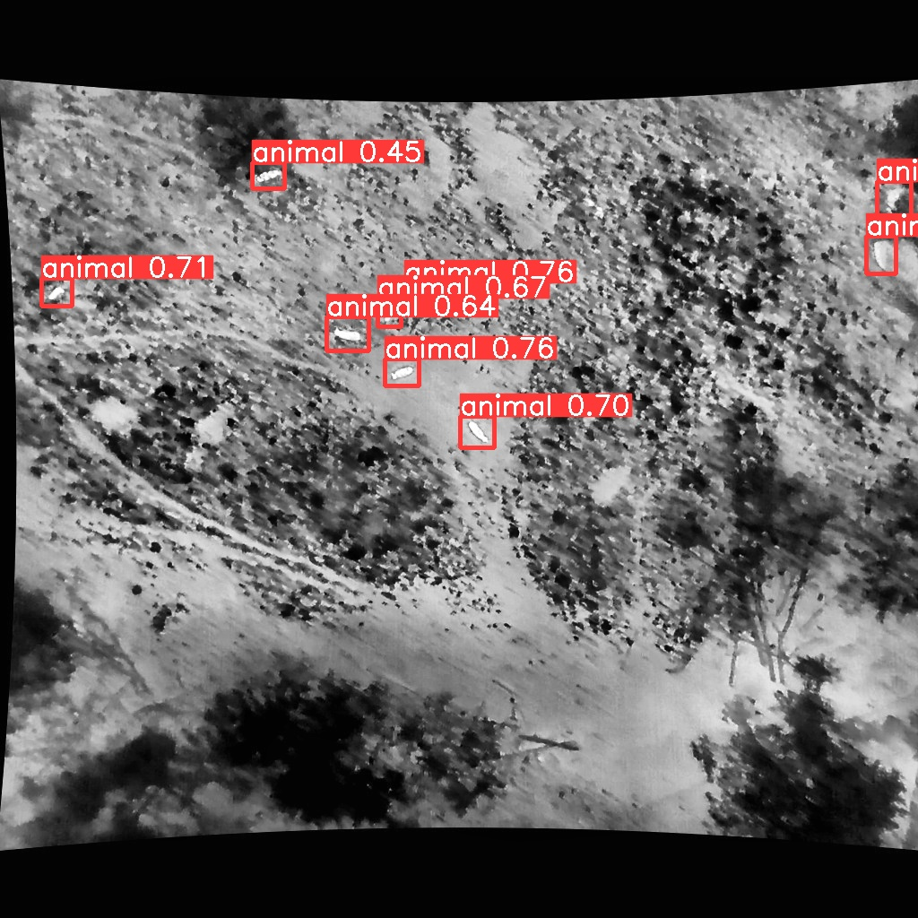
Project Presentation
Drone-based Wildlife Detection and Movement Analysis

Slide 2
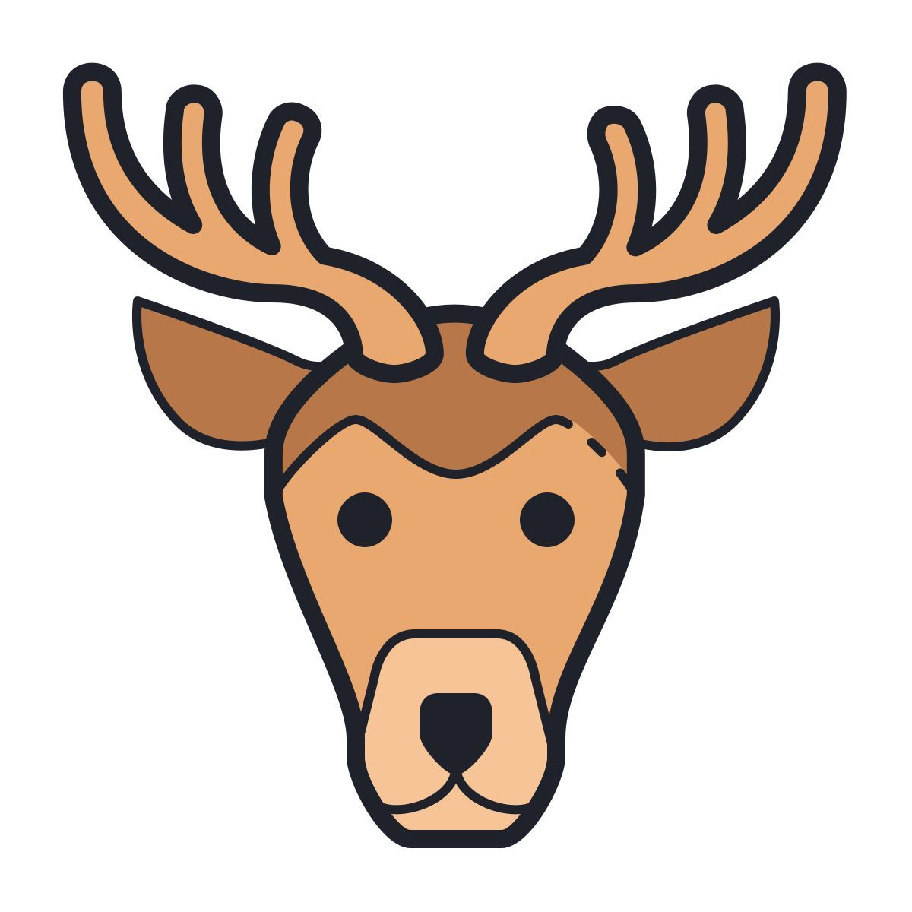


Members of FLYING HIRSCH
Karim Ortner
Lorenz Schlosser
Jonas Welt

Slide 3
Task
“Develop a computer vision pipeline that classifies if there is an animal (species) and tracks their movement over time.“
“The system will produce bounding boxes (with class labels), assign unique IDs to each animal across frames and analyse movement patterns such as trajectories and spatial distribution.“

Slide 4
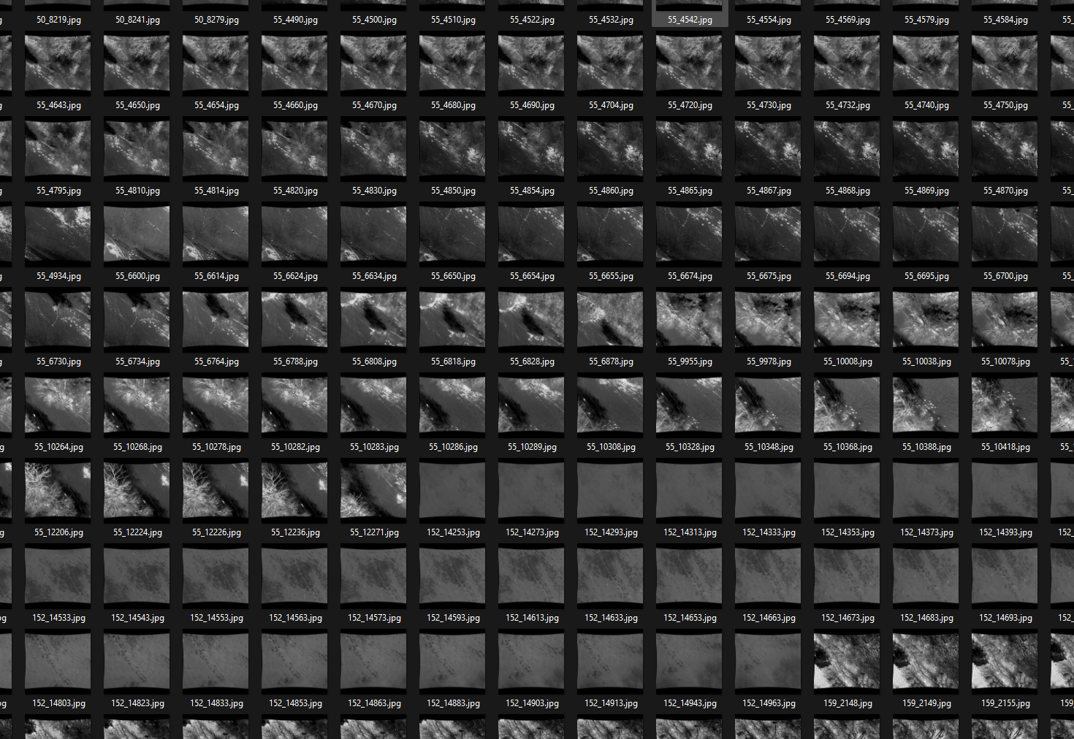
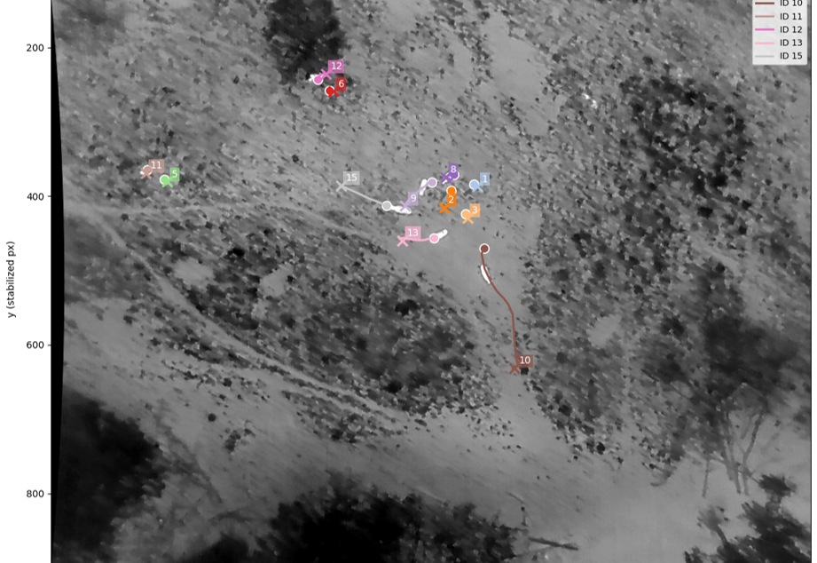
Approach - Overview
Choose & Explore Dataset
Data Preprocessing & Annotation
Train Object-detection
Train Object-tracking
Evaluate Model and create Statistics
Visualize Result

Slide 5
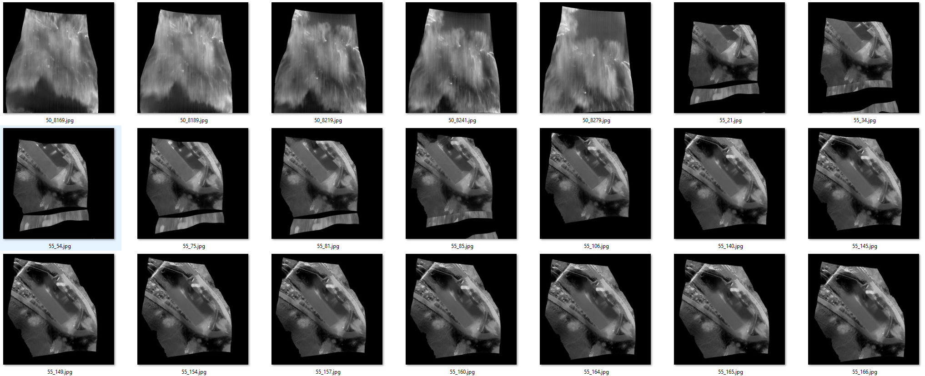
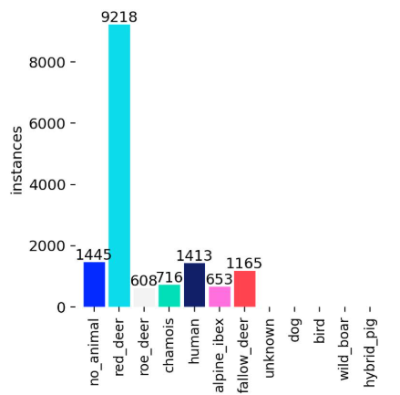
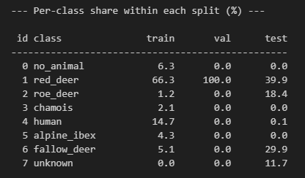
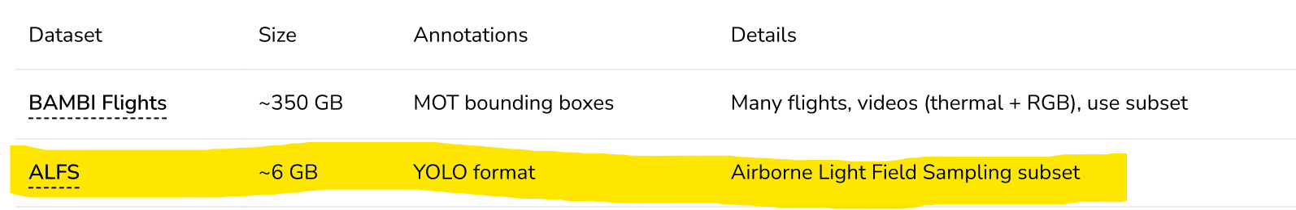
Dataset - ALFS
Advantage:
Annotated Animal species
Disadvantage:
very blurry
weird shapes
Huge class imbalance

Slide 6
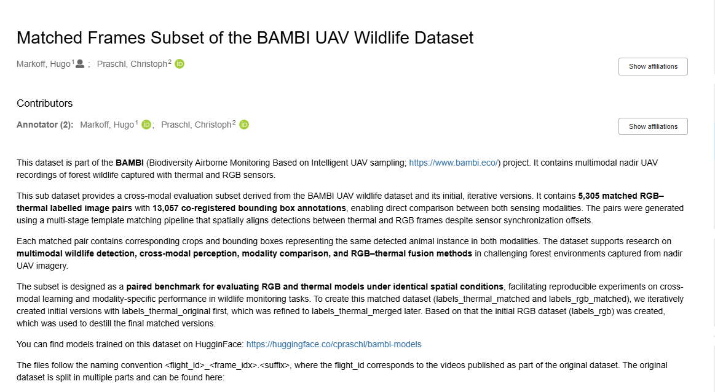
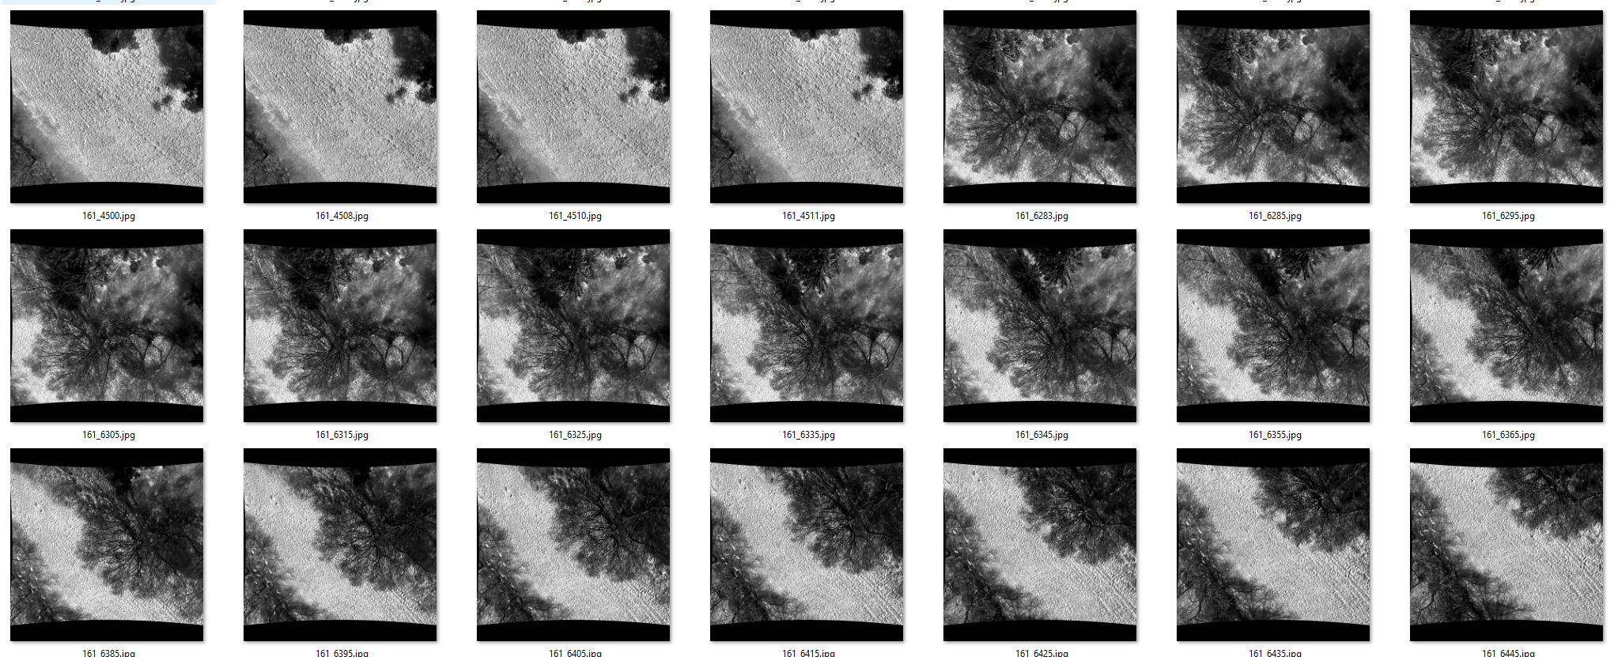
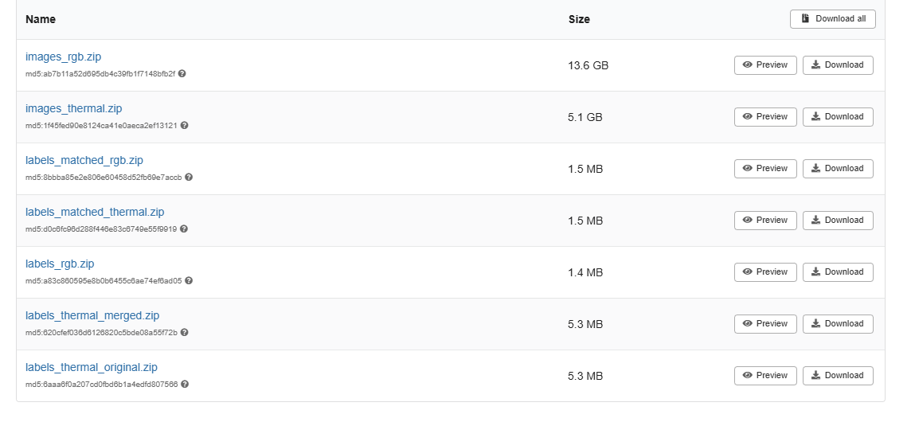


Dataset: Matched Frames Subset of the BAMBI UAV Wildlife Dataset
Better quality
Less labels
No species
Matched
Train/Val/Test Splits
Species (class imbalance)
https://zenodo.org/records/19034999

Slide 7
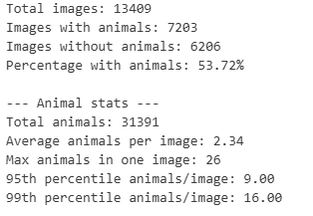
Explore Dataset
SPLIT:
TRAIN: 11.391
TEST: 01.934
VAL: 0.0084
Size / Labels:
Size: 1024 x 1024
Min area: 21.00 px²
Max area: 61620.40 px²
Avg area: 1922.42 px²
Huge class imbalance -> every animal = 1class

Slide 8
Approach - Overview
Choose & Explore Dataset
Data Preprocessing & Annotation
Train Object-detection
Train Object-tracking
Evaluate Model and create Statistics
Visualize Result

Slide 9
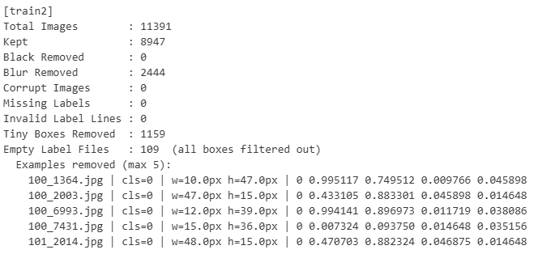


Data Preprocessing & Annotation
Clean dataset from
Blurry images (Laplacian)
Black images
Too small / invalid labels
Min-max normalization
Scales each image -> 0–255 range, increasing contrast & make animals more visible
Make Train/Val/Test split
Was given
Corrected Split (based on flight id)

Slide 10
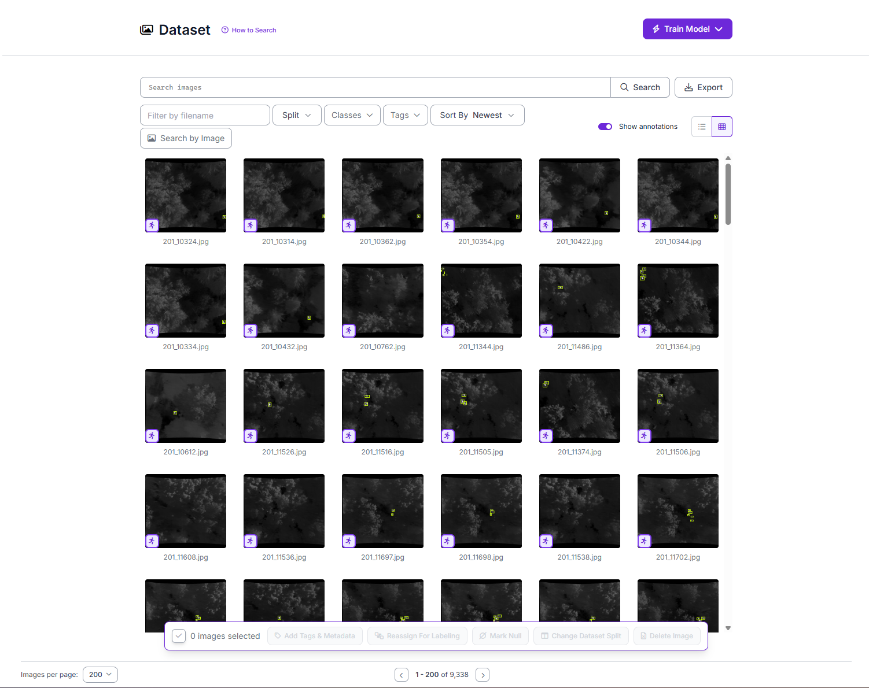
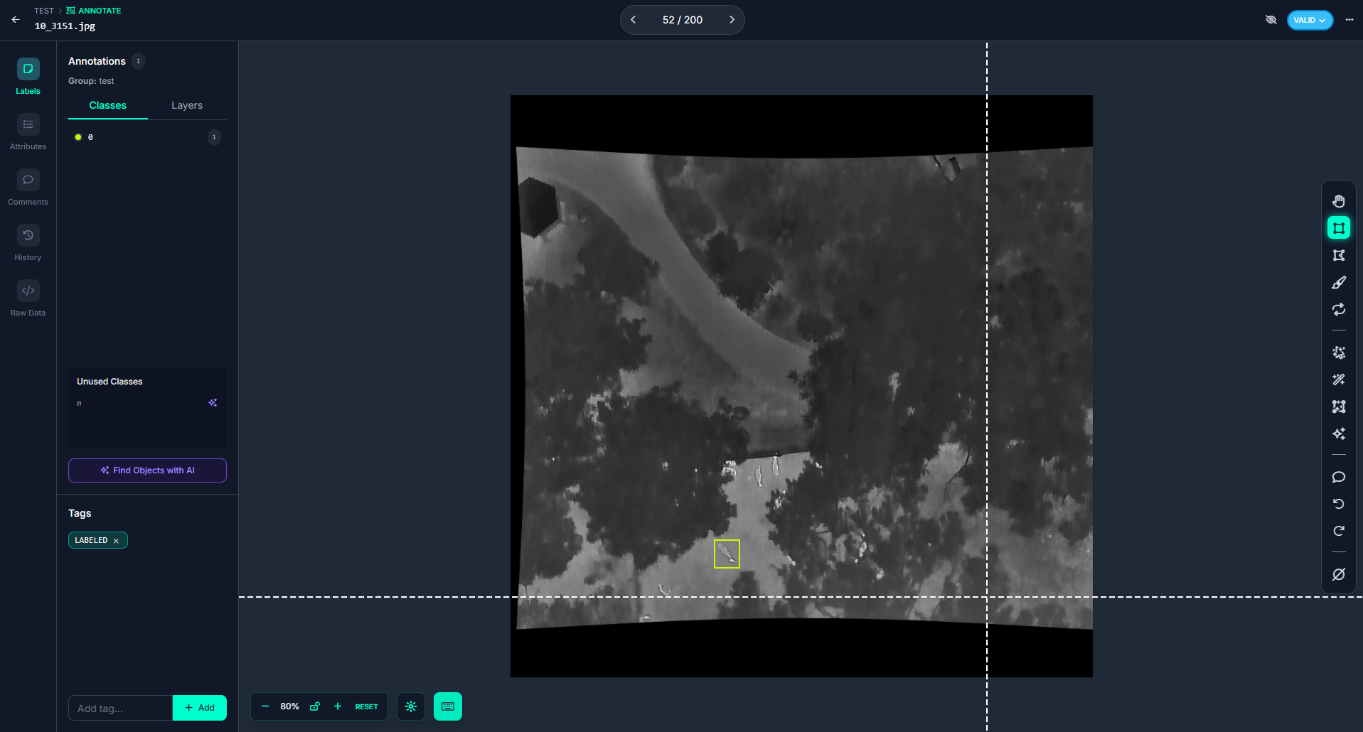
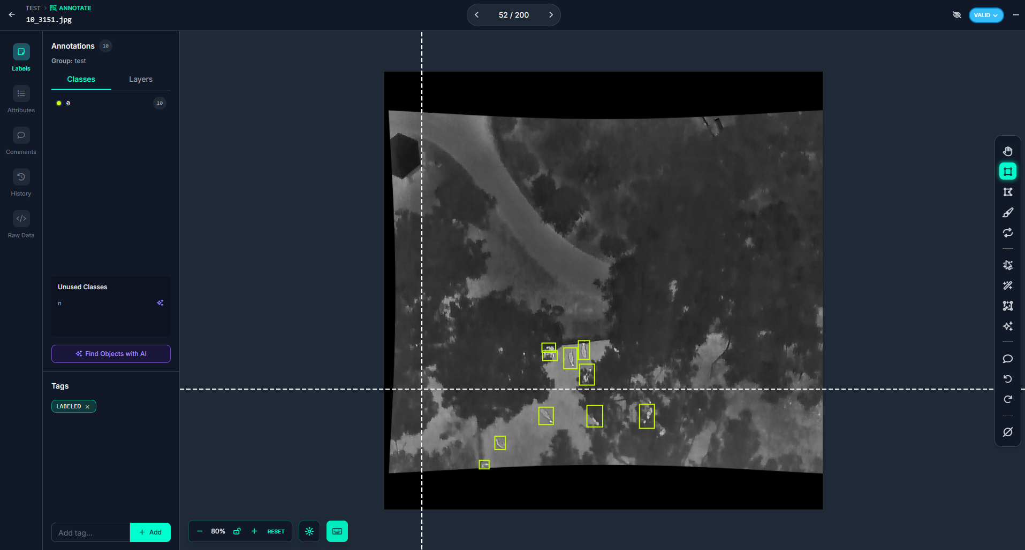
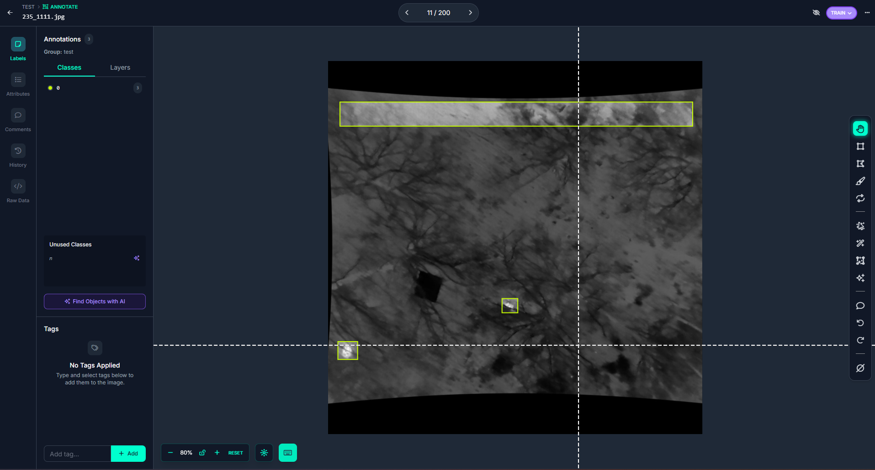
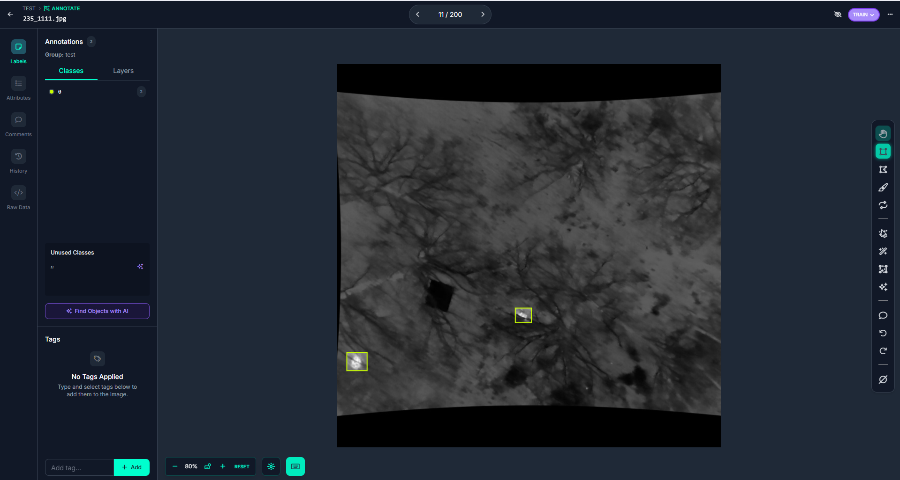

Data Preprocessing & Annotation
ROBOFLOW
Annotated 9.338 images (train & val)
Removed wrong annotations
Corrected sizes
Created new annotations
used RGB images for better insight

Slide 11
Approach - Overview
Choose & Explore Dataset
Data Preprocessing & Annotation
Train Object-detection
Train Object-tracking
Evaluate Model and create Statistics
Visualize Result

Slide 12
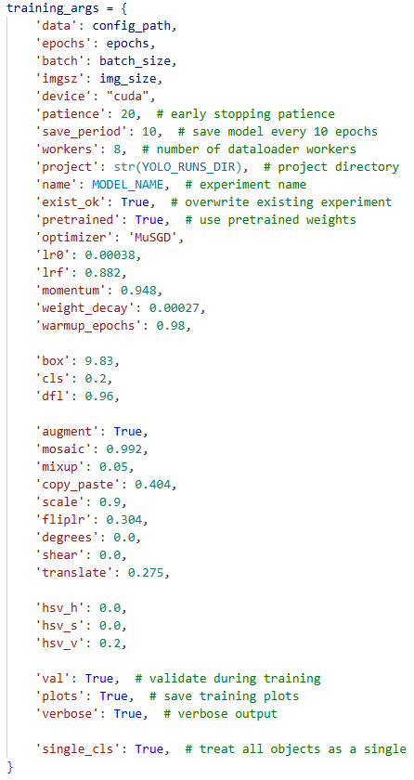
Train Object detection
Goal: detect animals reliably in thermal drone images
Tried YOLO11 with different YOLO checkpoints
Used YOLO26 with different YOLO checkpoints and parameter profiles (fast, balanced, quality)
Changed HSV_H/S to 0 due to thermal images
Used data augmentation parameter to make model more robust
Mosaic (combine 4 images into 1)
Erasing (rand remove image regions)
Degrees (rand rotation)
Translate (rand shifts)
Scale (rand zooms)
Retrained with older best weights
Had multiple stages / different approaches of training –> next slide

Slide 13

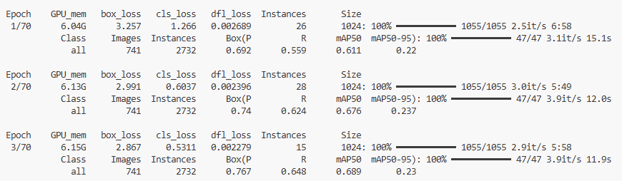
TRAINING APPROACHES
Take the raw dataset and train without preprocessing with YOLO11
1
Changed to YOLO26 Model
2
Preprocess and remove blurry images
3
Limit to classes with enough data (from 12 to 8 classes)
4
Change Dataset and limit to only 1 class (animal or no animal)
5
Improved Annotations for ~9k samples on ROBOFLOW
6
Fine-tuned YOLO parameters Increased image size to 1024
7
MAP-50:
2%
3.5%
6%
8%
35%
66%
70%

Slide 14
Approach - Overview
Choose & Explore Dataset
Data Preprocessing & Annotation
Train Object-detection
Train Object-tracking
Evaluate Model and create Statistics
Visualize Result

Slide 15
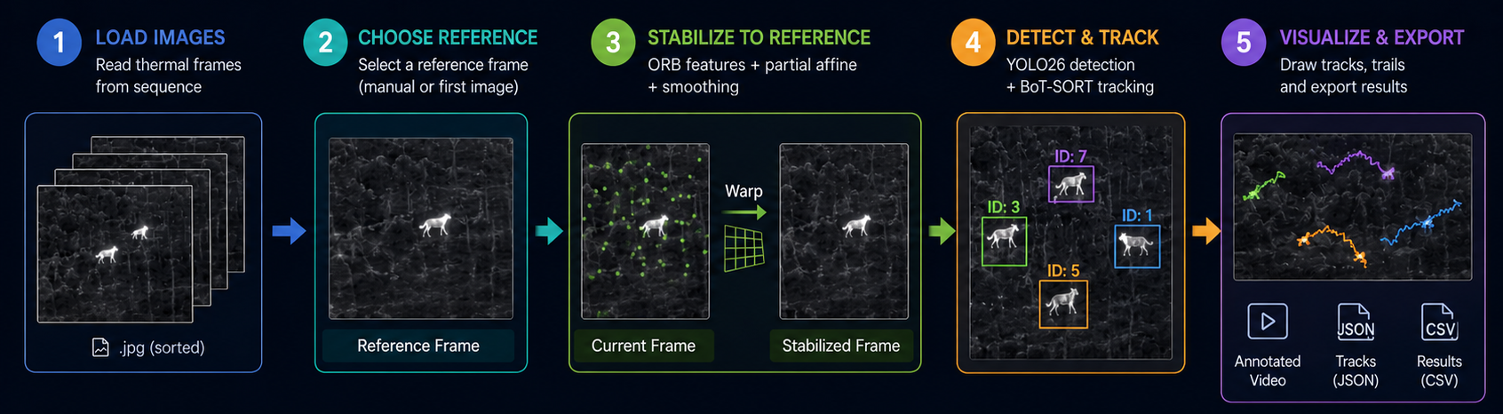
Train Object Tracking
Goal: track detected animals across thermal drone image sequences
Stabilize images to compensate drone movement with selected reference frame
Detected image landmarks to estimate drone movement (5000 orb features)
Applied transform smoothing to reduce trajectory noise
Used YOLO animal detector on stabilized frames
Applied BOTSORT for assigning persistent animal IDs
Generated trajectories based on bounding-box center points

Slide 16
Approach - Overview
Choose & Explore Dataset
Data Preprocessing & Annotation
Train Object-detection
Train Object-tracking
Evaluate Model and create Statistics
Visualize Result

Slide 17
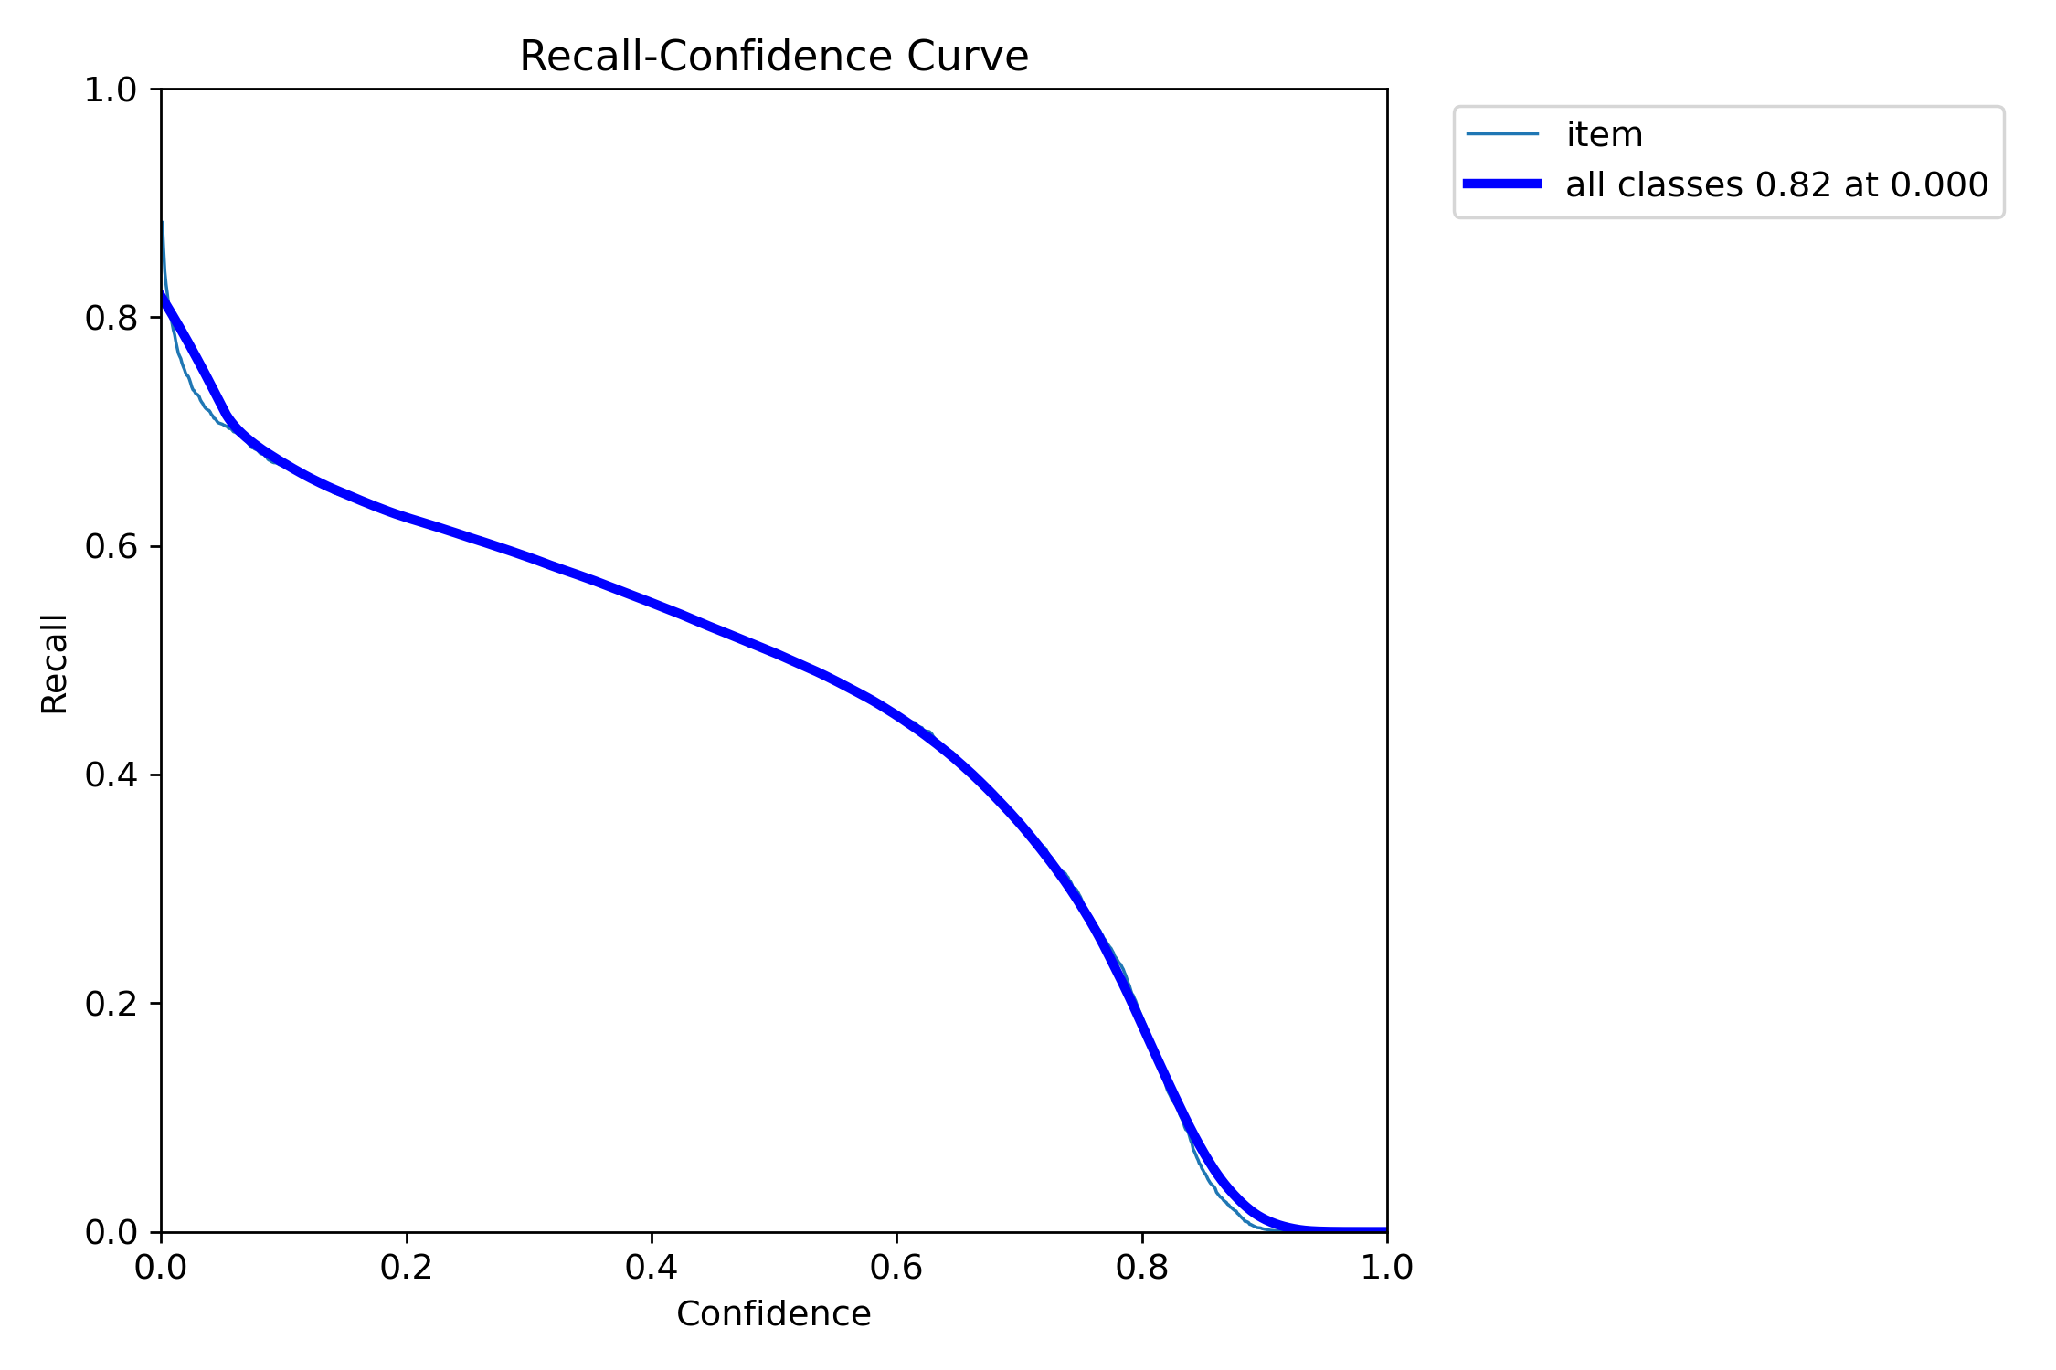
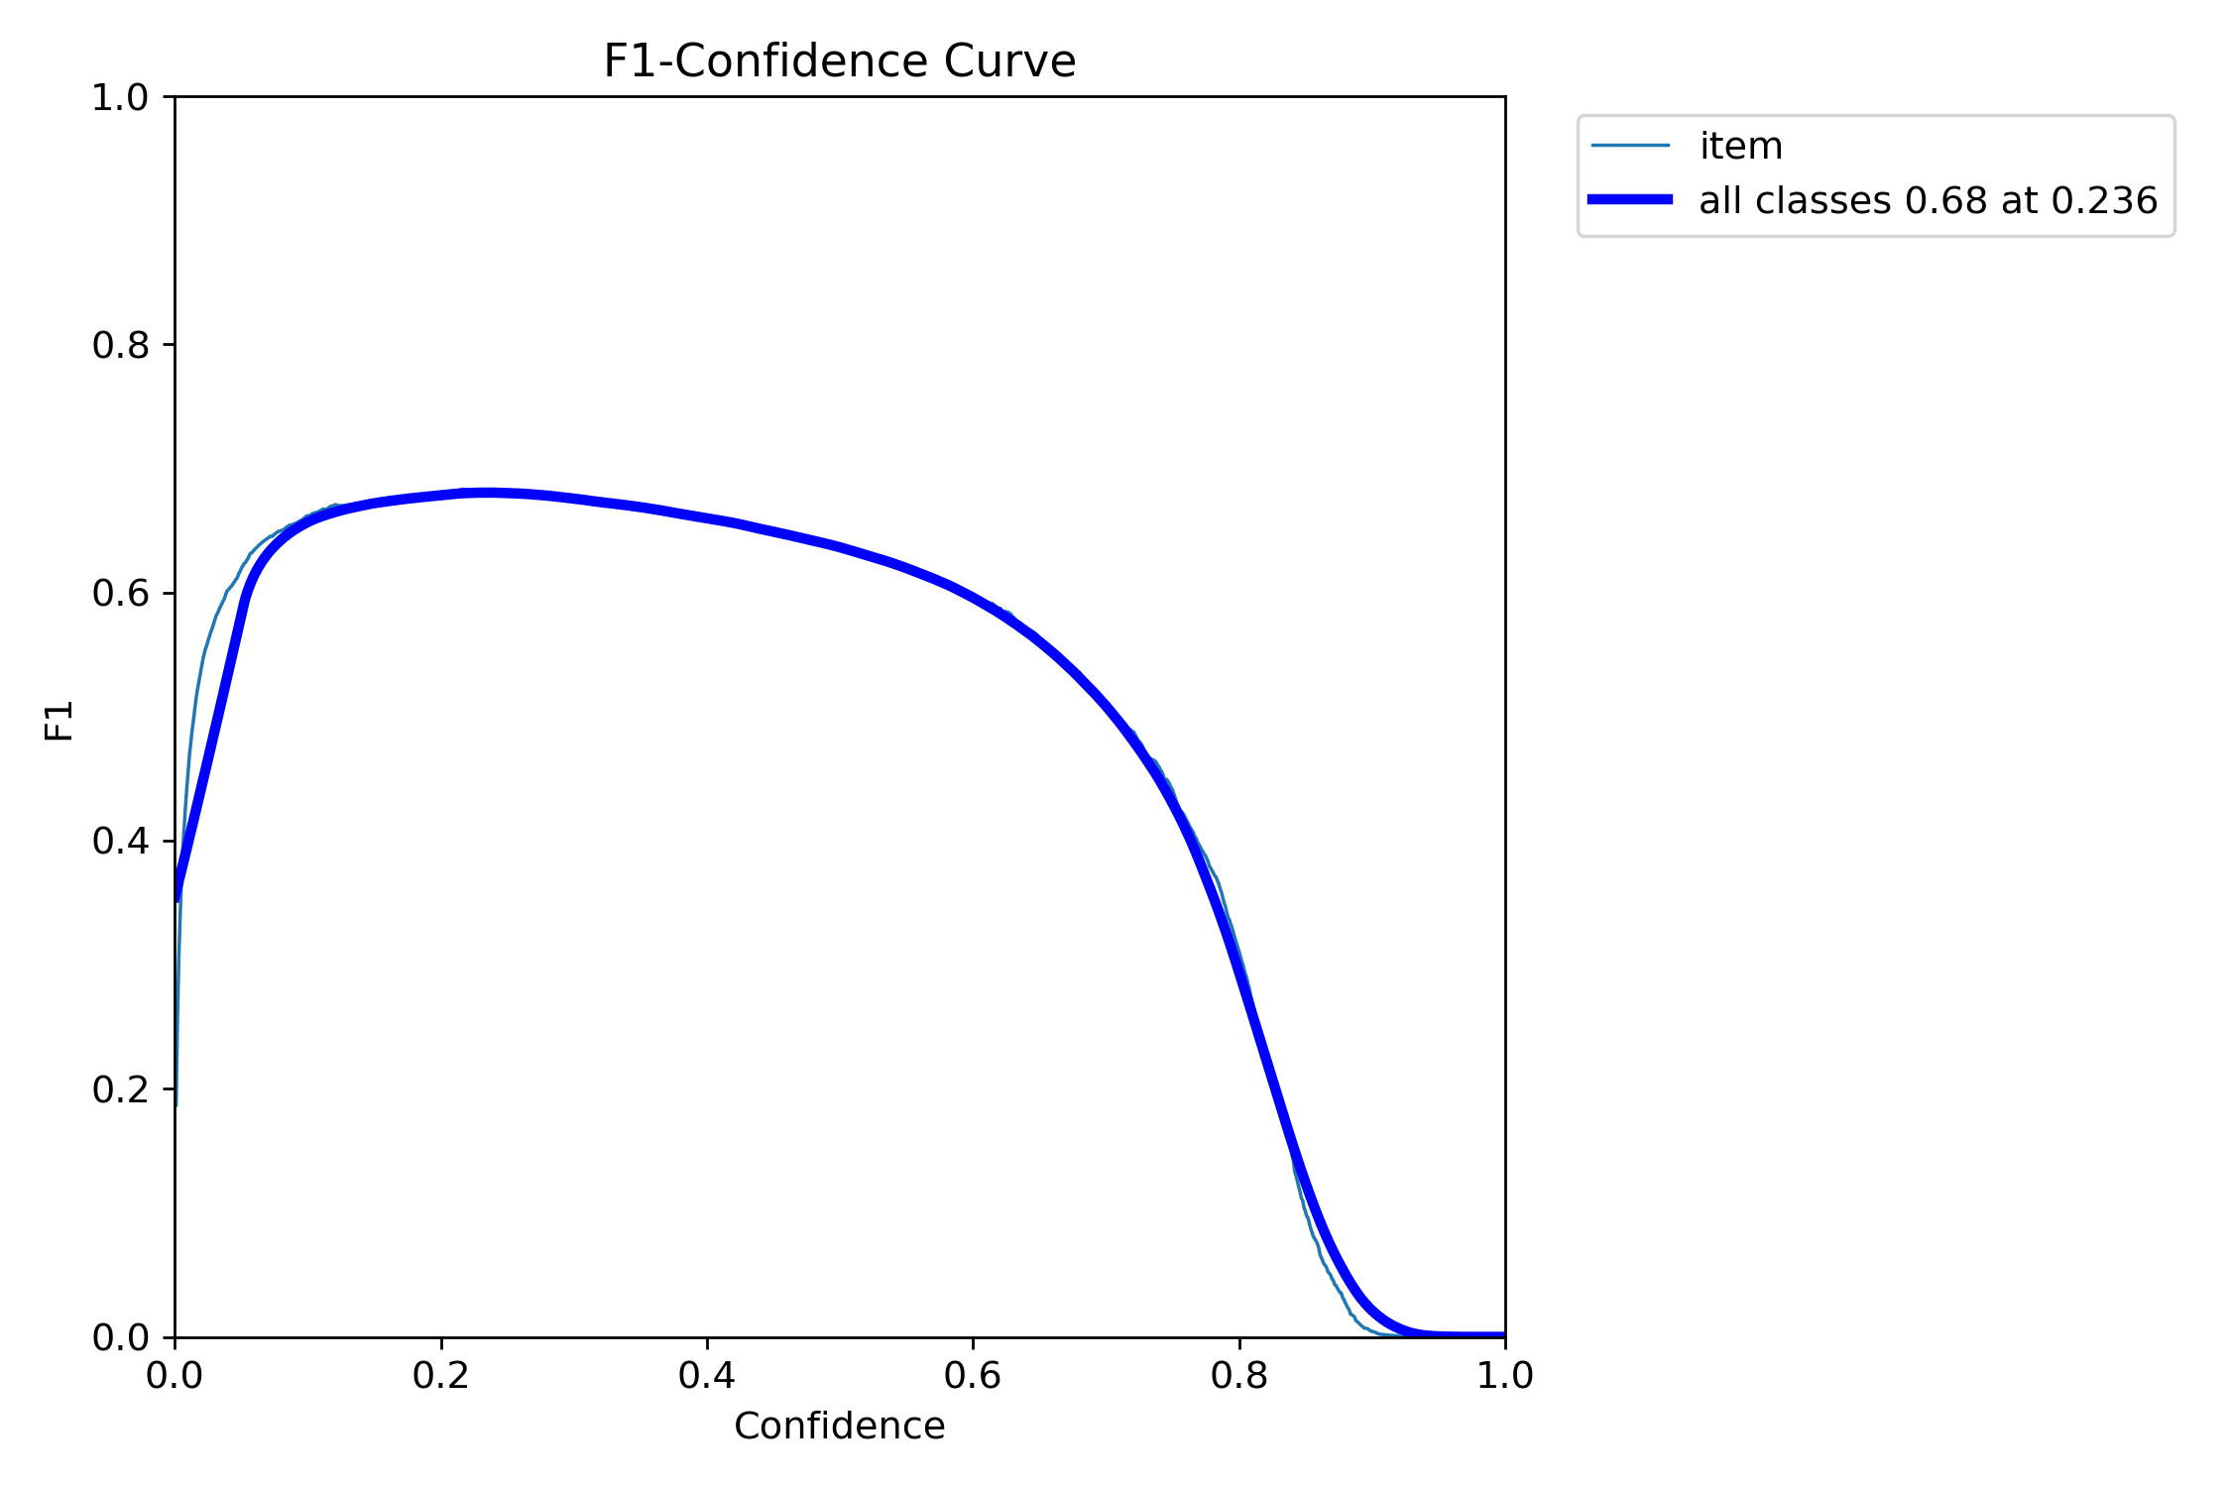
Evaluate Model and create Statistics
Epoch | Box (P | R) | mAP50 | mAP50-95
1 | 0.692 | 0.559 | 0.611 | 0.220
5 | 0.768 | 0.584 | 0.663 | 0.224
10 | 0.777 | 0.637 | 0.686 | 0.228
15 | 0.747 | 0.644 | 0.675 | 0.216
Best | 0.760 | 0.652 | 0.709 | 0.247

Slide 18
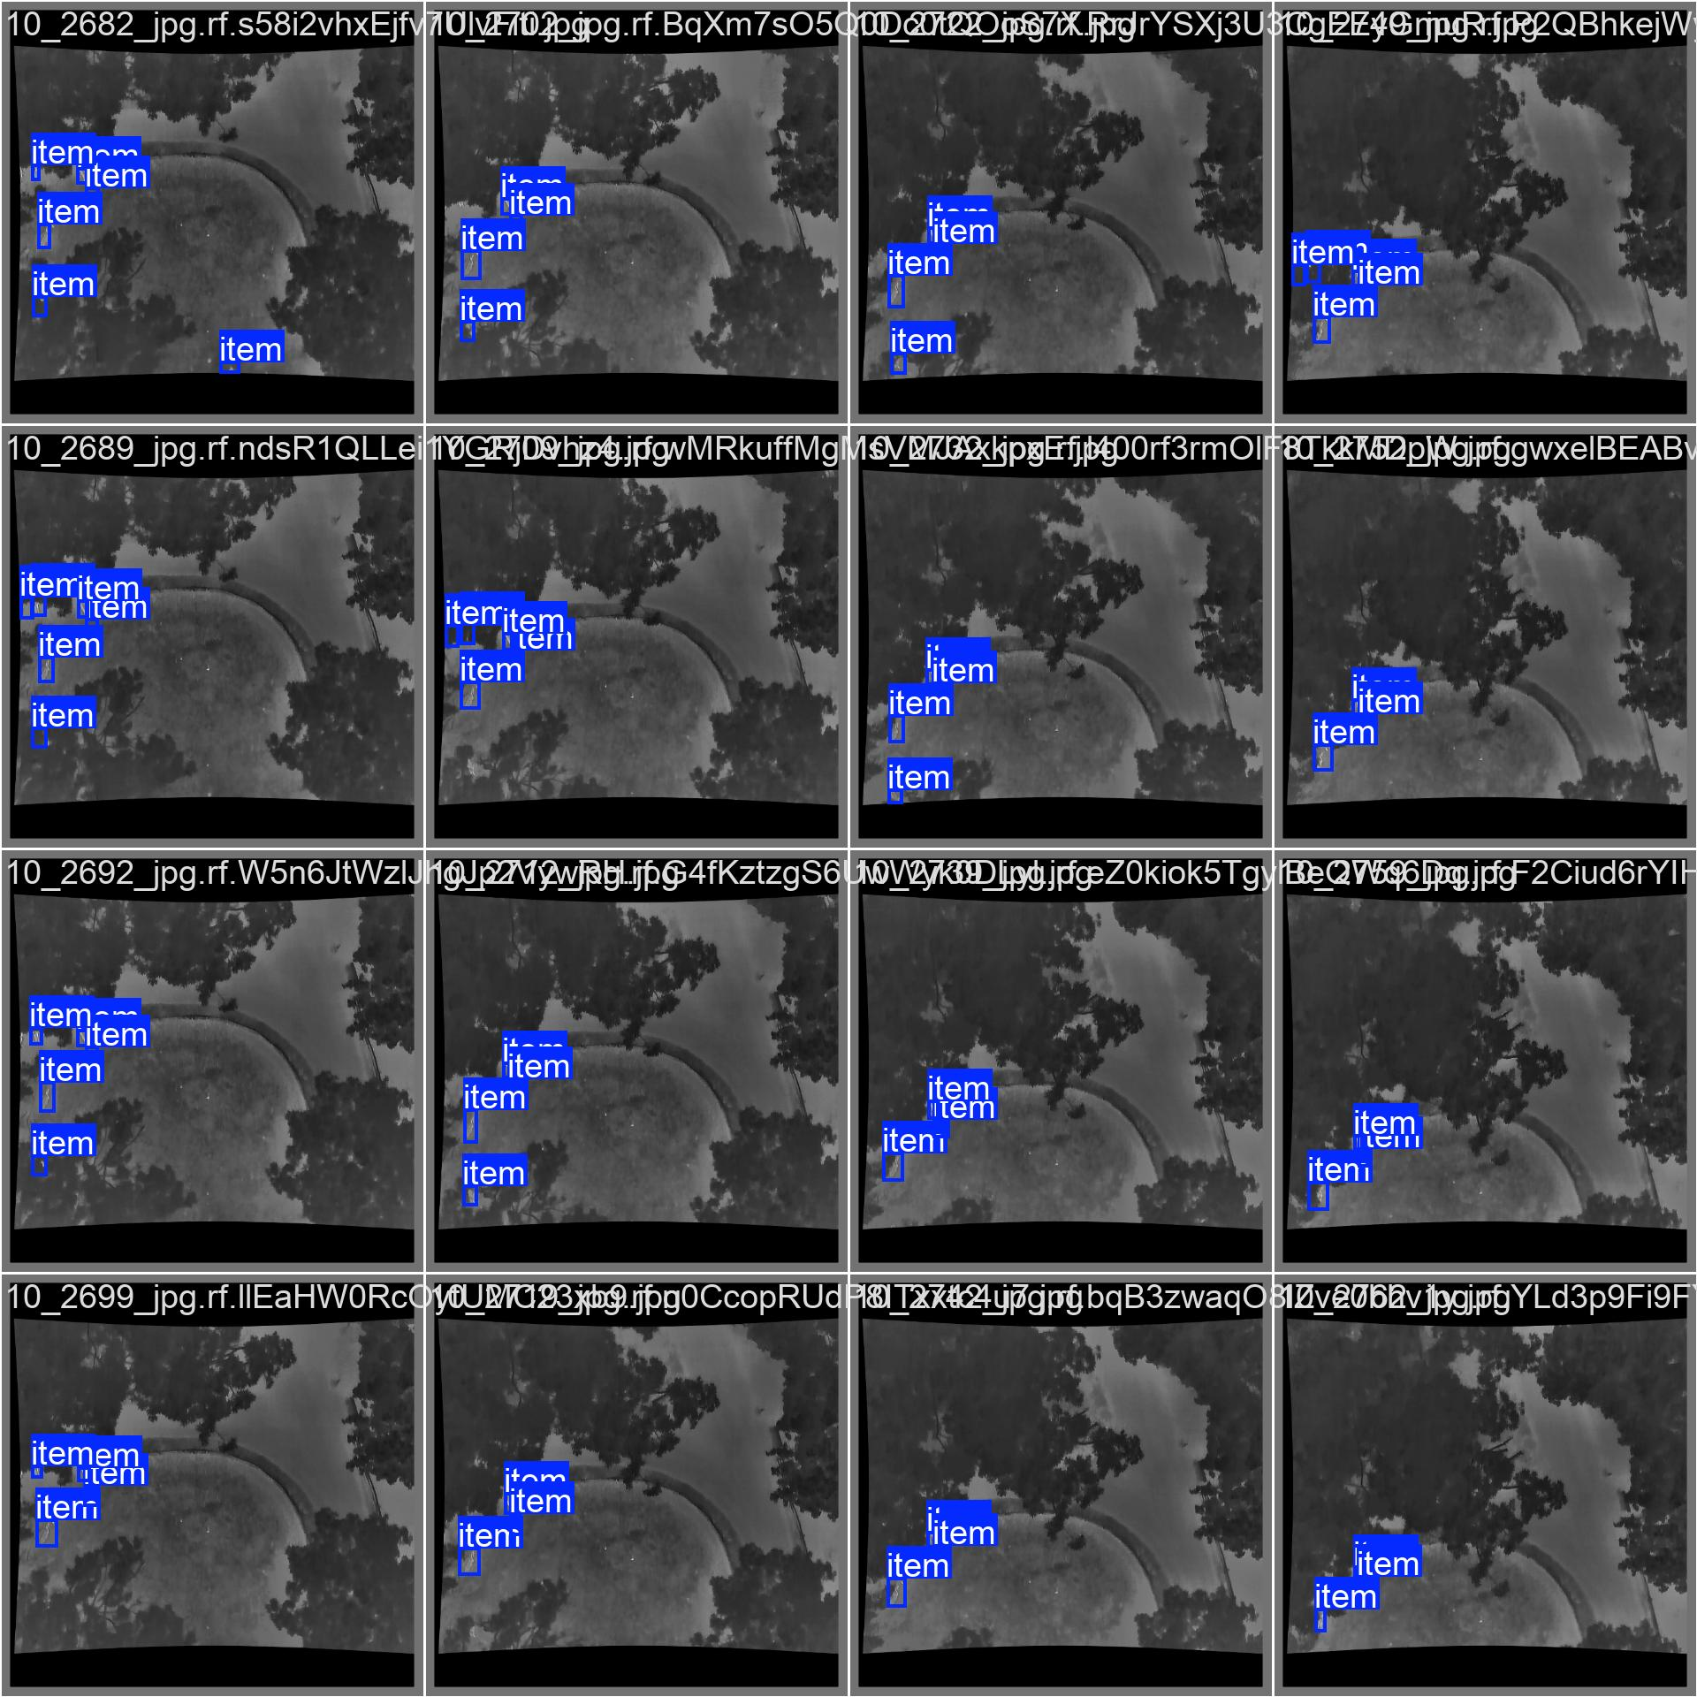
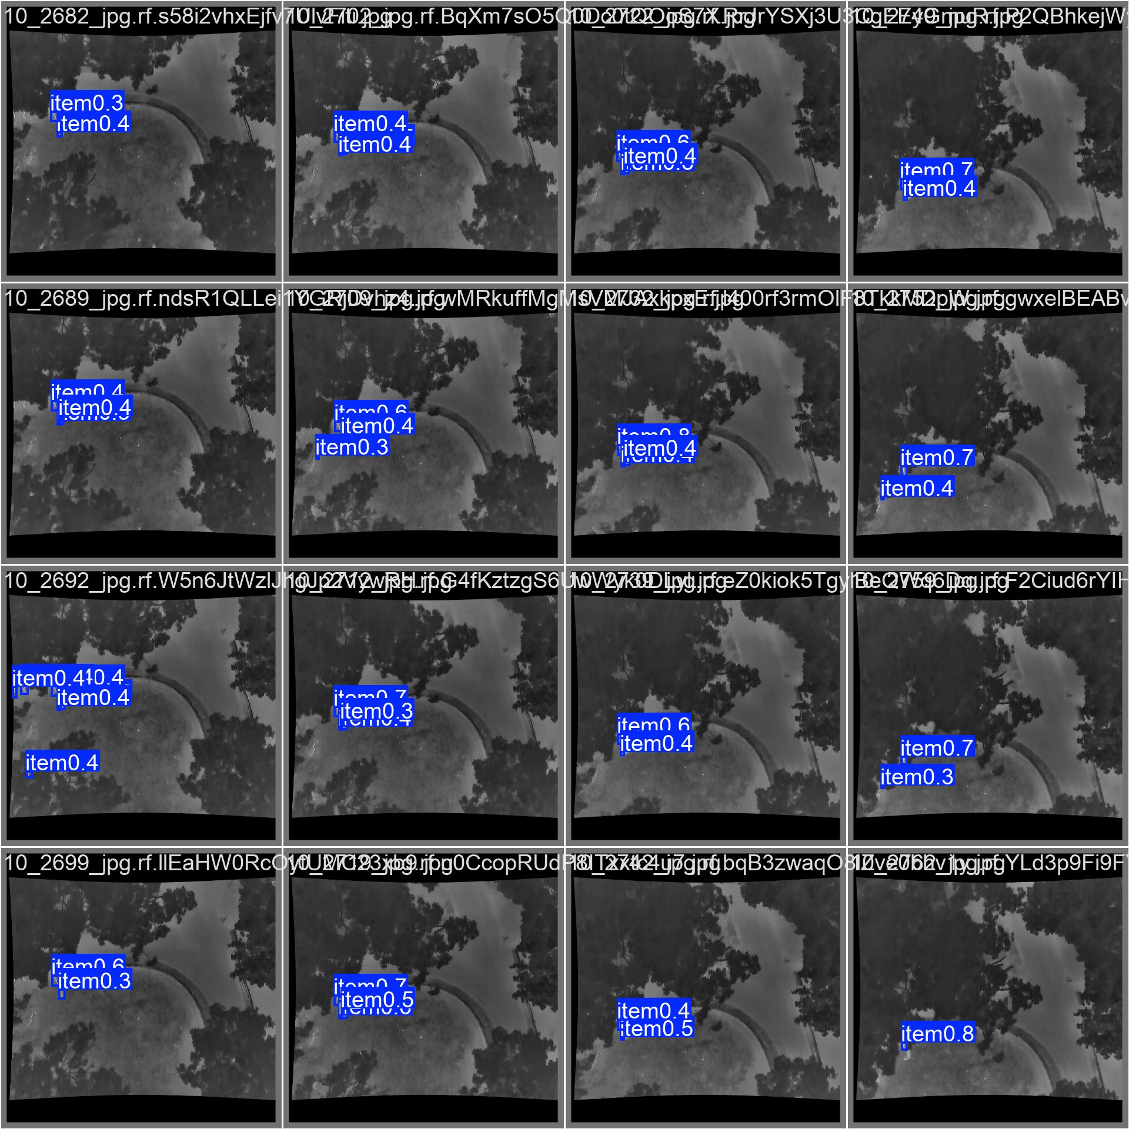
Ground Truth: Prediction:

Slide 19
Approach - Overview
Choose & Explore Dataset
Data Preprocessing & Annotation
Train Object-detection
Train Object-tracking
Evaluate Model and create Statistics
Visualize Result

Slide 20
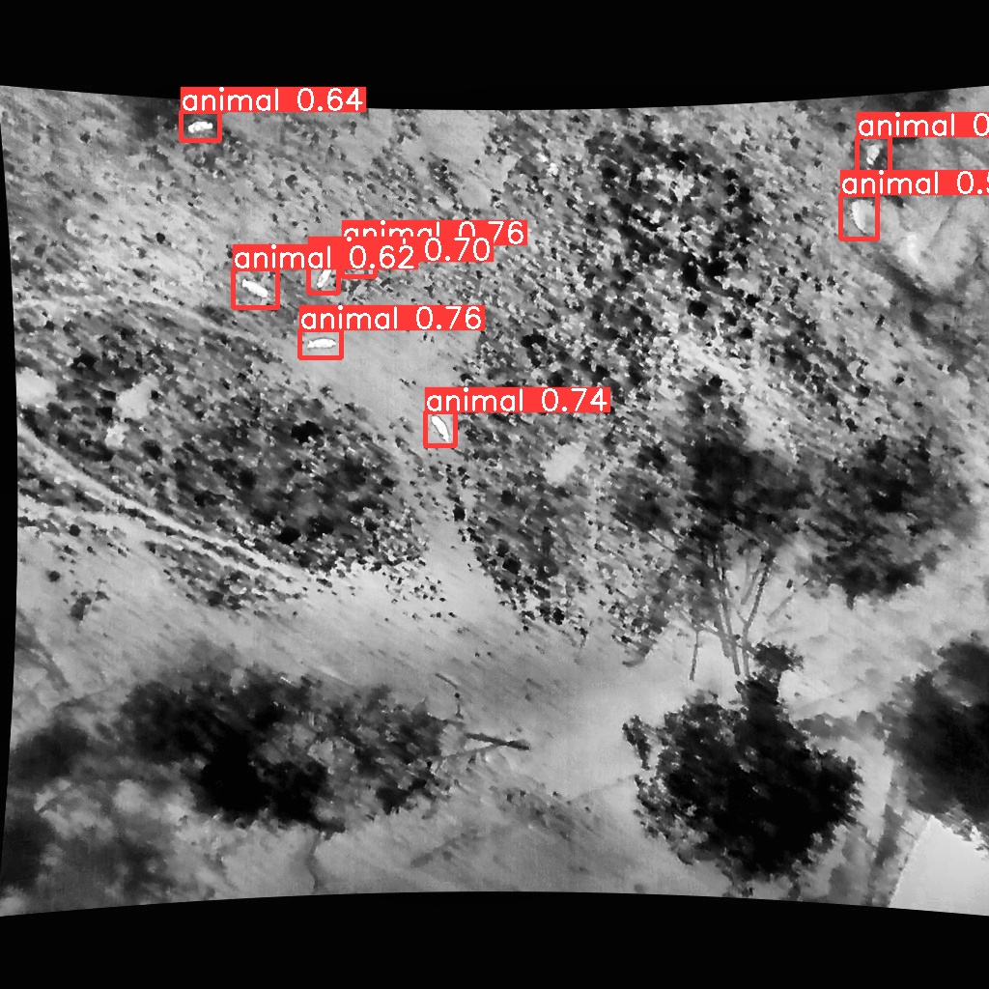
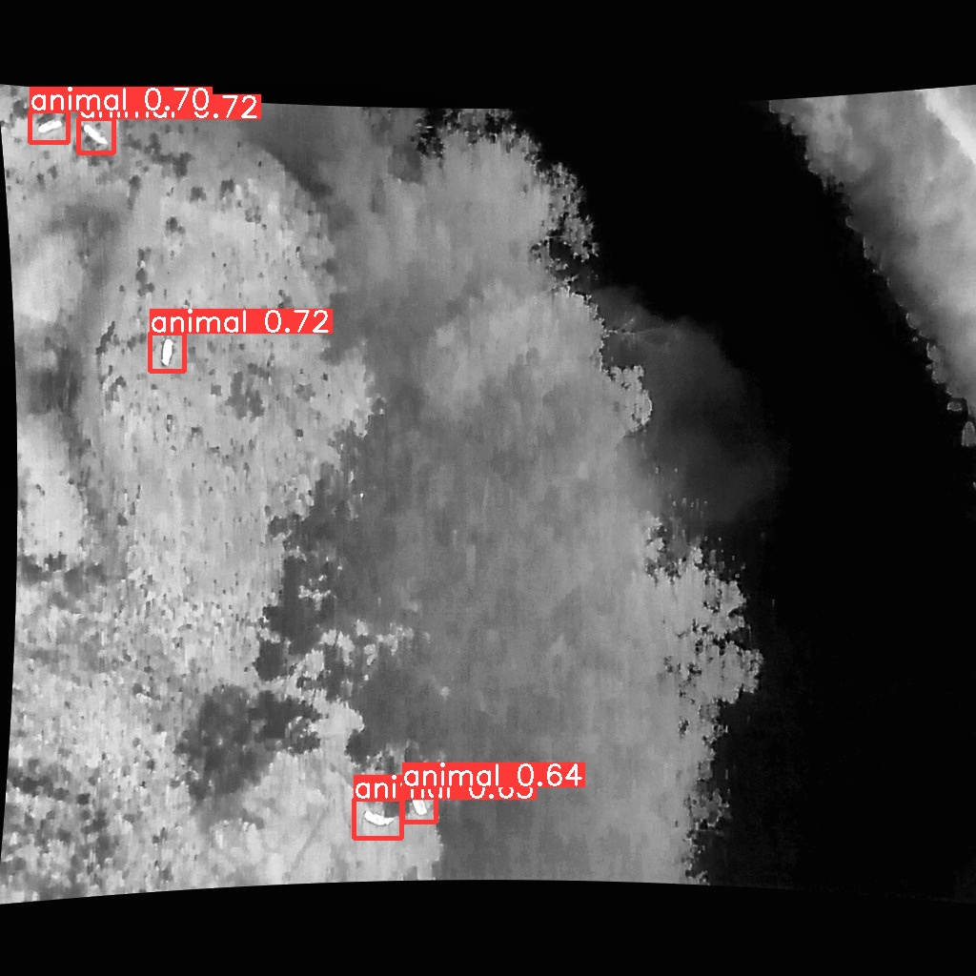
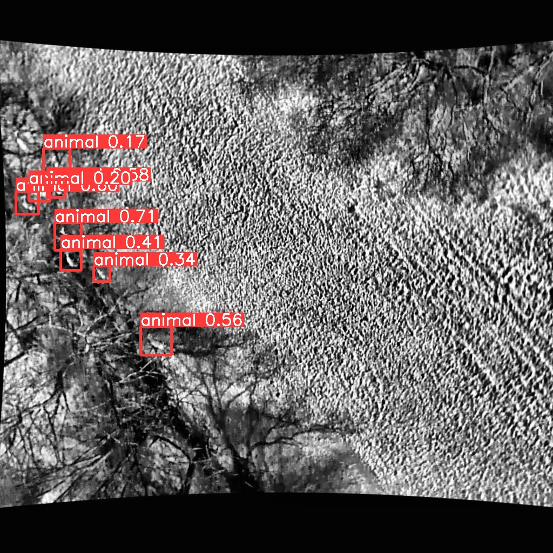
Visualize Result - Detection

Slide 21
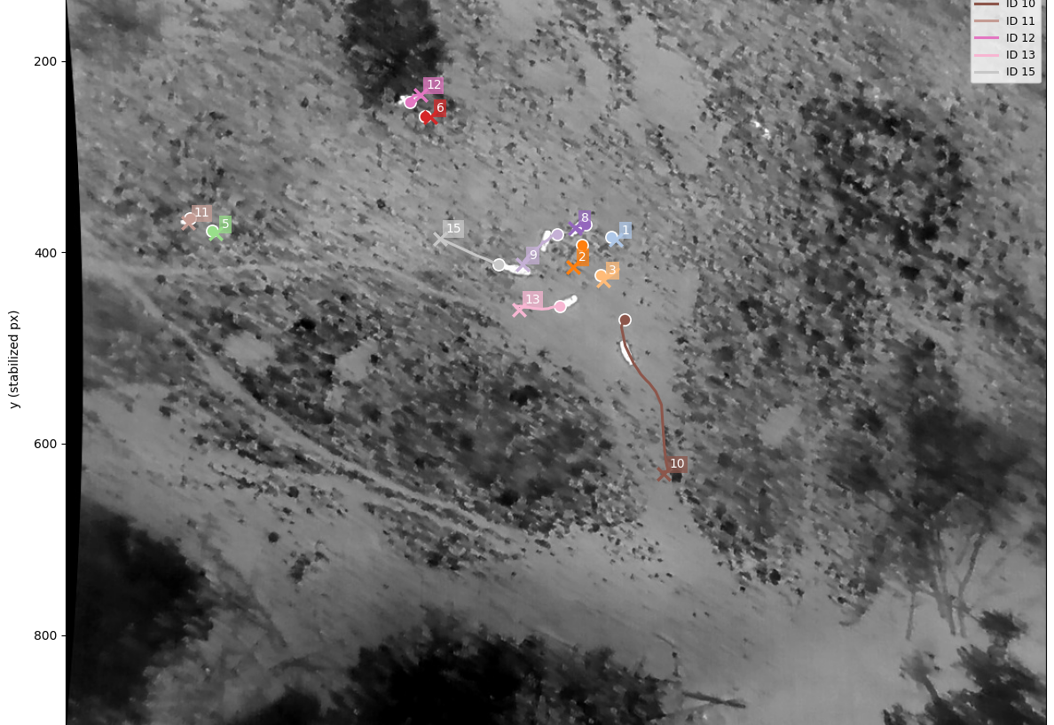
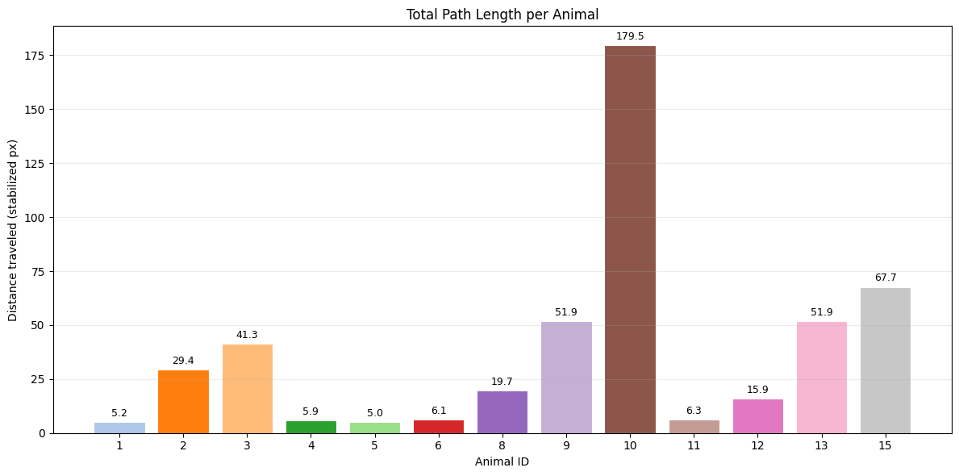
Visualize Result - Tracking

Slide 22
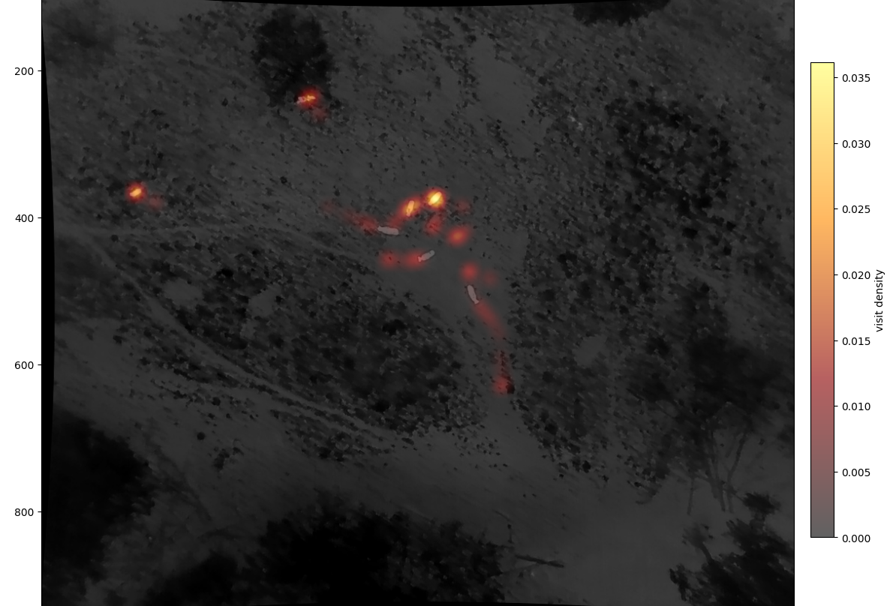

Slide 23
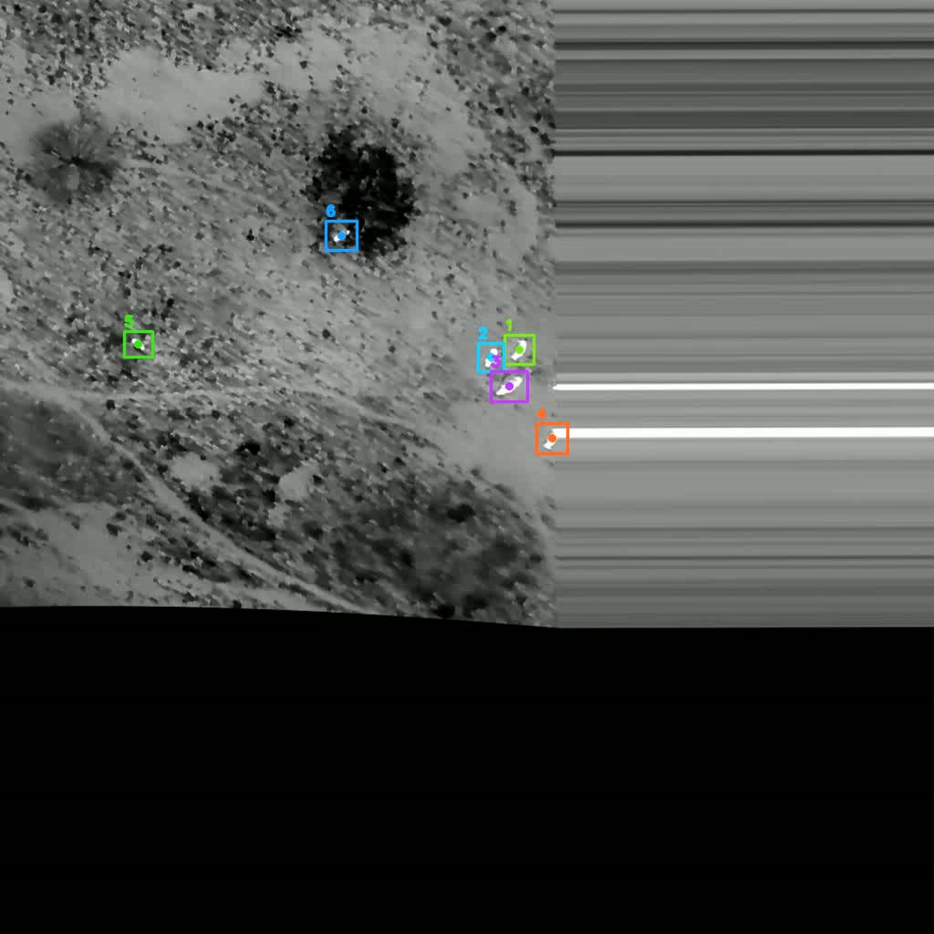
Stabilized Video sequence with overlaid IDs

Slide 24
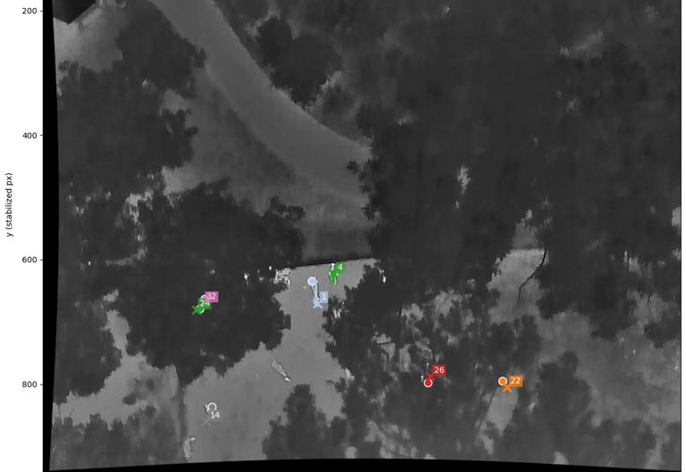
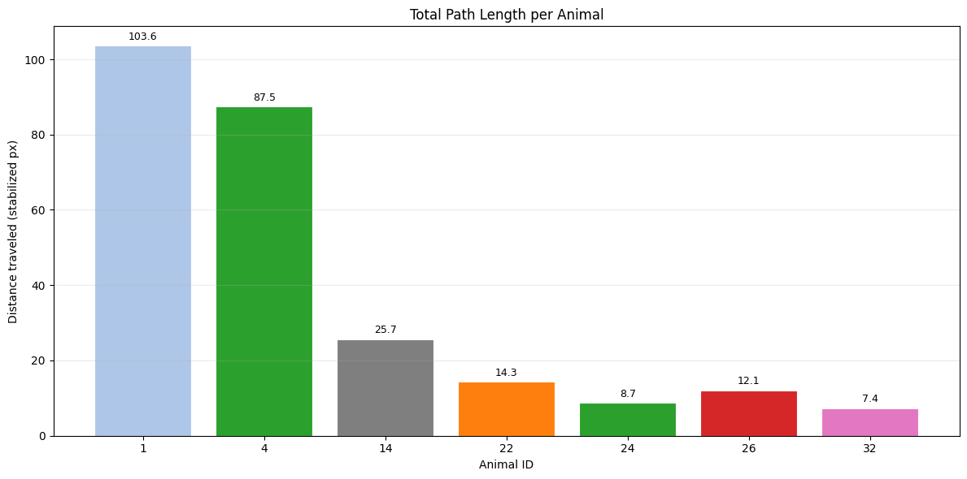
Visualize Result – second Track

Slide 25
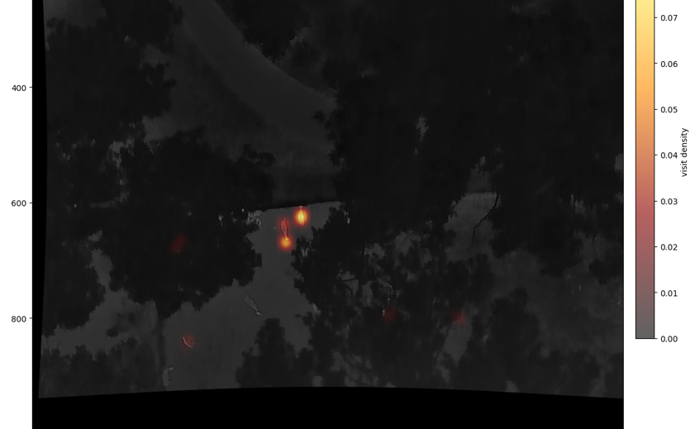

Slide 26
Thank you for your attention!

