Slide 1
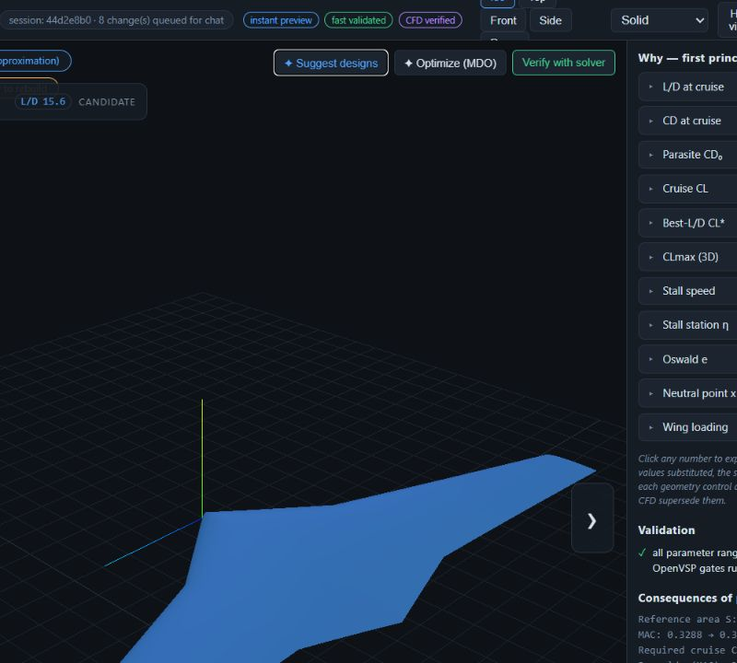
MECHANICAL ENGINEERING PORTFOLIO
ASTRA
Mission intent -> parametric geometry -> mesh -> CFD evidence.
A reviewable blended-wing-body drone design workflow built around explicit assumptions, deterministic gates and honest result quality.
Lindon Vaz
Mechanical Design and CAE
github.com/L-Vaz/Astra
Notes:
[Sources]
- README.md
- reports/verification-2026-07-10/report.md
- portfolio/assets/ui/cockpit-candidate-analysis.png
- README.md#astra

Slide 2
CHALLENGE AND OWNERSHIP
A mission brief becomes a reviewable engineering problem
Astra connects requirements, geometry and simulation without hiding the assumptions between them.
Concept design often fragments the requirement, CAD model and analysis case. Astra keeps those stages linked, versioned and inspectable.
INHERITED FOAM-AGENT FOUNDATION
ASTRA EXTENSION
LangGraph CFD workflow
BWB requirement schema and inverse sizing
Case planning, input writing and execution
Parametric OpenVSP geometry
Review and correction loop
Concept candidates and cockpit
RAG-backed OpenFOAM configuration
VSPAERO screening and deterministic Gmsh farfield
Post-processing and visualization foundation
Versioned sessions, gates and result-quality verdict
Aerodynamics-first conceptual design. Structures, propulsion, manufacturing and flight validation remain outside the present scope.
Source: README.md
02
Notes:
[Sources]
- README.md
- src/main.py
- src/mcp/fastmcp_server.py
- reports/verification-2026-07-10/img/top.png
- README.md#astra
- README.md#foam-agent
- README.md#what-astra-adds
- README.md#scope-and-limits

Slide 3
DESIGN SYSTEM
One traceable loop links intent to evidence
Every stage creates an artifact, applies a gate and invalidates downstream evidence when the design changes.
MISSION
GEOMETRY
FAST AERO
MESH
CFD
VERDICT
Structured requirements
OpenVSP model and STL
VSPAERO sweep
Gmsh farfield
OpenFOAM case
Quality report
Units and assumption disclosure
Ranges, cross-checks and watertightness
Trim and plausibility
Cells, patches and checkMesh
Execution and monitored histories
Convergence, plausibility and mission
REVISION BEHAVIOUR
Upstream revisions preserve history but invalidate downstream results until those stages are rerun.
The engineering record stays reviewable: what changed, what became stale and what must be rerun remain explicit.
Source: docs/agent-guidance/bwb-design-loop.md
03
Notes:
[Sources]
- docs/agent-guidance/bwb-design-loop.md
- src/services/design_session.py
- src/services/evaluate.py

Slide 4
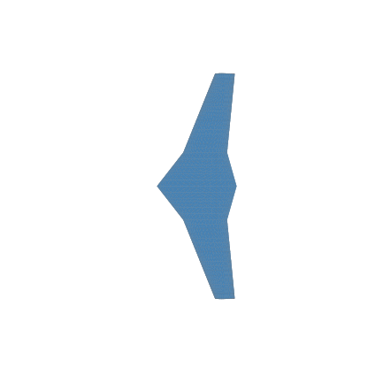
REQUIREMENT-DRIVEN DESIGN
The concept is sized from forces, not styling
Steady level flight requires lift to balance weight; the requirement solver closes the planform around that physical constraint.
FIRST-PRINCIPLES SIZING
L = W; q = 0.5 rho V^2; S = W / (q CL)
Lift balances weight in steady level flight. Dynamic pressure converts the mission condition into the wing area required at the chosen lift coefficient.
RECORDED GOLDEN CASE [C]
Mission payload
Cruise condition
Reference area
Span / aspect ratio
2 kg [C]
25 m/s at 100 m [C]
0.952 m2 [C]
2.29 m / 5.5 [C]
The interface distinguishes the value requested, the value in force and the bound that forced any change. Constraint closure remains visible instead of silently rewriting the brief.
Source: reports/verification-2026-07-10/report.md#4-physics-results-golden-design
04
Notes:
[Sources]
- reports/verification-2026-07-10/report.md#4-physics-results-golden-design
- docs/decisions/0002-close-the-stage-1-requirement-set.md
- reports/verification-2026-07-10/img/top.png

Slide 5
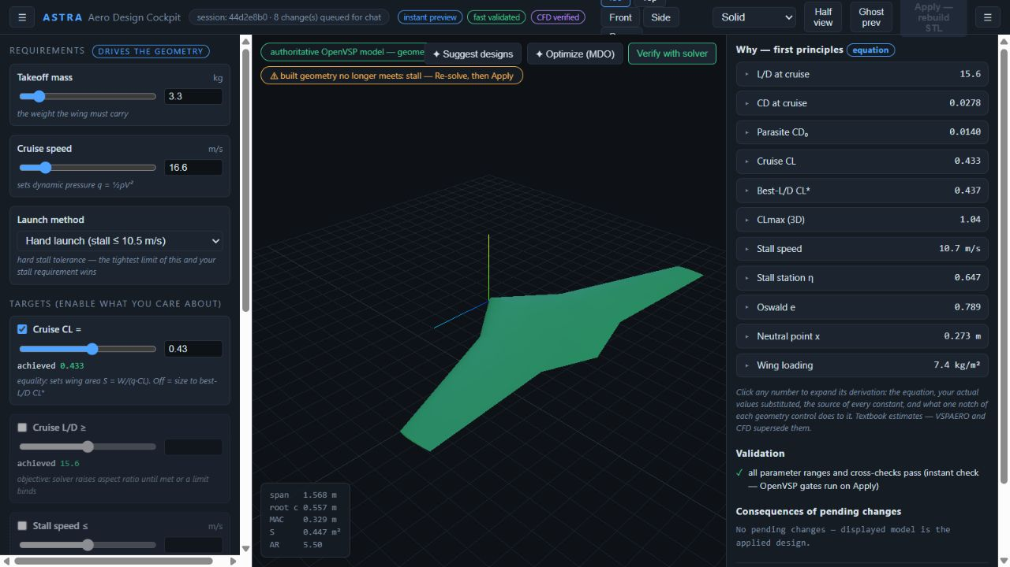
PARAMETRIC GEOMETRY AND COCKPIT
Design variables stay connected to their consequences
The cockpit exposes geometry, constraints and first-principles explanations while server-side validation remains authoritative.
WHAT THE INTERFACE EXPOSES
Requirement controls show targets, achieved values and active bounds.
The WebGL planform is an instant preview; Apply rebuilds the authoritative OpenVSP model.
Existing candidates can be compared without overwriting the accepted geometry.
Equation estimates remain labelled separately from VSPAERO and CFD evidence.
REAL EXISTING SESSION CAPTURE [C]
Source: src/cockpit/static/cockpit.js
05
Notes:
[Sources]
- src/cockpit/static/cockpit.js
- src/cockpit/server.py
- docs/agent-guidance/task-maps.md#11-cockpit-ui-requirements-first-explorer
- portfolio/assets/ui/cockpit-overview.png
- src/cockpit/static/index.html
- src/services/candidates.py

Slide 6
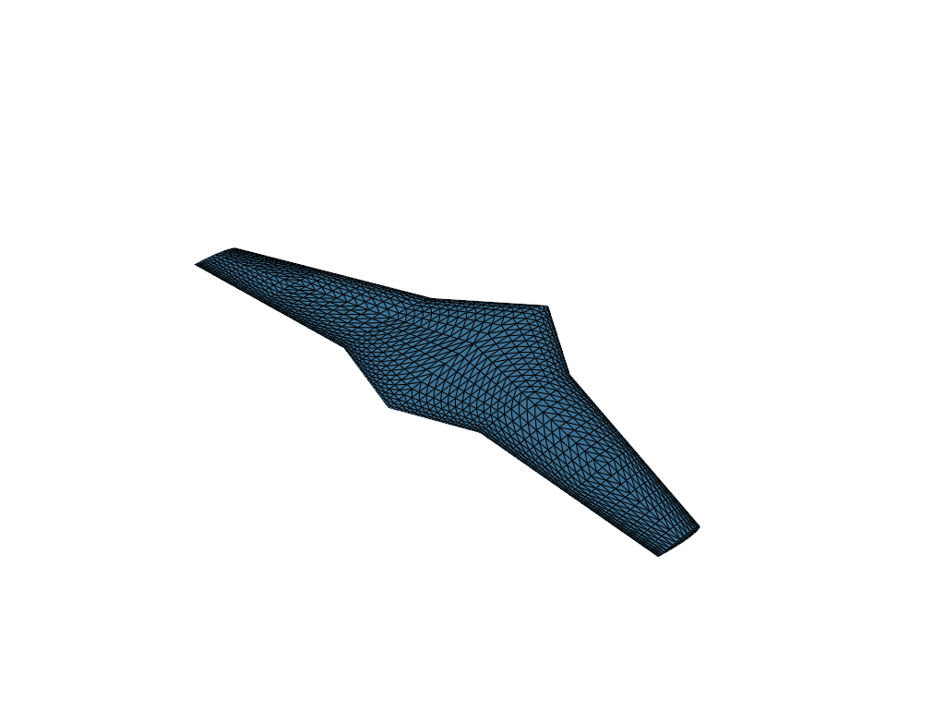
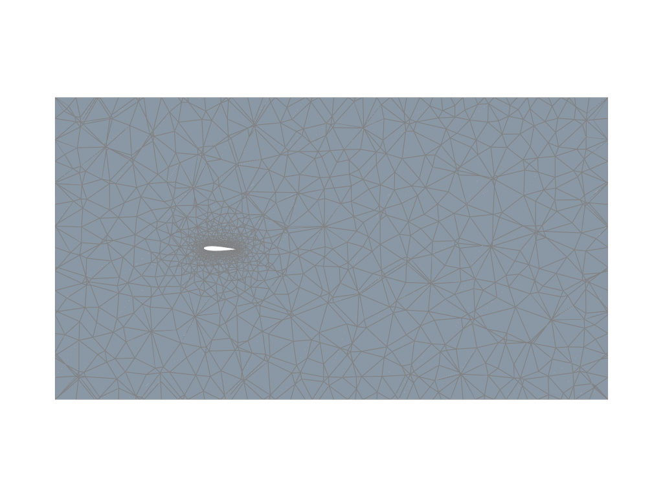
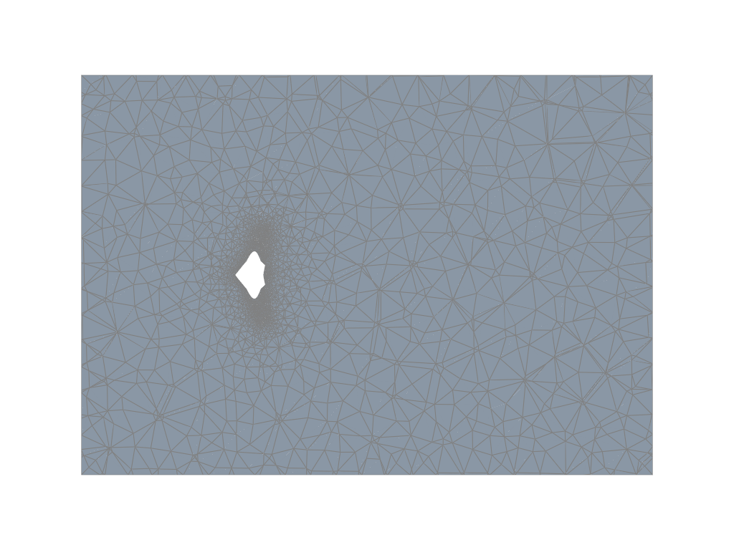
MESH GENERATION
Deterministic mesh gates protect the solver handoff
The validated OpenVSP surface is retained as the boundary while the farfield volume and patch types are generated and checked deterministically.
DETERMINISTIC HANDOFF
Use the watertight STL triangles directly as the aircraft boundary.
Generate the farfield with deterministic Delaunay tetrahedralization.
MEASURED MESH-QUALITY CHANGE [C]
Classify aircraft walls and the symmetry plane before case writing.
Netgen optimization reduced average non-orthogonality from 22.6 to 17.9 and maximum skewness from 2.6 to 1.5 [C].
Stop on zero cells, conversion failure or a failed mesh-quality gate.
Source: reports/verification-2026-07-10/report.md#run-8
06
Notes:
[Sources]
- reports/verification-2026-07-10/report.md#run-8
- domain_packs/bwb/gmsh_farfield.py
- src/services/bwb_mesh.py
- reports/verification-2026-07-10/img/mesh_aircraft_surface.png
- reports/verification-2026-07-10/img/mesh_slice_y.png
- reports/verification-2026-07-10/img/mesh_slice_z.png
- reports/verification-2026-07-10/report.md#run-4
- src/services/mesh.py

Slide 7
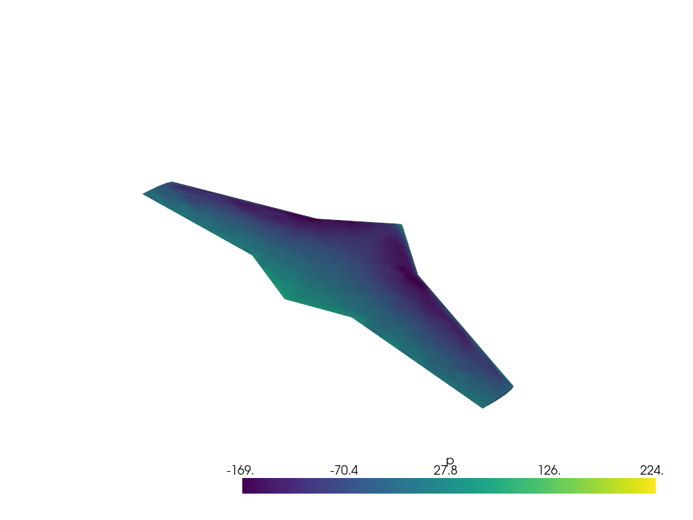
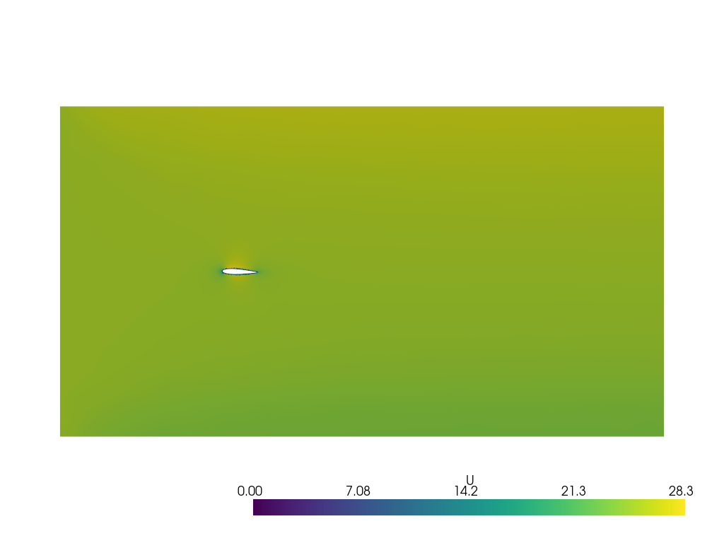
CFD EVIDENCE
Flow fields make the result physically inspectable
Pressure and velocity images are presented as evidence from the named verification case, not as generic simulation decoration.
SURFACE PRESSURE
VELOCITY MAGNITUDE
The surface field shows the pressure distribution over the BWB, including the leading-edge suction region [C].
The symmetry-plane slice shows stagnation, acceleration over the body and the downstream wake [C].
Source: reports/verification-2026-07-10/report.md#cfd-results-converged-komegasst-solution--100-iteration-restart
07
Notes:
[Sources]
- reports/verification-2026-07-10/report.md#cfd-results-converged-komegasst-solution--100-iteration-restart
- reports/verification-2026-07-10/img/surface_pressure.png
- reports/verification-2026-07-10/img/U_slice_y.png

Slide 8
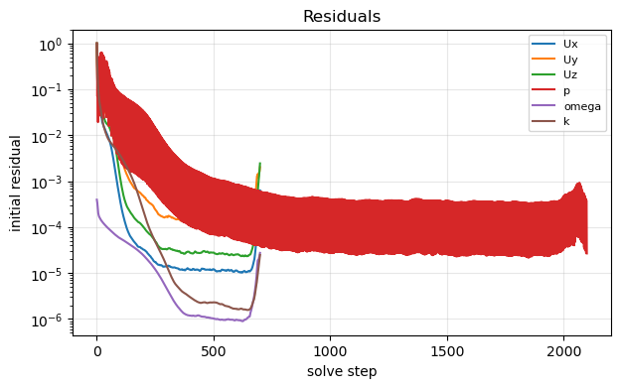
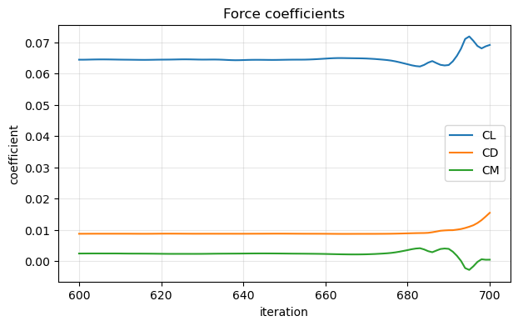
VERIFICATION
A clean solver exit is not the engineering verdict
Astra combines convergence, force history, plausibility and the mission target before accepting a result.
WHAT THE EVIDENCE SUPPORTS
WHAT REMAINS UNPROVEN
The case ran, the monitored solution settled, the fields can be inspected and the quality gate identified a mission-level disagreement.
The coarse result is not a validated final aerodynamic performance prediction and does not close mesh independence.
RECORDED RESULT [C]: CFD CL 0.065 VS REQUIRED 0.181 -> REVISE-DESIGN
Source: reports/verification-2026-07-10/report.md#4-physics-results-golden-design
08
Notes:
[Sources]
- reports/verification-2026-07-10/report.md#4-physics-results-golden-design
- src/services/evaluate.py
- reports/verification-2026-07-10/img/residuals.png
- reports/verification-2026-07-10/img/force_coeffs.png
- reports/verification-2026-07-10/report.md#run-10

Slide 9
ENGINEERING OUTCOMES
The project demonstrates judgement as well as automation
The strongest outcome is a workflow that exposes uncertainty, records decisions and refuses unsupported certainty.
DEMONSTRATED CAPABILITIES
ENGINEERING LESSONS
Requirement decomposition and parametric sizing
A successful process exit does not establish valid physics.
CAD-to-mesh workflow integration
Probabilistic steps need deterministic validators and fallbacks.
Multi-fidelity aerodynamic analysis
Verification gates and failure diagnosis
Mesh quality can dominate solver behaviour and result credibility.
Technical UI and engineering communication
NEXT EXPERIMENT [D]
run controlled coarse, medium and fine mesh tiers, then compare force stability, lift and near-wall resolution. The hypothesis is falsified if refinement does not narrow the model disagreement or improve the near-wall evidence.
Source: reports/verification-2026-07-10/report.md#6-key-lessons-worth-remembering-for-phase-3
09
Notes:
[Sources]
- reports/verification-2026-07-10/report.md#6-key-lessons-worth-remembering-for-phase-3
- docs/decisions/README.md
- src/services/evaluate.py
- AGENTS.md#must-preserve
- reports/verification-2026-07-10/report.md#run-8
- reports/verification-2026-07-10/report.md#7-open-items

Slide 10
EVIDENCE AND LIMITS
Astra is a transparent extension, not a black-box claim
The portfolio separates inherited infrastructure, authored engineering work, measured evidence and unresolved limitations.
ATTRIBUTION
CURRENT LIMITS
Astra extends the open-source Foam-Agent CFD foundation. The inherited graph remains the CFD spine; the BWB design loop, cockpit, design-session lifecycle and physical-quality gates are the Astra extension.
Aerodynamics-first conceptual design only
No structural, propulsion or manufacturing validation
No flight-test evidence
VLM does not model stall; stall limits are analytic
The displayed CFD result remains a coarse verification case
TOOLCHAIN
Python / OpenVSP / VSPAERO / Gmsh / OpenFOAM v10 / FastAPI / three.js / LangGraph
Lindon Vaz
linkedin.com/in/lindon-vaz-
github.com/L-Vaz/Astra
Engineering work should be defendable: source the number, show the problem, record the decision.
Source: README.md
10
Notes:
[Sources]
- README.md
- https://github.com/csml-rpi/Foam-Agent
- https://github.com/L-Vaz/Astra
- README.md#foam-agent
- README.md#what-astra-adds
- README.md#scope-and-limits

